Slide 1
IEPR Workshop
Commercializing Critical Facility Microgrids in California
Modular, Scalable, Product-Centric Design
Vipul Gore, President & CEO
07 July 2020

Slide 2
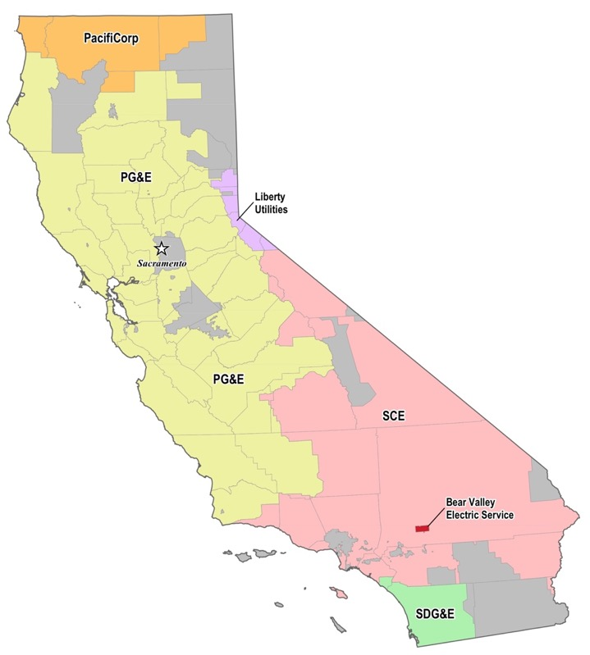

Gridscape Critical Facility Microgrid Network
5 Microgrids in Operation
15 Microgrids in Design/Construction
16 Microgrids in Contract
20+ Microgrids in Sales
Total: 50+ Microgrids by 2021/22
(CEC EPIC-Funded)
Sacramento
Grass Valley
EnergyScopeTM Microgrid DERMS
Marin County
(CEC EPIC-Funded)
San Leandro
Grocery Store
Hayward
(CEC
EPIC-Funded)
Fremont
EV Fueling Station
Food Processing
Plant
Milpitas
Residential
Community
Lancaster
(CEC EPIC-Funded)
Hotel
Fontana
Fire Station
Emergency Shelter
Coachella
EMS
Valley Center
Police Station
(Indian Tribe Govt)
911 Response Center
San Diego

Slide 3
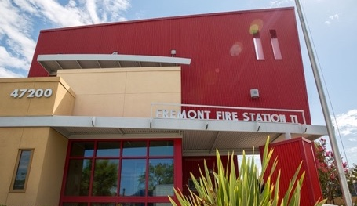
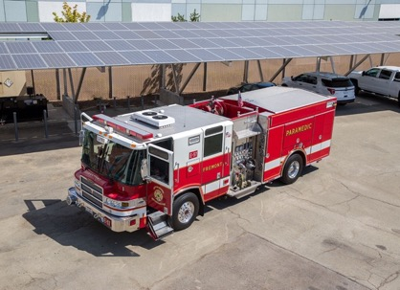
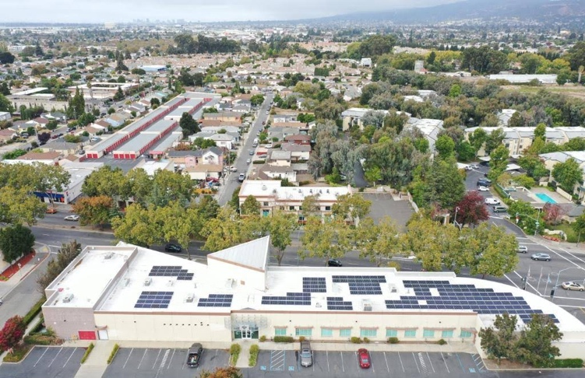
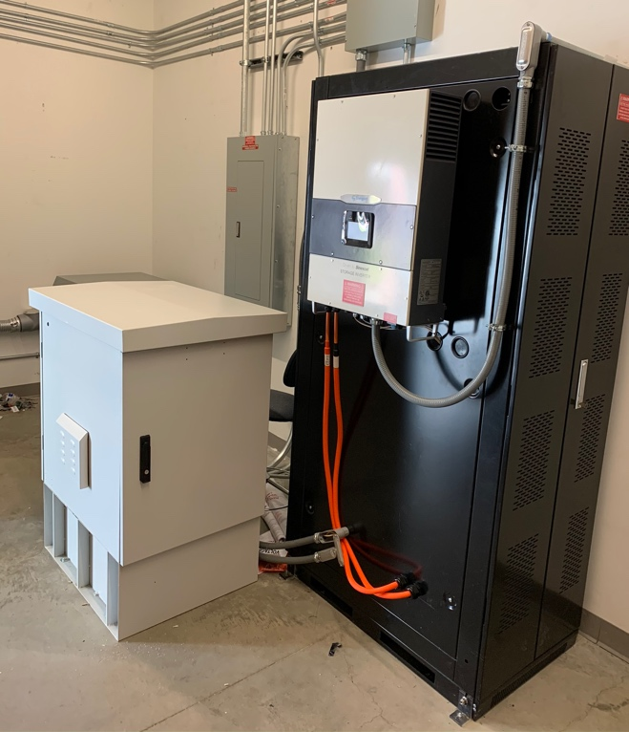
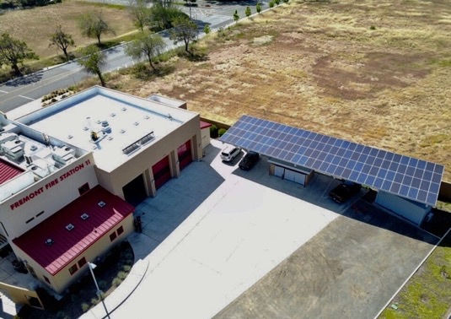
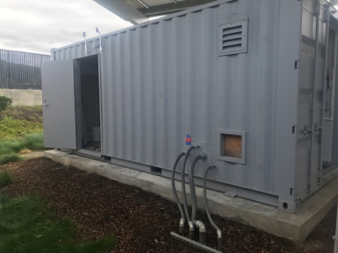
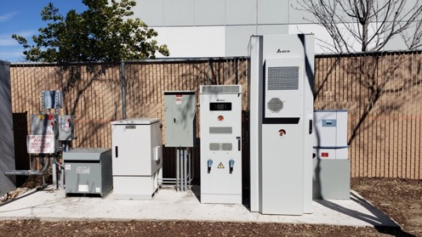
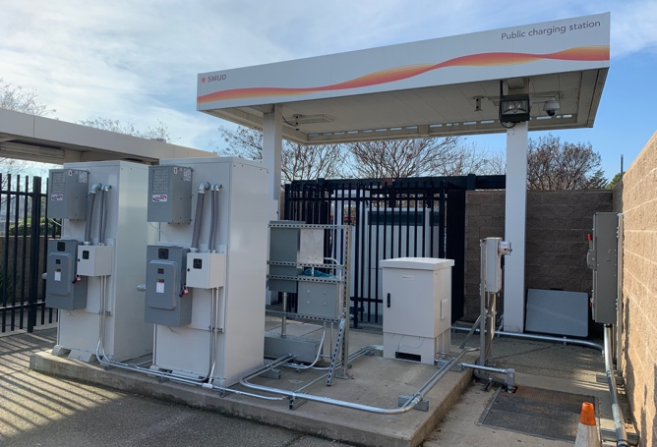
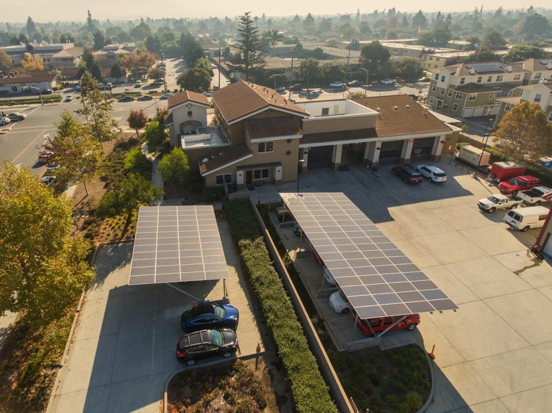
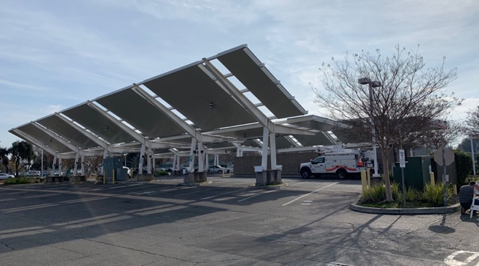
Gridscape Microgrid Deployments
Photo Credit: CEC
Photo Credit: CEC

Slide 4
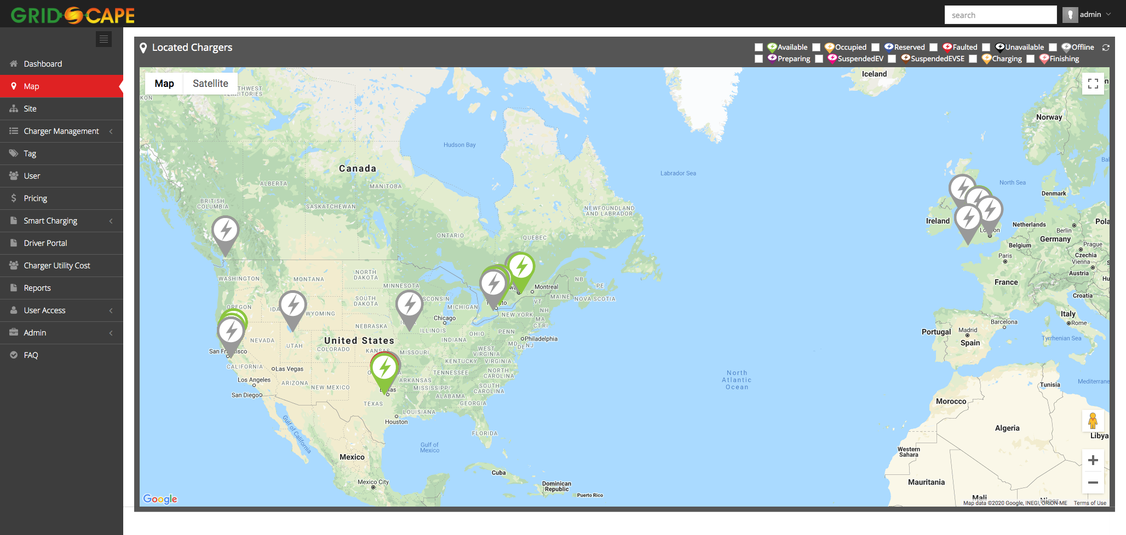
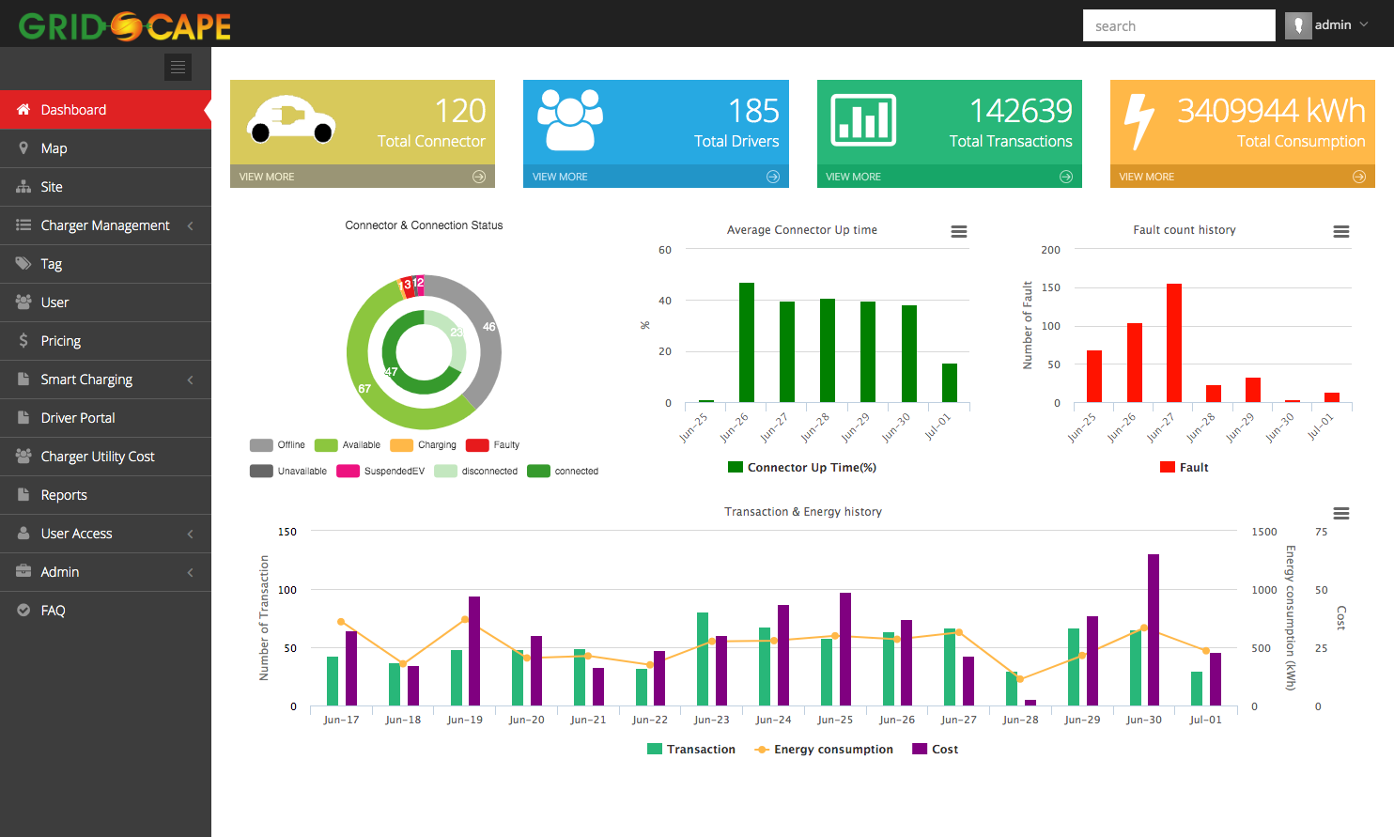
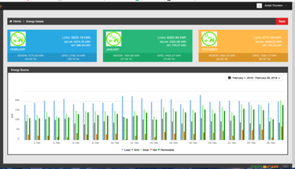
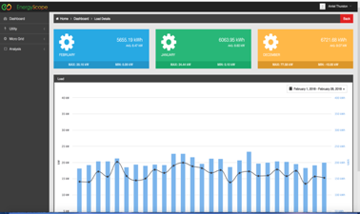
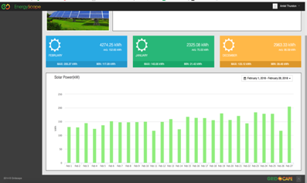
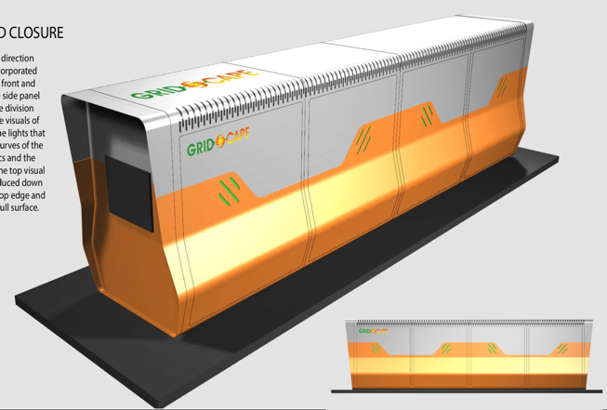
Gridscape EnergyScopeTM Microgrid System
Modular, Scalable Microgrids
  Integrated outdoor-rated, expandable box that includes battery energy storage, inverter, controller, interconnection relay, critical load panel and other essential components
  Low installation cost & maintenance
  Cloud based Remote Control and Management
  On-Demand Reporting
  Remote management of Critical Load panels
  On Site and Off Grid Mode (Islanded)
  24-hour grid resiliency for critical loads
  “Infinite” Power Mode
  Cost Parity with ESS + Controller in 2020
  UL 9540 certification
  Ancillary Grid Services via OpenADR/DNP3
V3.0
Fontana, Marin, Hayward
2020-2021

Slide 6
Challenges & Opportunities
Challenge | Description | Opportunities
Private Financing (essential for commercialization) | Small Critical Facility Microgrids are very difficult to finance fully with private funding | Continue Incentive Programs (SGIP, ITC) through 2030 Establish a Value of Resilience (Microgrid Tariff, Displacement Cost of Fossil Fuels) Create new ancillary grid service revenue adder for cluster of small microgrids, in a quantifiable and standardized way Continue Grant Programs : EPIC, DOE, FPIP Prioritize subsidies for smaller projects. Large Microgrid Projects are financeable and do not need subsidies
Time to Deploy (project timeline) | It takes long time to design, construct and deploy Permit Process (AHJ) Interconnection Time Procurement Costs | Standardize Designs and Building Code to speed up permitting. Create online portal/checklists similar to residential PV/battery projects Prioritize and standardize Interconnection Process Promote vertical integration of technologies, i.e. Modular, Scalable technology ”plug-n-play” blocks based on standards
Awareness & Decision Making | Critical Facility Operators (Decision Makers) need a lot of education to understand importance of microgrids | Develop market outreach and awareness building programs Allow and promote data-driven approach – what sites benefit the most in terms of energy savings, resilience and grid stability? Develop building code to mandate renewable microgrids for new/renovation projects for public facilities Increase public awareness, education to general public Standardize community microgrids
Cost to Deploy | Material costs (Batteries, PV, Interconnection Devices) need to stabilize/decrease for financial viability & bankability Market Uncertainty Customs/Tariffs | Promote product-centric approach. Custom microgrids are very expensive to build and deploy

Slide 7
Vipul Gore
CEO
Phone: +1 510 366 6336
Email: vipulgore@grid-scape.com www.grid-scape.com
Thank You

