Slide 1
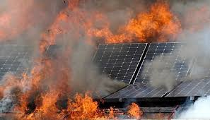
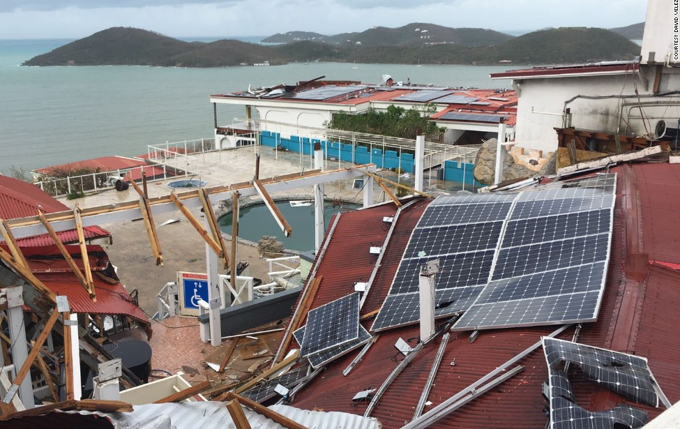
Need for Diversity, Reliability, Resilience
Diversity = Resilience
Need bioenergy and renewable hydrogen for reliability

Slide 2
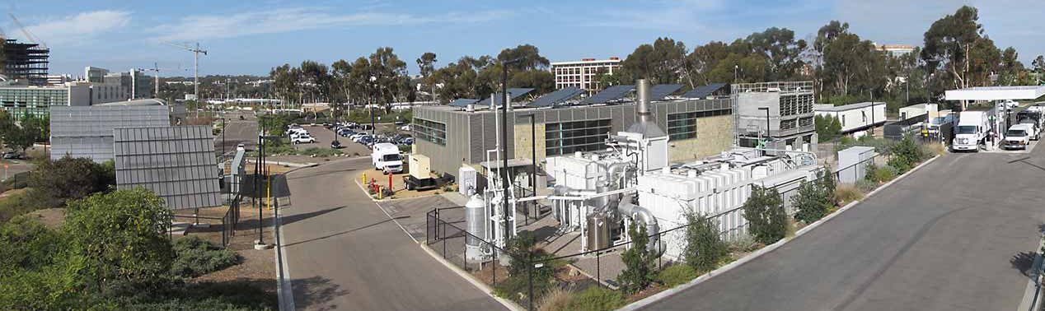
Bioenergy Can Provide:
Flexible generation and baseload power
The only carbon negative fuel – 2-5x lower carbon than solar or wind
Long-duration energy storage
Liquid or gaseous fuels for backup generators
Renewable hydrogen for fuel cells

Slide 3
California’s Technically Available Organic Waste Feedstocks
Feedstock | Amount Technically Available | Billion Cubic Feet Methane | Million Gasoline Gallon Equivalents
Landfill Gas | 106 BCF | 53 | 457
Animal Manure | 3.4 M BDT | 19.5 | 168
Waste Water Treatment Gas | 11.8 BCF | 7.7 | 66
Fats, Oils and Greases | 207,000 tons | 1.9 | 16
Municipal Solid Waste (food, leaves, grass) | 1.2 M BDT | 12.7 | 109
Municipal Solid Waste lignocellulosic fraction) | 6.7 BDT | 65.9 | 568
Agricultural Residue (Lignocellulosic) | 5.3 M BDT | 51.8 | 446
Forest, Sawmill, Shrub & Chaparral Residues | 26.2 M BDT | 256 | 2,214
BIOGAS POTENTIAL |  | 468.5 | 4,044
Sources: Rob Williams and Stephen Kaffka, UC Davis, presentation to the California Energy Commission on January 30, 2017;
Lawrence Livermore National Lab assessment of forest, sawmill, shrub & chaparral residues

Slide 4
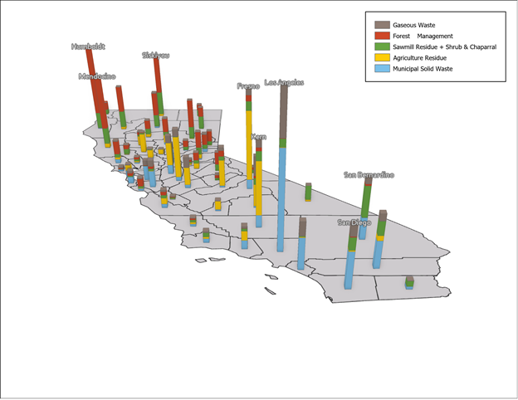
Waste biomass is broadly distributed in California
4.9 MT
We estimate that 58 million bone-dry tons will be available from waste sources in 2045
100% conversion to CO₂ would yield 106 MT CO₂
Only waste biomass considered – no energy crops

Slide 5
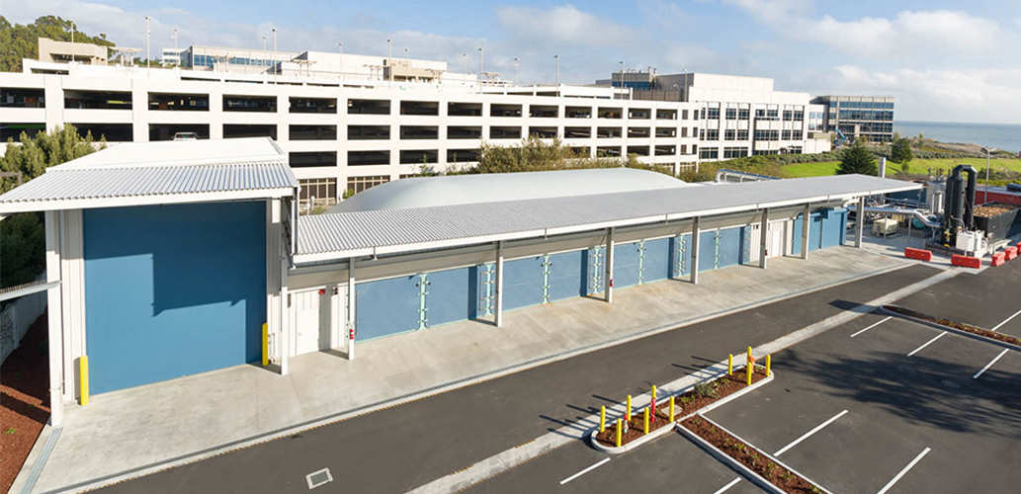

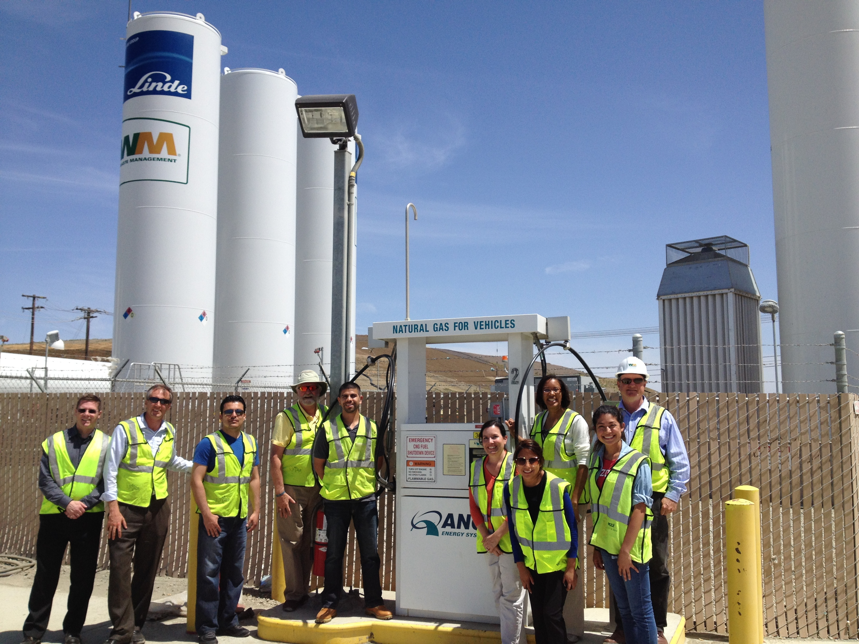
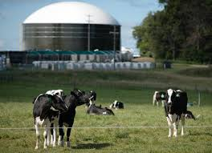
Biogas can Provide Locally Sourced,
Carbon Negative Generation and Storage

Slide 6
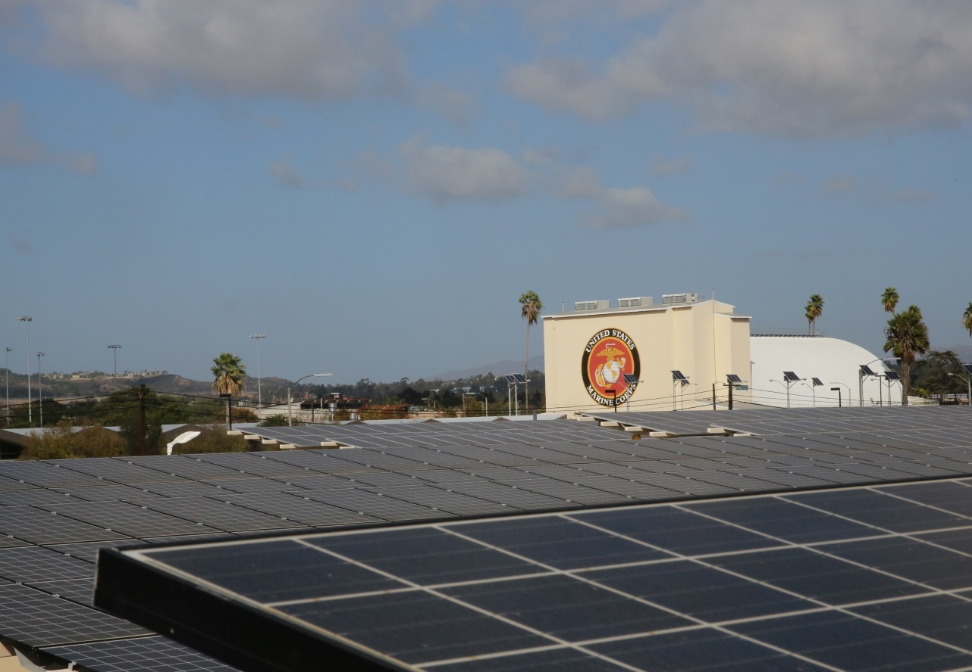
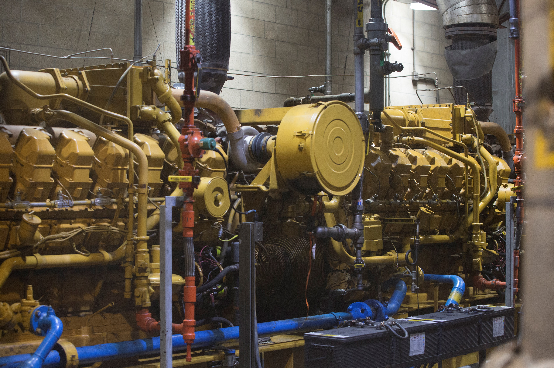
Miramar Marine Corps Air Station
20 MW microgrid in San Diego County
Includes 3.2 MW of landfill gas powered flexible generation
The microgrid uses solar energy and biomethane to keep mission-critical buildings operational during power shut-offs.

Slide 7
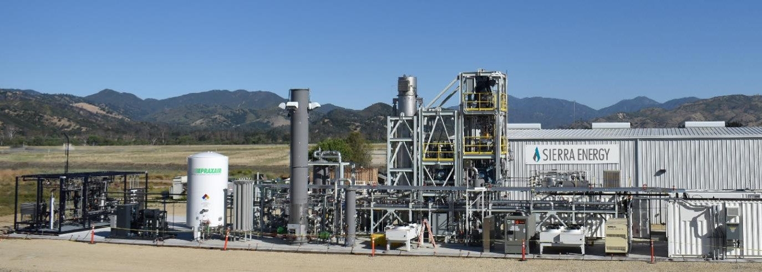
Fort Hunter Liggett – Monterey County
U.S. Army has zero waste and zero net energy goals
U.S. Army Base Fort Hunter Liggett will convert on-base waste to power and vehicle fuels to become zero net energy

Slide 8
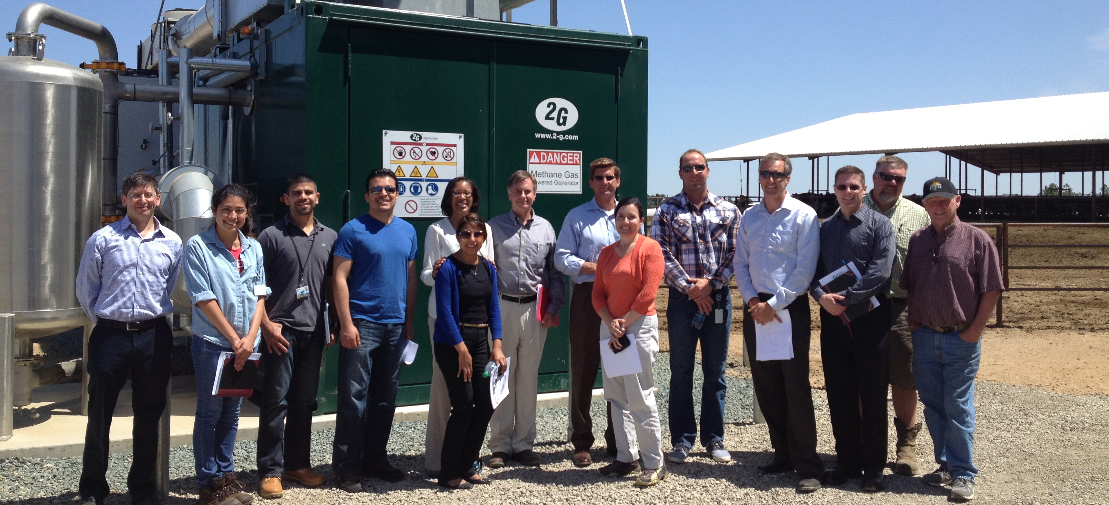
Policy Changes Needed
Need microgrid tariff that requires diverse portfolio
Need to include flexible generation and long duration storage
Need pricing mechanism that accounts for additional grid services, carbon negative fuels, upstream benefits
Need to focus on renewable resources, including quickly ramping up renewable hydrogen production for fuel cells
Need to ensure that anti-islanding measures don’t preclude microgrids

