Slide 1
Elisa Wood
Editor-in-Chief
elisa@microgridknowledge.com
The world’s largest website devoted to all things microgrid.

Slide 2
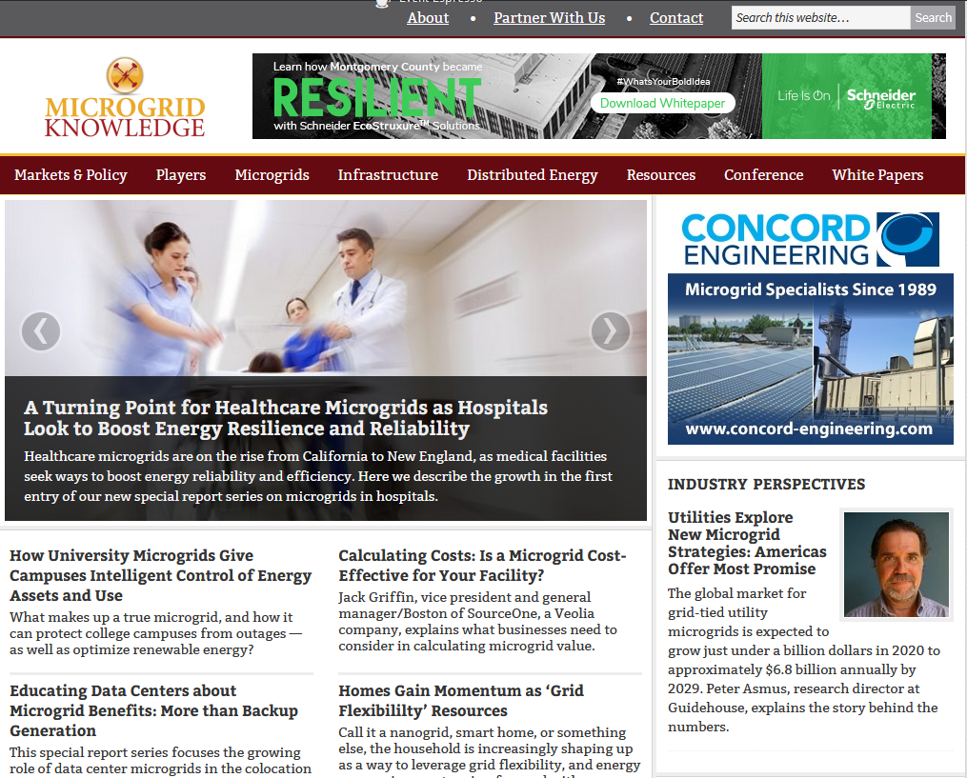
More than 3,500 free articles. World’s largest microgrid white paper library. Largest annual microgrid conference
Top state for readership?
California
Most read article in last 12 months?
“It’s Dark in California but the Message is Clear: More Microgrids Needed”

