Slide 1
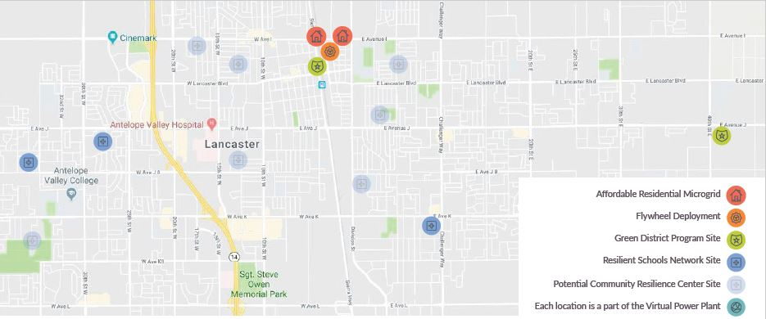








Lancaster Advanced Energy Community Microgrids
Presentation by Richard Schorske
Executive Director, ZNE Alliance | IEPR - Microgrid Symposium | July 9, 2020

Slide 2
Project Outcomes
Develop ZNE Residential Communities
Renewable Microgrids & Innovative Energy Storage
Improve Community Resilience
School-Based Microgrids & Resilience Centers
Optimize DER Value
Virtual Power Plant (VPP) & Green District Energy Storage Program
Scale AEC Solutions
Case Studies & Tools to Scale Statewide

Slide 3
Lancaster AEC Residential Microgrid
Goal | Objectives
Develop ZNE residential communities demonstrating diverse renewable microgrid technologies & configurations | 1.1. Construct a renewable microgrid at Avenue I -- including 273 kW of solar, 780 kWh of battery storage to serve 78 ZNE affordable homes (single family) 1.2. Construct a renewable microgrid at Sierra Highway – including 584 kW of PV, 1.67 MWh of battery storage, and 500 kWh of flywheel kinetic energy storage to power 167 ZNE affordable homes (multi-family) 1.3. Pilot a new residential rate design supporting community-scale microgrids to capture & share DER value streams with ZNE community residents

Slide 4
Virtual Power Plant Framework for MG/DER Integration
Goal | Objectives
Optimize the value and improve the economic attractiveness of clean energy assets through launch of a DER-based Virtual Power Plant (VPP) | 3.1. Integrate 5 MW of local solar assets 3.2. Integrate 10 MWh of storage 3.3. Integrate 5 MW of flexible load PV & storage deployed in 5 city facilities and 13 schools Including 3 school microgrids & 2 residential microgrids

Slide 5
Key Challenges | Solutions / Alternatives
Meeting Zero Net Energy standard cost prohibitive | Adopt Zero Net Emissions standard to utilize 100% green energy from LCE with resilience
Original master meter design may not be feasible or cost-effective within CCA constraints | Explore master-metered approach for mobile homes allowed under current law. (Working with SCE & legal team on this option) Explore network of distributed nanogrids – to mitigate regulatory issues re. cost recovery and consolidated billing, and reduce costs by avoiding need for LCE to own distribution
New approaches to ZNE & community resilience may be needed if master-metered approach cannot gain approval within project timeline | Explore integration of 3 innovative technologies that enhance resilience w/ zero emissions Microgrid in a Meter with variable frequency Transverter Utilizes existing smart meter socket (e.g. RMA adapter for PV) to create physical islanding mechanism. 20 minute install – no new subpanel. Can auto-island in outage or manually island to go offgrid with solar/BESS Variable frequency inverter reduces energy use on motor driven appliances by ~40% - validation via CalTestBed soon (Neworld Energy) V2G Integration Home Chademo Fast Charger enables bi-directional operation of Nissan Leafs & Mitsubishi Outlanders now (CCS version in Q1 with more OEMs) Integrated DCFC/inverter/BESS enables robust resilience, grid services Ossiaco “decibel” product available this summer - ~ $5K/unit BTM Solar Allocator Enables full self-consumption across units in MUD apartments Energy paid for thru rents – increasing building value & reducing bills No backfeed, NEM, or utility permission needed. (Powertree Services)
Notes:
ES
TASK 2: Microgrids for ZNE Residential Developments: Energy Solutions will manage the subcontractors and project partners for this task, working closely with the City of Lancaster, LCE, Blue Strike Environmental, Gridscape Solutions, and Olivine to build, commission, operate, and evaluate two distinct community microgrids. As Task Manager, Energy Solutions will support the City through the interconnection process and coordinate among the team members project partners to prepare the public housing developments to operate as ZNE microgrids.
Goal: Leverage the design work done in Phase I to build two, distinct community microgrids in public housing developments that demonstrate highly scalable examples of residential microgrids
Objectives:
Leverage the design work done in Phase I to demonstrate an all-electric, very low emissions community that is a good grid citizen, has increased resiliency, and is cost competitive with traditional mixed fuel developments.
Integrate 4-hr. flywheel energy storage into the design and operation.
Create a microgrid toolkit for CCAs and local governments that addresses soft cost barriers, design challenges, the interconnection process, contracts, and electric rates/billing for residential microgrid developments.

