Slide 1

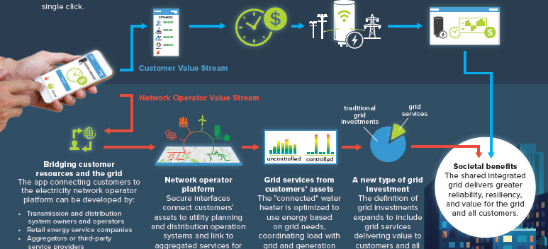




Validated, Transparent, and Accessible Microgrid Valuation and Optimization Tool: DER-VET™
Customer Values
Customer benefits
Models how DERs can Provide Customer Value Streams
T&D Values
Network operator platform
Grid services from customers’ assets
A new type of grid investment
Greater reliability, resilience, and value for all customers
Evaluate Grid Investment, Technologies, and Services
Develop a robust technical analysis and economic optimization tool used for the design of microgrids and DER deployments that is a publicly-available at www.der-vet.com

Slide 2
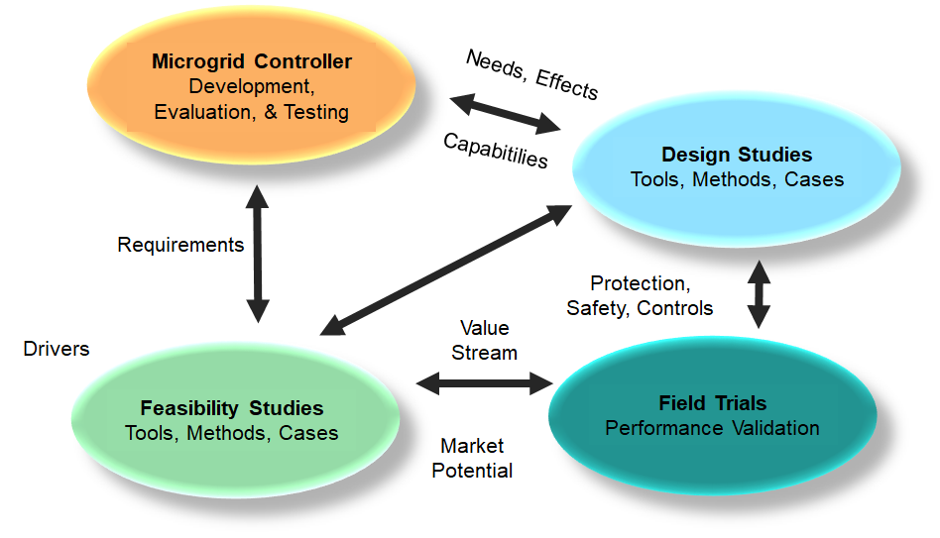
Industry Needs & Gaps
Provide tools for grid planners and technology developers to design and analyze DER in utility grids and microgrids
Technology to address resilience with microgrids exist however better planning tools were needed to design them more effectively
Value streams and business case for DERs and microgrids have not been easily quantified
Multi-market value stream analysis inadequate, i.e. from front-of-meter and behind-the-meter
No streamlined user interfaces for different users and use-cases
No one tool handles DER/microgrid analysis capability and industry solutions have not had the capability for needed tool connection or data exchange
Detailed DER models and degradation information had not been embedded in available models
Uncertainty and equipment reliability & downtime information has not been developed nor embedded in tools
Market participation models needs development

Slide 3
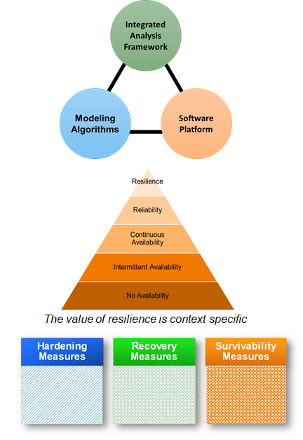
Project Anticipated Benefits
Enhanced Modeling Tools for Microgrids
  Quantitative estimate of benefits to support for a wide range of decision makers
    Locational Screening
    Reliability & Resiliency
    Energy Value
    Capacity Value
    Ancillary Services Value
    GHG Emissions
  Qualitative or intangible benefits include consensus on the best approaches for deploying microgrids in support of increased DER penetration, grid benefits, and customer resiliency
  Metrics for “Value of Supply”

