Slide 1



Enabling Microgrids
Alex J. Morris, Executive Director
July 9, 2020

Slide 2

About CESA
Founded in 2009, the California Energy Storage Alliance (CESA) is a non-profit membership-based advocacy group committed to advancing the role of energy storage in the electric power sector through policy, education, outreach and research.
2

Slide 3
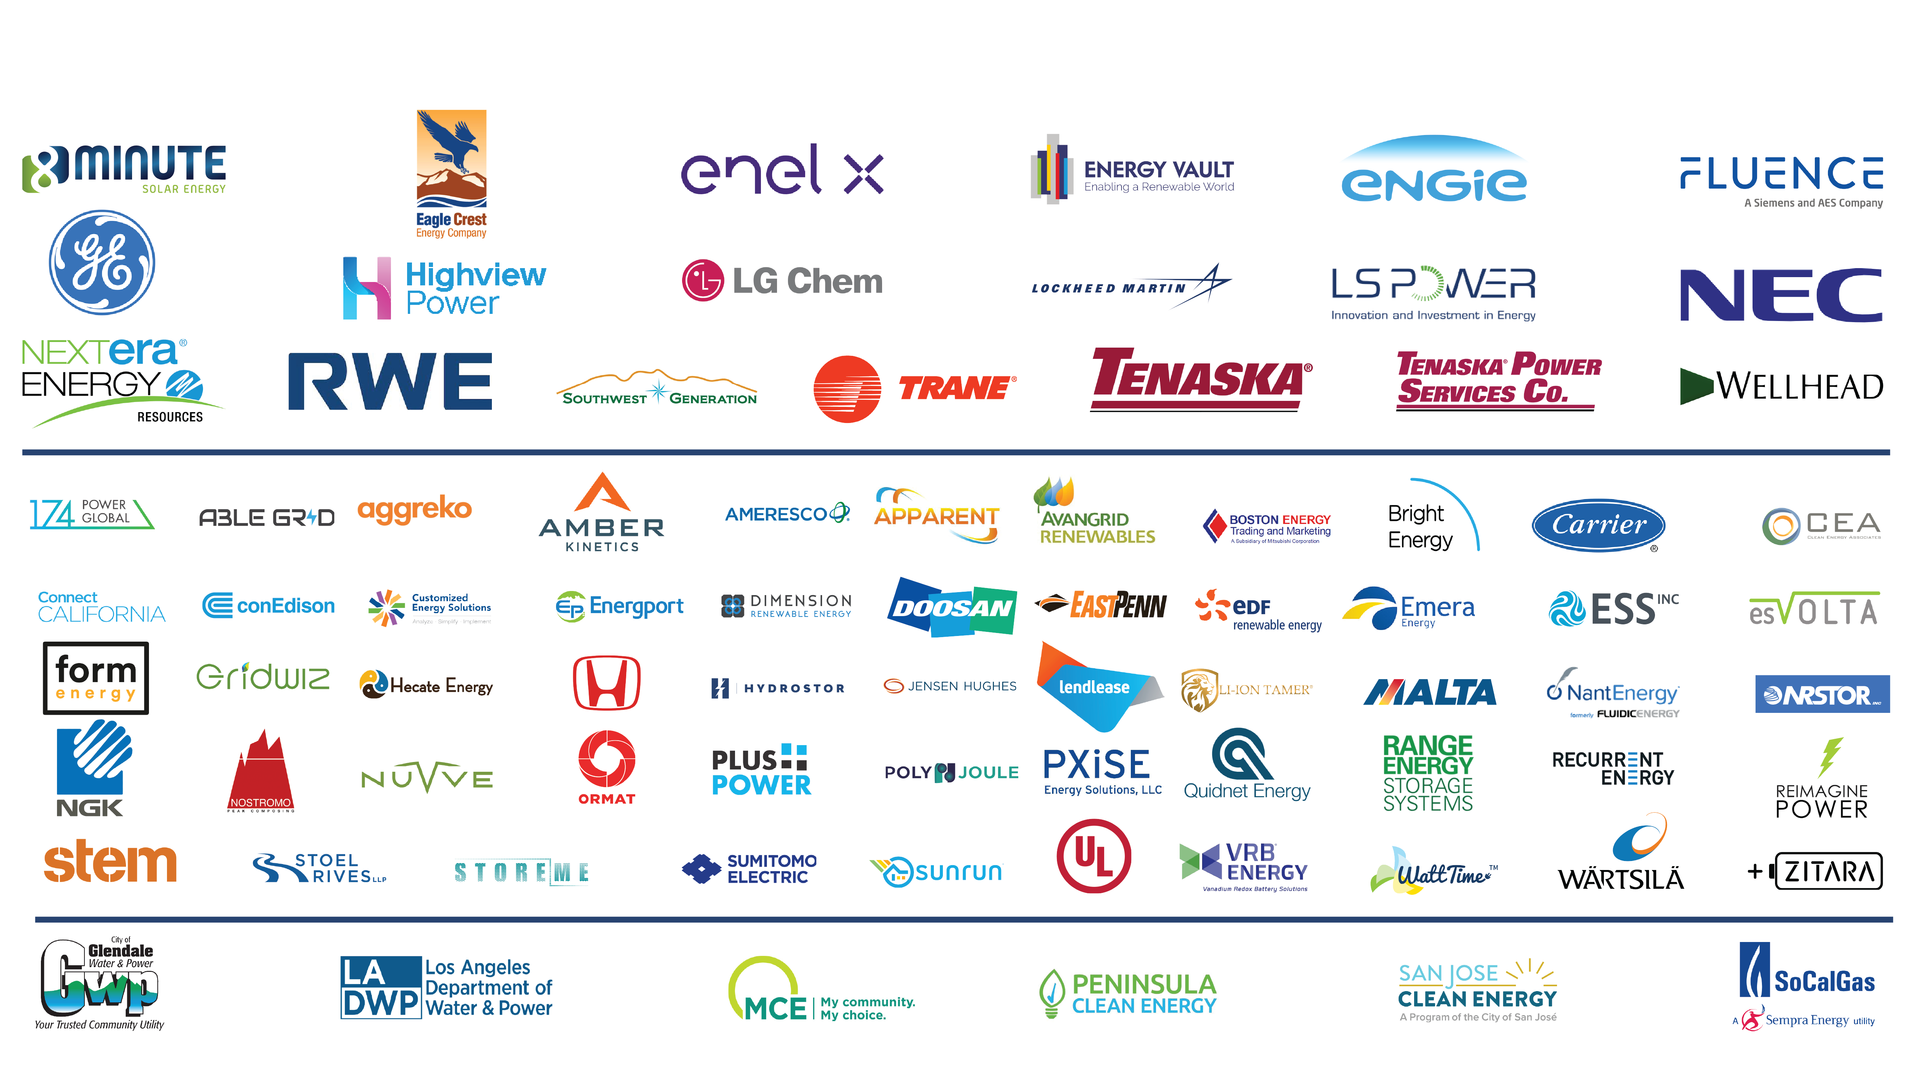
CESA Members

Slide 4
Enabling Microgrids
CESA salutes the CEC & CA for exploring storage tools to serve our needs
CESA study coming soon – short and long-duration microgrids can augment CA needs for storage
  CESA’s membership is for all storage industry, including hydrogen and cutting-edge long-duration
Microgrid acceleration is very doable:
  Right-size the solutions
  Create economic signals, e.g. ‘resiliency’ valuation and RA benefits
  Unleash SGIP – many projects will benefit customers and also mitigate PSPS pain
  Continue to seed the market with RD&D: 2nd life, in-state lithium harvesting, long-duration RD&D, and also address financing hurdles for emerging tech.
  Enable storage additions to existing solar
  Support the development of third-party-owned microgrids

Slide 5

Please contact me at:
Alex Morris
amorris@storagealliance.org
www.storagealliance.org

