Slide 1
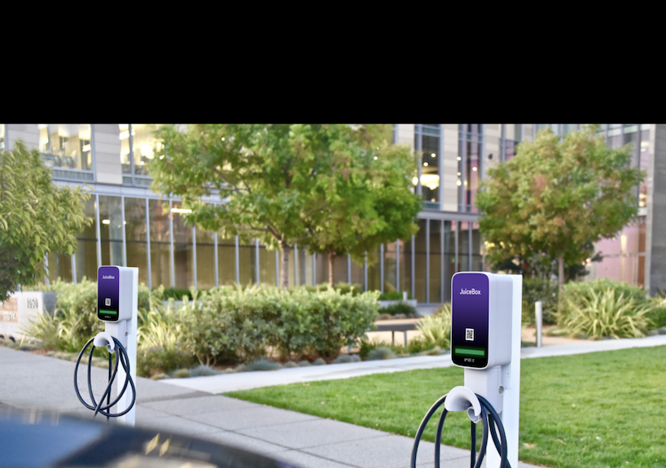
Attracting Private Capital +
New Business Models for
EV Charging Infrastructure
Marc Monbouquette, Regulatory Affairs Manager
CEC IEPR Panel – June 24, 2020
Notes:
Registrants:
https://na96.lightning.force.com/lightning/r/Report/00O2M000009GRGRUA4/view

Slide 2
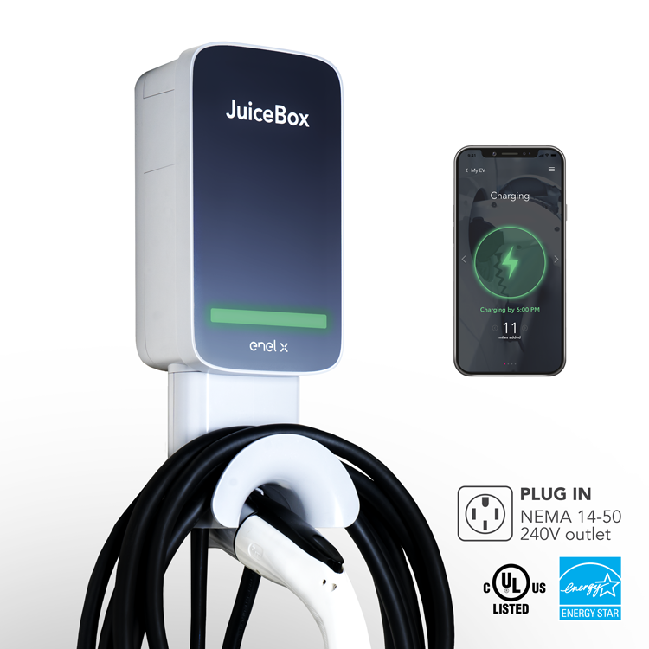
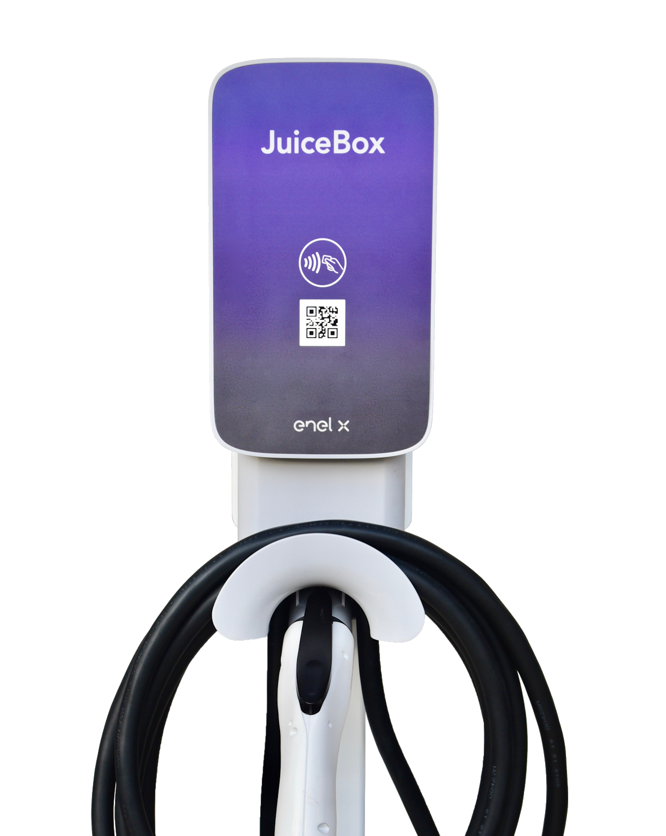

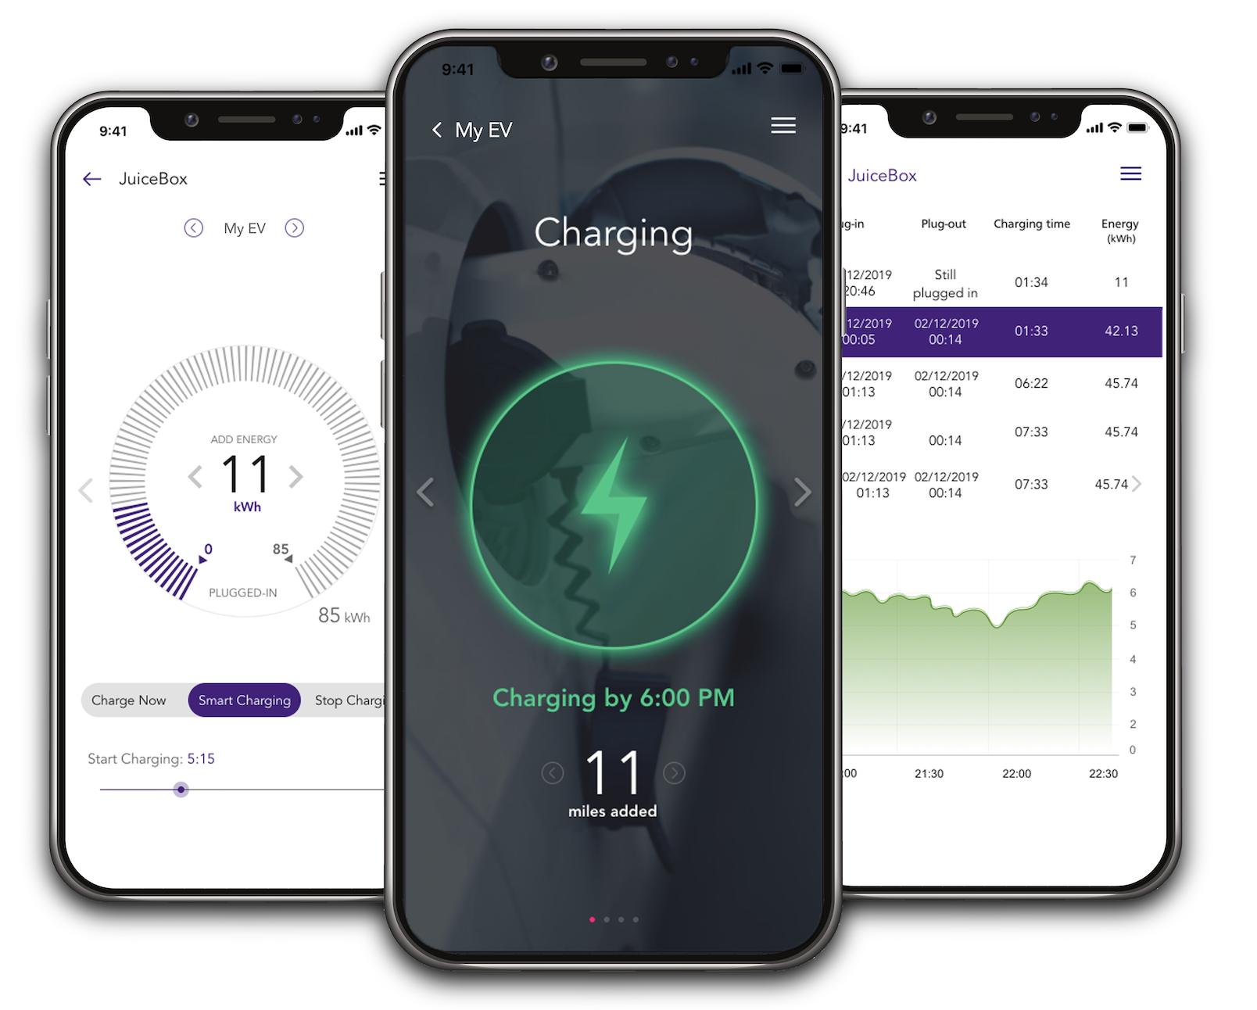





Enel X Ecosystem
An open system ensuring interoperability
Smart EV Infrastructure
New models coming soon
EVSE
back-end
Utility
Platform
Customers
1
2
3
4
JuiceNet Enterprise- residential/commercial
Energy & Grid Services
Smartphone app &
Dashboard
EVs
OEM back-end
Energy Front Office & Markets Interaction

Slide 3
Guiding Principles
The provision of infrastructure and services from utilities and third parties should be guaranteed, predictable, and streamlined
Think outside of the box of ratepayer funding and up-front rebates
Maximize the use of VGI through market approaches, financing structures, and open standards

Slide 4
Recommendations
Create tariffed solutions for standardized customer access to make-ready infrastructure (both sides of meter) and VGI across customer segments
Institute new financing mechanisms for utility infrastructure provision through site-specific (or «on-tariff») cost recovery
Establish an «always on» EV infrastructure fund to attract patient institutional capital with a state-backed loan guarantee
  Challenge will be to deliver on utilization
Monetize VGI through existing or emerging market pathways, or combine incentives with new financing approaches, and use value to offset payback costs for EV infrastructure
  E.g., tariffed option for advanced load management to avoid upgrades
  $/kWh incentives for new, permanent midday load to avoid solar curtailments

Slide 5
Benefits
Responds 1:1 to market demand for infrastructure without the need to forecast priority segments or rely on ratepayer budgets (though these can still be used to achieve policy goals)
Allows for utility ratebasing of infrastructure that transfers to site host ownership once paid off
(Mostly) does not require cost-effectiveness tests to deploy VGI

Slide 6
thank you! marc.monbouquette@enel.com

