Slide 1
IEPR Joint Agency Workshop on Vehicle-Grid Integration & Charging Infrastructure Funding: Session 2
CALeVIP
Brian Fauble
Energy Commission Specialist II

Slide 2
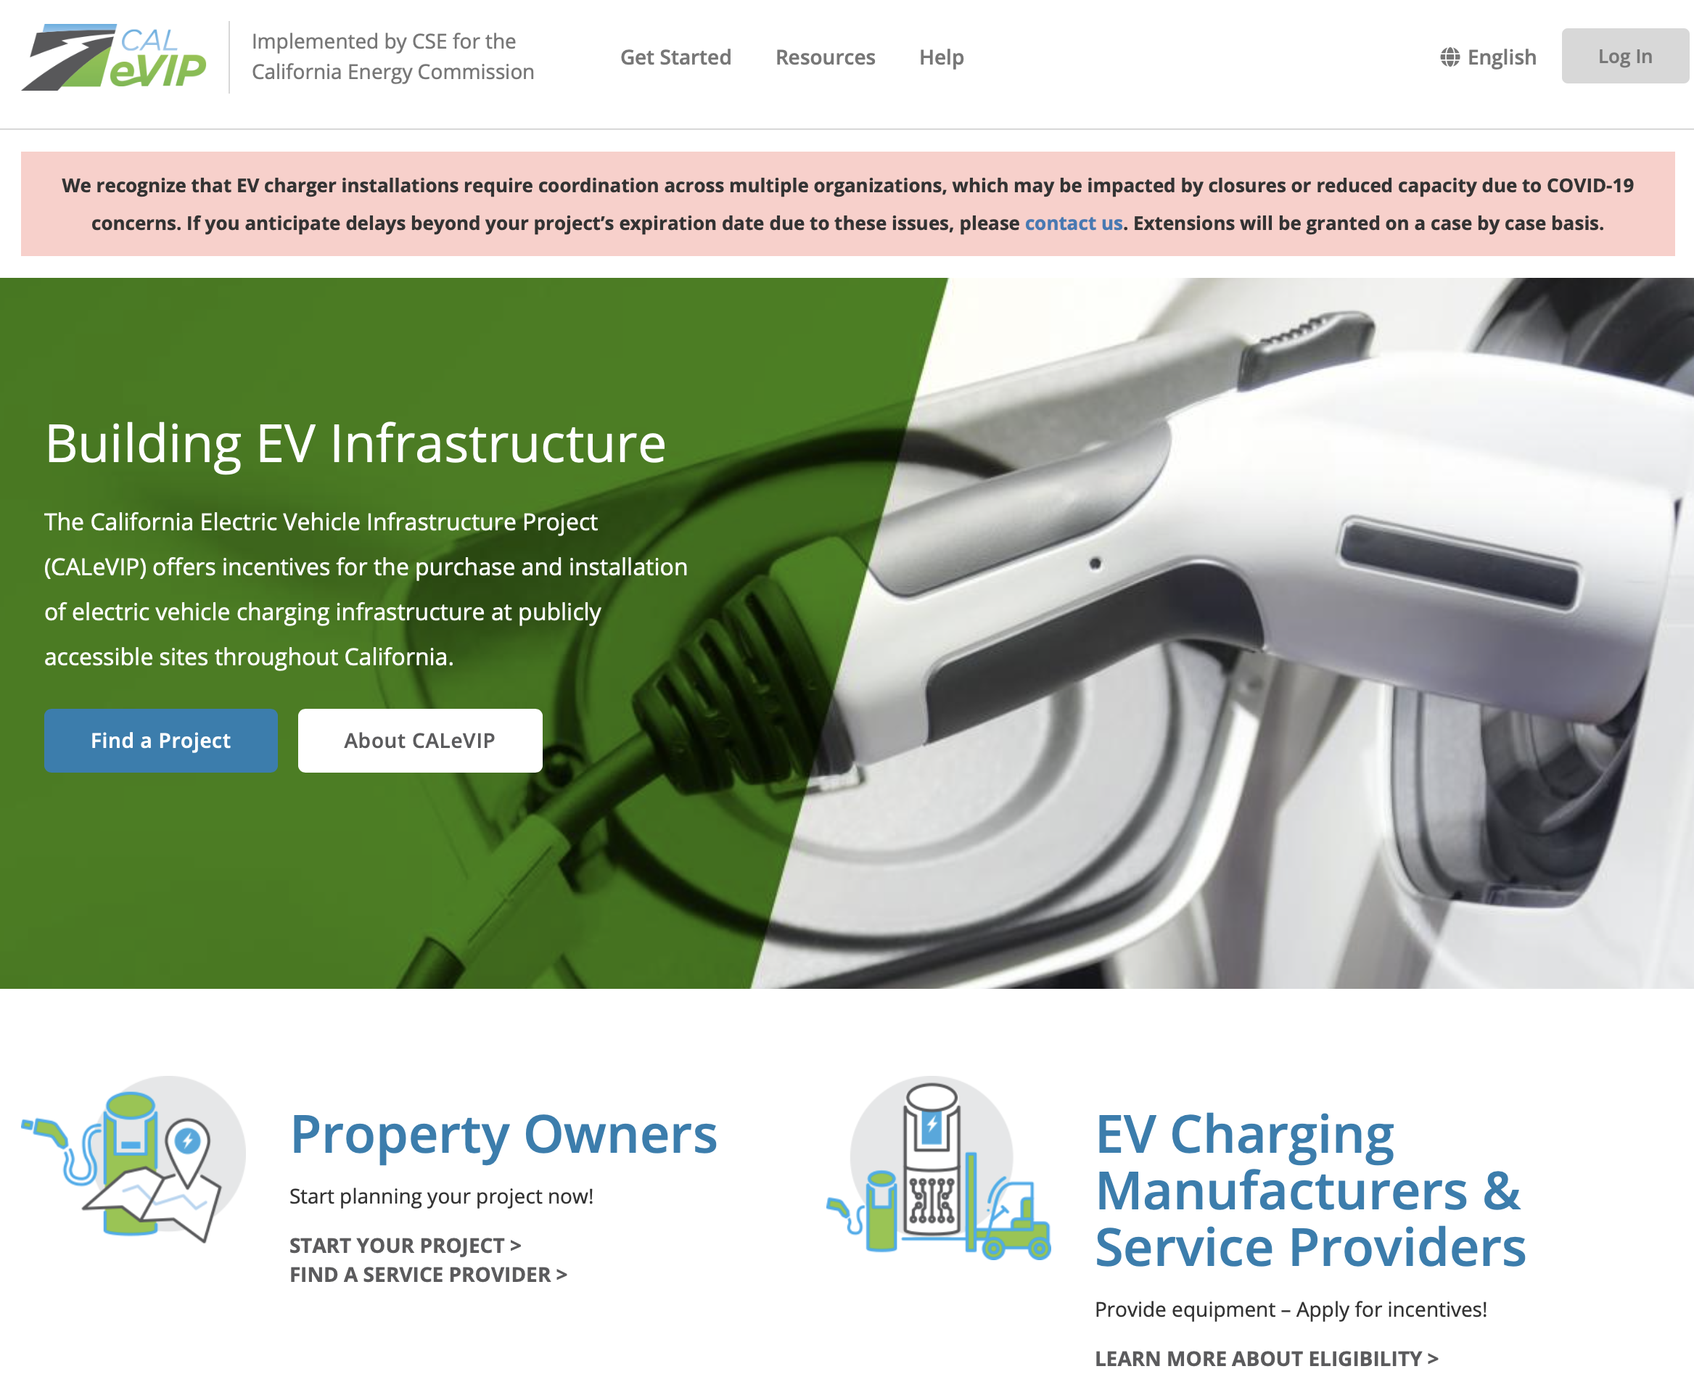
CALeVIP Background
2
www.calevip.org
Notes:
California has a goal of deploying 250,000 electric vehicle car chargers by 2025, including at least 10,000 direct current fast chargers.
To address this goal, the Energy Commission decided we needed a more streamlined mechanism to provide funding for EV chargers.
The California Electric Vehicle Infrastructure Project (CALeVIP) is one mechanism that was deployed.
CALeVIP is a online interface (at calevip.org) that releases multiple regional incentive projects that are deployed in a specific region and has requirements tailored to its region and needs.
The CALeVIP website not only lets the public view and apply online for incentive funding, but it provides many educational resources on electric vehicle chargers.

Slide 3
CALeVIP Existing Projects
Incentive Project | Launch Date | Counties | Funding | Technologies
Fresno County | December 2017 | Fresno | $4 million | Level 2
Southern California | August 2018 | Los Angeles Orange Riverside San Bernardino | $29 million | DC Fast Chargers
Sacramento County | April 2019 | Sacramento | $15.5 million* | Level 2 & DC fast chargers
Northern California | May 2019 | Shasta Humboldt Tehama | $4 million | Level 2 & DC fast chargers
Central Coast | October 2019 | Monterey Santa Cruz San Benito | $9 million** | Level 2 & DC fast chargers
San Joaquin Valley | December 2019 | San Joaquin Kern Fresno | $14 million | Level 2 & DC fast chargers
Total: |  |  | $75.5 million
3
*CEC funding: $14 million, Partner funding: $1.5 million
**CEC funding: $6 million, Partner funding: $3 million over three years
Notes:
CEC share vs partner share

Slide 4
CALeVIP 2020 Projects
Incentive Project | Launch Date | Counties | Funding | Technologies
Sonoma Coast | Launching July 8, 2020 | Mendocino Sonoma | $6.75 million* | Level 2 & DC fast chargers
Peninsula-Silicon Valley | Launching Fall 2020 | San Mateo Santa Clara | $56 million** | Level 2 & DC fast chargers
San Diego County | Launching Winter 2020 | San Diego | $21.38 million*** | Level 2 & DC fast chargers
Total: |  |  | $84.13 million
*CEC funding: $5.1 million, Partner funding: $1.65 million over three years
**CEC funding: $33 million, Partner funding: $23 million over four years
*** CEC funding $15.8 million, Partner funding: $5.58 million over three years
4
Notes:
Read Slide

Slide 5









2020 Incentive Project Partnerships

Slide 6
Eligible Costs
Equipment: EVSE, transformers, panels, advanced energy storage
Planning/design
Installation costs: labor & materials
Utility service orders
Demand management equipment
Networking agreements
Extended warranties
Stub-outs
Signage
Notes:
Note that permitting is ineligible

Slide 7
CALeVIP Evolution
Incentive Re-design
  Lower rebate amounts
  50kW rebate and 100kW+ Rebate
Areas of focus
  Sonoma Coast minimum rural investment
Installation checkpoint reviews
  Make sure installations stay on track
Future considerations
  Additional application requirements
  Additional checkpoint reviews
7
Notes:
CALeVIP continues to make enhancements over time to better serve the public.
With high oversubscription rates, we have re-designed our rebates to allow more chargers to be deployed and still keep a high participation rate.
We are utilizing our project partner's knowledge of the region to possibly implement areas of focus. Such as in the Sonoma Coast Incentive Project which has an additional incentive for Level 2 chargers in rural regions and requiring a percentage of the funding to be invested to sites in the rural regions.
With the 2020 CALeVIP Incentive Projects, installation checkpoint reviews are being added to make sure applications with reserved funds are effectively progressing.
Staff is exploring requiring additional checkpoint reviews in our 2021 incentive projects as well.
Other enhancements to the online application process are being considered to both streamline the process and to assure applicants that are applying are strong sites that are ready to get to work.

Slide 8
CALeVIP Benefits
Streamlined application process
Rebate is stackable with most rebate programs
EVSE permit streamlining
  Considered when selecting new project regions
Equipment requirements are leading to market improvements
8
Notes:
CALeVIP's streamlined online application process is easy to navigate and allows fair access to the incentive funding. The normal grant solicitation process is much harder for smaller mom and pops businesses to actively participate in when they likely only want a few chargers and cannot afford to hire a professional grant writer to submit their proposal.
CALeVIP's rebates are stackable with most other rebate programs, allowing stakeholders to leverage multiple funding sources to cover as much of their out-of-pocket costs as possible.
CALeVIP provides multiple benefits from its design, but has also seen external benefits that were not originally thought of.
CALeVIP has been used as a carrot to encourage local jurisdictions to update their EV charger permitting process to align with the AB 1236 EVSE permit streamlining law.
Our equipment requirements are also leading the way in terms of technology enhancements that provide benefits in public interactions, data collection, and management.

Slide 9
Customers are contributing about two-thirds of projects’ costs.
Source: Energy Commission Staff
9
Data is from the Fresno County Incentive Project which has 234 Level 2 connectors installed at 41 sites. Data through April 30, 2020
Notes:
The next few graphs will show data on completed CALeVIP applications from the Fresno County Incentive Project.
This graph shows the average project cost per connector for three different market segments. Public/Commercial, Multi-Unit dwellings, and Workplaces.
The red portion shows what the average rebate per connector that CALeVIP paid out compared to the grey portion which is the customer's cost share.
I want to point out that the customer may have received funding from other stackable rebate programs to cover all or some of their remaining costs.
The San Joaquin APCDs ChargeUp Program is one such stackable rebate project.
The important message from this graph is that CALeVIP was able to incentivize charger installations for roughly 1/3 of the project cost.

Slide 10
Site-owner anticipated costs by number of connectors installed
Source: Energy Commission Staff
Data is from the Fresno County Incentive Project which has 234 Level 2 connectors installed at 41 sites. Data through April 30, 2020
10
Notes:
This graph is similar again showing total costs for charger installations, but now at a site level and the bard represent the number of connectors that were installed at the site.
This graph is helpful for business owners to estimate how much an installation might cost them.
Mom and pops shops could expect to see an average cost of $31,563 to install 1-4 connects and have out-of-pocket costs around $19,000
Larger businesses with more parking availability, looking to install 8-10 connectors could expect around $104,000 with out of pocket costs around $66,000

Slide 11
CALeVIP and Customer Total Cost for Level 2 Installations
Source: Energy Commission Staff
11
Data is from the Fresno County Incentive Project which has 234 Level 2 connectors installed at 41 sites. Data through April 30, 2020
Notes:
This slide details completed Level 2 installations from CALeVIP and the participation of disadvantaged communities.
CALeVIP uses the Calenvirosceen 3.0 definition of DAC.
CALeVIP Level 2 projects to date have spent a roughly l $2.3 million as shown in the graph on the left.
57% of that $2.3 million was spent on sites in DACs.
The graph on the right shows the relationship of CALeVIP Level 2 rebates paid out to DAC and Non-DAC sites.
CALeVIP has paid out roughly $884,000 in rebates for completed Level 2 charger installations, and about $479,000 or 54% was issued for sites in DACs.
I also want to point out that if you reference the numbers at the top of each bar you see that CALeVIP has paid out about $884,000 for projects that had a total cost of about $2.3 million dollars.

Slide 12
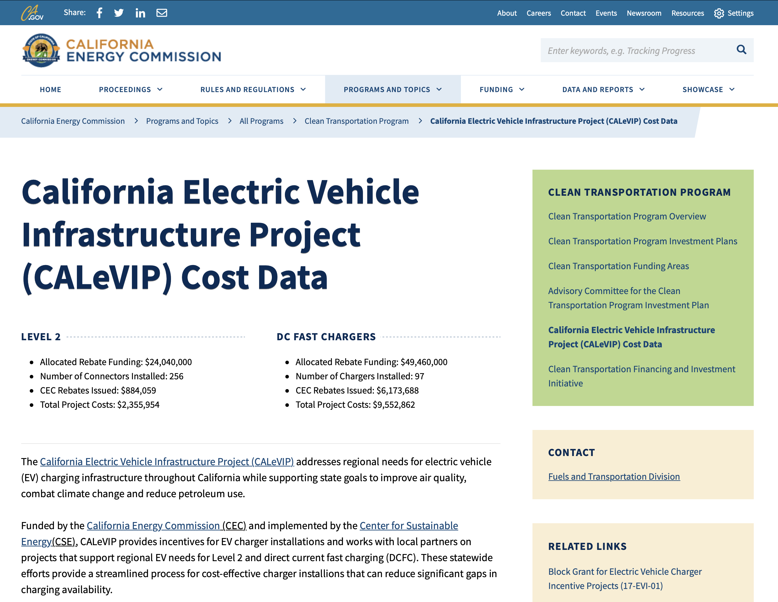
CALeVIP Cost Data Webpage
12
https://www.energy.ca.gov/programs-and-topics/programs/clean-transportation-program/california-electric-vehicle
Notes:
The data from the previous three slides only reflects completed installations from our Fresno County Incentive Project.
The Energy Commission launched an effort in March this year to share CALeVIP cost data with the public.
This website is located at the link below on the Energy Commissions website and there will soon be a direct link from the CALeVIP.org website to this page for easy access.
As more projects complete and our data grows staff will continue to update our graphics and webpage with the additional cost data.

Slide 13
Future CALeVIP Information
CALeVIP website: www.calevip.org
  Subscribe to always receive the latest CALeVIP information
Energy Commission Block Grant/CALeVIP docket webpage: https://www.energy.ca.gov/proceedings/energy-commission-proceedings/block-grant-electric-vehicle-charger-incentive-projects
Sign up for the new Energy Commission CALeVIP listserv
Center for Sustainable Energy email: calevip@energycenter.org
Notes:
Read slide

Slide 14
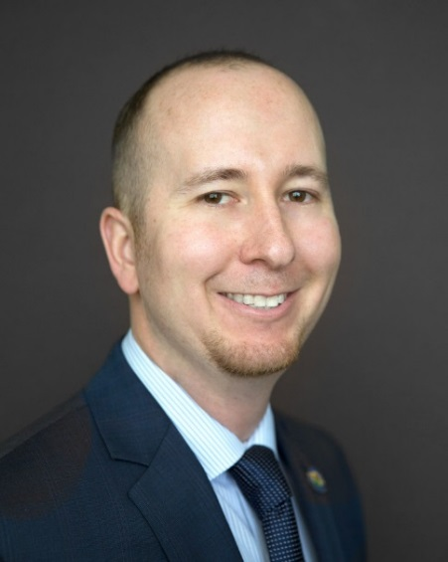

Thank You
Brian Fauble
Energy Commission Specialist II
(916) 654-3974
brian.fauble@energy.ca.gov
14

