Slide 1

Food Production Investment Program
June 2020 Overview
Kevin Uy
California Energy Commission
June 10, 2020

Slide 2

Program Background
The Food Production Investment Program (FPIP) funds drop-in and emerging energy technologies at food production facilities in California with the goal of reducing greenhouse gas emissions.
FPIP is part of California Climate Investments, a statewide initiative that puts billions of Cap-and-Trade dollars to work reducing greenhouse gas emissions, strengthening the economy, and improving public health and the environment — particularly in disadvantaged communities.
Notes:
The Food Production Investment Program, or "FPIP", funds drop-in and emergy technologies at food processing facilities in California.
All projects must reduce facility greenhouse gas emissions.
FPIP is part of California Climate Investments which re-invests procees from Cap-and-Trade into state agency programs focused on reducing GHG emissions and benefiting disadvantaged communities.

Slide 3
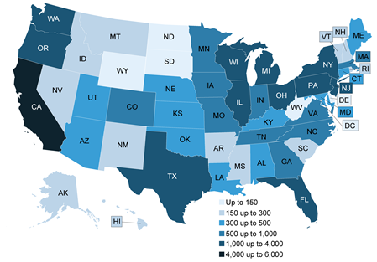
Food Production in California
Food and Beverage Manufacturing Establishments, 2017
California is largest food producer in the U.S. with 5,731 facilities*
$82 billion annual contribution to CA economy†
198,000 direct jobs; 562,000 indirect jobs†
Emits 3.2 million metric tons of CO2e emissions per year‡
*Source: United States Department of Agriculture, 2020
†Source: California League of Food Producers, 2015
‡Source: California Air Resources Board, 2019
Source: United States Department of Agriculture, 2020
Notes:
California is largest food producer in U.S. with 5,731 facilities (USDA Census Bureau data, 2020)
Food processing is a key economic sector in California. It contributes $82 billion annually to California's economy, provides 198,000 direct jobs, and 562,000 indirect jobs (CLFP, 2015)
Food processing is also a large contributor of GHG emissions with about 3.2 million metric tons of CO2 equivalent emissions per year (CARB, 2019)

Slide 4
Created by Collaboration
FPIP was designed in collaboration with public agencies, utilities, researchers, trade organizations, and most importantly food producers.
Food Processor’s Working Group
Government:
  California Air Resources Board
  California Department of Food and Agriculture
  California Energy Commission
  California Public Utilities Commission
  Office of the Governor of California
  San Joaquin Valley Air Pollution Control District
  South Coast Air Quality Management District
Utilities:
  Modesto Irrigation District
  Pacific Gas and Electric
  Sempra Utilities
  Southern California Edison
  Southern California Gas Company
  Turlock Irrigation District
Researchers:
  California Polytechnic State University, San Luis Obispo
  Lawrence Berkeley National Laboratory
  University of California, Davis
Trade Organizations:
  Agricultural Council of California
  California Cotton Ginners and Growers Association
  California League of Food Producers
  West Coast Advisors
Food Producers:
  California Dairies
  Campbell Soup Supply Company
  Foster Farms
  E&J Gallo
  Hilmar Cheese
  Land O Lakes
  Morning Star Company
  Pacific Coast Producers
  Stanislaus Food Products Company
  The Wonderful Company
Notes:
Before the program started, a working group was created which included public agencies, utilities, researchers, trade organization, and most importantly food producers.
In addition to public workshops, working group meetings were held to get feedback on the program as it formed.
The result was a program which was easy to apply to, conformed to the seasonal schedules of food producers, and provided funding for what they needed most – technologies.
In essence, FPIP was designed by food producers, for food producers.

Slide 5
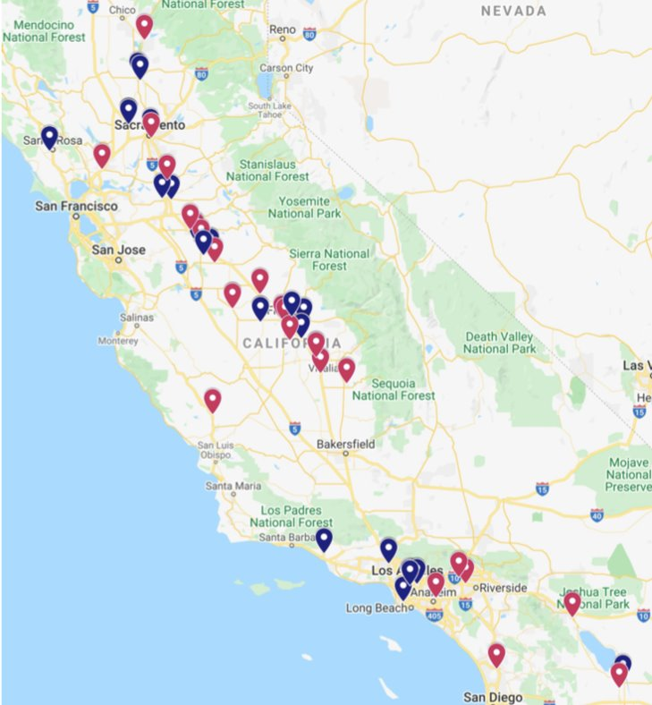


Project Locations to Date*
92% of projects are benefiting a disadvantaged and/or low-income community
65 total project sites
  13 Northern California
  35 Central Valley
  17 Southern California
Tier I
*Includes agreements pending formal approval at a CEC Business Meeting
Tier II
Notes:
This slide shows a map of FPIP project locations.
Tier I is funding for drop-in technologies such as boilers, compressors, and refrigerations sytems.
Tier II is funding for emerging technologies such as microgrids, solar thermal, and electrification technologies.
92 percent of FPIP projects are located in and benefiting disadvantaged and/or low-income communities.

Slide 6







Who Has Received Funding?
3
9
Animal Feed & Ethanol
Prepared Food Producers
Beverage, Breweries & Wineries
6
10
Meat & Rendering
6
14
Dairy Processing
Fruits, Vegetables & Nuts
Notes:
FPIP funding has gone to a variety of facilities including:
1) Ethanol & refining, 2) Beverage, breweries & wineries, 3) Dairy processing, 4) Prepared food, 5) Meat & rendering, and 6) Fruits, vegetables & nuts

Slide 7
Program Benefits
164,000 MT CO2e*​
Projected Annual Emissions Reduction​
$118M​
48 Projects​
Awarded​
35 Tier I & 13 Tier II​
*Preliminary staff estimate – actual results will be quantified during project measurement & verification​
Notes:
This slide shows FPIP by the numbers
$118 million awarded across 48 projects
164,000 metric tons of CO2 equivalent annual emissions reduction

Slide 8





GHG Savings are Significant
FPIP GHG savings are equivalent to:
35,400
2,712,000
27,800
Passenger Vehicles
10-year-old Trees
Homes
5%
of Onsite Emissions Generated by Food Products Manufacturing Sector*
*Some program emission reductions are from the Electricity and Chemicals Sectors​
Notes:
What do these number mean in other terms?
Over 35,000 passenger vehicles removed from the road, 2.7 million 10-year-old trees planted, and energy use from nearly 28,000 homes.
5% of the emissions from the food products manufacturing sector.
(3.3 million metric tons over the life of the program, rougly equivalent to the entire food processing sector emissions for one year)

Slide 9
How FPIP Makes an Impact
“FPIP is a game changer. It's allowing us to do a project that we love, which will really make us a better business. Ultimately, it will reduce the climate impact of our Santa Rosa plant by over a third, which is pretty profound."
- Paul Schiefer, Senior Sustainability Director, Amy's Kitchen
“We have a real commitment to the environment; we have a real commitment to the community and providing jobs. And just to reiterate, funds like [FPIP] make that all possible and [we] cannot thank you enough.”
- Armand Nicholi, Chief Financial Officer, One World Beef Packers
"As a large company operating across the country, we are often challenged by California's stringent regulatory facets. However, it's funding like FPIP, which drastically elevates our businesses, allowing thousands of employees to sustainably live and work in California."
- Kevin Yavari, Regional Environmental Sustainability Manager, Bimbo Bakeries USA
Notes:
FPIP has made a tremendous impact on food processing facilities.
The testimonials above were provided at our March Business meeting and the main takeaway is that these projects would not have happened if not for FPIP funding.

Slide 10
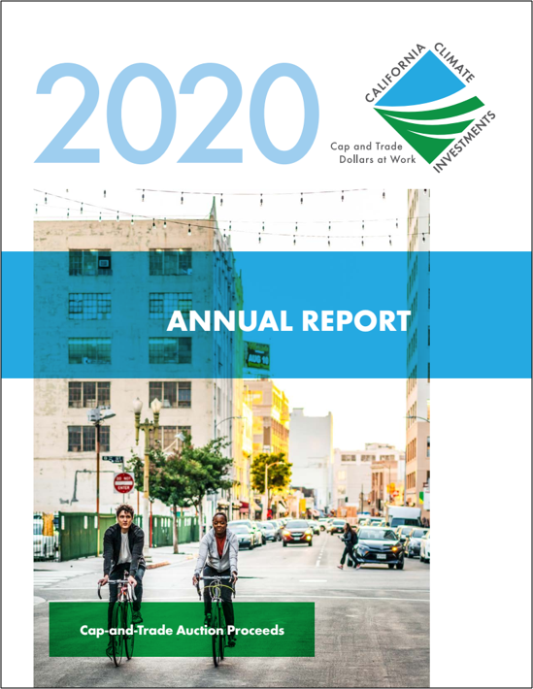
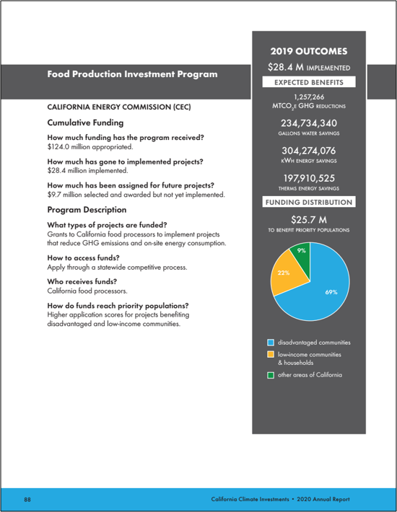
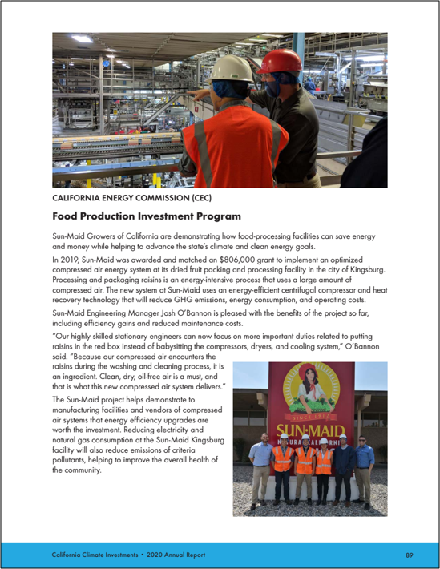
California Climate Investments Annual Report
Link to CCI Annual Report ​
Notes:
As mentioned previously, FPIP is part of California Climate Investments.
The CCI Annual Report to the Legislature was published in April and the Sun-Maid FPIP project was featured as a project highlight.
The report is available at this link.

Slide 11

Thank You!

