Slide 1


GFO-19-305 - Developing non-Lithium Ion Energy Storage Technologies to Support California’s Clean Energy Goals
ERDD - Robin Goodhand – June 10, 2020

Slide 2
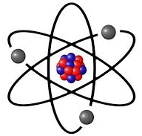
Solicitation Overview
California issues with integrating renewable energy and wildfire resiliency drive the need for a diversified portfolio of energy storage technologies.
This applied research solicitation will support seven emerging energy storage technologies move from the lab towards commercialization.
Electricity in
Electricity out
Energy
Storage
  Group 1 – non-Lithium ion energy storage technologies
    5 Awards
    Funding Required: $8,615,625
  Group 2 – Electrolytic Hydrogen
    2 Awards
    Funding Required: $2,270,725

Slide 3
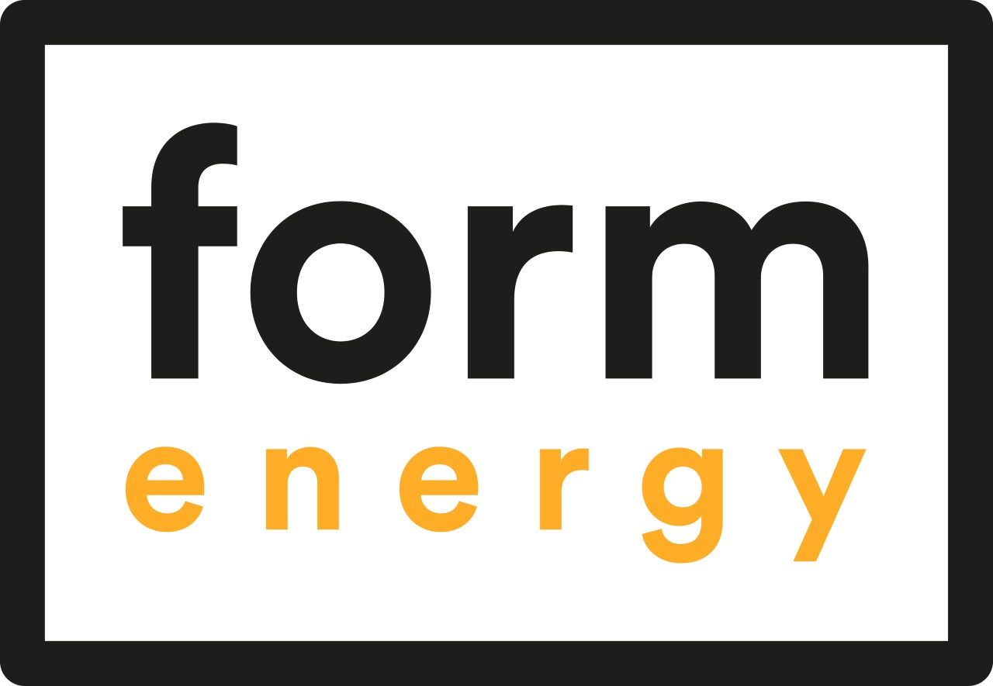
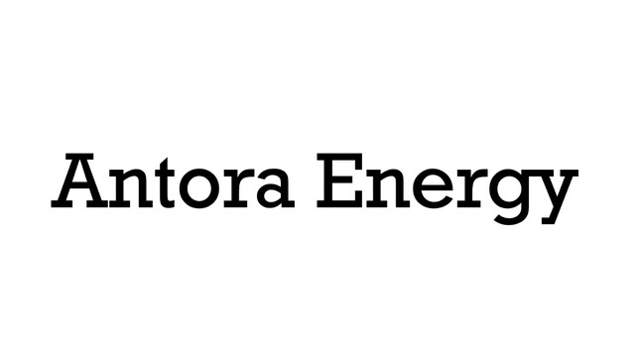

Awards Summary: emerging long duration storage
Aqueous Air-Breathing Energy Storage System for Multi-Day Resiliency
Commercialization of Lowest-Cost, Long Duration Energy Storage Systems
Solid-state Long Duration Energy Storage for Industrial Applications
Testing in industrial application
Targeting commercial / wholesale grid applications
Testing in agricultural application

Slide 4

Awards Summary: residential / commercial scale application energy storage.
California Zinc-ion Energy Storage Development and Validation Project
Zinc Batteries for California Electrical Customer Power Backup

Slide 5


Awards Summary: Electrolytic Hydrogen
Ultra-high Efficiency, Lower-Cost, Green Electrolytic H2 for Microgrids in California
Demand Based Renewable Hydrogen Power-to-Power Project

Slide 6
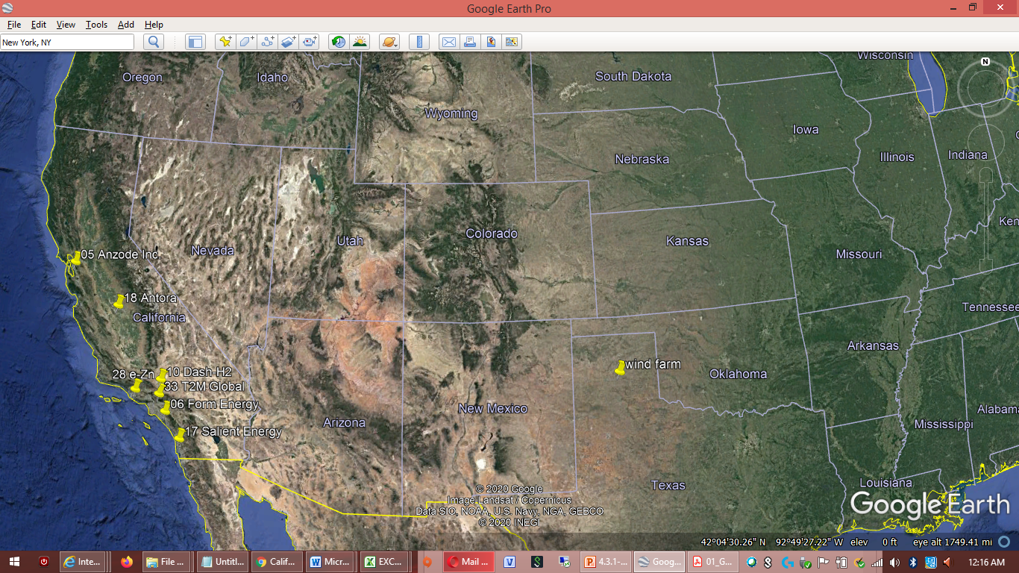
All Groups - Locations
Project locations across California

Slide 7
Questions

