Slide 1
C-PACE Financing
Commercial Property Assessed Clean Energy

Slide 2
What is PACE?
Property
Repaid as part of customer property tax bill
Based on available property equity
An alternative to traditional financing
Assessed
Clean
Only certain property improvements are eligible:
Energy and water efficiency
Energy generation and storage
Seismic retrofits
Energy
NOT A GOVERNMENT PROGRAM

Slide 3

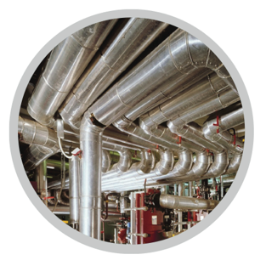

Eligible Improvements
COSMETIC
External glass
Windows & doors
Roofing
Reflective paints & coatings
Landscaping & Irrigation
Internal & external lighting
Building envelope
Sky-lighting or Day-lighting
EV Charging Stations
COMFORT & EFFICIENCY
Energy management systems
Insulation & air sealing
Ducting & ventilation
HVAC systems
Boilers & furnaces
Motors & drives
Chillers & refrigeration
Hot water
Core Plumbing
Graywater Systems
RENEWABLE ENERGY
Solar PV and Thermal
Co-Gen (CHP)
Wind
Geothermal
Energy Storage
SEISMIC RETROFITS
Soft Story
Non- Ductile Concrete

Slide 4
Financing Compared
Debt Financing
Cash Financing
PACE Financing
    Short Terms/Balloon Payments
    Personal Guarantees
    Reduces borrowing capacity
    Reduces net worth of building by amount of debt
    Reduces liquidity and available cash on balance sheet
    Reduces available cash for business opportunity
    Reduces return on equity
    Not callable. No covenants. Nonrecourse.
    Conserves cash and debt for higher yield investments
    Increases value of property without capital investment (offsetting liability) so increases building net worth

Slide 5

Benefits of PACE Financing
100% Financing
Up to 15 - 20% LTV (100% CLTV)
Up to 30 year terms
Self Amortized
Non-Recourse
Deferred Payments (2+ years)
Property is the borrower, not the property owner
Payments can pass through to tenants
Payments can transfer with sale of property

Slide 6
PACE PRODUCTS
New Construction
Retrofit/Rehab
Retroactive/Recapitalization
    Part of Capital Stack
    Replaces high interest loans
    Lowers overall financing costs
    Can encourage higher building standards
    100% Financing
    Longer Terms
    Not in Budget
    Replace. Don’t Fix.
    CapEx into OpEx
    Inject Liquidity
    Manage Cash Flow
    Debt Service
    COVID-19

Slide 7
Contact Information
Ryan Mazelli
Director, Commercial Program
Ygrene Energy Fund
Phone: 760.575.4675
Email: ryan.mazelli@ygrene.com

