Slide 1
Clean Energy Optimization Pilot
CEC Building Decarbonization Meeting
May 22nd 2020

Slide 2
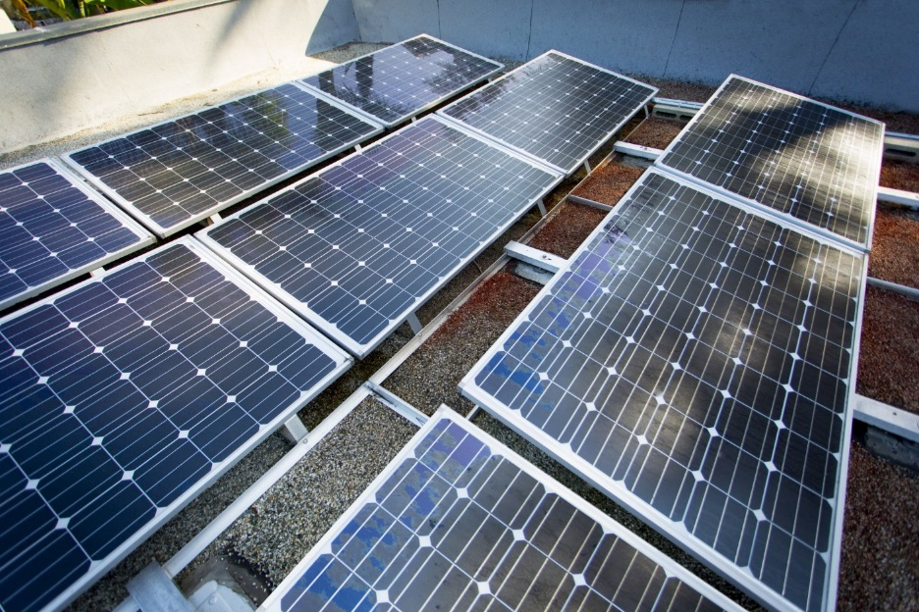
Clean Energy Optimization Pilot Overview
Background:
Part of SCE’s pathway to enabling a clean energy future, focuses on helping our customers make cleaner energy choices. SCE is continuing to explore the development of programs that specifically focus on GHG emissions reduction that will allow customers to choose and implement technology solutions that best suit their needs, while helping California achieve its aggressive environmental goals.
Objective:
Through this pilot, SCE will demonstrate how a utility can facilitate offerings that directly incent and accelerate on-site behind the meter GHG emissions reduction opportunities with large customers through a performance based GHG incentive.
GOALS
BENEFITS
Opportunity:
Incent and accelerate on-site, behind the meter opportunities.
  Pilot an incentive framework to encourage customers to reduce GHG emissions
  Determine the effectiveness and impacts of a performance based GHG incentive program
  Determine customer solution preferences using performance based GHG incentive
Alignment with the State’s and customers’ aggressive GHG reduction goals
Behind the Meter Opportunities
(On-site)
Allows the flexibility to focus on multiple technologies
Incentive payouts are performance based
Allows for scalability of opportunities across multiple industry sectors
Energy Efficiency
Cogeneration Efficiency
On-Site Renewables
Smart Load Growth
Clean Transportation
Energy Storage/DR
Electric Meter
Pilot Customer: UC Office of the President and California State University System
Gas Meter
Timeline: 4 years (Jul 2019 - Jun 2023)
Funding: GHG Cap and Trade Auction Revenues (D. 14-10-033)

Slide 3


Pilot Customers – UC and CSU
UC Davis – Veterinary School
Disadvantaged Community
UC Santa Barbara
Cal Poly Pomona
Disadvantaged Community
UCLA Santa Monica Medical Center
CSU Dominguez Hills
Disadvantaged Community
UC Irvine Medical Center
UC Irvine

Slide 4
How the GHG Incentive Works
Step 1: Meter Data Inputs (all meters within the “fence line”)
  Electric Meter(s)
  Natural Gas Meter(s)
    Both co-generation and heating
Step 2: Adjustments to Calculation
  Electricity used for Transportation
  Control Factors – Weather and Square Footage
Step 3: Conversion to GHG emissions
Output
  Baseline GHG trajectory (bold line), or
  Performance in GHG tons/sq. ft. (green arrows)
Baseline
GHG Emissions
Year
Incentive will be based on Commission approved price for per metric ton of CO2 reduction (IRP Proceeding).
Notes:
Inputs
Electric Meter - Sum of master meter and associated electric meters
Natural Gas Meter - Sum of master meter for natural gas used for heating, master meter for natural gas used for cogeneration, and all associated natural gas meters
Adjustments
Electricity Used for Transportation - Separate metering for electricity used for transportation electrification, where possible. Electricity removed from baseline, savings of switching from gasoline to electricity added to performance.
Control Factors - Control for weather through the use of Heating/Cooling Degree Days
- Control for square footage
Conversion to GHG
Electricity – Multiply by grid emissions intensity
Natural Gas – Multiply by Natural Gas CO₂ intensity (tCO₂/Th)
Output
Output in Tons of CO₂/sq..

Slide 5
CEOP Activities Customers Are Currently Exploring
Pilot Incentivizes only Behind-the-Meter Opportunities
Specifically, campuses are exploring:
  Energy Efficiency
  Operational Efficiency
  Conversion to an all-electric centralized system
  Supply side – air-handler replacements
  Controls
  Distributed Energy Resources – Solar and Battery
  Electrification of Gas Boilers
  Electric Vehicle Charging

Slide 6
SCE’s Other Building Decarbonization Activities
SCE Whitepapers¹
  Clean Power and Electrification Pathway
  Pathway 2045
Programs in Flight
  Clean Energy Optimization Pilot
  Emerging Technologies Cooking Electrification Demonstration
  Plug Load and Appliance – Upstream Space and Water Heating Heat Pumps
  Electric Reach Codes
  Clean Energy and Resiliency (CLEAR) Rebuild Program
  San Joaquin Valley Pilot Projects
Programs in Planning
  Building Electrification Pilot (IQP)
  Building Electrification New Construction Pilot (IQP)
  Self-Generation Incentive Program (SGIP)
  New Homes Energy Storage Pilot (NHESP)
  Energy Storage Procurement / Investment Plan Smart Heat Pump Water Heater Program (SHPWHP)
¹ https://www.edison.com/home/our-perspective/pathway-2045.html

