Slide 1














About Silicon Valley Clean Energy
A Community Choice Energy agency formed in 2016 & governed by 13 local communities
Campbell | Cupertino | Gilroy | Los Altos | Los Altos Hills
Los Gatos | Monte Sereno | Morgan Hill | Milpitas
Mountain View | Santa Clara County | Saratoga | Sunnyvale

Slide 2
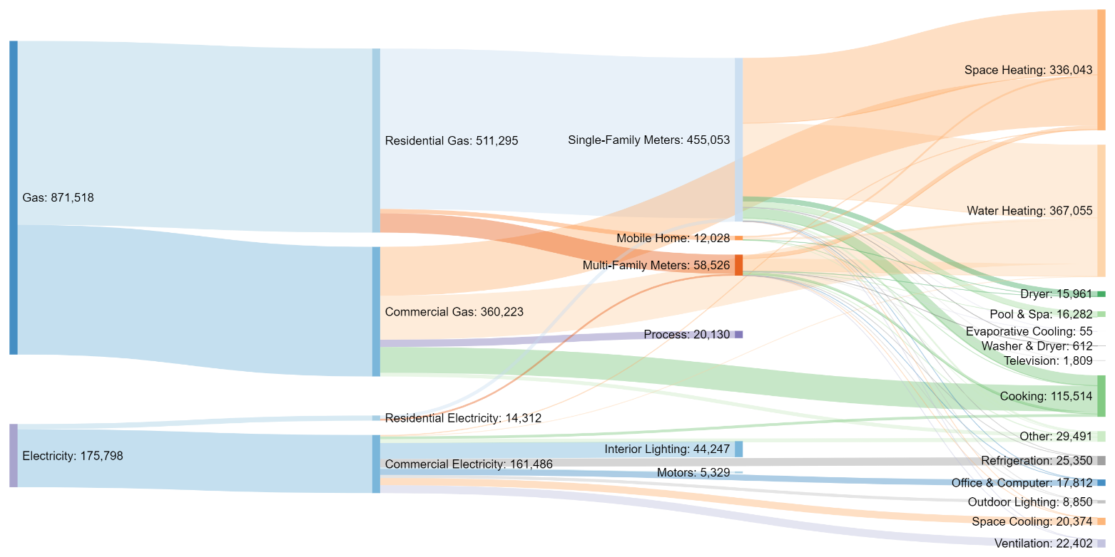
SVCE Community Building Stock Emissions
Units: Metric Tons CO₂

Slide 3
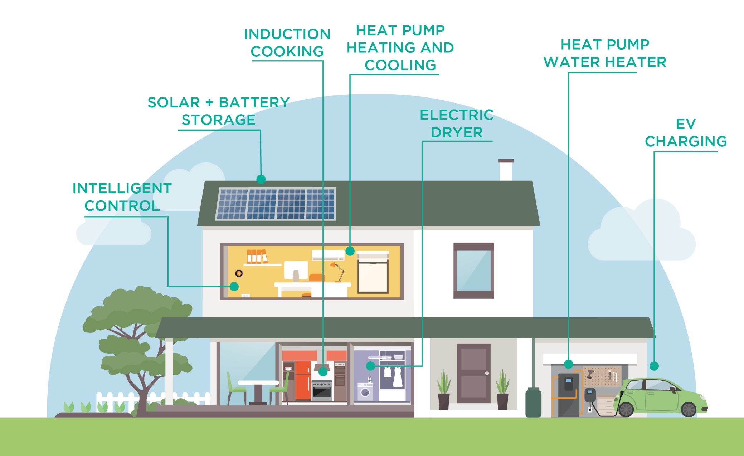
The All-Electric “FutureFit” Home

Slide 4

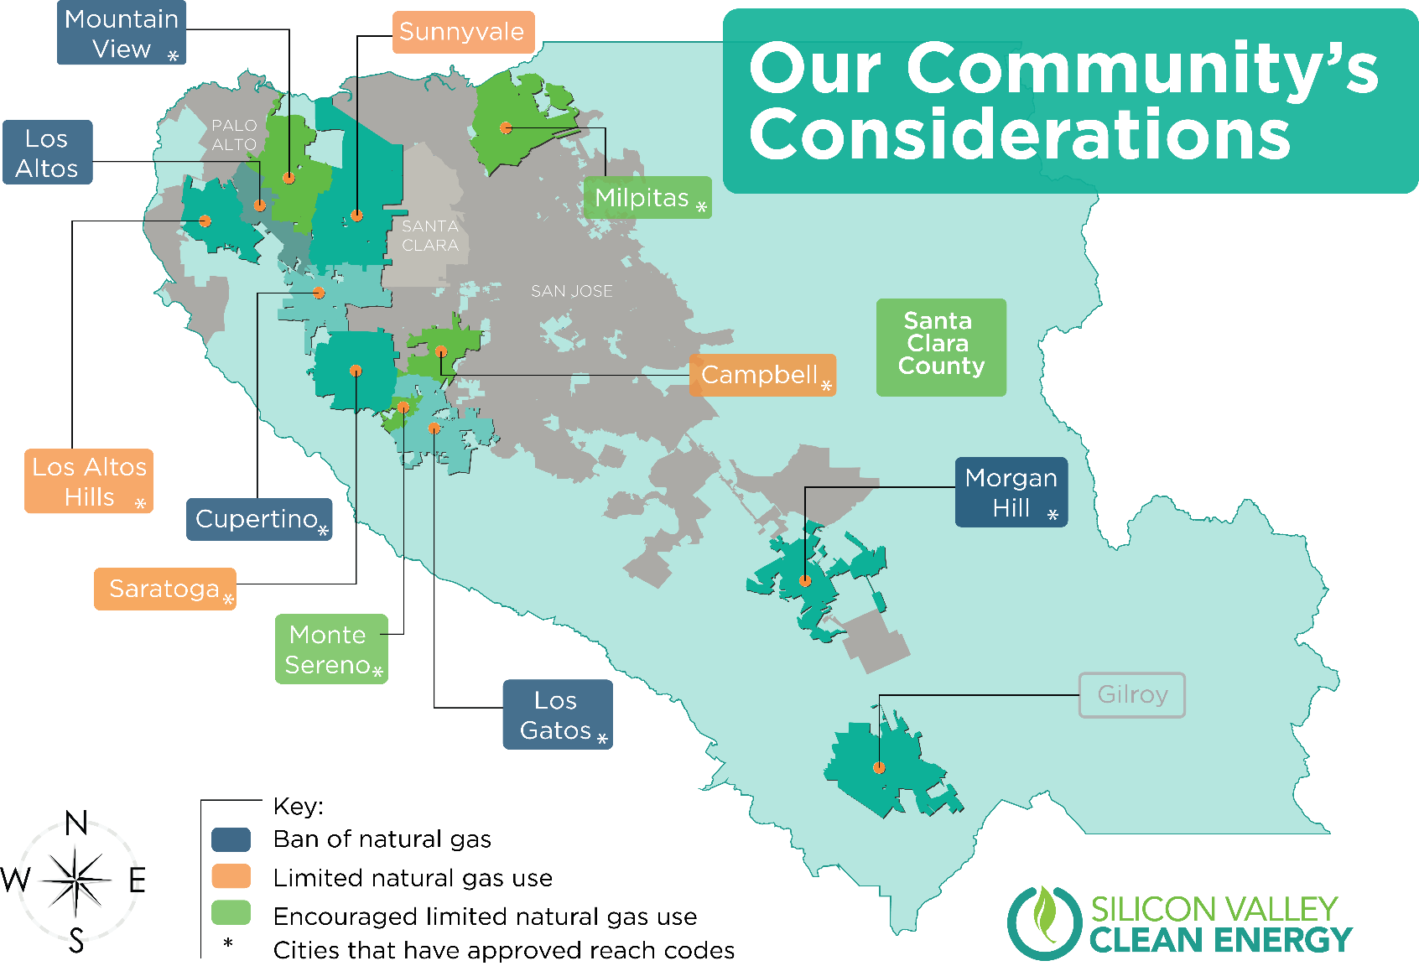
Reach Codes
9 of 13 member agencies adopted reach codes
3 agencies still in progress of adoption

Slide 5
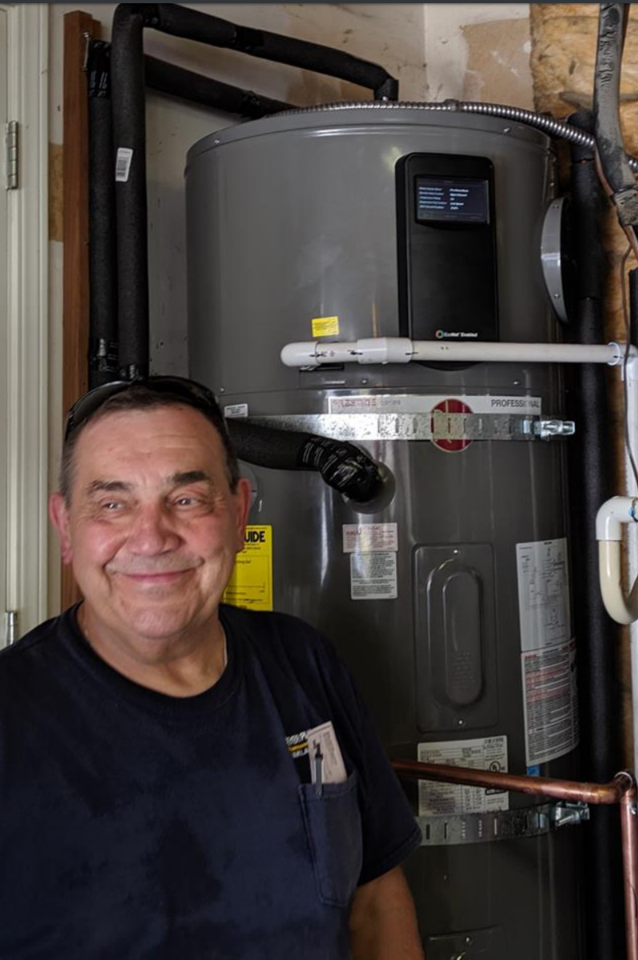
Heat Pump Water Heater Program
Situation
Nascent retrofit heat pump water heater market
Solution
Incentive to switch from gas to electric heat pump water heater
Additional incentive for electric service panel upgrade
Target of 100 installations in two years
Results
82 systems installed in six months; final 18 delayed due to COVID
35% of installations also upgraded to 200A service panel
EM&V phase beginning June 2020
Co-funded by the Bay Area Air Quality Management District

Slide 6
Virtual Workforce Development for COVID Relief
5 Online Webinars
(core curriculum)
Core Curriculum
Electrification 101
Hot water Systems
Solar + Batteries
Appliances
HVAC
5 Online Tech Talks
(specific technologies)
6 Hour Self-paced Online curriculum
Eligibility
Licensed Contractor
Union Member
$500 Compensation
Customer & Contractor Testimonials
Up to $3000 Rebate for installing at home or workplace
Outcomes
Understand why market is shifting to electric
Familiar and Conversant with health, safety, economic benefits
Utilize technology
Pursue vast array of existing in-depth trainings and certifications

Slide 7
Lessons Learned
  Key barriers:
    Electrical panel and distribution system upgrades
    Contractor education, awareness, readiness
    Resilience concerns
    Consumer education & awareness
  Key opportunities:
    Health & safety benefits resonate
    Demand signal via local and/or state policy
For more information on SVCE’s complete programs portfolio, please see https://www.svcleanenergy.org/programs/.

