Slide 1

SMUD Commercial Multifamily New Construction and Retrofit Decarbonization Programs
Leah Pertl
Supervisor, Commercial Programs
May 22, 2020
Commissioner Workshop on Building Decarbonization:
Opportunities and Challenges of Buildings Sectors -Multifamily

Slide 2
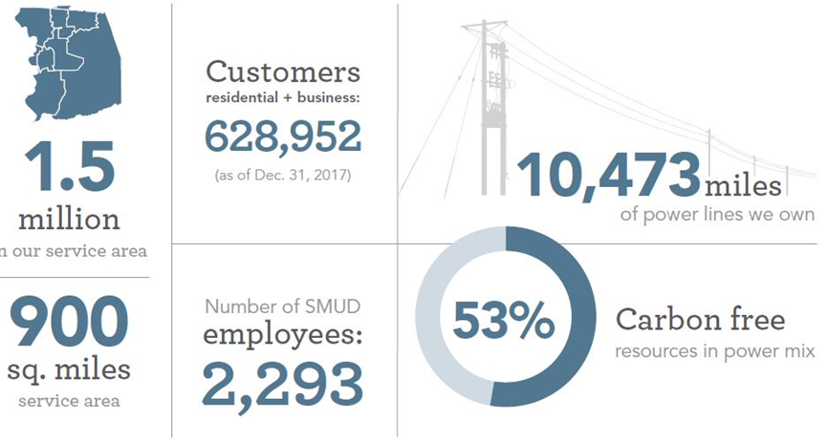

About SMUD
SMUD began serving Sacramento in 1946 and is now the nation’s sixth-largest community-owned, not for profit electric utility.
SMUD is owned by its customers who elect a seven-member Board of Directors
Notes:
Meeting California’s ambitious environmental goals will require significant electrification of
water heating, space heating and cooking equipment. Replacing natural gas appliances with
electric appliances can reduce greenhouse gas emissions from residences by up to 60
percent, and provides cost savings for most customers.

Slide 3
Smart Homes
New Residential Construction Incentive Program

Slide 4
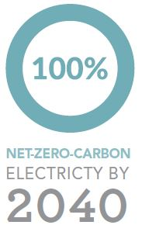
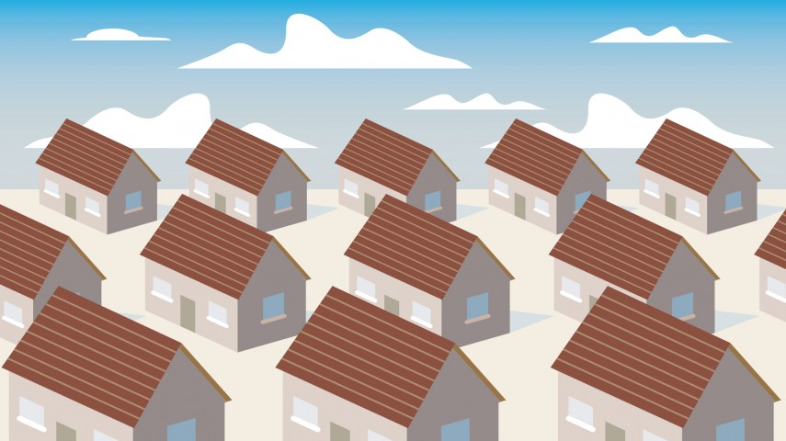
Plan to Achieve Net Zero Carbon
SMUD will transform the Sacramento region by making bold investments over a 20 year timespan, maximizing local renewables and electrification. SMUD plans to be a net carbon zero utility by 2040.
To accomplish this SMUD’s All Electric Smarthomes program incentivizes builders to adopt all-electric construction practices, the program assures that the home produces less carbon with time until it is a zero emissions home by 2040.

Slide 5
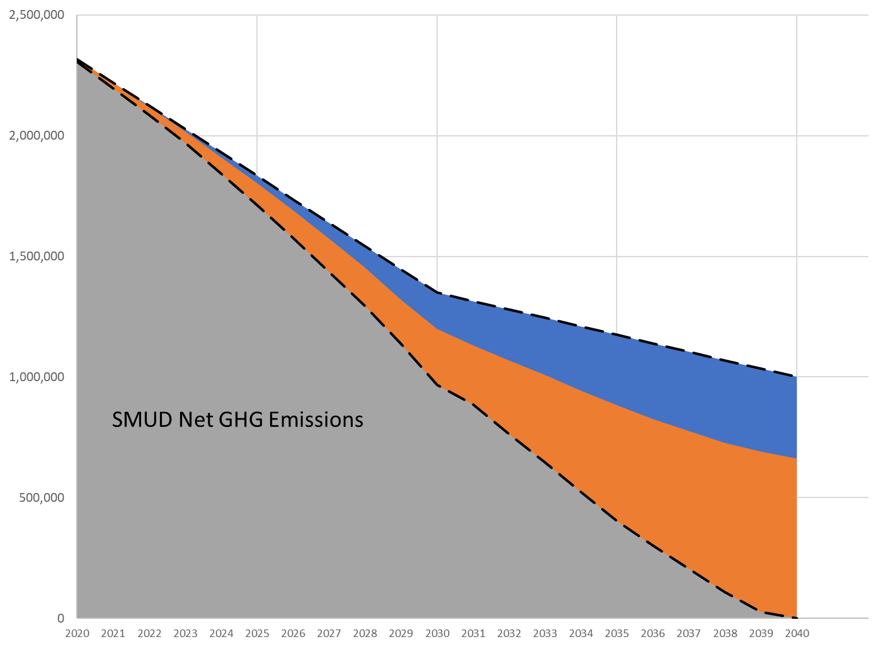
Why the Smart Home Program
2020 Carbon Emissions
Generation Decarbonization
Carbon Emissions (Tonnes)
Grid Carbon Emissions
Community Impact
Attributed Building Decarbonization
Net Carbon Emissions
Attributed Vehicle Decarbonization
5
5
Notes:
What that looks like is here, with our electricity supply emissions to serve our retail footprint as the top declining dashed line. Our attributable building and transport decarbonization reduce those emissions to zero. In reality, the total emissions reductions in buildings and transport will be larger than the attributable share. This is due to state and federal policies and other levers that are pushing in this same direction.
Our attribution evaluation has us claiming about ¼ to 1/3 of the total emissions reductions over the 20 year period.

Slide 6
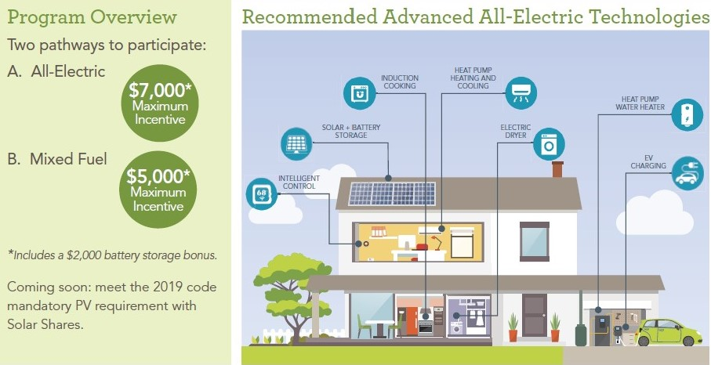
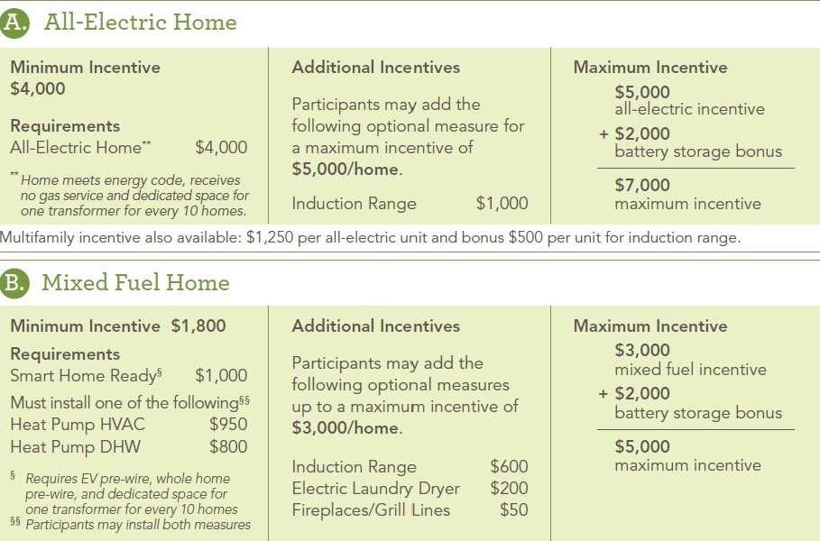
Elements of the Smart Home Program
Mixed Fuel Multifamily Incentives also available up to $1,190 max. per unit including $300 bonus per unit for induction range

Slide 7

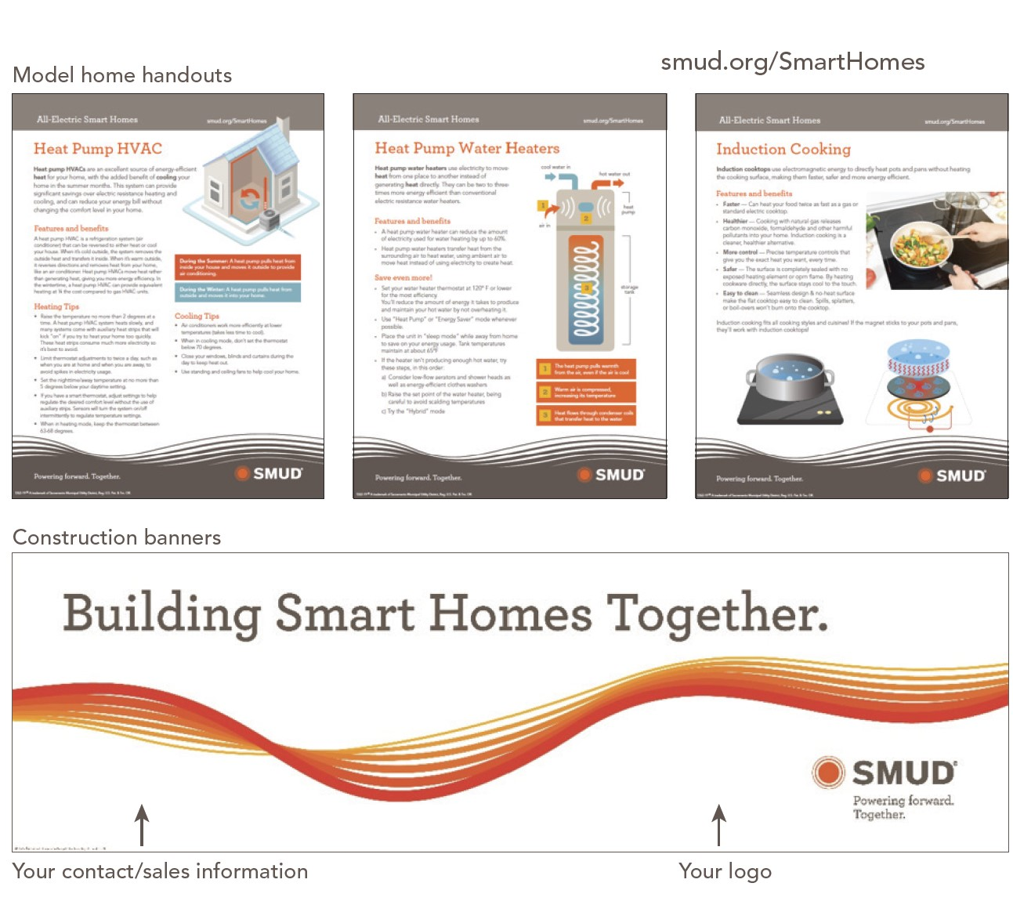
Smart Home Program Builder Support

Slide 8
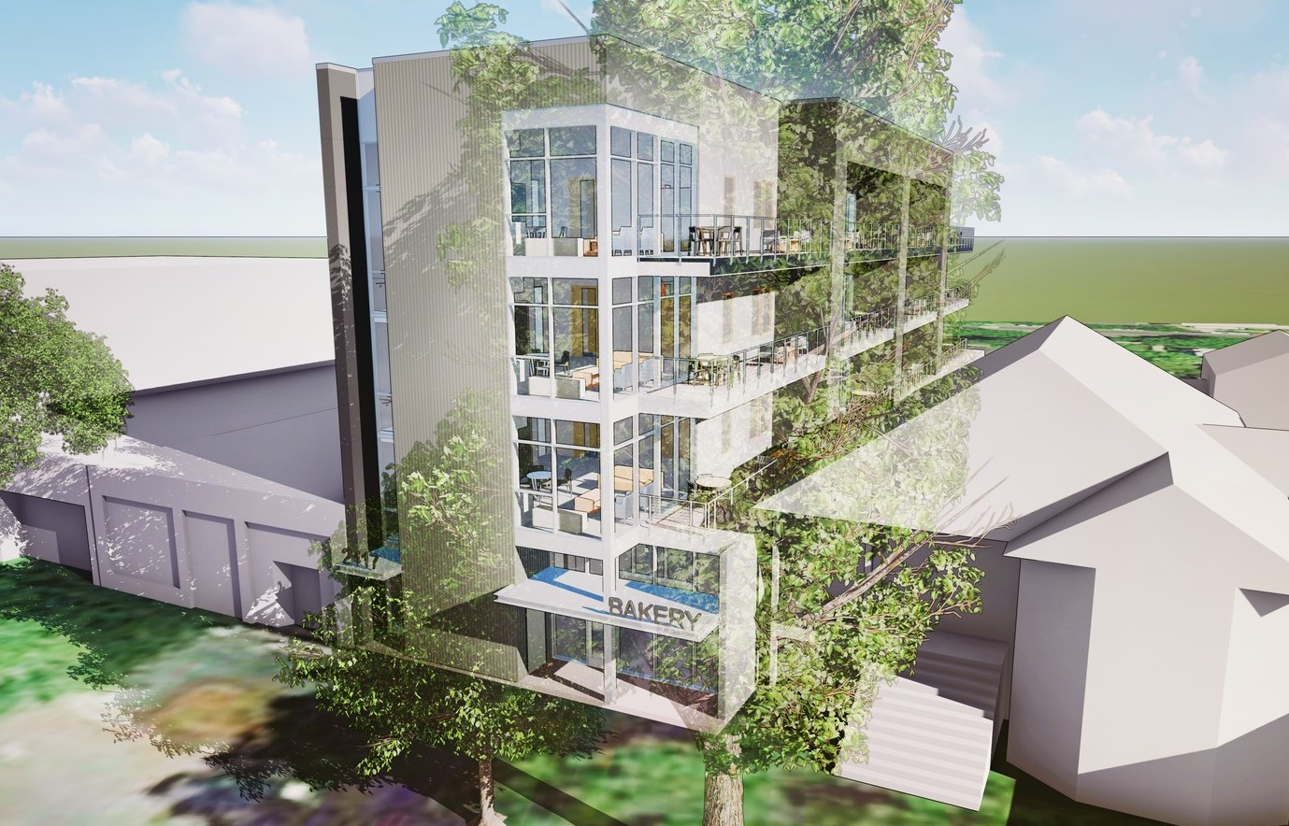
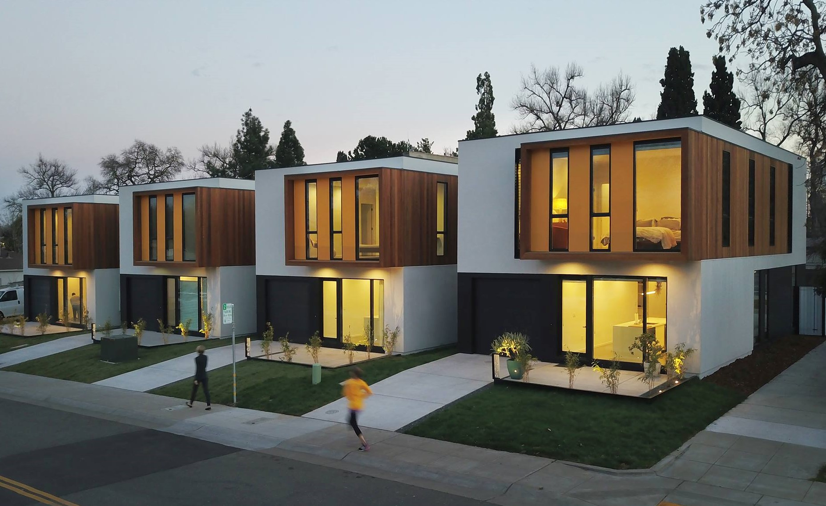
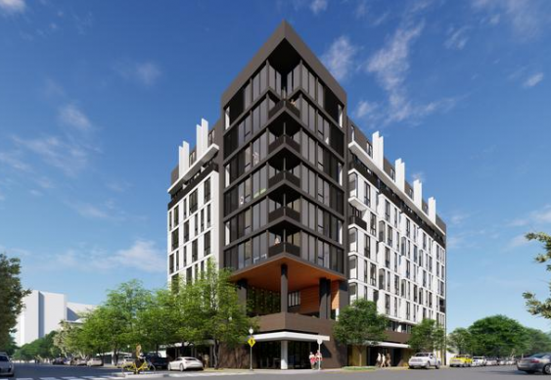
Smart Home Program Progress
All-Electric - Committed Projects (through 2022)
Builders/Developers – 36 w/ 56 Developments
Current Program Total Applications - 1,838 Units
Current Program Planned Incentive Total - $6.2M through 2022
Single Family Residential - 940 Homes
Incentives - $4.7M
Multifamily Residential - 898 Units
Incentives – $1.5M
All-Electric – Pipeline through 2025
Builder/Developers – 15 (3 are current participants)
Current Total - 5,103 Units
Current Pre-Agreement Incentives Total - $17.4M
Single Family Residential - 3,222 Homes
Incentives - $14.5M
Multifamily Residential – 1881 Units
Incentives - $2.8M

Slide 9
Multifamily Program
Beneficial Electrification Program

Slide 10



Multifamily Program
Transitioning from energy efficiency to electrification offerings
focusing on:
fossil fuel usage
long term carbon savings.
Who can participate?
Multifamily sites with 5 or more units with participating customers receiving prescriptive rebate amounts per measure installed
low income incentives for qualifying multifamily sites.
Apartments
Dorms
Hotels (SRO)

Slide 11
Multifamily Program
HP HVAC
HP DHW
Induction Cooking
Multifamily beneficial electrification program offering prescriptive incentives for qualifying measures
(gas to electric conversions only)

Slide 12
Multifamily Program
Bonus Incentives
Electric Panel Upgrades
Engineering and Permit Support
EVSE
Low Income
Bonus Incentives

Slide 13



Multifamily Program
Customers
      Building Owners
      Property Managers
      Tenants
    What’s unique to this program?
      Tenant Engagement through..
        Digital delivery
        Apartment visits
        Community events

Slide 14

Multifamily Program
Goals
While carbon reduction is the primary goal, the Program also aims to maximize co-benefits
  Indoor air quality
  Health
  Tenant Comfort
  Energy Savings

Slide 15
Equipment Menu – Incentive Rates
Electrification Incentives
  Based on deemed savings values based on equipment type, performance, and replacement
    (capped @$150,000/project)
Air Source Heat Pumps
$600-$1,100/apt
Residential Storage Water Heater (unitized)
$1500/apt
Induction Cooktops
$200/apt
Split System(or central plant) serving multiple units $1500/apt
Electric Panel upgrades $500/panel

Slide 16
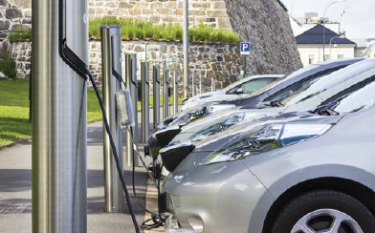
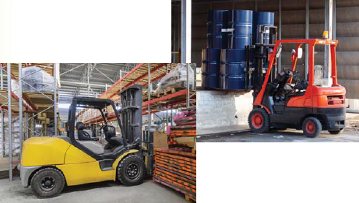
Electric Vehicle Programs
For Level 2 electric vehicle chargers
  CEC CALeVIP offers up to $6,500/port
  OR
  SMUD offers $1,500/port
Notes:
The electric vehicle charging program is currently being revamped, and will focus on Smart Chargers.

Slide 17
Low Income Incentives
Eligibility Guidelines (Effective March 1, 2019)
Persons in Household | Monthly Income
1 | $2,082
2 | $2,818
3 | $3,555
4 | $4,292
5 | $5,028
6 | $5,765
Additional members (each) | $737
Up to an additional 25% incentives
  50%+ of the tenants must be active participants in SMUD’s Energy Assistance Program Rate
    (capped at $25,000/project)

Slide 18

SMUD’s Outreach Plan
Smart Homes & Multifamily Programs
Program Website and collateral
SMUD Program Team
Strategic Account Advisors
3rd Party Program Support
Engagement
Builder Support
Industry
Tenant

Slide 19
Questions
Leah Pertl
Supervisor, Commercial Programs
916-732-7088
Leah.Pertl@smud.org

Slide 20
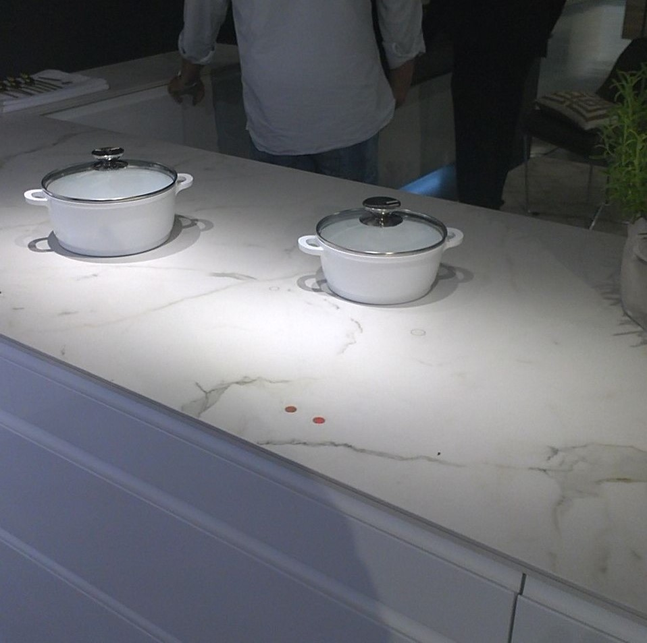
Why the focus on Induction Cooking?
 |  | Induction A (Frigidaire) | Induction B (GE) | Induction C (Samsung) | Resistance Ceramic (Whirlpool) | Resistance Coil (Frigidaire) | Gas Burner (Samsung)
Heat Up (5 lb Water) | Water Heat Up Time | 5.3 min | 5.8 min | 6.4 min | 18.8 min | 11.5 min | 14.1 min
 | Efficiency | 86.20% | 86.80% | 85.30% | 70.30% | 72.30% | 30.60%
Temp Response | Large Pot 200°F Overshoot | 0.8°F | 0.8°F | 0.8°F | 7.1°F | 4.9°F | 1.7°F
 | Induction advantage for Overshoot |  |  |  | 89% | 84% | 53%
 | Large Pot Cooldown to 190°F | 18.8 min | 20.6 min | 18.8 min | 38.1 min | 26.5 min | 23.9 min
 | Induction advantage for Cooldown |  |  |  | 49% | 27% | 19%
Almost 3x faster than gas
More efficient
Better temp response
  less overshoot
  faster cooldown
Healthier: No NOx, formaldehyde, carbon monoxide
Safer: less risk of burning, CO, other dangers associated with gas
~$10 more to operate per year

