Slide 1

Technical Challenges for Decarbonization Retrofits in Multifamily Buildings
Katie Wu
May 11, 2020

Slide 2

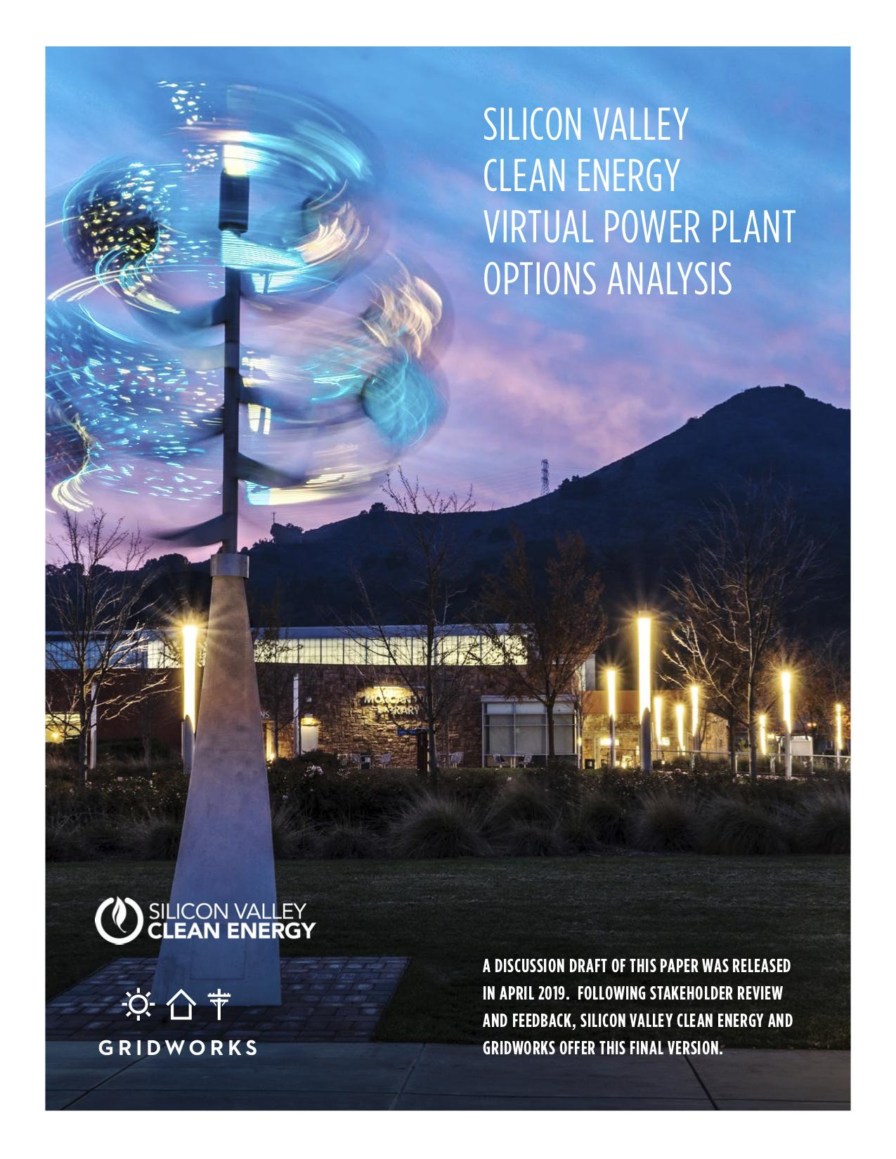

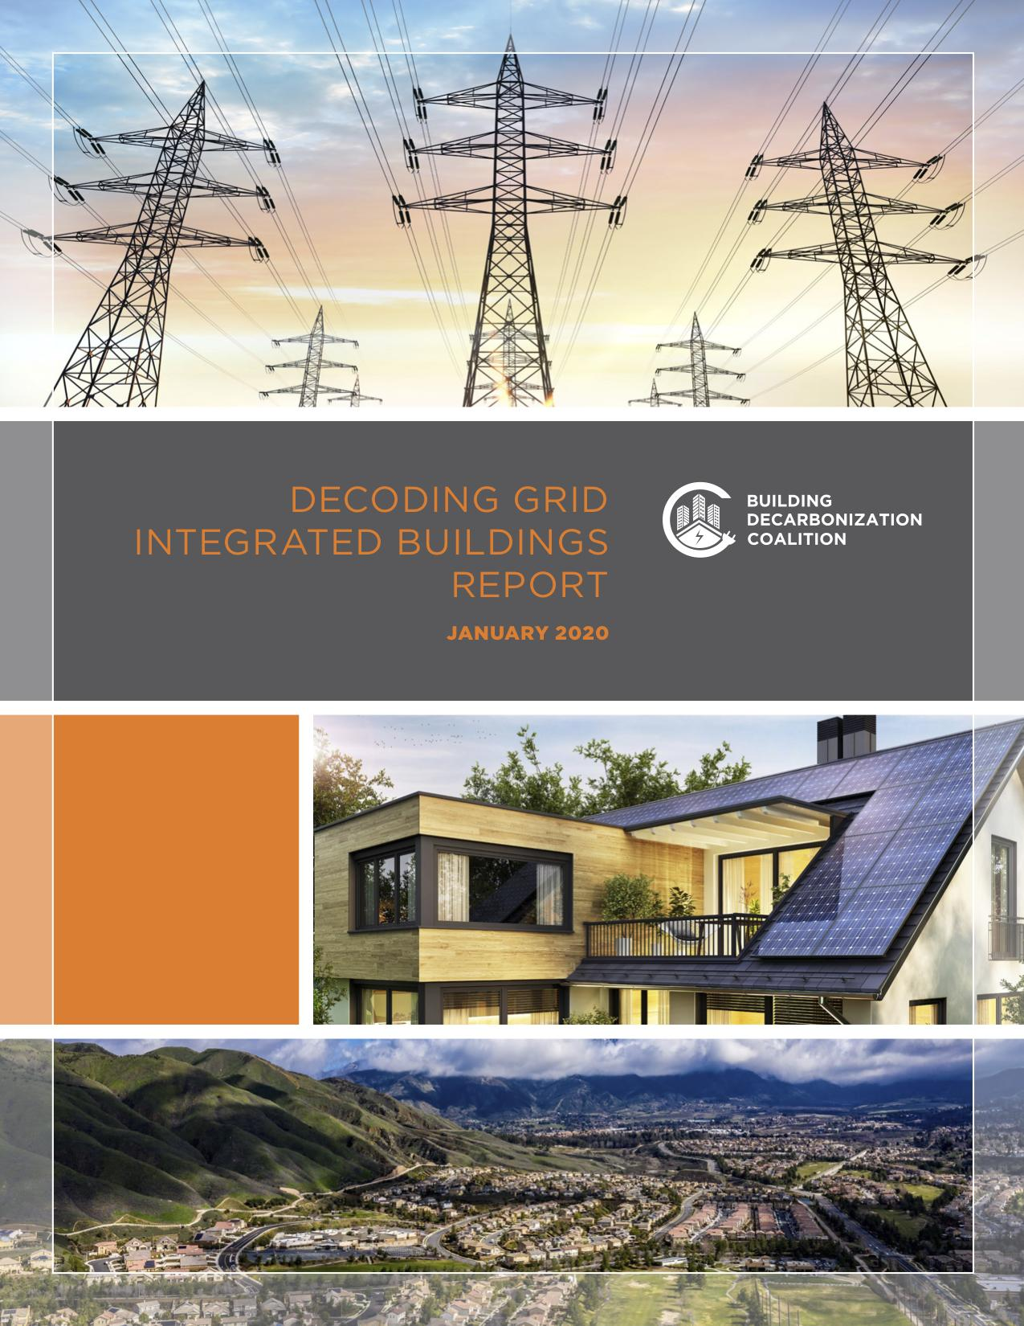
Gridworks’ Mission
To convene, educate, and empower stakeholders working to decarbonize electricity grids
Notes:
Since 2010, Gridworks has enabled its mission through four strategies:
Identify high-value challenges to decarbonizing electricity grids;
Convene stakeholders and provide them neutral ground, technical support, and facilitation to identify break-through solutions;
Publish and help implement identified solutions; and
Adapt successful solutions to new markets.

Slide 3
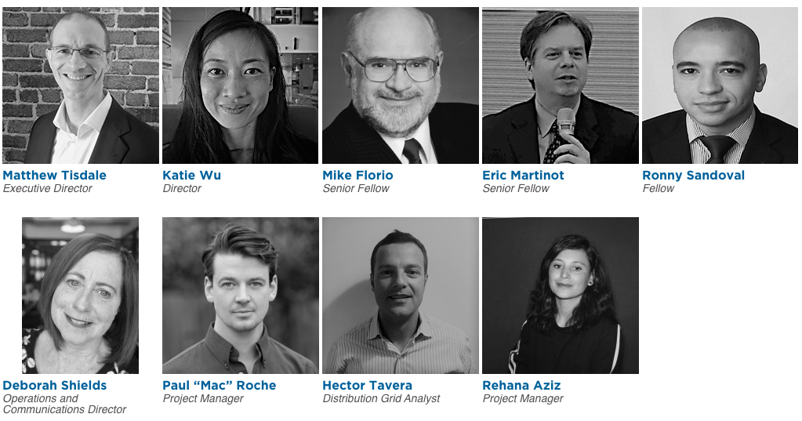
The Gridworks Team

Slide 4
Challenges for Decarbonizing Multifamily Buildings
For Tenants
Lack of control over appliances (space heater, water heater, cooktop)
For Property Managers
Lack of monetary benefit to decarbonize
Uncertain bill impacts and/or lack of economic electricity rate option(s)
Potential for displacement from a retrofitted unit
Lack of high demand, high capacity dryers for shared laundry rooms
Decarbonization retrofits are complex projects

Slide 5
Challenges for Decarbonizing Multifamily Buildings (Cont.)
For Contractors
Lack of simple, repeatable retrofit package - each project is unique
For Electric Infrastructure and the Grid
Capacity and energy demand increases on building-level electrical infrastructure (e.g., unit and building electrical panels, transformers, distribution system)
Lack of appliance availability in the market - procurement delay impacts emergency replacements

Slide 6
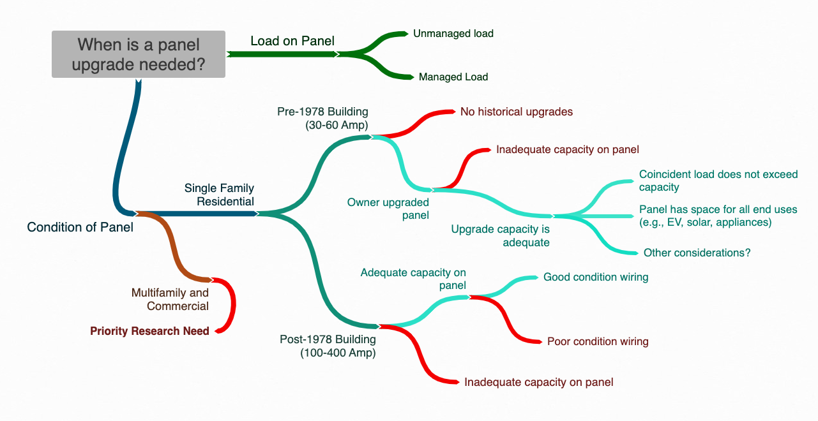
Better Understanding of Multifamily Building Panels Needed
Multifamily and commercial buildings are priority research areas, but we can apply logic from the single-family residential sector

Slide 7
Recommendation 1: Offer Pilots and Incentives
Leverage existing programs and new funding for pilots and incentives to make multifamily buildings “electric-ready” and provide low-emissions, low-amperage appliances
(CEC) Building Decarbonization (SB1477) BUILD pilot - $60M available for new low income residential housing
(CPUC) Energy Savings Assistance (ESA) Program - recognize the health, comfort, and safety benefits of decarbonization
(CPUC) Solar on Multifamily Affordable Housing (SOMAH) Program - for installed projects, ensure panel capacity and breaker space can accommodate potential future load increases

Slide 8
Recommendation 2: Provide Customer Support
Create a customer-centric platform to support building decarbonization
(CPUC) Support a statewide consumer education campaign to promote the benefits of building decarbonization
(CEC) As part of AB3232 implementation, develop a customer-facing project guidance platform in coordination and consultation with contractors and labor representatives to ensure project options are feasible and affordable
(CEC and CPUC) Consult with housing organizations to identify tenants’ needs and property managers’ capacities to install building decarbonization end uses

Slide 9
Recommendation 3: Implement Load Management Strategies
Leverage multifamily buildings as grid-integrated resources and implement load management strategies to smooth demand on the grid
(CEC) Consider specific use cases for multifamily buildings in the Load Management Rulemaking and establish standards to enable technical engagement by January 1, 2022
(CEC and CPUC) In collaboration with stakeholders, study and assign quantitative value to the reliability of virtual power plants to manage load

Slide 10
Recommendation 4: Update Load Calculation Approaches
Conduct load studies and update load calculation approaches to balance safety standards and infrastructure needs
(CEC) Work with the California Building Standards Commission and local governments on the interpretation of the National Electrical Code and its application in the California Electrical Code
(CPUC) Direct load serving entities to clarify and update base load assumptions to ensure efficiency standards are accurately considered
(CEC and CPUC) Consult with the Governor’s Office of Business and Economic Development to develop a Building Decarbonization Permitting Guidebook to clarify acceptable load calculation approaches and provide project examples

Slide 11
Thank You!
Contact:
Gridworks: https://gridworks.org/; info@gridworks.org
Katie Wu: katiewu@gridworks.org

Slide 12
Resources
Decoding Grid Integrated Buildings Report: https://gridworks.org/wp-content/uploads/2020/02/Decoding-Grid-Integrated-Buildings_WEB.pdf
Decoding Building Decarbonization Research Agenda:
https://gridworks.org/wp-content/uploads/2020/02/Decoding-Building-Decarb-Research-Agenda_final.pdf
2019 California Energy Efficiency Action Plan
https://ww2.energy.ca.gov/business_meetings/2019_packets/2019-12-11/Item_06_2019%20California%20Energy%20Efficiency%20Action%20Plan%20(19-IEPR-06).pdf
Clean Energy in Low Income Multifamily Buildings Action Plan
https://listserver.energy.ca.gov/business_meetings/2018_packets/2018-11-07/Item_06.pdf

