Slide 1
Opportunities and Challenges to Decarbonize Residential Buildings
May 22, 2020

Slide 2
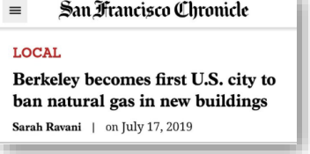
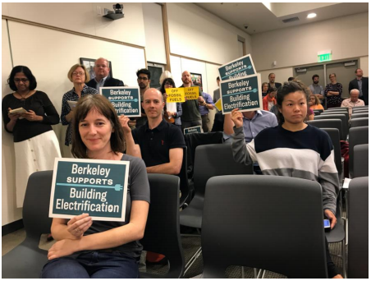
PG&E’s Path to Get to Yes!

Slide 3
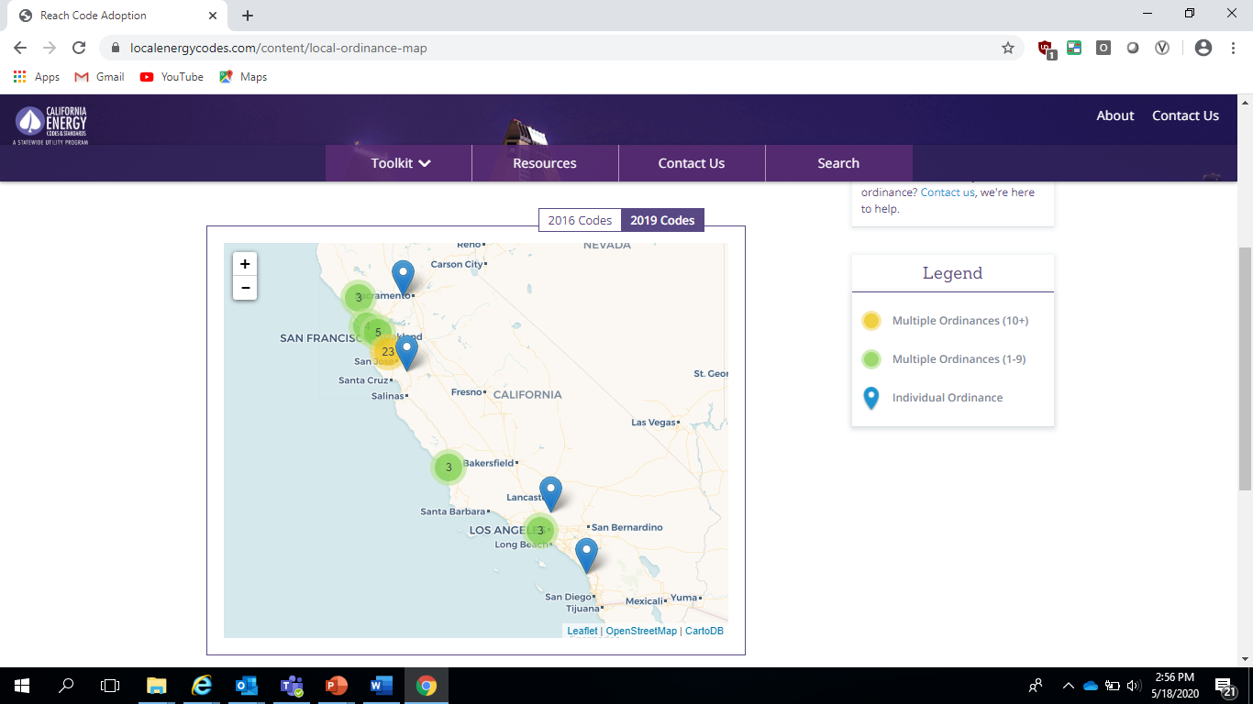

PG&E supports local governments’ call for all-electric new construction
Local governments successfully adopting Reach Codes – 2019 Codes
25 Letters of Support
Support
California’s climate and clean air goals
Long-term decarbonization objectives
Local government policies that promote
all-electric new construction when cost effective
Meet the needs that all-electric buildings
will require
Avoid
Investments in new gas assets that might later prove underutilized
Extreme cost shift to gas customers that remain
Berkeley
Brisbane
Campbell
Cupertino
Foster City
Gilroy
Healdsburg
Los Altos Hills
Los Gatos
Menlo Park
Mill Valley
Monte Sereno
Morgan Hill
Mountain View
Petaluma
Redwood City
Richmond
San Francisco
San Jose
San Luis Obispo
San Mateo County
Santa Clara County
Santa Cruz
Seaside
Windsor
Source: localenergycodes.com

Slide 4
ZNE Demonstration Projects showcase benefits of all-electric new construction
Activity | 2009 | 2011 | 2013 | 2015-2017 | Jul | 2018 | 2019
Single Home Demonstrations
DeYoung ENERGYSMART Home
DeYoung Zero Electric Home
DeYoung Monitoring Case Study Report PG&E ZNE Builder Demo Projects Case Studies
Community Projects
DeYoung Envision ZNE Community
Meritage Fontana Community
Cost-Effectiveness Studies
Super Efficient Home
Considering All Electric
Learning what works
Pulte
Meritage
CHISPA
DeYoung
PG&E EPRI Project
‘Mostly electric’ community
SCE EPRI Project
Low Rise New Construction

Slide 5


PG&E’s research identified opportunities to educate and inform customers
Customer Perception: Gas is anything that needs heat
  Customers perceive natural gas to be more efficient than electricity when it comes to appliances that require heat
  Gas is cheaper and more reliable
  Gas is less sustainable and less clean
Customer Perception: Electricity is everything else
  Residential customers also perceive that electricity gives them more control over their usage than gas
  Electricity is safer and healthier
  Renewable electricity is the future
PG&E customer research conducted from June to August of 2018

Slide 6





Advanced Energy Rebuild (AER) Program underscores opportunities and challenges of all-electric new construction
AER Enrollment Statistics
223
70
95
104
82
Projects Enrolled
223 single family
All-Electric Projects
Projects Installing Solar PV
Projects Installing Heat Pump Space Heaters
Projects Installing Heat Pump Water Heating

Slide 7
San Joaquin Valley (SJV) DAC Electrification Pilots will inform opportunities and challenges in low income communities
SJV DAC Proceeding
Phase 1: Identify DACs in the San Joaquin Valley
Phase 2: Implement pilots to increase access to affordable energy
Phase 3: Evaluate, Review Data and Analyze Economic Feasibility
Pilot Objectives
Provide access to affordable energy by reducing total energy costs for participating households
Collect data for use in Phase III of the proceeding.
11
Pilot Communities in San Joaquin Valley
11
8
1
Total Electrification Pilots
Electrification Pilots in PG&E territory
Natural Gas Pilot
(SoCal Gas)
PG&E-Territory Electrification Pilots
Electrification Pilot Offerings
PG&E Administrator: Cantua Creek, Allensworth, Seville
Third Party Administrator: Alpaugh, Fairmead, Lanare, La Vina, Le Grand
Target: 1,260 households
Electric Appliances: Heat Pump Water Heater, Heat Pump Heating and Cooling, Electric Cooktop/Range, Electric Clothes Dryer
Enrollment assistance
Replace propane/wood-fueled appliances with electric
Energy efficiency and weatherization measures
Electric panel upgrades (if needed)
Repairs and remediation (if needed)
Enrollment in existing programs (CARE, ESA, SGIP, etc.)
10-year Bill Protection Discount
5-year Tenant Protection

Slide 8
Thank You!
Questions, Comments, Thoughts…Please Reach Out
Meghan Dewey
Manager, Income-Qualified Programs and Disadvantaged Communities
meghan.dewey@pge.com
415-216-8845

