Slide 1
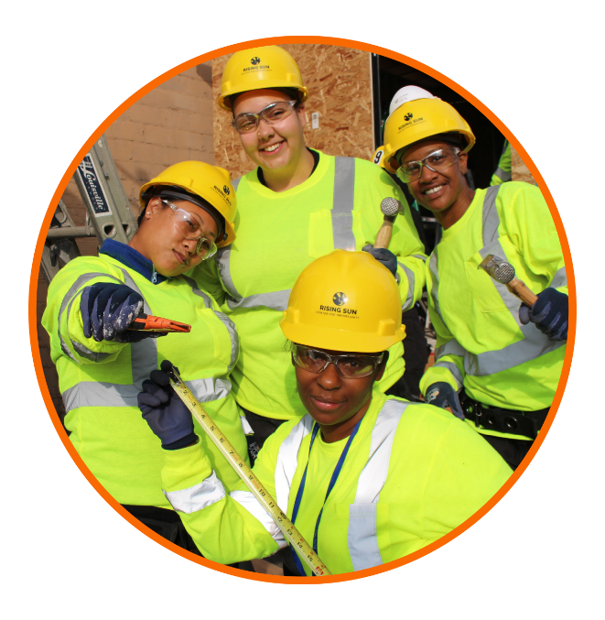
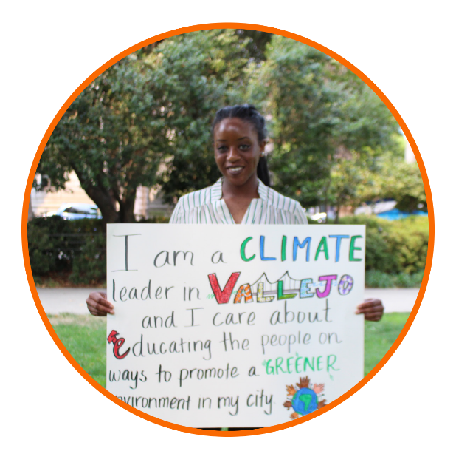
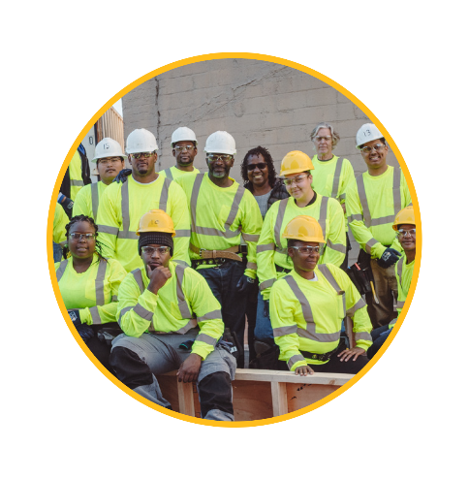
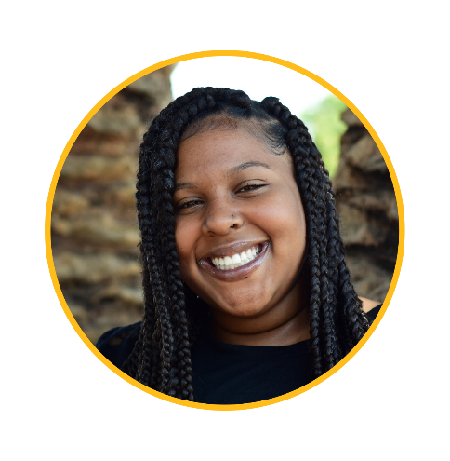

Slide 2

Mission
Our mission is to empower individuals to achieve environmental and economic sustainability for themselves and their communities

Slide 3




Expertise
Equity
We believe that economic, environmental, and social opportunities should be accessible to everyone.
Workforce Development
We focus on high-road, clean economy careers in construction, the building trades, solar, and energy efficiency.
Underserved Populations
Our programs prioritize low-income youth, women, and individuals in reentry.
Community Outreach
We specialize in working in and with underserved, hard-to-reach, and disadvantaged communities.

Slide 4
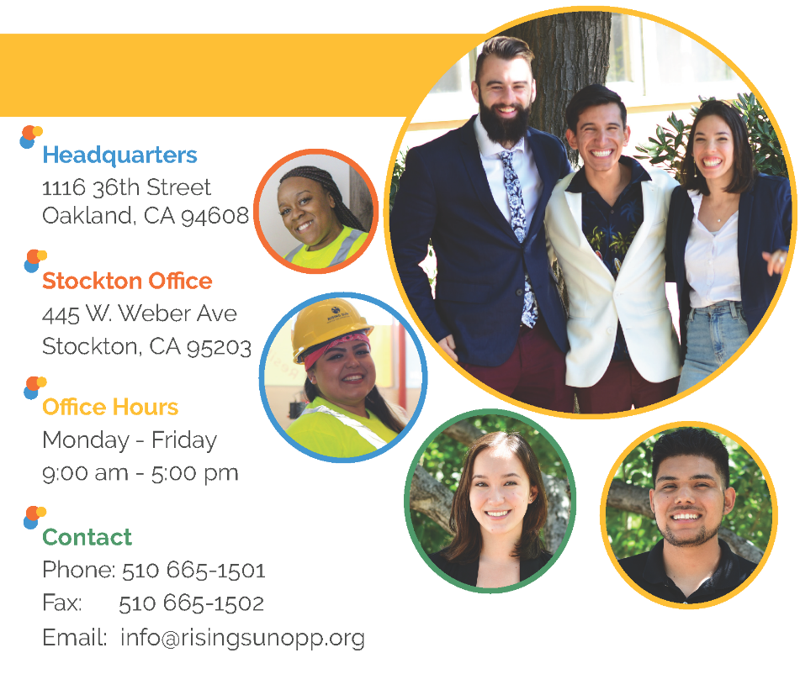
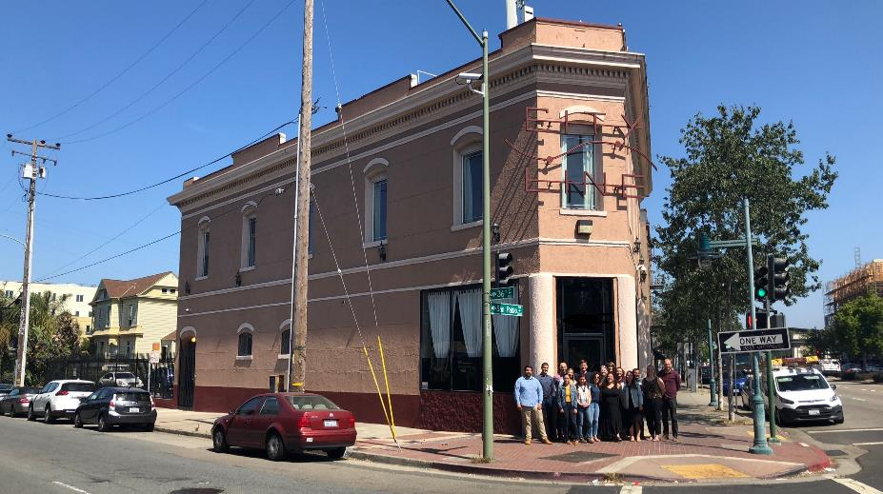

Where to find us

Slide 5
People.
Planet.
Pathways.
Opportunity Build
Climate Careers
Provides a pathway out of poverty through preparation for construction and building trades apprenticeships
Offers one of the only all-women pre-apprenticeship training programs in the country
Holistic training + supportive services
Gives 150 young people their first green job every year, helping over 3,000 residents save energy
Social enterprise model: youth employment + residential energy efficiency
Low-income youth, underserved communities
Programs

Slide 6
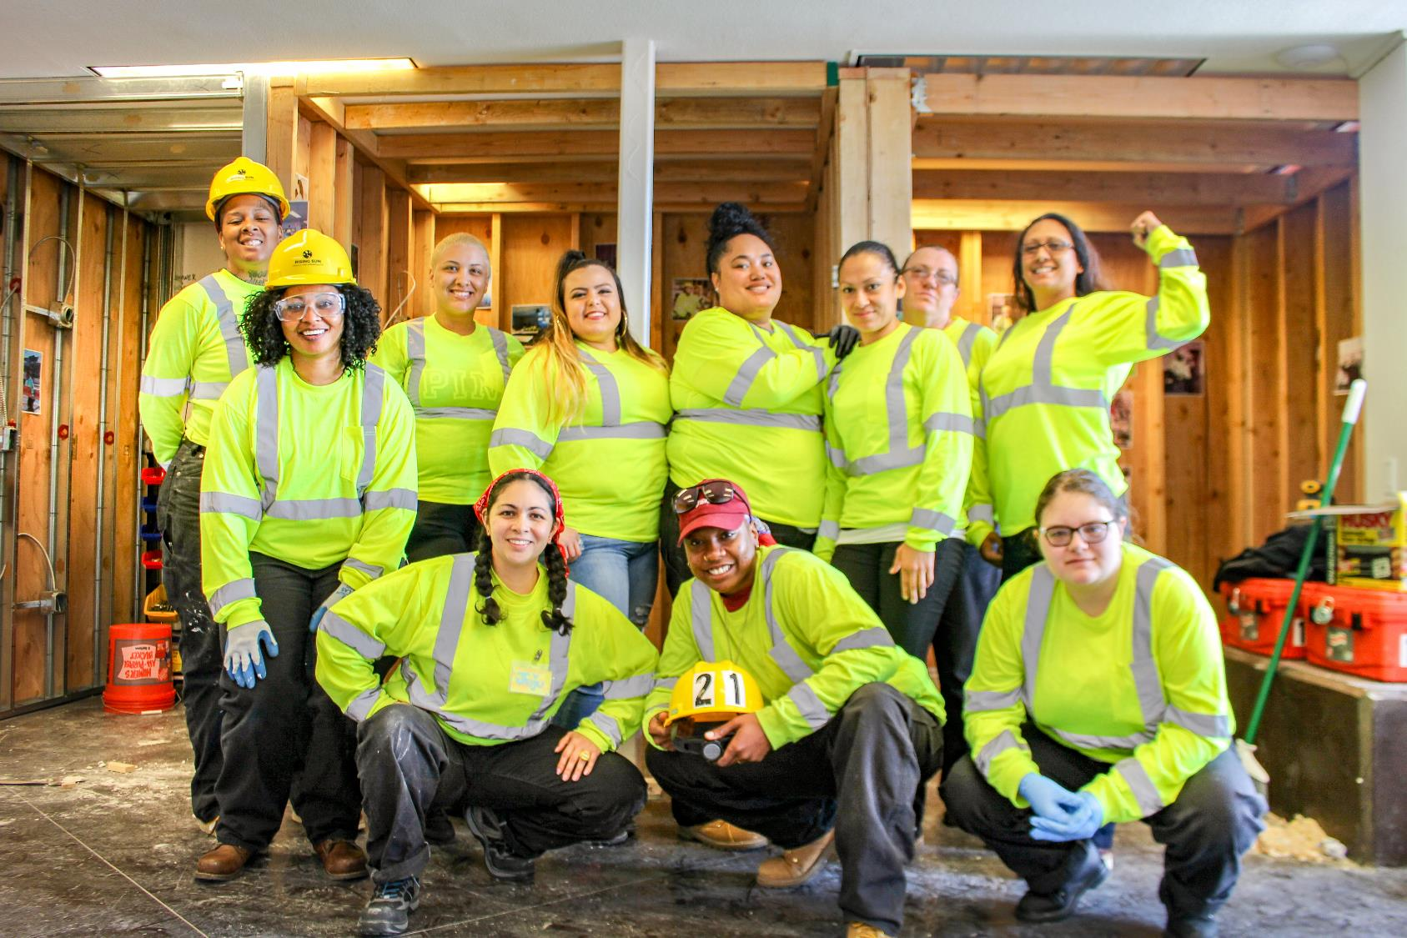
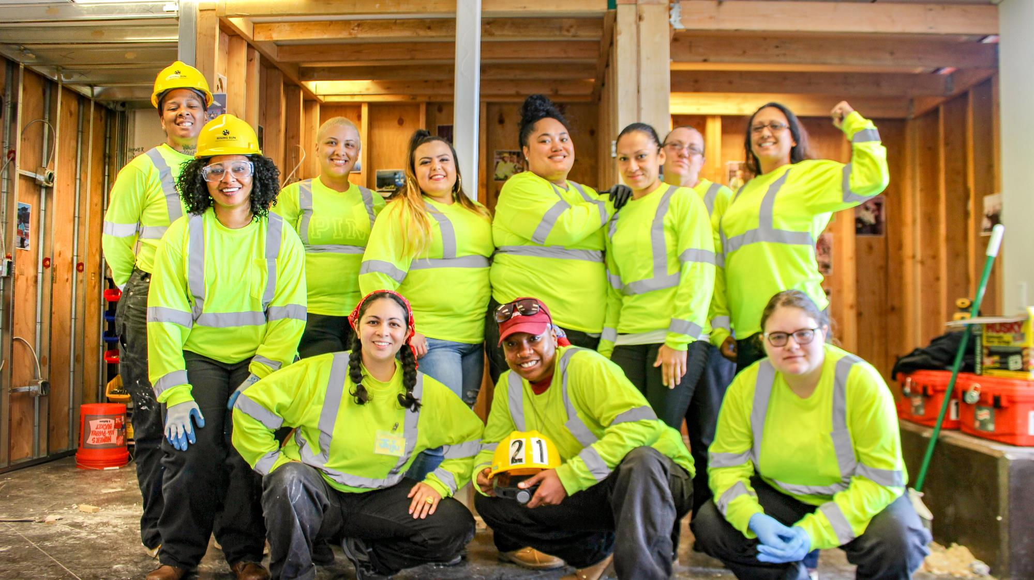

Slide 7
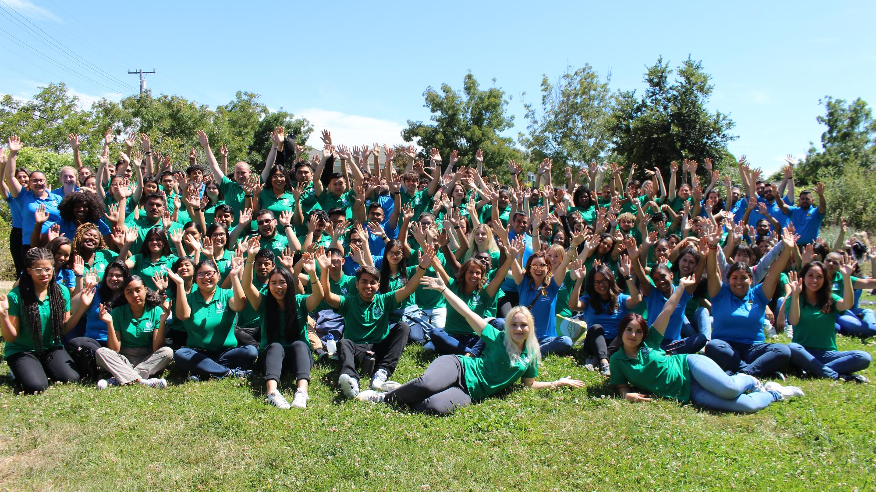

Slide 8
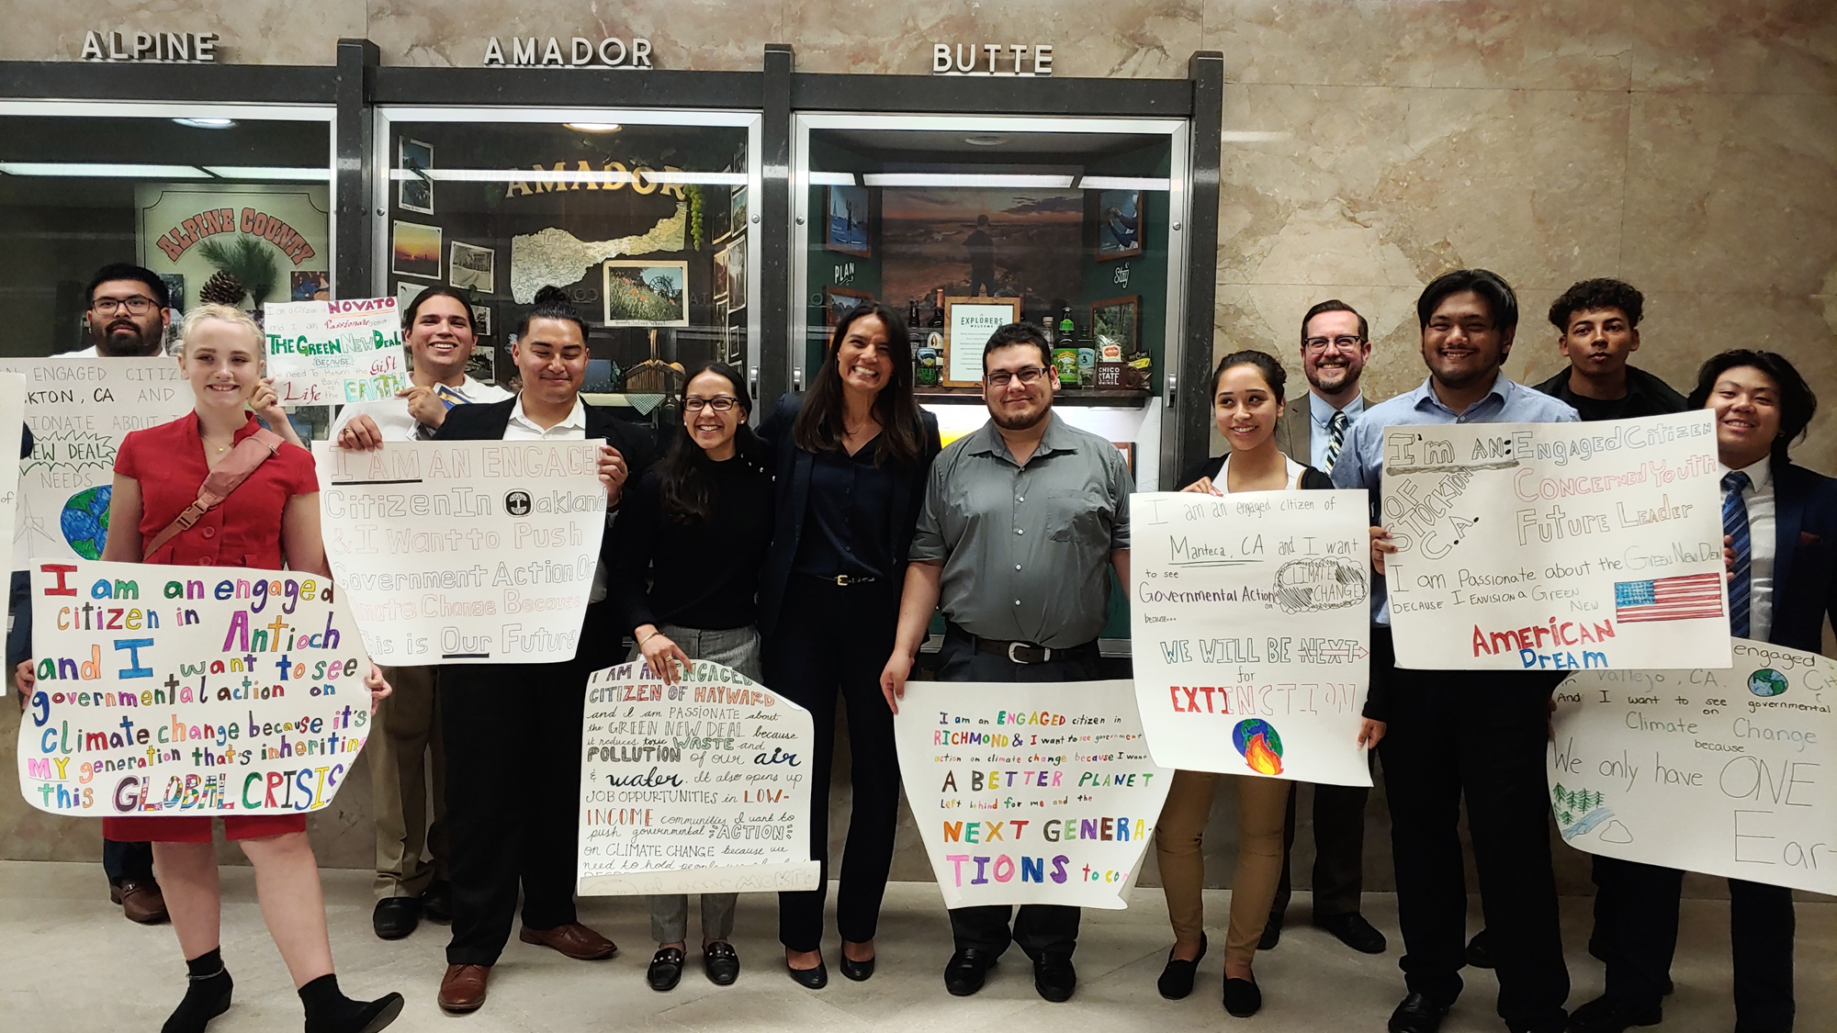
Policy Work
Job quality and access for disadvantaged workers
Equitable energy/climate program access
Prioritization of frontline communities in climate investments

Slide 9
Make green jobs quality jobs.
Family-sustaining wages for entry-level workers
Employer-provided benefits
Career pathways/advancement opportunities
Workplace safety
Worker voice
Hiring targets for low-income households, disadvantaged communities, and workers with barriers to employment
Funded training, supportive services, case management
Project Labor Agreements, Community Workforce Agreements, Community Benefits Agreements with labor standards and targeted/local hire language
Job and metrics tracking for accountability

