Slide 1
Moving People: Heavy-Duty Zero-Emission Vehicle Opportunity
Presentation to
California Energy Commission
May 21, 2020

Slide 2
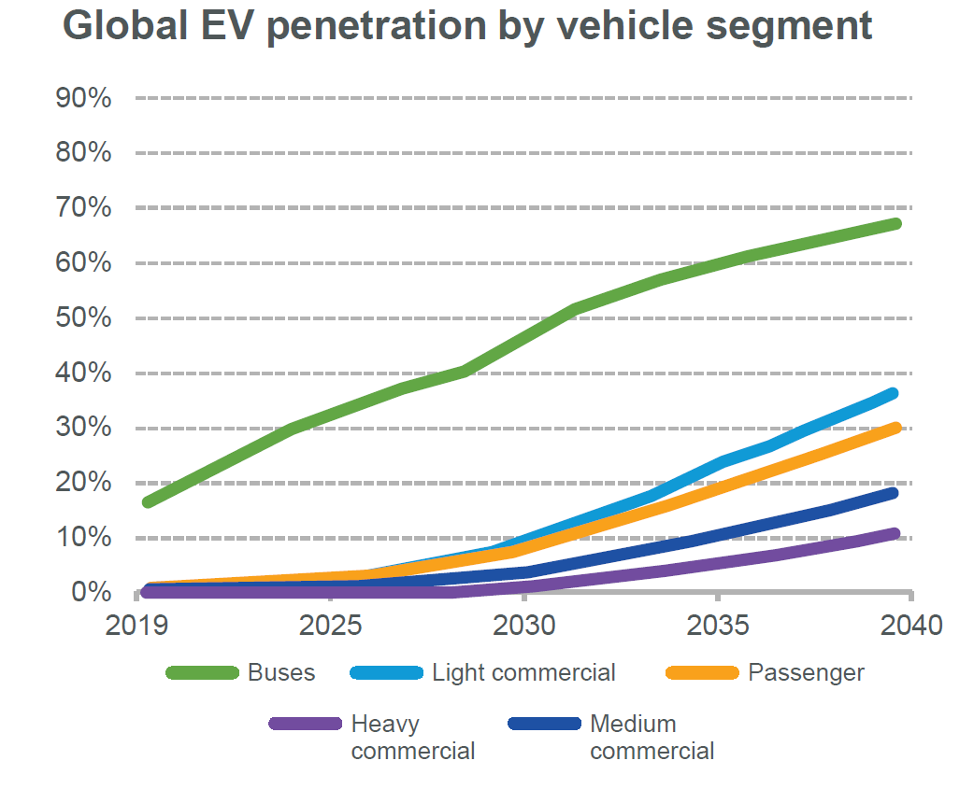






TRANSIT BUSES LEADING EV ADOPTION
Major cities adopting EV technology for transit buses
New York
Chicago
Washington D.C.
100% EV by 2040
4,700 buses
Piloting since 2014
2,100 buses
100% EV by 2045
1,900 buses
Seattle
Philadelphia
Miami
100% EV by 2034
1,500 buses
Piloting since 2017
1,500 buses
50% EV by 2035
800 buses
California mandates 100% electric transit buses by 2040
New purchase mandates
25%
→
50%
→
100%
by 2023
by 2026
by 2029
12,000 buses across California
(17% of nationwide fleet)
Source: Bloomberg BNEF “EV Outlook 2019”
Source: National Transit Database; agency websites; 2017 American Public Transportation Association Fact Book
Notes:
http://maynard.wickedlocal.com/news/20180618/state-senate-passes-clean-energy-bill
https://blog.ucsusa.org/daniel-gatti/massachusetts-senate-unanimously-endorses-a-bold-vision-for-clean-transportation

Slide 3
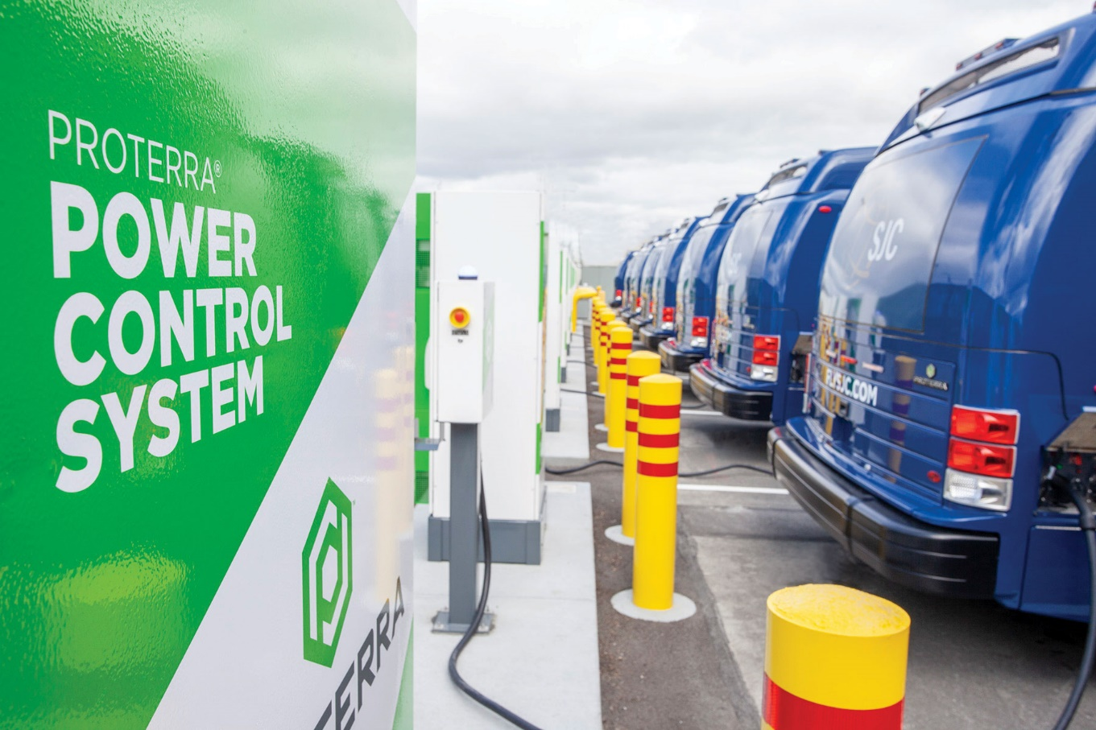
HD ZEV MARKET TODAY
Purchase barriers eliminated
due to:
  Improved range
  Proven performance
  Sharp decline in battery costs
  Charging standardization
Today’s challenges:
  Infrastructure
  Energy management
  Full fleet electrification planning

Slide 4
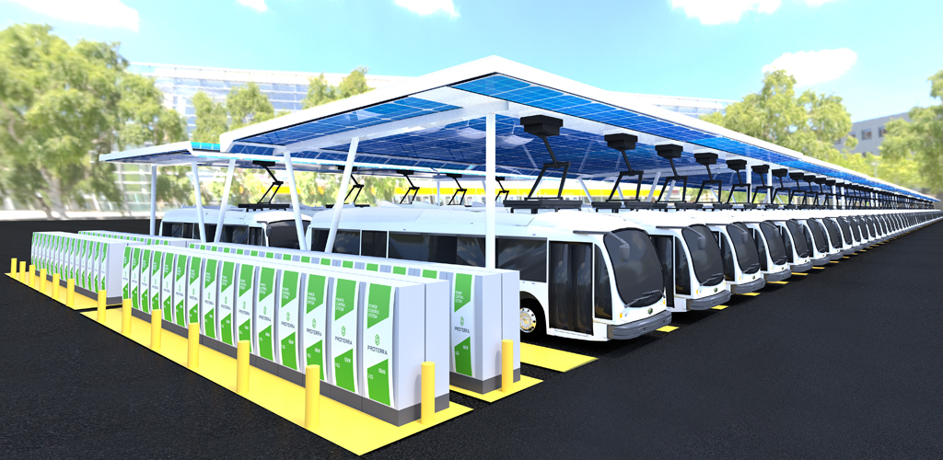


Smarter charging
INTELLIGENT
  Automated and rules-based
  vehicle charging
UNIVERSAL
  Standards-based, OCPP 1.6 open communications protocol-compatible
REMOTE
  Can be located up to 500 feet
  from dispenser
SCALABLE
  Can be installed side-to-side and back-to-back for high-density charger banks
Notes:
This image really speaks to the future of transit, with fully electrified fleets powered by clean energy. Even though today you may only be installing enough chargers for a handful of electric buses, you need to be looking ahead to the future to plan for scale, and Proterra offers a full suite of solutions to help you do that.

