Slide 1



School Transportation and ZEV
INTEGRATING ELECTRIC VEHICLES WITH OUR MOST SENSITIVE RECEPTORS

Slide 2




An Investment in Our Future
“ Children and teens may be more sensitive than adults to the health effects caused by air pollution – especially children with asthma.”
-- Centers for Disease Control & Prevention
https://www.cdc.gov/air/air_health.htm
“Children riding a school bus for many years face a diesel-related cancer risk that is 30 times higher than what government agencies generally consider acceptable.”
-- Natural Resources Defense Council
https://archive.commondreams.org/news2003/1016-09.htm
24 million children
454,000 school buses
90% diesel powered

Slide 3
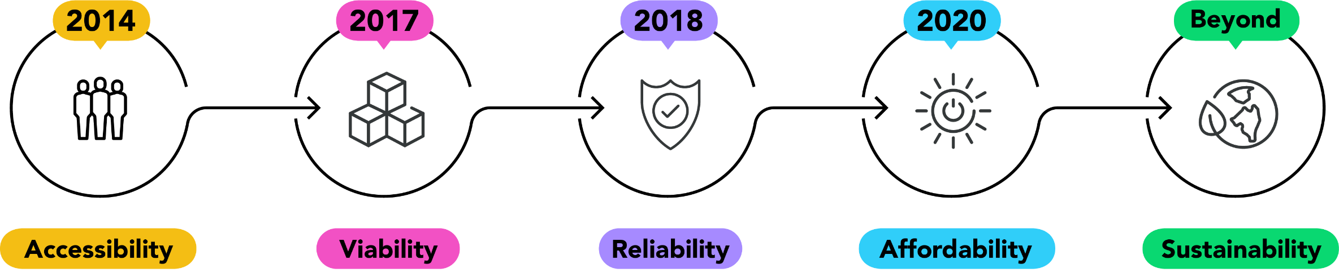

Trends, Challenges & Opportunities
EV school bus deployments in CA
Limited providers
Technology still in development
Educating customers
Dispelling rumors
Experiencing the technology (demos & ride and drives)
Training programs and continued education
Supporting the product both in-field & remote
Proving up-time performance / telematics
Grant funded programs enable more deployments
Rise in acceptance of technology
Savings with fuel & maintenance costs
Leveraging V2G & LCFS credits lowering Total Cost of Ownership
Continued innovations will expand viable routes & usage
Training and support remain critical to a successful implementation

Slide 4
First Steps Towards a 100% ZEV Future
CEC School Bus Replacement Program
  $75 million – funding for electric school buses
  231 – electric school buses awarded
  1,500* – buses requested for replacement vs awarded
  15 – 20,000+ – number of remaining diesel powered
  school buses needing to be replaced in CA
Low-Carbon Transportation Grants by Air Resources Board
  $182 million – funding in FY19-20, for clean trucks, buses and
  off road freight (HVIP + CORE)
  Settlement Agreements
  $130 million – VW Settlement for ZEV school, transit & shuttle buses
  replacing approximately 425 vehicles
-- 2020-2021 Investment Plan Update for the Clean Transportation Program – First AC Mtg Combined PPT
https://efiling.energy.ca.gov/GetDocument.aspx?tn=232450&DocumentContentId=64466

Slide 5
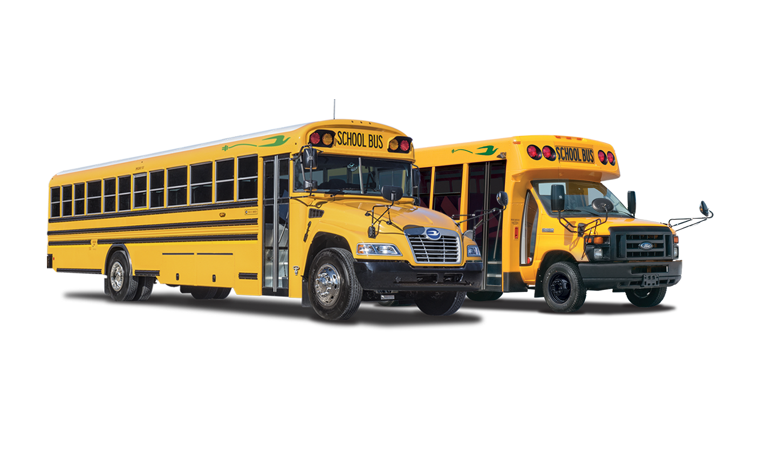

Thank you!

