Slide 1
Hourly Temperature Data on Cal-Adapt
Energy-Related Environmental Research
Energy Research & Development Division
December 18, 2019
Martine Schmidt-Poolman, PhD, MScEng
Notes:
Introduction. house keeping, Workshop overview. Logistics for communicating (chat and/or Q&A).
Good afternoon! Thank you for joining today’s workshop But first, a few words about logistics. The Workshop is being recorded and will be posted. If you have questions or comments during the presentations, please ask questions or use the Q&A WebEx function and the host will try reply. There will be plenty of time for open discussion at the end of the presentation.

Slide 2

Purpose of Workshop
Discuss energy stakeholders’ needs for hourly temperature data to be available on Cal-Adapt for use in forecasting.
Input from workshop plus public comments (written and/or oral) will be used to determine:
  which dataset(s) should be made available on Cal-Adapt, in which manner, and
  how Cal-Adapt can support efforts and/or ongoing coordination between institutions.
Notes:
Energy sector stakeholders have
expressed interest in having sub-daily temperature projections as well as
observed historical temperature observations made available on Cal-Adapt.

Slide 3
Rulemaking Directs to Cal-Adapt
CPUC’s Decision on Phase 1 of Adaptation Rulemaking, issued Nov. 1, 2019*:
Defines climate change adaptation for energy utilities in the state.
Anchors acceptable data to California’s Climate Change Assessments process, acknowledging the state’s role in selecting recommended scenarios.
Directs IOUs to Cal-Adapt as a source of data.
Establishes criteria for acceptability of additional data or models.
* Decision 19-10-054, Rulemaking 18-04-019, Decision on Phase 1 Topics 1 and 2 web link: http://docs.cpuc.ca.gov/PublishedDocs/Published/G000/M319/K075/319075453.PDF

Slide 4
Workshop agenda
Presentations
    Owen Doherty, Eagle Rock Analytics:
    A Reproducible, Reliable and Regularly Updated Sub-Daily Weather Archive for California’s Energy Systems
    David Pierce and Dan Cayan, Scripps Institution of Oceanography:
    Future projections of hourly surface temperatures in California
Guided Discussion
Notes:
Therefore workshop will include:
Presentation of hourly temperature data products of two research projects supported by Electric Program Investment Charge (EPIC) program funds.
And exploration of user needs in relation to these data, which could be made available on Cal-Adapt

Slide 5

A Reproducible, Reliable and Regularly Updated Sub-Daily Weather Archive for California’s Energy Systems

Slide 6
Setting the Stage
Presently no reference hourly dataset in California
Aim: Identify an hourly weather dataset and implementation framework
  Critically evaluated various datasets and QA/QC protocols
  Systematically tested stations and identified a stable, representative subset
  Developed recommendations for implementation

Slide 7
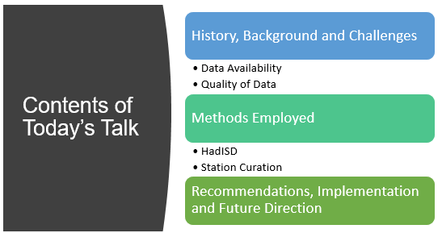
Contents of Today’s Talk

Slide 8
Expectations for Hourly Data
Every user of weather data has different needs and requirements for weather data
Assumptions of user needs:
  Reproducible Methods
  Continuously Updated
  No Hands-On Human Review
  Seasonally and Diurnally Consistent
  Some Missing Data Okay
  Long Records Required

Slide 9
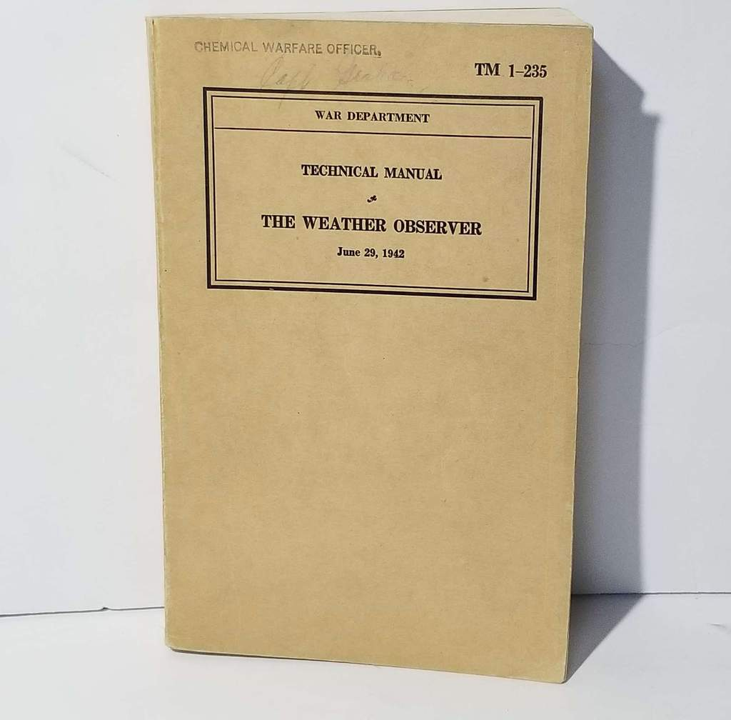
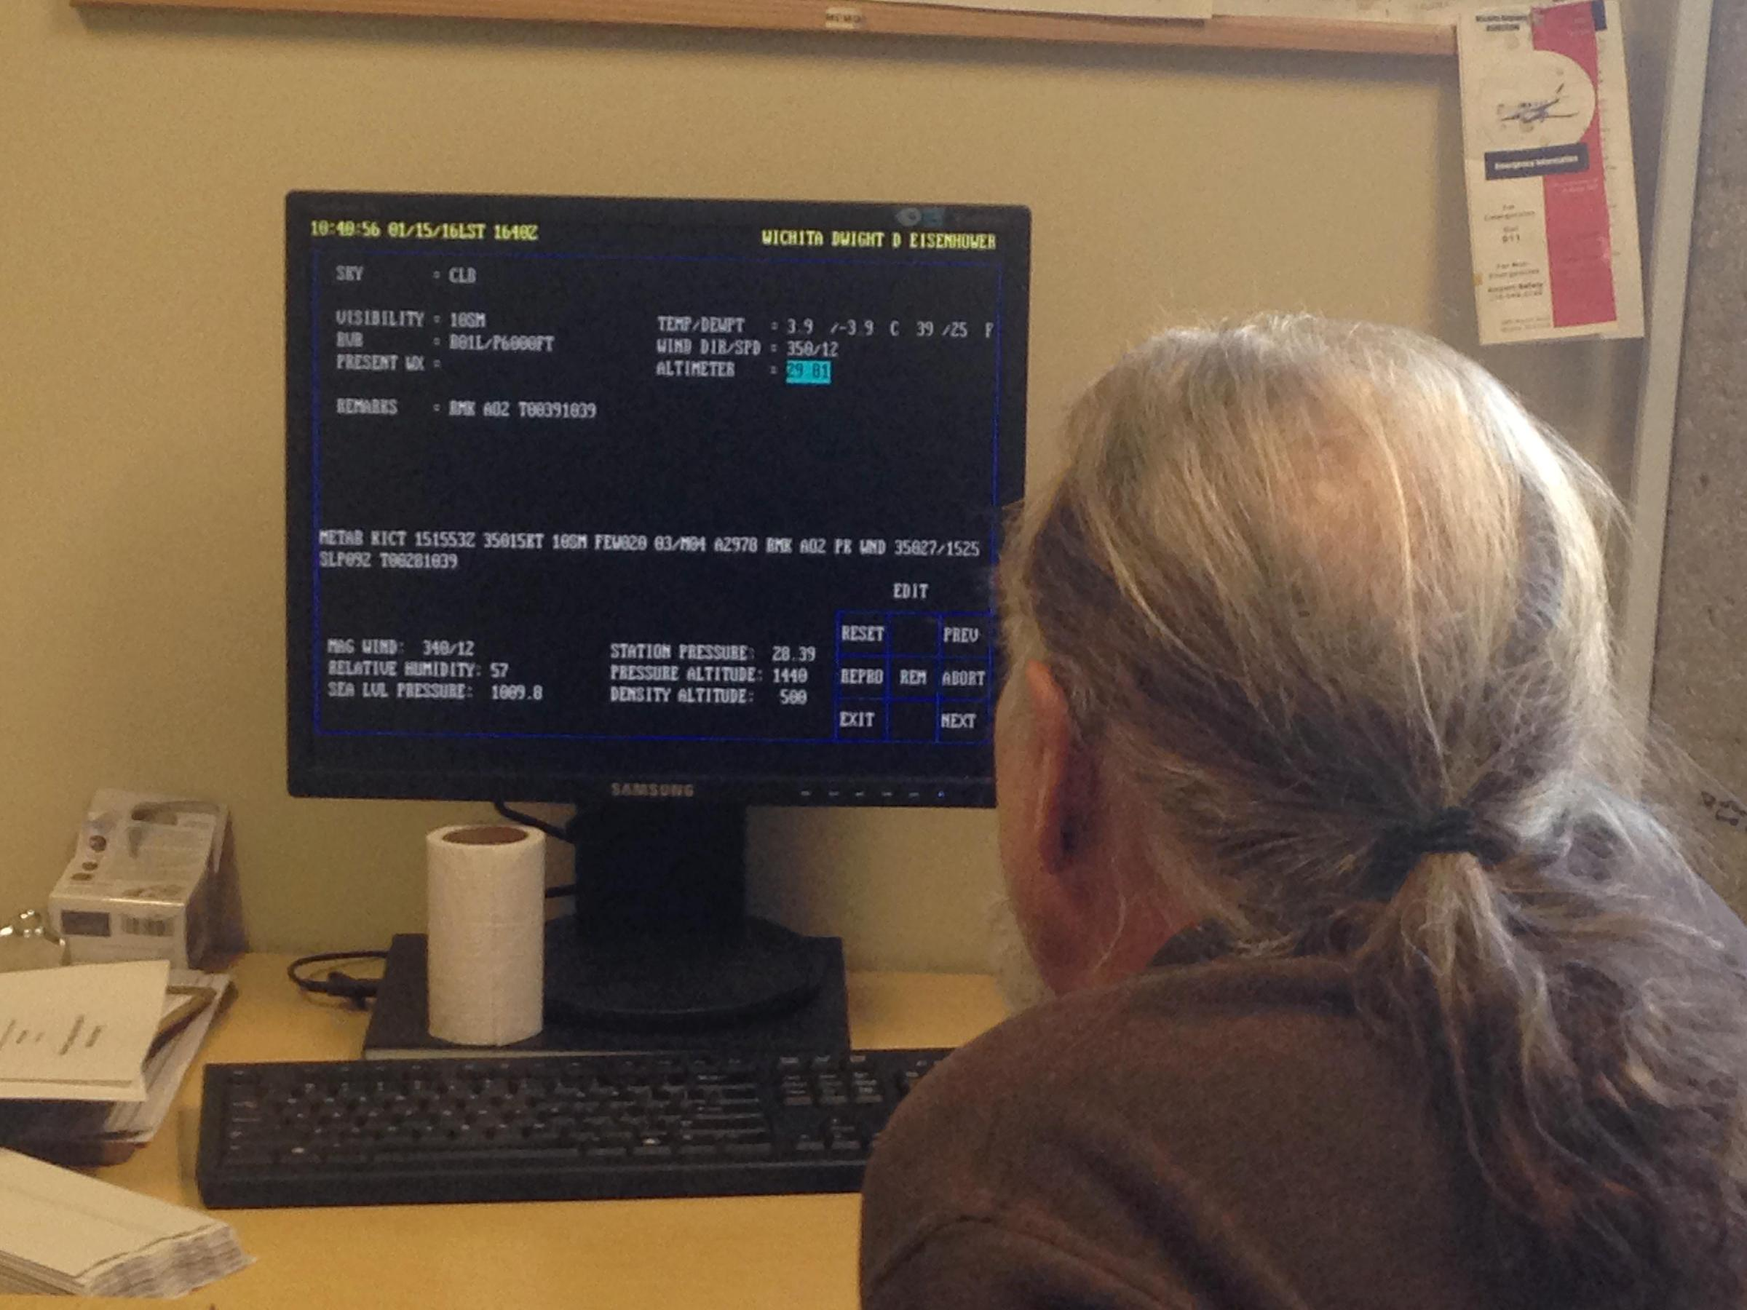
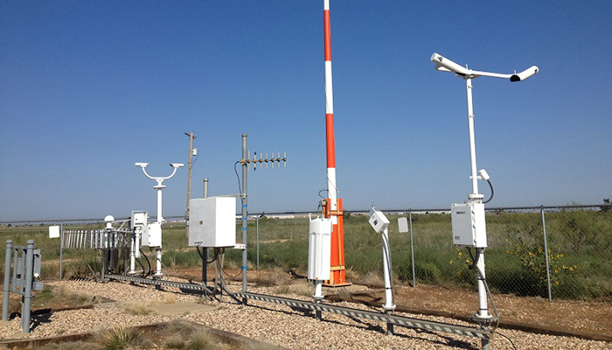
How Weather Data is Collected
Image: kmuw.org
Image: noaa.gov

Slide 10
Confidence in Weather Data
High
Temperature
Sea Level Pressure
Dew Point
Wind Speed
Wind Direction
Wind Gusts and Peak
Visibility
Sensible Weather
Cloud Cover
Confidence
Hourly Reports
Special Reports
Two Minute Observations
Low

Slide 11
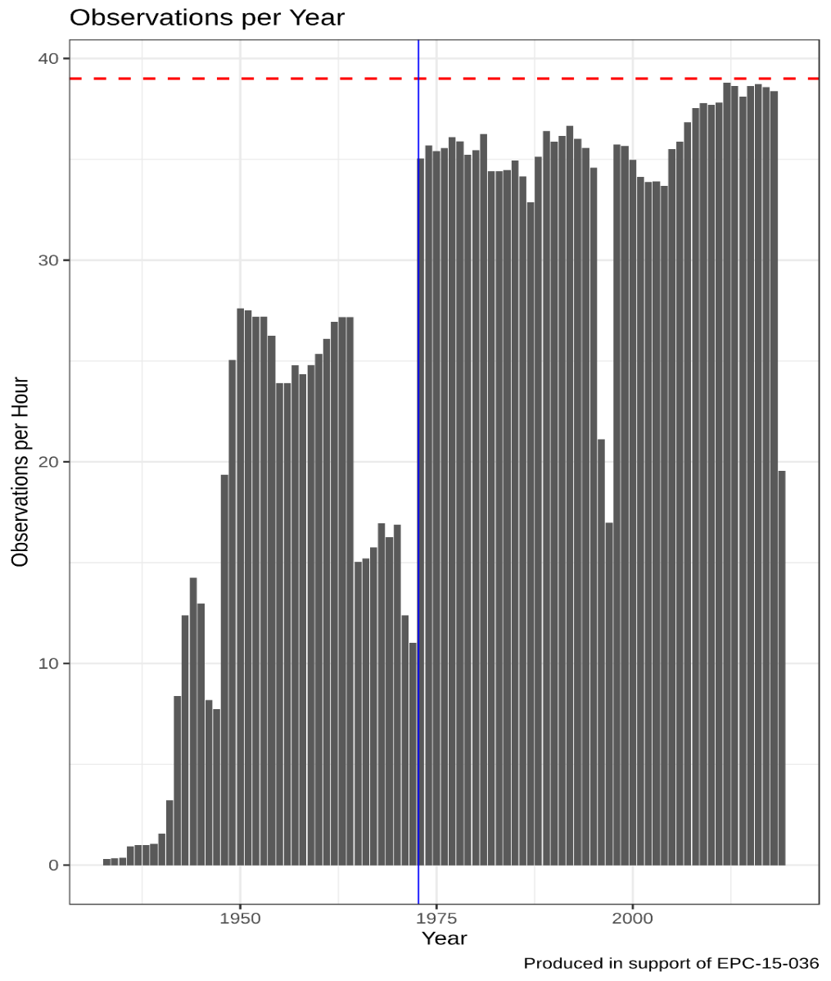
Eras in Weather Data Records:
1931 - 1948: Dawn of Flight
1948 - 1965: Written Era
1966 – 1972: Dark Ages
1973 – 1998: Quality Era
1999 – present: Automated Era

Slide 12
Tiers of Quality Assurance
Fully Automated
Automated with Human Augmentation
Hand Adjusted
Low Effort
High Effort

Slide 13
Sources of Systematic or Persistent Errors
Site movement
Changes in local environment
Instrumentation changes
Changes in observer
Change in procedures
Change in data processing
Digitization and database errors
Source: Environment Canada
WMO Homogenization Guidance (2018)

Slide 14
Method Overview
Systematic test of an externally produced temperature database (HadISD)
Identify stations in California of a sufficient quality and record length

Slide 15
Errors That Get Caught
Automated QA/QC Tests For:
Frequent repeated values
Repeating streaks
Climatological outliers
Spikes
Excess Variance
Inhomogeneity (but not corrected for)

Slide 16
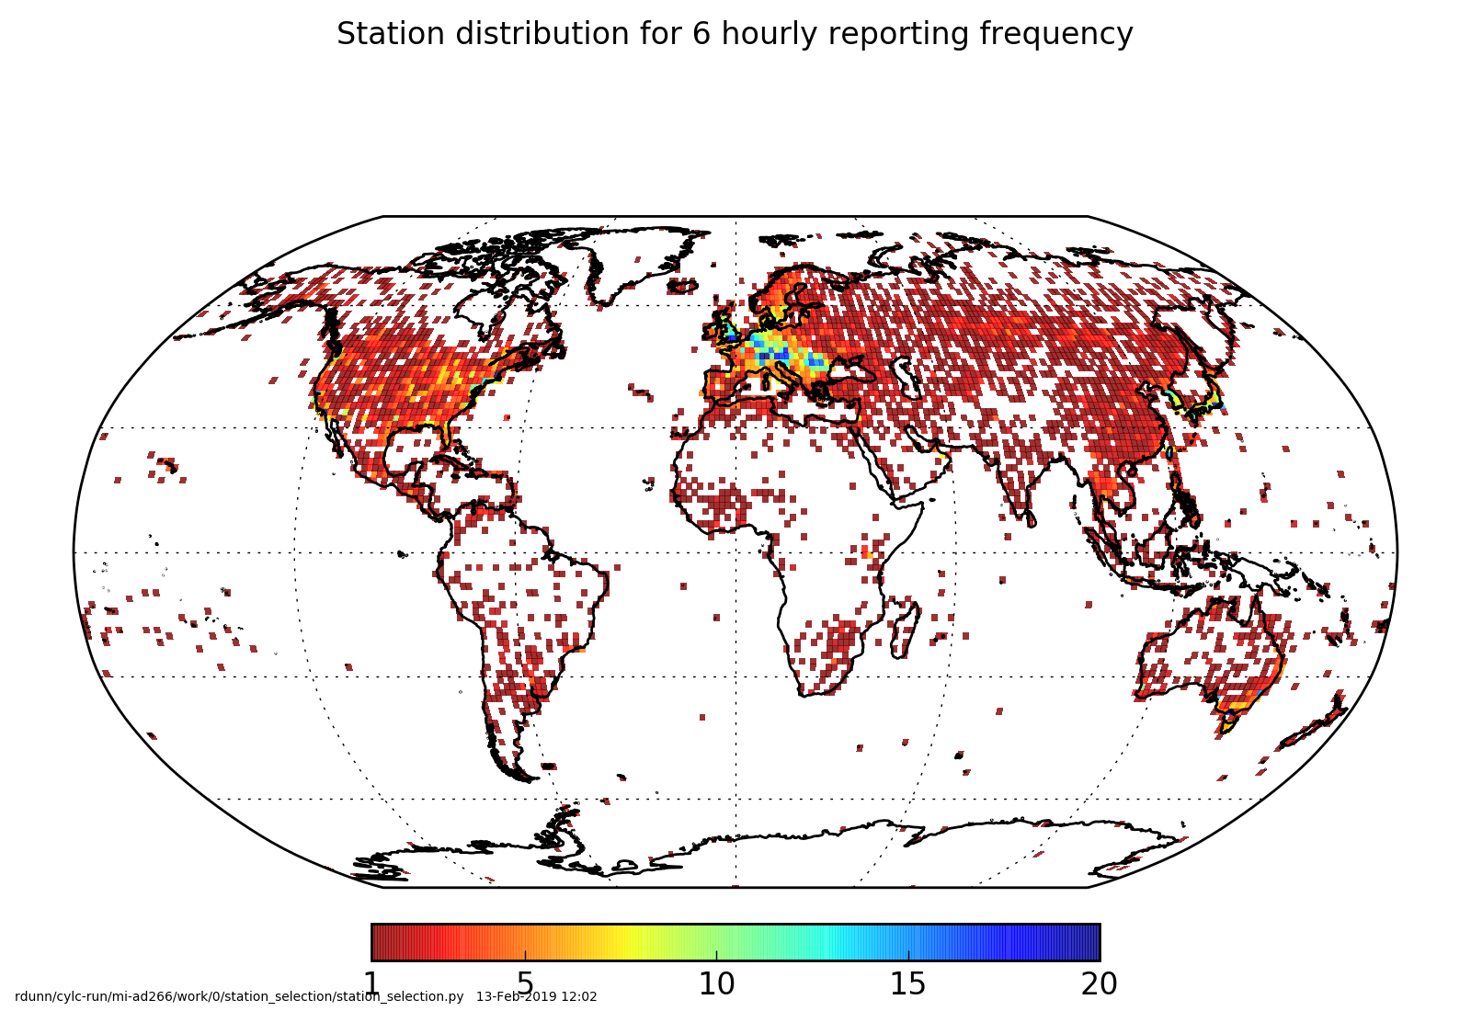
ISD and HadISD

Slide 17
Spatial Coverage

Slide 18
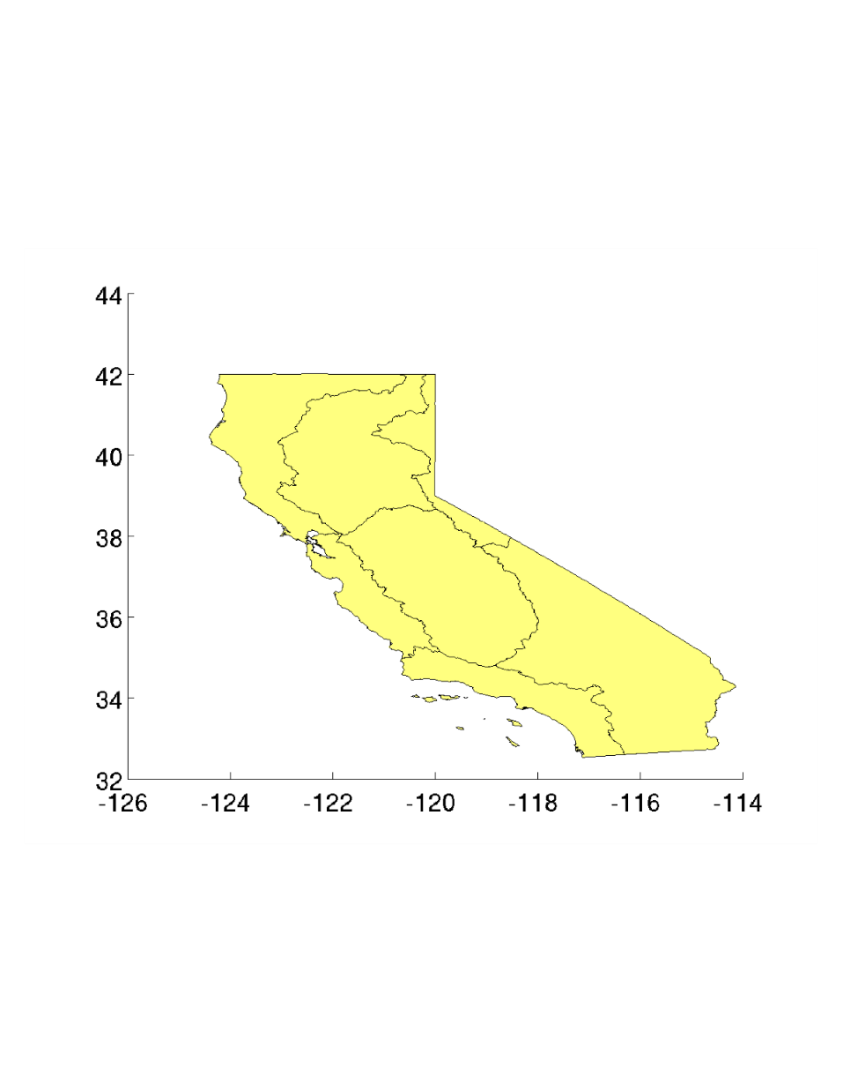
Stations by Climate Division
1
3
2
4
5
7
6

Slide 19
Temporal Coverage

Slide 20
Internal Tests of HadISD Record
Desired Characteristic | Internal Test
Long term stable record | Data spans 1973 to 2019 and has n>30 years
Representative of diurnal cycle | Data has 24-hour coverage (66% passed) for n>30 years of full day coverage
Consistency over the year | Data has full 12-month coverage (66% passed) for n>30 years of full seasonal coverage
Few missing observations | Missing rate of observations is <20%
High quality observations | Failure rate of QA/QC is <2%

Slide 21
Room for Improvement
Coastal Bias in Removal
Improper Merging of Records

Slide 22
Recommendations, Implementation and Future Direction

Slide 23
Temperature Formulations

Slide 24
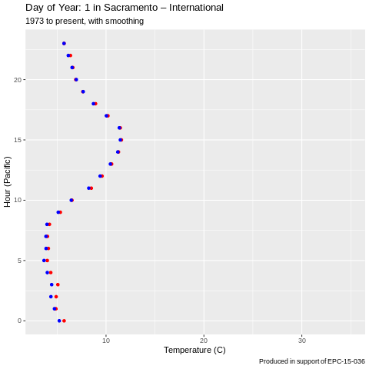
Typical Meteorological Year Profiles

Slide 25
Options: Alternative QA/QC
  HadISD
  HadISD Tuned for California
  Spatially variant QA/QC protocol for California
Good
Better
Best
Less Effort
More Effort

Slide 26
Options: Data Level as Service
 | Quality Level | Data Description
0 | Raw | Original Data With No QA/QC
1 | Flagged | Data Flagged By Error Type
2 | Cleaned | Data Homogenized & Flagged Data Removed
3 | Filled | Removed Data Points Interpolated

Slide 27
Options:
Automated Workflow
Repository
Generate Actionable Variables
API
Download Portal
Station Selection
Tool
Aggregation and Subsetting
Aggregation and Subsetting
External Server
Visualization?

Slide 28
Options: Beyond Temperature
Temperature
Sea Level Pressure
Dew Point
Wind Speed
Wind Direction
Wind Gusts and Peak
Visibility
Sensible Weather
Cloud Cover
High
Confidence
Low

Slide 29
Acknowledgements & Contacts
Funding for this work from EPC-15-036
Co-PI Amato Evan of UCSD/SIO
Guidance from Susan Wilhelm, Guido Franco and Martine Schmidt-Poolman
Grateful to Technical Advisory Committee
Contact Me:

Slide 30
Future projections of hourly surface temperatures in California
David W. Pierce
Daniel R. Cayan
Scripps Institution of Oceanography
Division of Climate, Atmospheric Sciences, and Physical Oceanography dpierce@ucsd.edu

Slide 31
What we did and how it relates to you
Project purpose:
  Generate hourly temperatures at 29 selected meteorological stations (1950-2100)
Had:
  Daily gridded temperature minimum/maximum (Tmin/Tmax) across the State
What we did:
  Localized the gridded data to each station
  Devised new method for inferring hourly values from daily Tmin/Tmax
How it might relate to you:
  QC process on hourly training data
  Estimates of hourly temperature if only Tmin/Tmax available

Slide 32
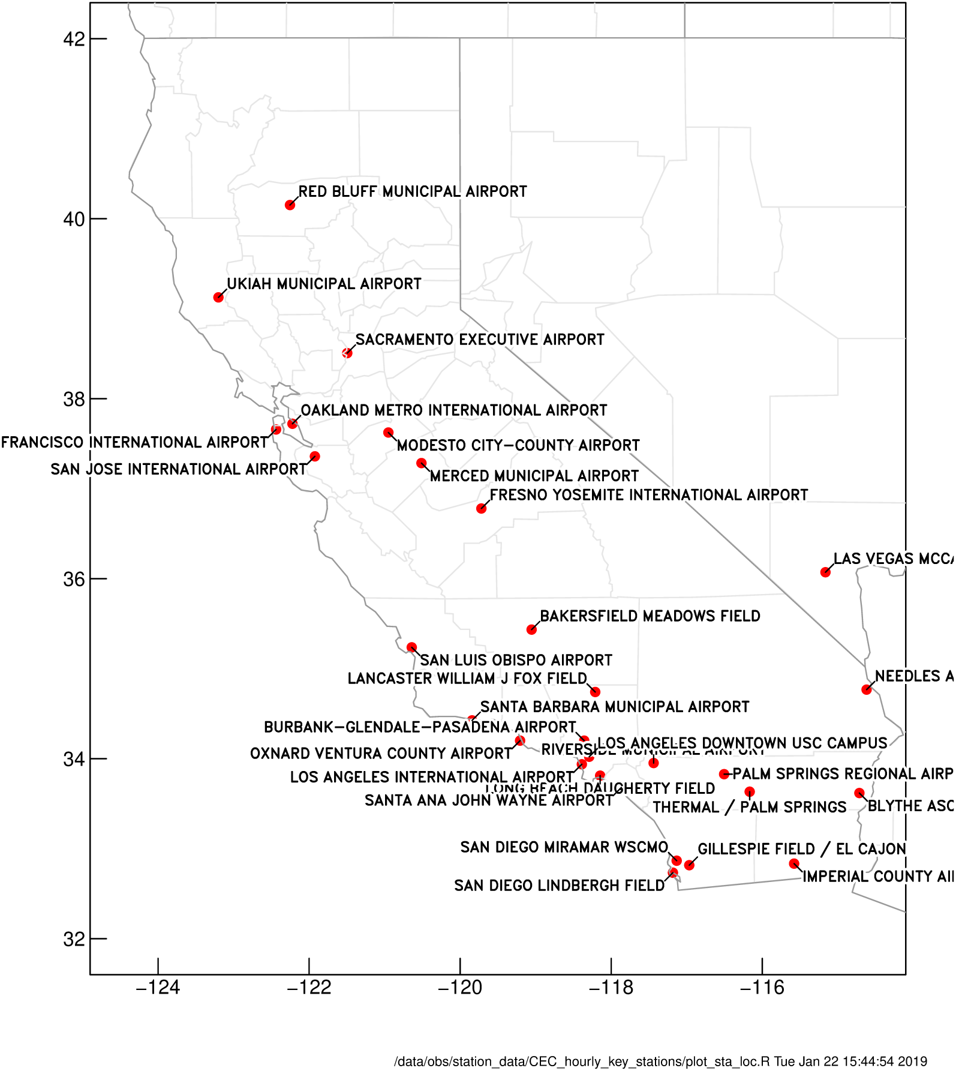
29 met stations of interest to energy industry

Slide 33
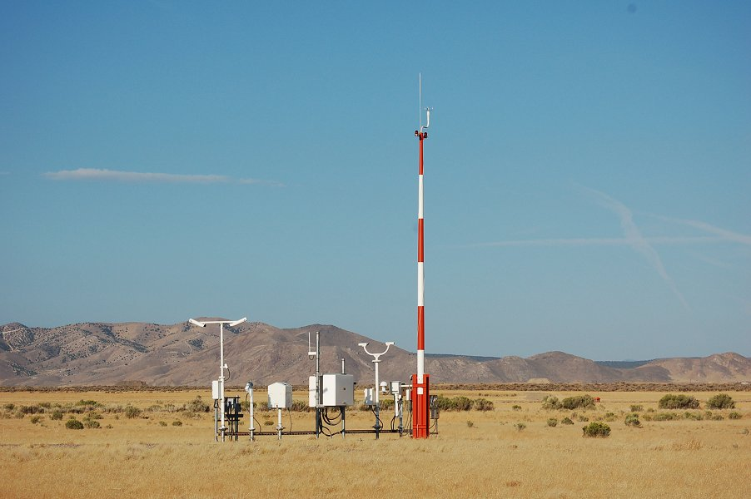
Data sources
Hourly station data:
Primarily from CEC, 2000-2018
Augmented by ASOS (automated surface observing system) from Iowa State University Iowa Environmental Mesonet (https://mesonet.agron.iastate.edu/request/download.phtml)
Gridded data:
LOCA (Localized Constructed Analogs) from cal-adapt.org. 6 km, daily Tmin/Tmax, from 10 Global Climate Models (GCMs). 1950-2100

Slide 34
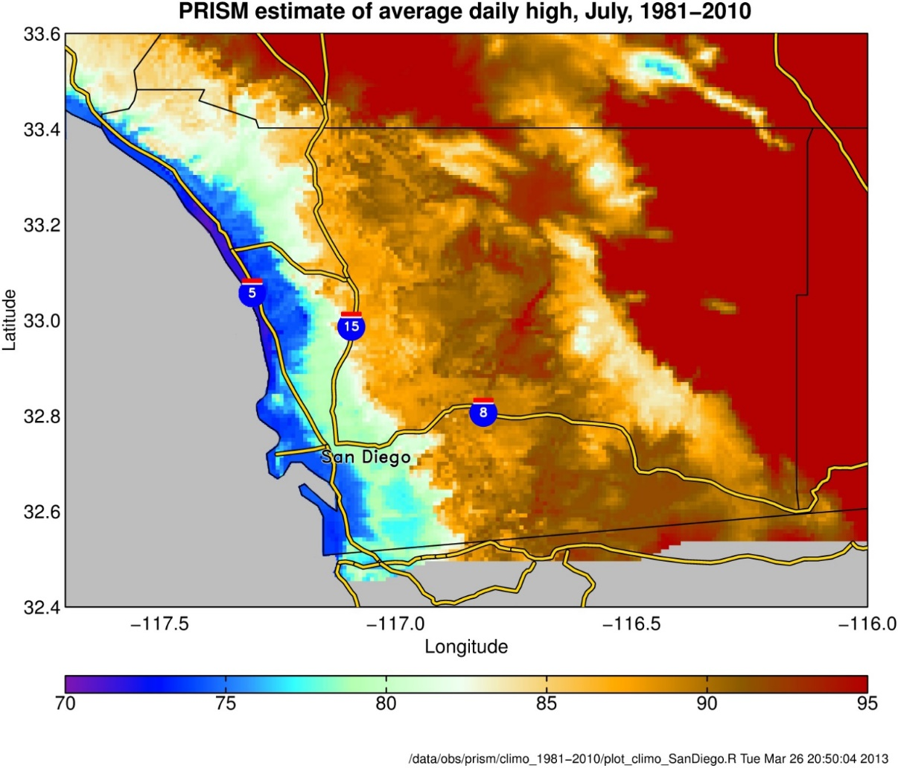
Localizing gridded data to a station
Gridded data is 6 km (3.6 mile) resolution
In California, need to adjust for temperature gradient near coast (0.25 C/km, or 0.7 F/mile)
Adjust for elevation difference (~6.5 C per kilometer, or 3.5 F per 1000’).
Monthly quantile mapping bias correction from obs station data to gridded data
6 km

Slide 35
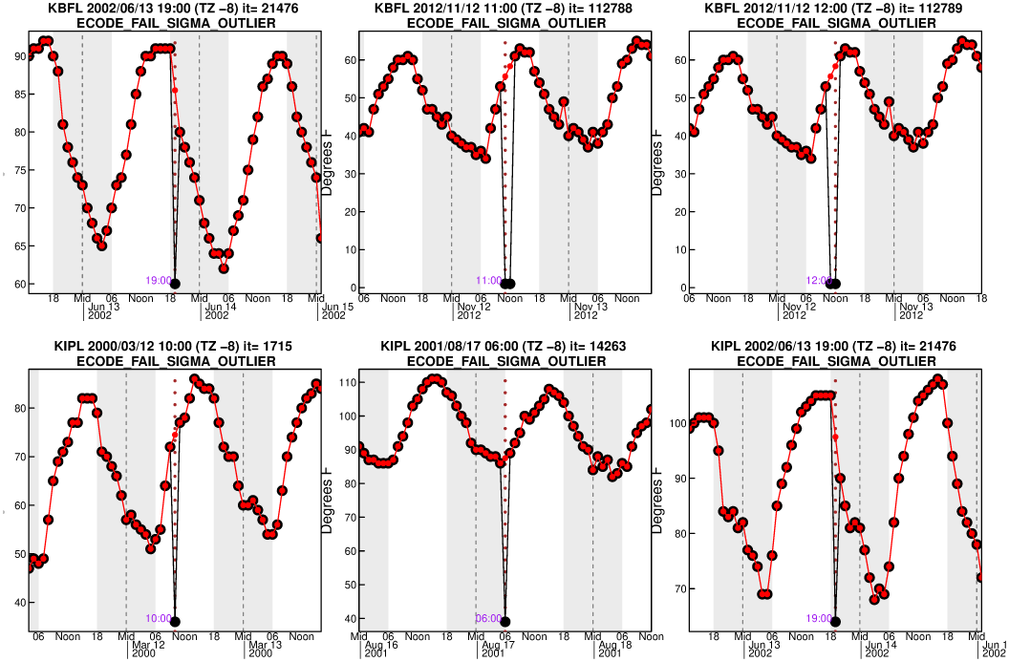
Quality Control: Extreme Outliers
Hourly anomalies > 8 standard deviations away from linearly interpolated point

Slide 36
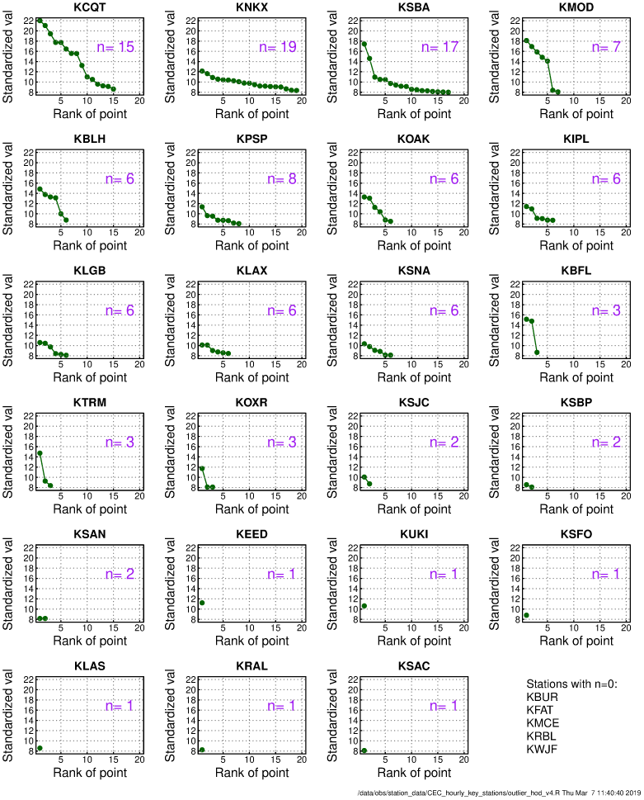
Wide variation of station quality
USC campus
S.D. Miramar
Santa Barbara
Modesto
Las Vegas
Riverside
Sacramento
Burbank
Fresno
Merced
Red Bluff
Lancaster

Slide 37
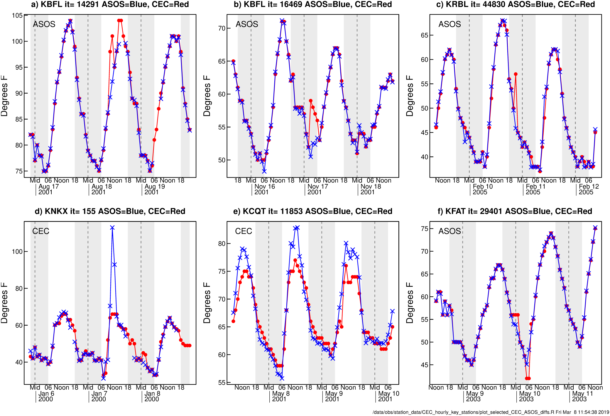
Comparing CEC to ASOS data
Red: CEC data
Blue: ASOS data
Took the solution with less “jumpiness” (sum of squares of difference w.r.t. previous point)

Slide 38
Summary of QC procedure
Extreme outliers (hourly, seasonal standardized anomaly values >8 standard deviations in the 3-day high-pass filtered data)
“Least jumpy” data where CEC differs from ASOS > 2 F
Sequences of identical bad values (that are not extreme outliers)
Large “jumps” from preceding and successive data values that are not extreme outliers (using a “jump spectrum”).

Slide 39
Disaggregating Tmin/Tmax to hourly values
Start with the 3-day sequence of Tmin/Tmax daily temperature anomalies (6 values)
Look for best matching historically observed sequence of 6 Tmin/Tmax anomalies. (Observed sequence must be within +/- 45 days of day of year being matched)
Scale observed Tmin/Tmax to match day being disaggregated

Slide 40
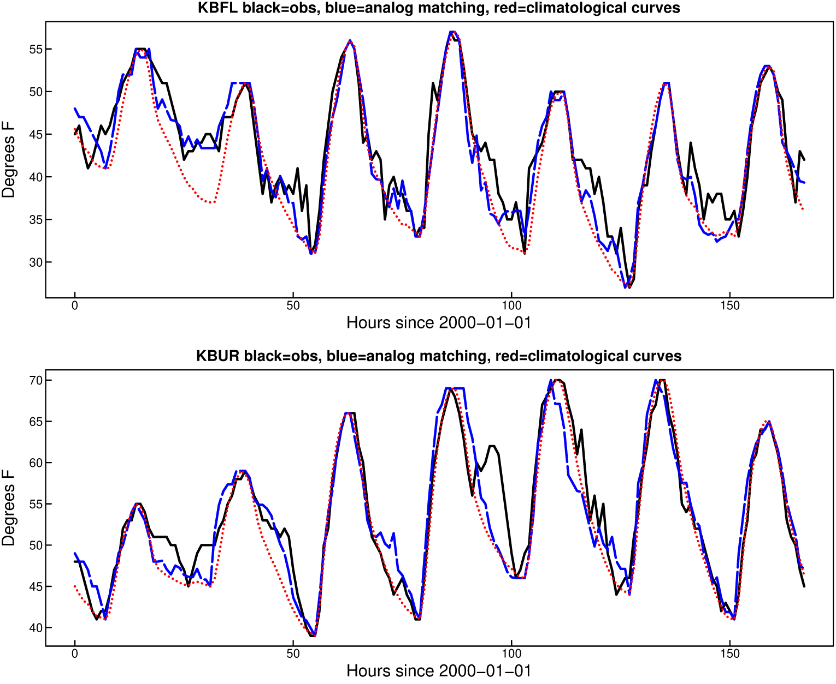
Example solutions
Black: Original hourly observations
Blue: Our matching technique
Red: Climatological diurnal cycle fit to Tmin/Tmax for comparison

Slide 41
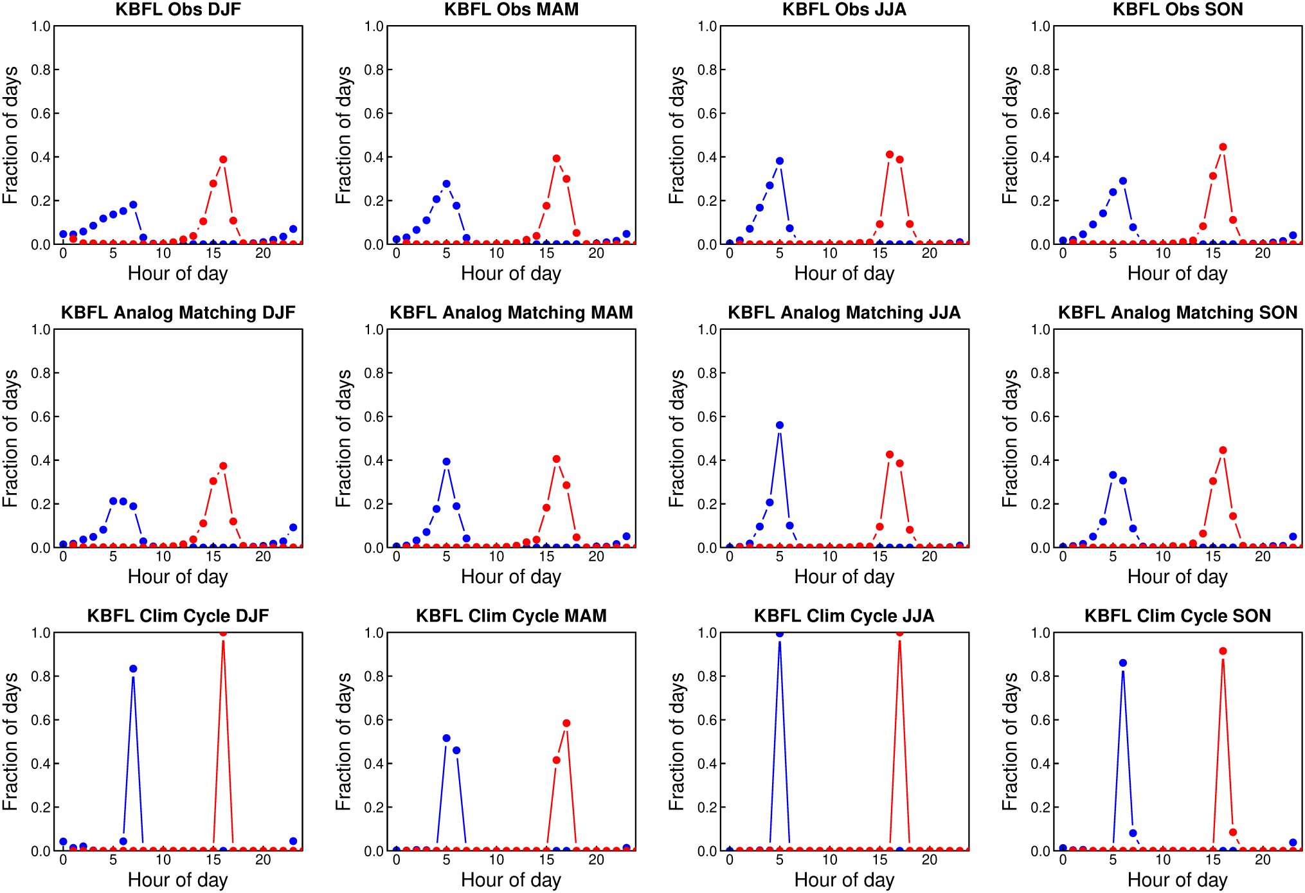
Histogram of warmest (red) & coolest (blue) hour of the day
Top: observed
Middle: Our method
Bottom: Climatological diurnal cycle

Slide 42
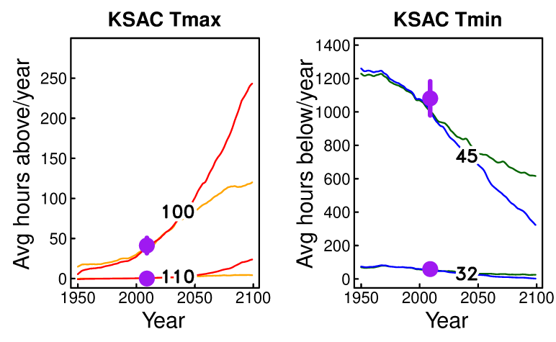
Change in future hours/year above/below thresholds
Purple dots: historically observed
Red, orange: # hours/year >= 100 (110) F for medium emissions scenario (orange), high (red)
Blue, green: # hours/year <= 45 (32) F for medium emissions scenario (breen) and high( blue)

Slide 43
Summary
Implemented various kinds of QC on hourly station temperature data
Devised a new method for disaggregating daily Tmin/Tmax to hourly
The new method captures sub-daily variability much better than the traditional “climatological diurnal cycle” method
Used the new method to project changes in number of hot hours (> 100, 110 F) and cold hours (< 32, 45 F) in California out to year 2100

Slide 44
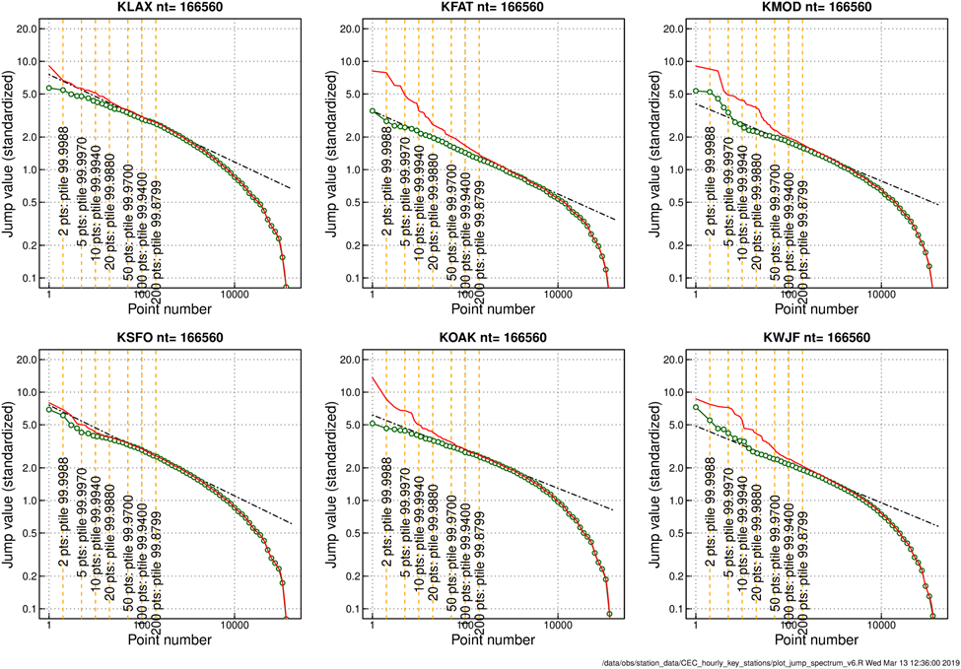
Example jump spectra
Npts = 166,560
Red: Original CEC data jump spectrum before any QC
Green: After removing extreme outliers, ASOS merge, and removing runs of bad values, but before any large jumps removed
Black dashed line: best fit line to points 20-1000

Slide 45
Discussion Questions
General feedback about presentations
  In what manner can what was presented be useful for you if it were up on Cal-Adapt?

Slide 46
Discussion Questions (#2 of 6 slides)
Hourly Temperature Data
  What spatial coverage would be considered “sufficient”?
      For specific users?
      To cover relevant infrastructure?
  What time periods/ time lengths of data are preferred?
      For what purpose?
      Set by whom?
  What are the requirements to the data?
      e.g.: What is considered an acceptable error rate?

Slide 47
Discussion Questions (#3 of 6 slides)
Hourly Temperature Datasets
Which datasets are being used now?
Where can they be accessed?
How often should the/a dataset be updated?

Slide 48
Discussion Questions (#4 of 6 slides)
Display on Platform
In what form will the data be needed/desired? For example:
      Temperature relative to daily normals?
      Temperature relative to daily and hourly normal?
What distinction is there between the downloadable data and the visualization tools?
      What data should be included in visualizations?
      What is useful to be available for download (but not needed in visualizations)?

Slide 49
Discussion Questions (#5 of 6 slides)
General Questions
Which other variables are of interest to you for forecasting purposes?
Numerous other data/variables may be available. These may have not gone through the same QA/QC process as the hourly temperature data:
    Would it be useful to have that data be hosted on the Cal-Adapt platform?

Slide 50
Discussion Questions (#6 of 6 slides)
General Questions
How can Cal-Adapt facilitate coordination between IOUs and state entities regarding areas where climate change adaptation must be integrated into activities, planning, etc.? (e.g., demand forecasting)
What other processes or data sharing activities should we be aware of?
What other comments, concerns or feedback do you have for us to take into consideration?

Slide 51
Thank You!
Please submit your comments by January 2, 2020
Submit electronically through the Energy Commission’s “Research Idea Exchange” docket: https://efiling.energy.ca.gov/Ecomment/Ecomment.aspx?docketnumber=19-ERDD-01
Or by email to the Docket Unit at: docket@energy.ca.gov
  Please include:
    Submittal to docket 19-ERDD-01
    Subject: Comments to Workshop Hourly Temperature Data on Cal-Adapt
Or by paper copy to the Docket Unit: California Energy Commission || Docket Unit, MS-4 || Re: Docket No. 19-ERDD-01 || 1516 Ninth Street || Sacramento, CA 95814-5512
Visit https://www.energy.ca.gov/event/workshop/2019-12/staff-workshop-hourly-temperature-data-cal-adapt to view the webinar notice, presentation, and WebEx Recording (forthcoming)

