Slide 1
Energy Commission’s
Technical Assistance & Financing Programs for Water & Resource Water Sectors
Energy Commission’s
Technical Assistance & Financing Programs for Water & Resource Water Sectors
Shahid Chaudhry
Shahid.chaudhry@energy.ca.gov
November 19, 2019

Slide 2
Energy Management @ Water & Resource Water Facilities
Energy Management @ Water & Resource Water Facilities
Water Conservation Energy Management
Water Use Efficiency Energy Efficiency
Renewable Energy Generation

Slide 3
Energy Partnership Program / EPP & Energy Financing Program / ECAA
Energy Partnership Program / EPP
ASHRAE Level II Energy Audit of Facilities by CEC Staff and/or Consultant to Identify Energy Saving Opportunities
Covers Up to $20,000 Worth of Services
Energy Financing Program / ECAA
Loan @ 1% Interest to Implement Energy Projects
Up to $3 Million
Principal + Interest Repayable within 20 Years

Slide 4
Eligible Entities
Eligible Entities
Cities, counties, hospitals, colleges, universities, public care facilities, and special districts.
ECAA has provided 882 loans totaling $449.3 million Since Inception in 1979.
ECAA is a first come, first served program.
No Loan Ever Defaulted.

Slide 5
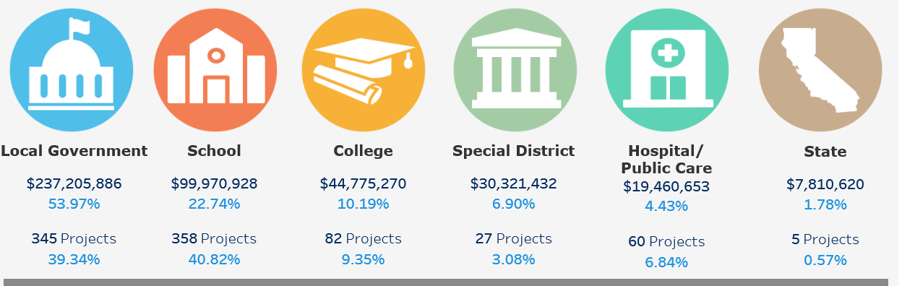
Funding Overview
Funding Overview

Slide 6
Examples of Funded Projects in W&RW Sector
Examples of Funded Projects in W&RW Sector
Premium Efficiency Pumps & Motors, VFDs, Increasing Reservoir Capacity, Aerators Upgrading, Cogeneration System, Renewable Energy Projects, SCADA System, Treatment Process Modifications, etc.
  City of Big Bear Lake / DWP 275 kW PV Project
  Amador Water Agency 440 kW In-Conduit Turbine
  City of Santa Rosa Upgrading Pumping Stations
  San Elijo JPA Activated Sludge System Performance Optimization

