Slide 1







Partnership to Foster Innovation
$550k
(2018 ICP)

Slide 2
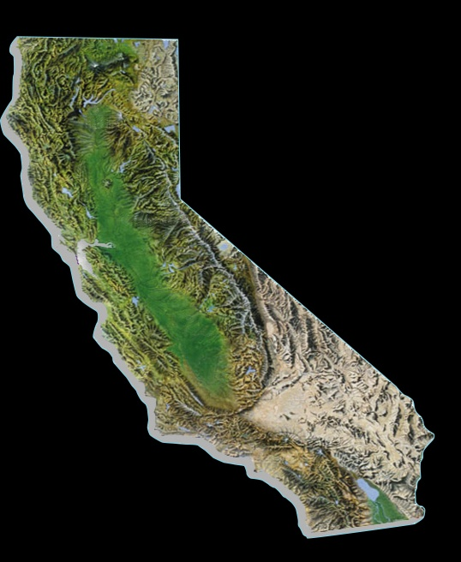
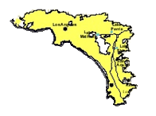
Metropolitan Water District of Southern California
Regional water wholesaler
Includes 6 counties
5,200 square miles
26 member agencies
250-300 retail water agencies
19 million people
Add about 150,000 people/yr
Imported water supplies meet about half of retail demands

Slide 3

Program Basics
Competitive grant since 2001
Open to everyone
Simple process
Selection by panel of expert judges
Study conducted by the applicant
Notes:
How many people are already familiar with the ICP program?
Since it’s inception… List categories of projects
The partnership started to grow

Slide 4
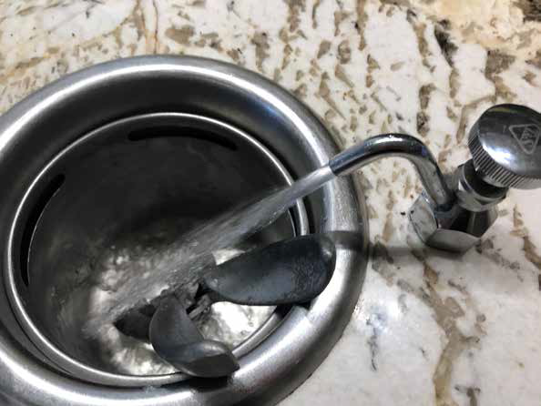
Evaluation Criteria
Project Innovation
Market Impact Potential
Project Preparedness
Cost Effectiveness
Notes:
Transition to next slide-
So this is not going to be a really technical presentation.
We’re just trying to give you a cross section of the types of projects that have been part of the ICP program over the years
But I do like tables and charts, so I’ll start with this one

Slide 5
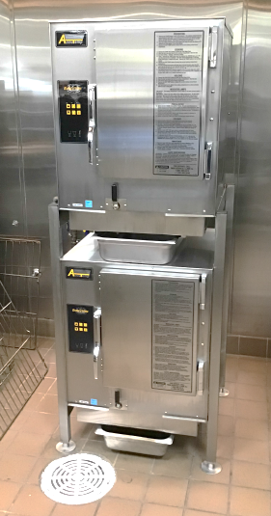
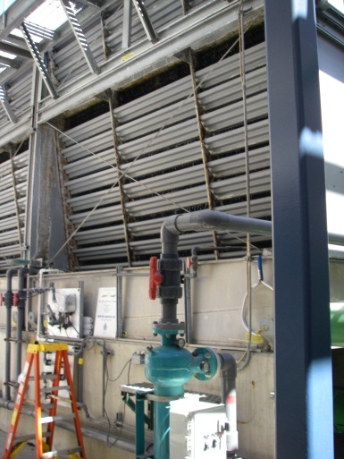
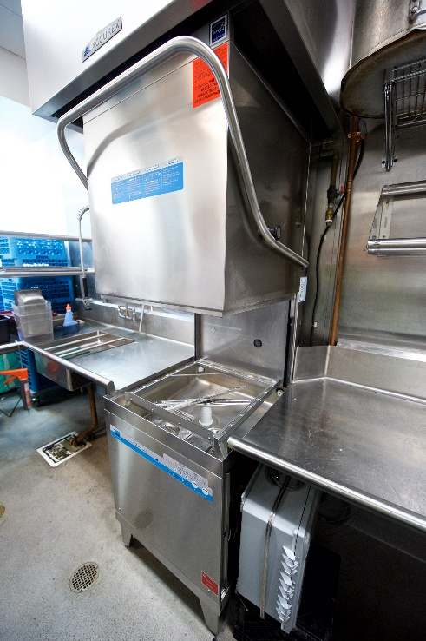
ICP Results
Over $3.5 Million in Grants
79 ICP Project Granted
Over 450 Applications Received
Notes:
Transition to next slide-
So this is not going to be a really technical presentation.
We’re just trying to give you a cross section of the types of projects that have been part of the ICP program over the years
But I do like tables and charts, so I’ll start with this one

