Slide 1
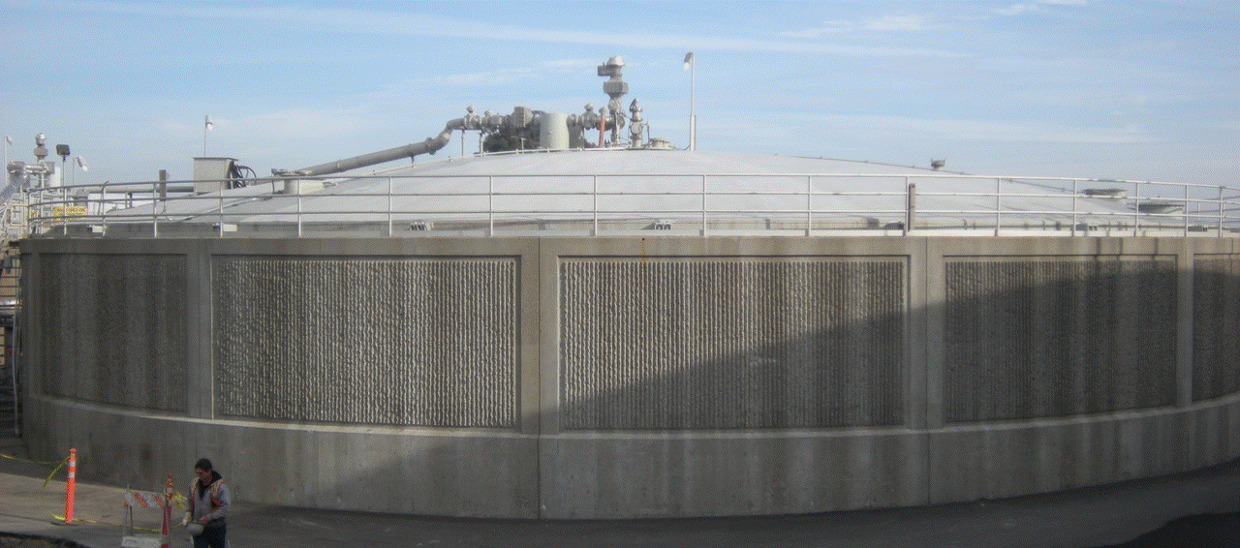


EPC 14-046: FoodWaste Extraction and Co-Digestion of Organic Wastes
11/19/2019
CEC Water Workshop
«««««««««««««
CEC Water Workshop

Slide 2

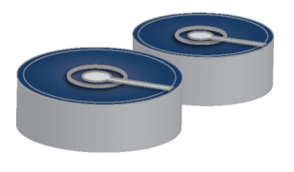
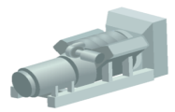
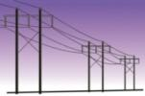
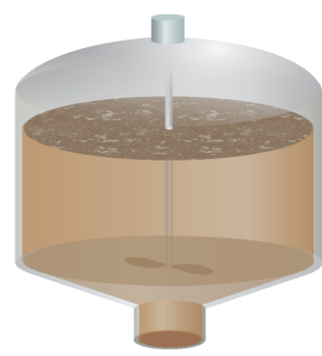

CO-DIGESTION KNOWLEDGE SHARE
Co-digestion Background
CO₂
Diverts organic wastes from disposed in landfills
    prevents greenhouse gas emissions
Enhances biogas production
CH₄
CNG
Wastewater Solids
CO₂ Removal
CNG Vehicle Fuel
CO₂
Heat
Digester heating
Energy recovery
CH₄
Use at WWTP
Add to Grid
Engine
Electricity
Liquid Wastes
Anaerobic Digester
at WWTP
Sludge Liquor
Return to WWTP
Liquid Fertilizer
Feed Stocks
Residuals
Solids
Soil Amendment
Further Energy Extraction
Solid Wastes

Slide 3
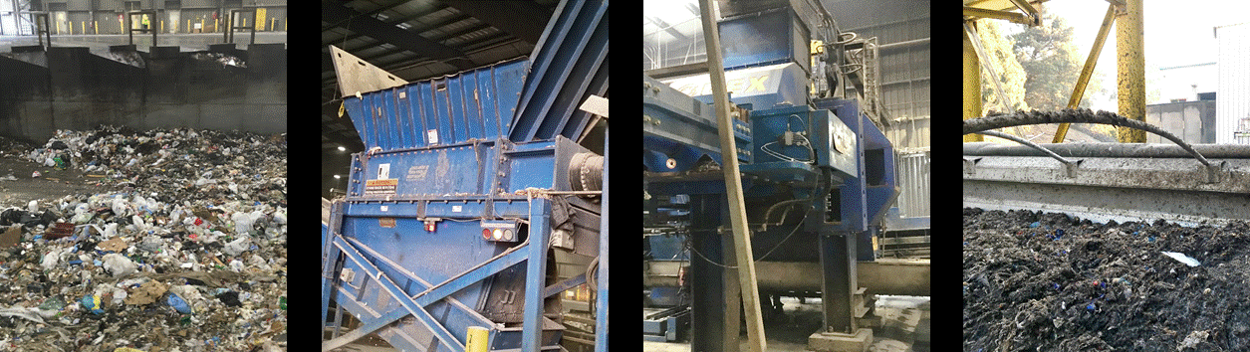
CO-DIGESTION KNOWLEDGE SHARE
Project Objective 1
Demonstrate a novel food waste extraction technology - OREX by Anaergia

Slide 4
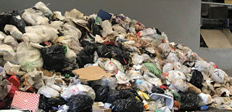
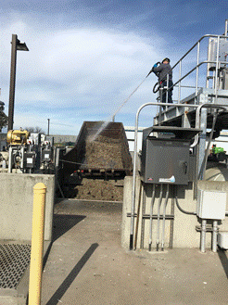
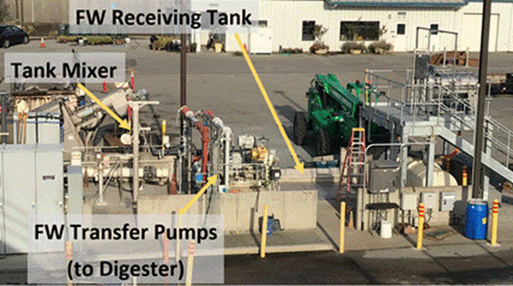
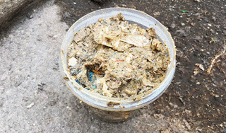
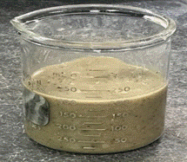
CO-DIGESTION KNOWLEDGE SHARE
Project Objective 2
Strategic loading of sludge, FOG and food waste to the digesters to lower dewatered cake mass @ Silicon Valley Clean Water, Redwood City, CA
UNSORTED WASTE
EXTRUDED WASTE
POLISHED WASTE

Slide 5
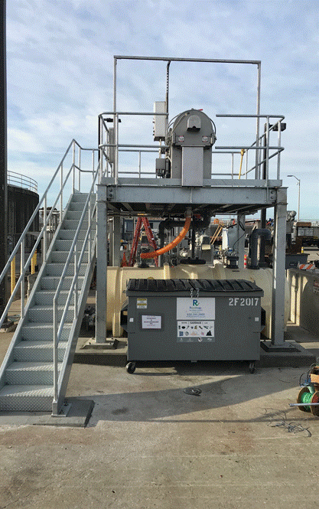
Summary of Key Results
Key Results
Improvement in Digestion: Addition of FOG and FW increased VS destruction by 3 to 10%, in comparison to the benchmarking tests
Increase in unit gas production: Up to 40% increase with FOG addition and 20% with FW addition
  5% of FW by volume increased gas production by ~25%
Improvement in dewatering: Reduction in cake mass requiring disposal by ~10 to 12%
SVCW PADDLE FINISHER

Slide 6
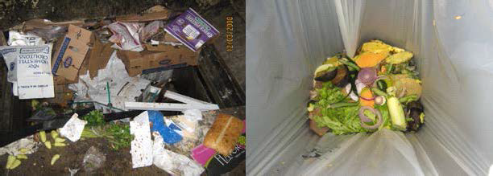
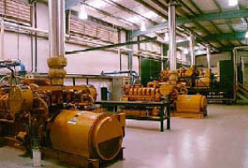
Summary of Key Results
Cost Benefit Analyses
Food Waste Pre-processing: Cost of extraction by OREX is ~45% less expensive than conventional source separation program
Co-digestion at WRRFs:
  ROI 6 to 8 years for 15 MGD plant
  ROI 4 to 5 years for a 100 MGD plant
Increase in Energy Recovery: 26 MW at 25% VS loading and 30% market penetration
Reduction in Greenhouse Gas Emission: Reduction of 201,000 MTCO₂e/Year (at 25% VS loading and 30% market penetration)
Food Waste to Energy

Slide 7
Next Steps
SVCW is planning to implement co-digestion:
  Initiated impact study for implementation in October, 2019
  Expected full scale implementation by 2022
OREX Unit Installations:
  Eight units installed globally since EPIC project initiation
  1 Unit being installed in CA in 2019
  1 Unit scheduled to be installed in 2020
  Others in pipeline

Slide 8
THANK YOU
Ganesh Rajagopalan, Ph.D., PE, BCEE
Kennedy/Jenks Consultants
(949) 567 2162
rganesh@kennedyjenks.com

