Slide 1
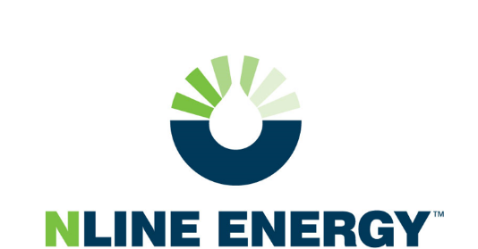
Presentation information
California Energy Commission: Water Workshop
In-Conduit Hydropower
November 19, 2019
Matthew Swindle, Chairman and CEO

Slide 2
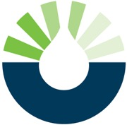
NLine Energy:
What We Do
Mission
Harness wasted energy in existing infrastructure
Create cost-effective renewable electricity
Provide immediate financial benefit to customers
Conduit & Small Hydro
Thermal Energy Recovery
Small Pumped Hydro
Overview
91% of Small Conduit Hydro Development in CA*
33% of Small Conduit Hydro Development in US*
Association of California Water Agencies (ACWA) Approved Preferred Provider**
Offices in CA, OR, and NH
Retrofit / Rehab
*2013-pres. Approved FERC NOI Conduit Exemption filings by MW
**Competitive RFQ process (2010-2018)
Notes:
History of Company

Slide 3
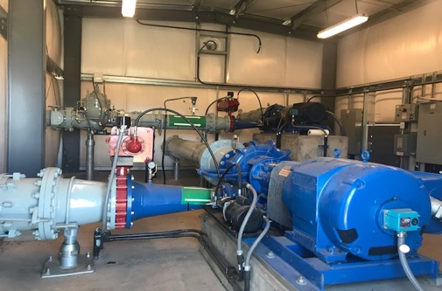
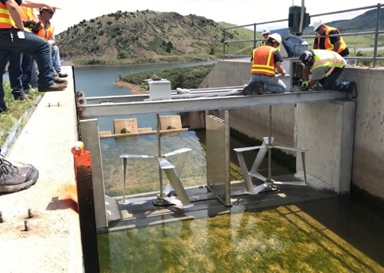
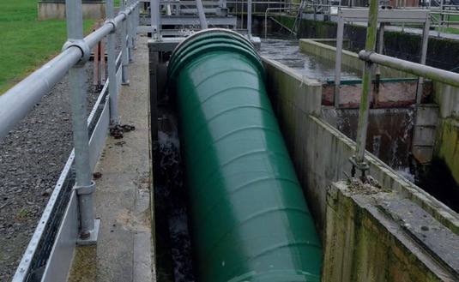
In-Conduit Hydropower
  “Hydroelectric generation potential from man-made conduits such as tunnels, canals, pipelines, aqueducts, flumes, ditches, or similar man-made water conveyance that are operated for the distribution of water for agricultural, municipal, and industrial consumption”
Source: Park, 2006.
Pump-as-turbine system for pipeline application (Source: Amador Water Agency)
Hydrokinetic turbine system in canal
(Source: Emrgy)
Archimedean screw turbine installed at WWTP outfall
(Source: Advanced Pump and Hydro Systems Ltd, UK)

Slide 4
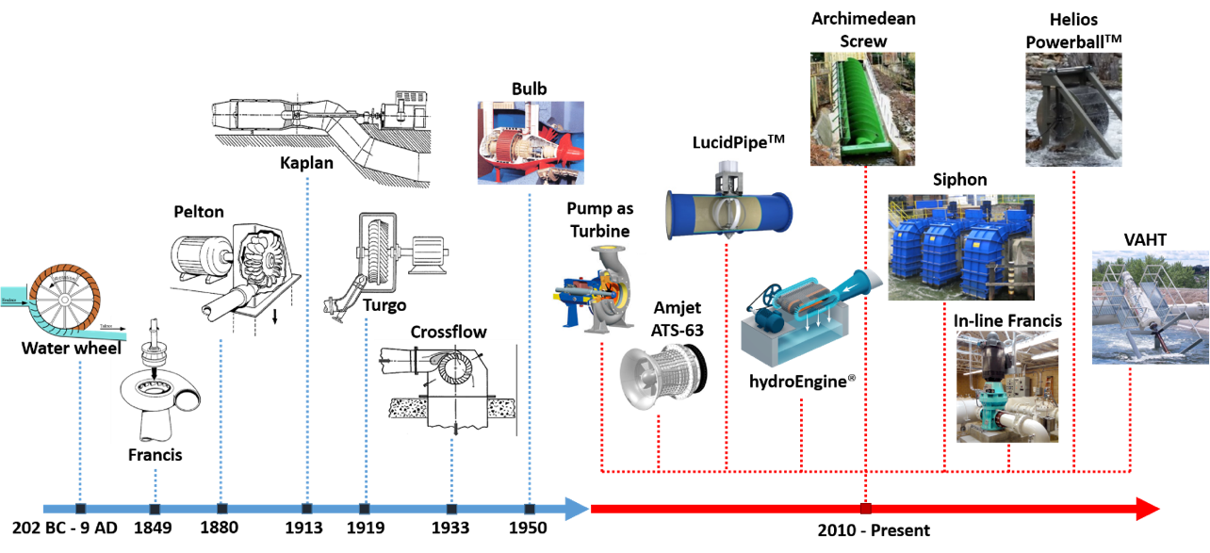
Recent Changes
Simplification of regulatory and permitting processes for in-conduit hydropower projects
“Technological Renaissance” in small hydro-turbines systems
Notes:
Provide opportunities to revisit sites that were previously considered to be technically or financially infeasible

Slide 5
In-Conduit Statewide Assessment
Assessment | Estimated Potential (MW)
Minimum potential uninstalled capacity (USGS) | 368
Maximum potential uninstalled capacity (SWRCB and DWR) | 414
Currently installed capacity | 343

Slide 6
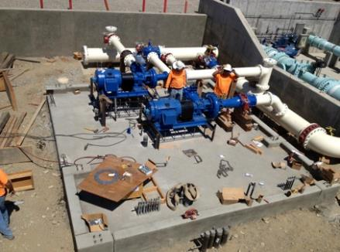
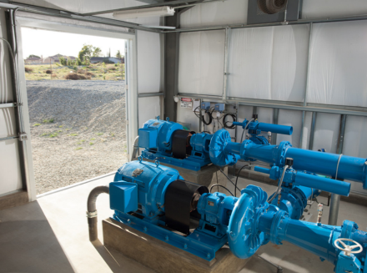
Fontana Water Company: Sandhill WTP Project
Site Name | Sandhill WTP
Head | 277-347 ft
Flow | 4-13 cfs
Technology | Pump-as-Turbine
Turbine(s) rating | 310 kW
Annual generation | 1,936,000 kWh
Annual revenue | $100,000
Project cost | $1,675,000
Subsidies | $848,000
Payback | 8 years
30-yr net savings | $4,200,000
Status | Commissioned (2013)

Slide 7
San Gabriel Valley Water Company: B24 Project
Site Name | B24
Head | 110-170 ft
Flow | 5-8 cfs
Technology | Pump-as-Turbine
Turbine(s) rating | 72 kW
Annual generation | 430,000 kWh
Annual revenue | $56,000
Project cost | $1,300,000
Subsidies | $760,000
Payback | 8.9 years
30-yr net savings | $2,325,000
Status | Commissioned (2019)

Slide 8
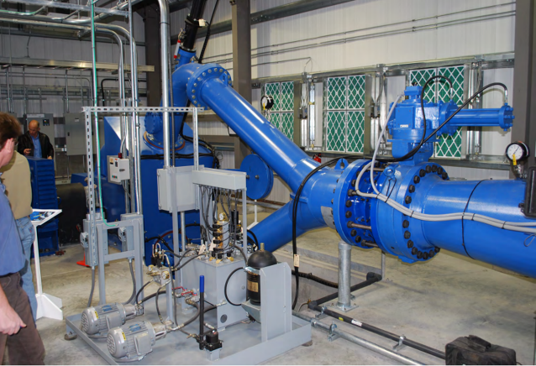
Amador Water Agency:
Ione Reservoir Project
Site Name | Ione Reservoir
Net Head | 460-500ft
Flow | 1-6 cfs
Technology | Pelton
Turbine rating | 1,065 kW
Annual generation | 1,383,000 kWh
Annual Revenue | $216,000
Project cost | $2,917,000
Subsidies | $750,000
Payback | 11.6 years
Status | Commissioning (Q1 2020)

Slide 9
Summary
The technological renaissance of in-conduit hydropower turbines has largely encouraged new installations
A number of sites with different configurations offer potential for harnessing energy through in-conduit hydropower
Simplification of the regulatory and permitting process provides a more favorable ground for in-conduit hydropower projects
Project financial viability should comprehensively assess project costs, revenue opportunities and availability of grants/incentives
The interconnection process with the grid should be opportunely planned with the local electric utility
Design and operating strategies of in-conduit hydropower projects should minimize interference with current operations
While a number of water utilities in California have already implemented in-conduit hydropower systems, there is still a large in-conduit hydropower untapped potential in water supply systems.

Slide 10
Future Research Topics
New funding opportunities should be evaluated and an improved understanding on the regulatory landscape for in-conduit hydropower projects should be achieved
Understanding of the sensitivity of the project economics on critical parameters is essential (e.g. tariff rate structures, project size, grants/incentives, etc.)
Mandates that simplify interconnection process for conduit hydropower projects are needed
Holistic approaches to integrated water-energy management that involves participation from different stakeholders are needed
The understanding of the potential for harnessing hydrokinetic energy and the corresponding technology should be improved

Slide 11
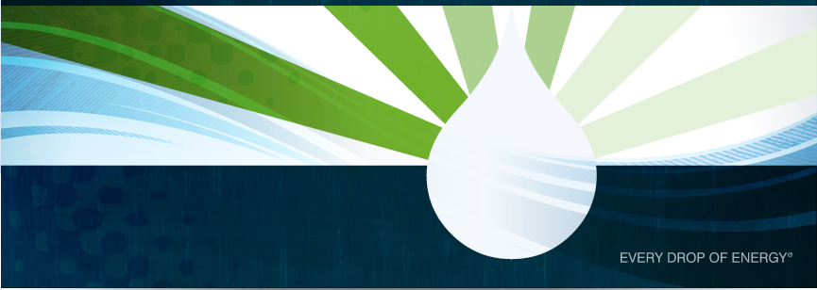
Contact information
NLine Energy, Inc.
5170 Golden Foothill Parkway
El Dorado Hills, CA 95762
o: 916.235.6852 | f: 866.444.4320
www.nlineenergy.com
Notes:
08/25/10
11

