Slide 1

Advancing Demand Response in the Water Sector
Frank Loge, Ph.D.
Professor, Civil and Environmental Engineering
Director, Center for Water-Energy Efficiency
November 19, 2019
Notes:
Photo Credit: Ivan Bandura from Unsplash

Slide 2
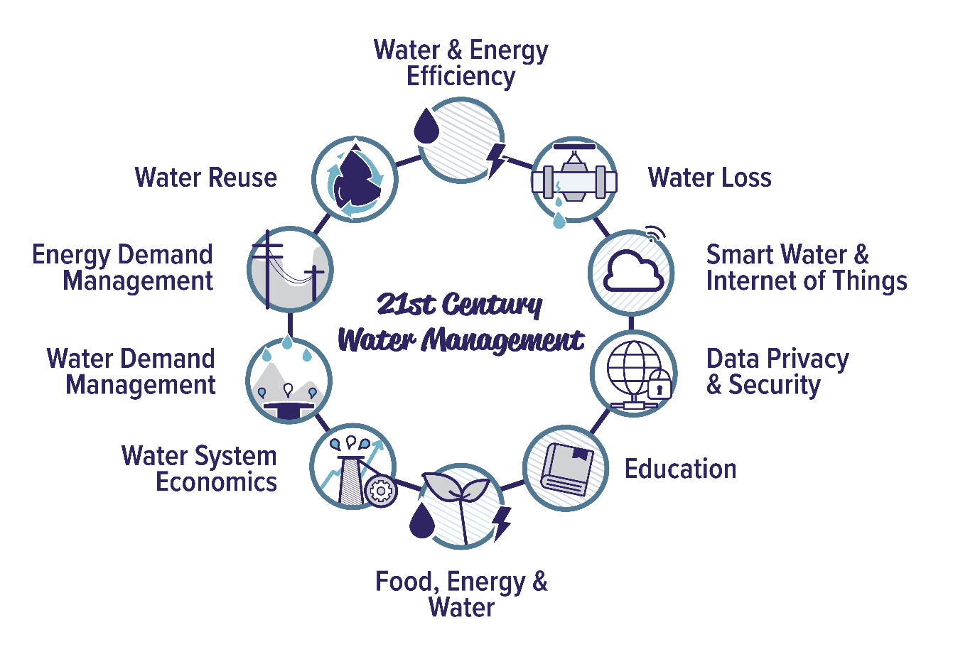
Introduction to CWEE
Advance water management solutions for the integrated savings of water & energy resources

Slide 3


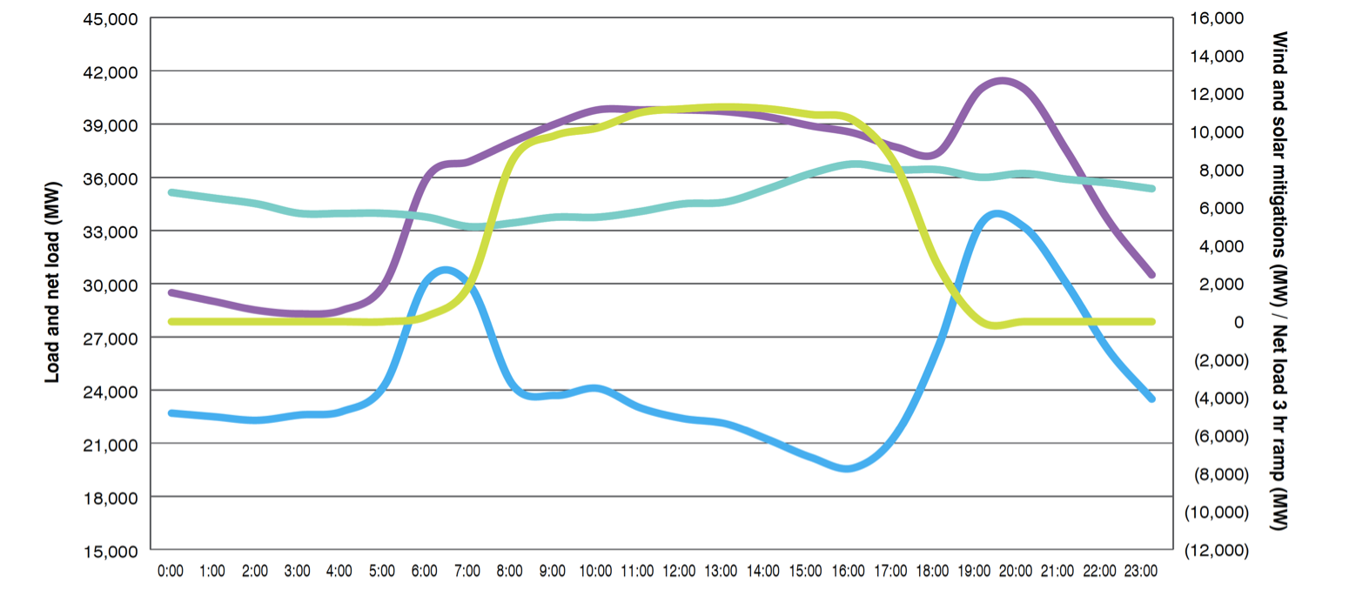
Changing Energy Sector
Figure from Clean Coalition 2013
Notes:
Net load – load minus the renewable energy non-dispatchable renewable energy resources.
California has pursued increased renewable integration to reduce ghgs produced by generating electricity.
Much of the renewable resources developed have been solar. Because solar is intermittent and non-dispatchable, meaning it can’t be turned on at will, several operational challenges have developed.

Slide 4
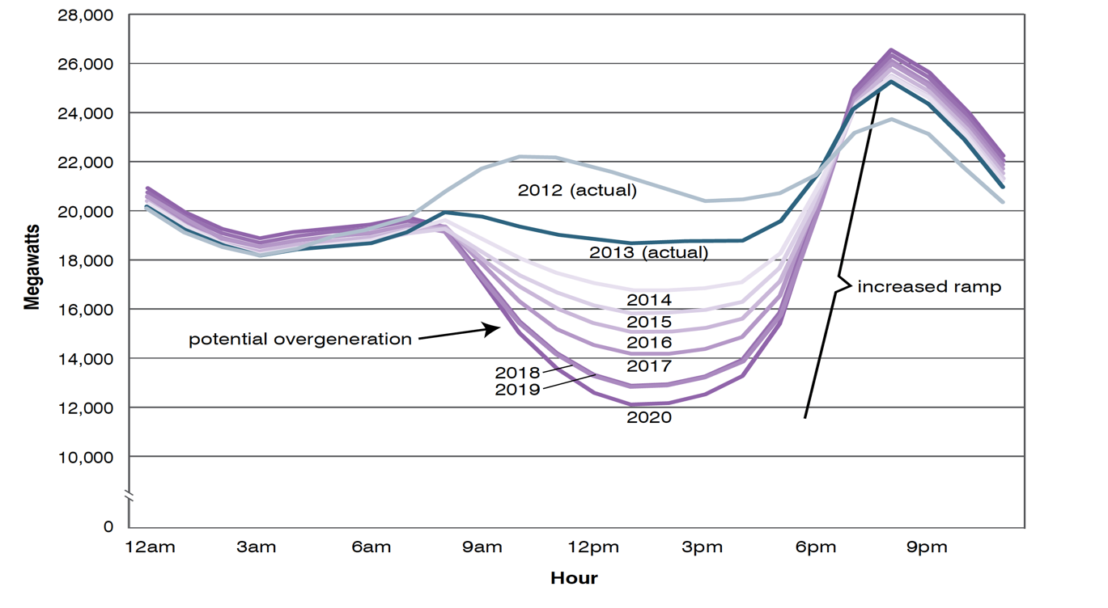
Shifting Energy Loads
Pursued Energy Sector Solution:
Energy Demand-Side Management
Figure from CAISO 2013
Notes:
, several operational challenges have emerged, this includes an increased ramp that dispatchable energy sources such as natural gas have to meet in order to provide for peak customer demand in the evening and the increased risk of overgeneration.
One of the ways that the energy sector is trying to remedy this is by promoting customers to shift their energy use out of the time period of peak demand, and potentially to move it into the time period when solar energy is available. Our center is particularly focused on shifting energy into the time frame when solar is available in order to decrease ghgs and increase solar integration.

Slide 5
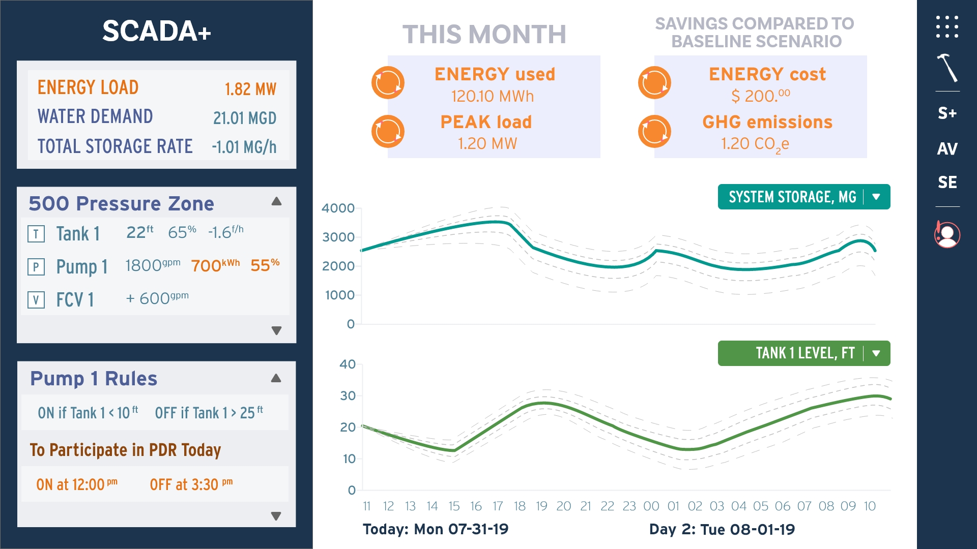
Energy DMS: User Dashboard
Notes:
Tablet, desktop or web-browser

Slide 6
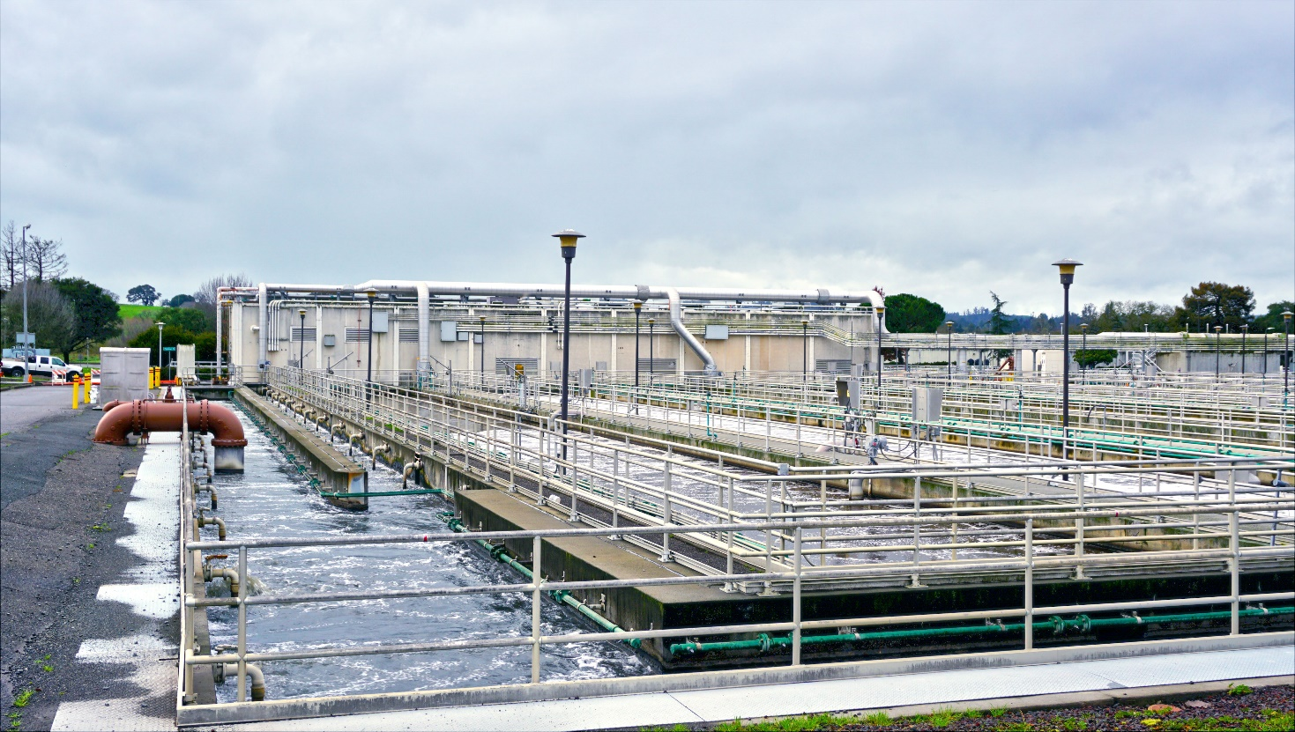
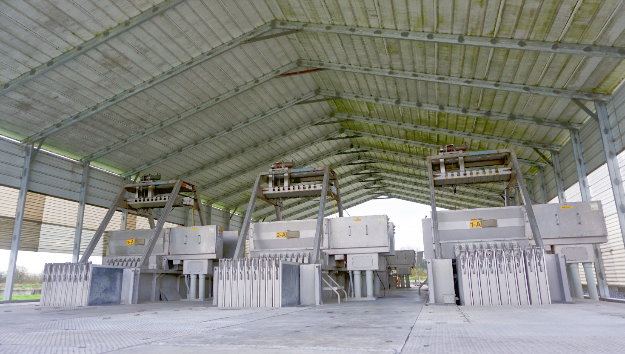
Wastewater Sector: Microgrid Potential
Water Treatment Pond
UV Disinfection
Total WWTP Energy Load ~3-5 MWH
Notes:
Picture (L-R): Treatment facilities, and UV disinfection
Allow a WWTP to perform load shifting to benefit the energy sector
Similar project objective as with MNWD but with different processes (i.e., water treatment reliant to bacteria health and less able to predict demand)

Slide 7
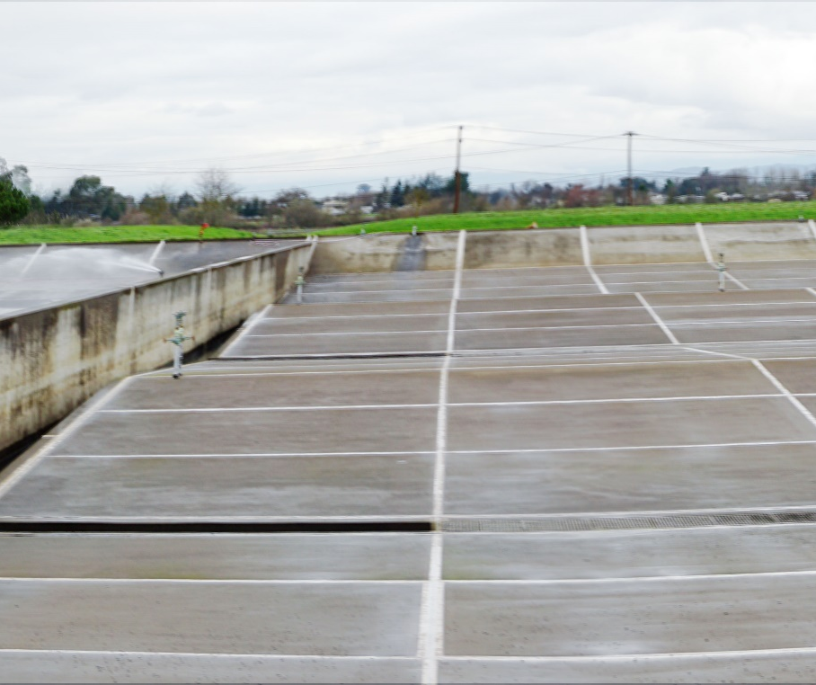
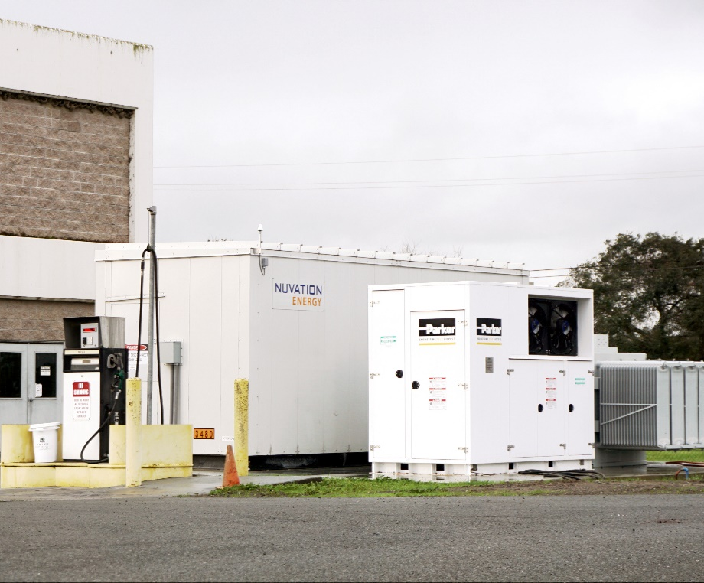
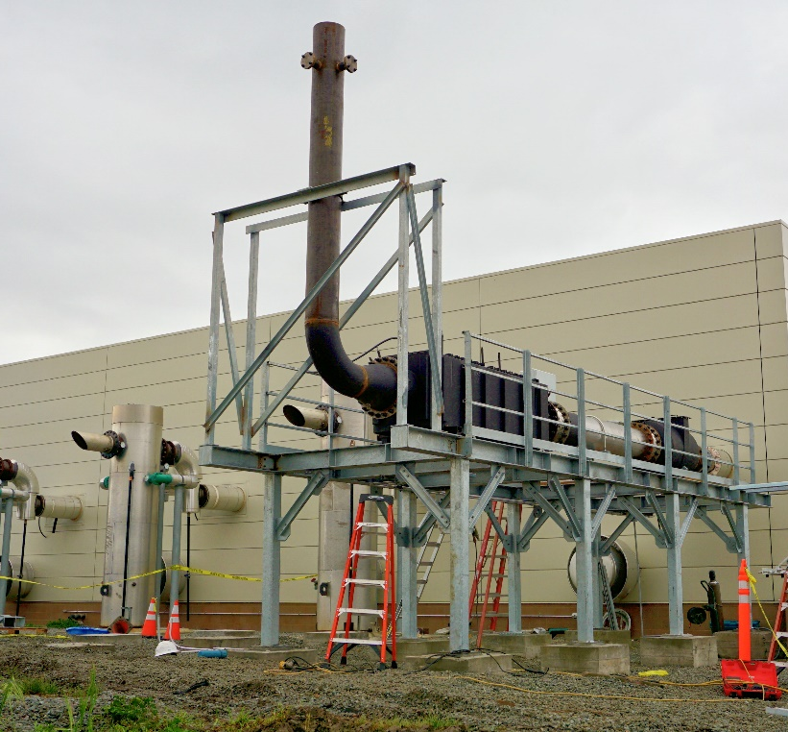
Wastewater Sector: Modifying Operations
Flow Equalization Basins
Batteries
Combined Heat & Power
~1-2 MWH LS
Capability
~O.5 MWH LS
Capability
Stabilizes Load

Slide 8
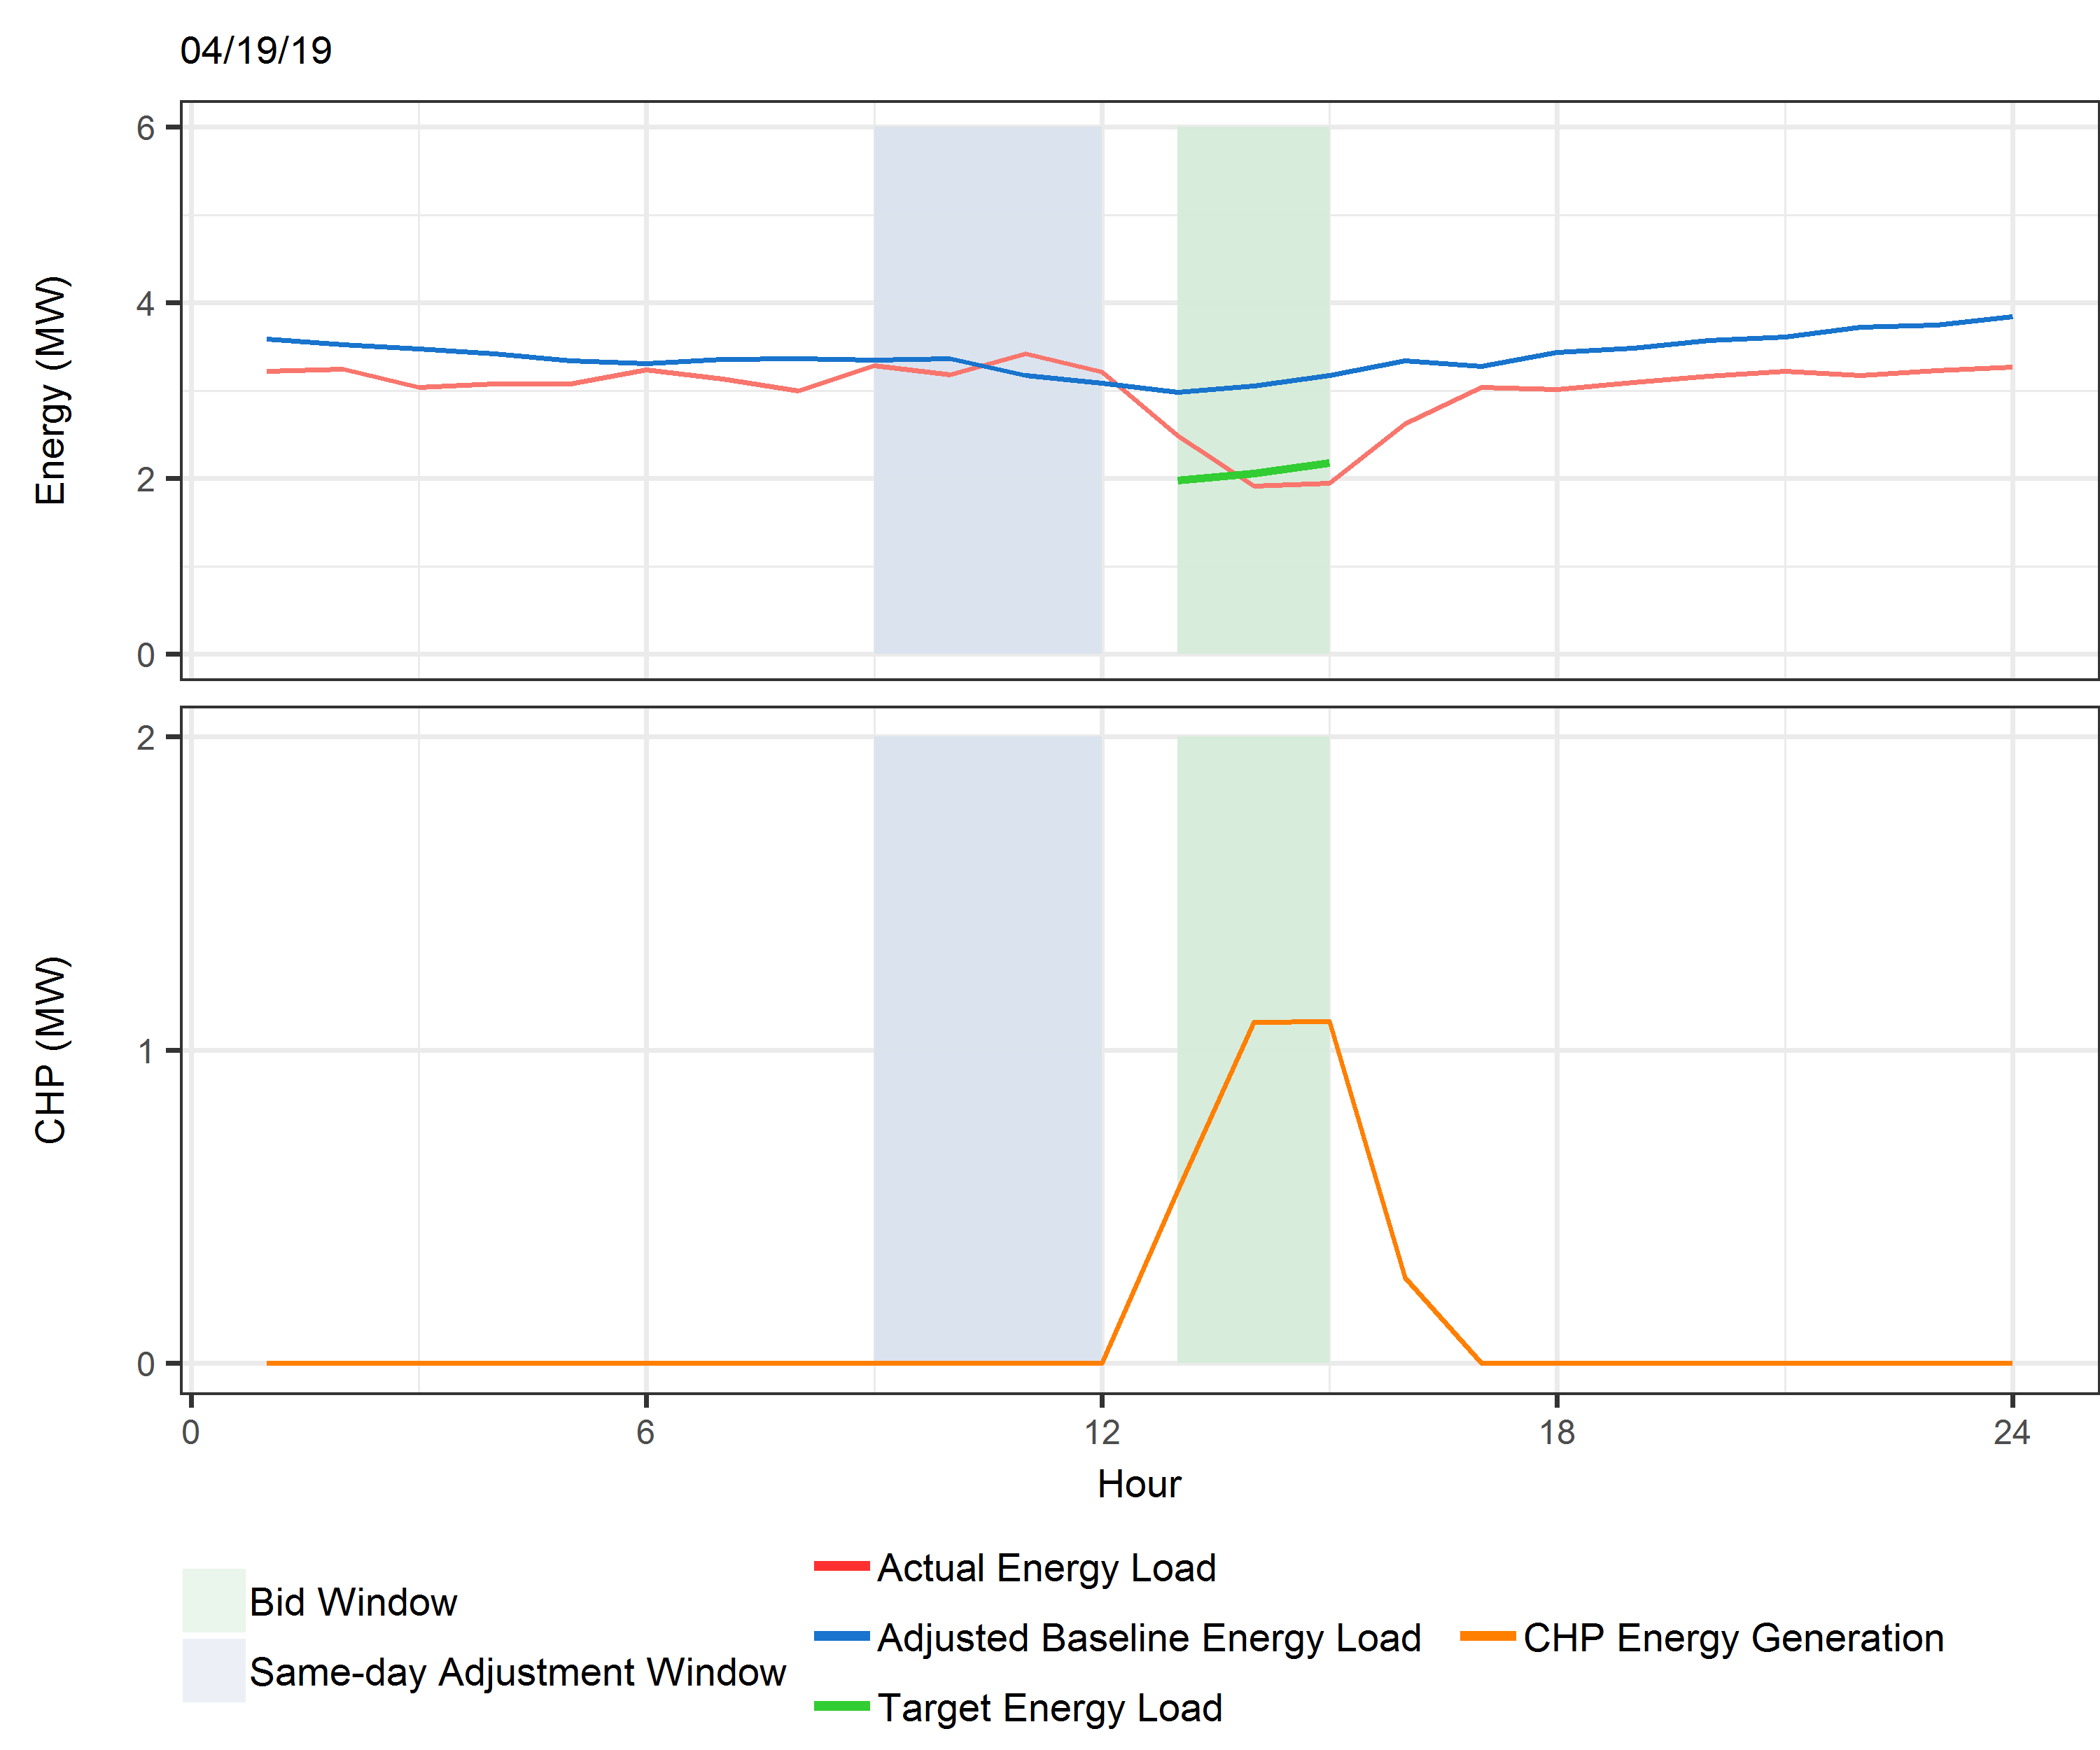
PDR at Laguna WWTP
Notes:
, several operational challenges have emerged, this includes an increased ramp that dispatchable energy sources such as natural gas have to meet in order to provide for peak customer demand in the evening and the increased risk of overgeneration.
One of the ways that the energy sector is trying to remedy this is by promoting customers to shift their energy use out of the time period of peak demand, and potentially to move it into the time period when solar energy is available. Our center is particularly focused on shifting energy into the time frame when solar is available in order to decrease ghgs and increase solar integration.

Slide 9
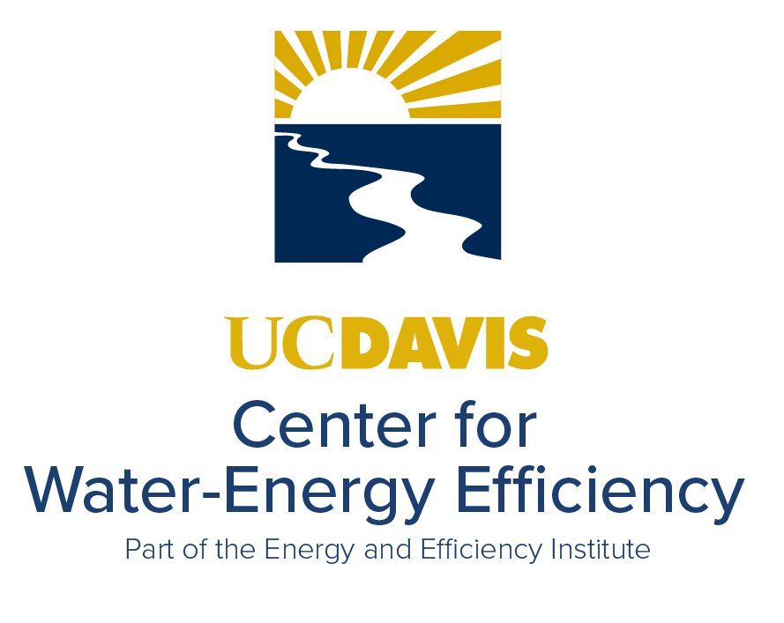
Thank You
Contact Info:
Frank Loge
(530) 754-2297
fjloge@ucdavis.edu

