Slide 1
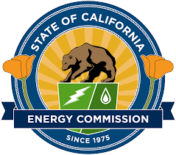
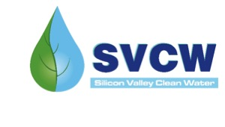

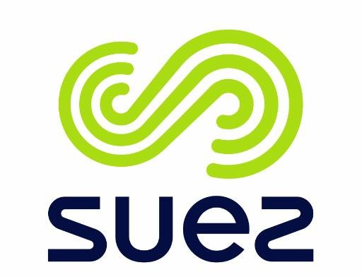




Maximizing Water and Energy from New Anaerobic Secondary Wastewater Treatment
Sebastien Tilmans, PhD, PE stilmans@stanford.edu Eric Hansen, PE, BCEE ehansen@svcw.org

Slide 2
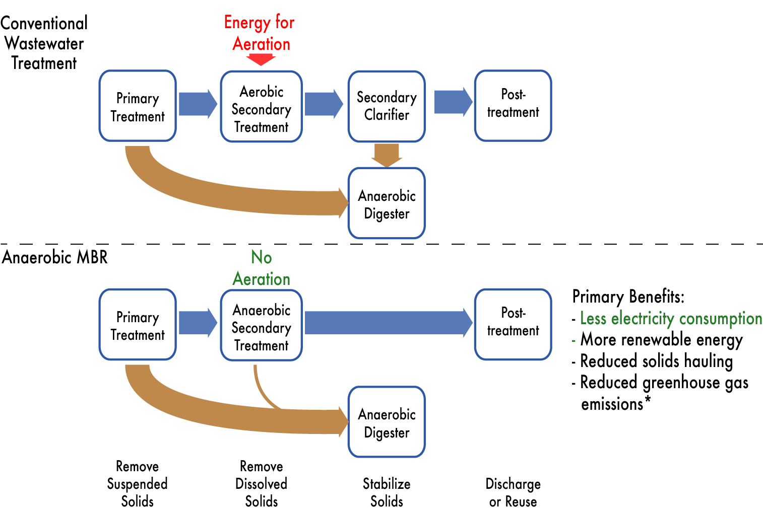
Anaerobic Secondary Treatment Could Transform Conventional Process Trains

Slide 3
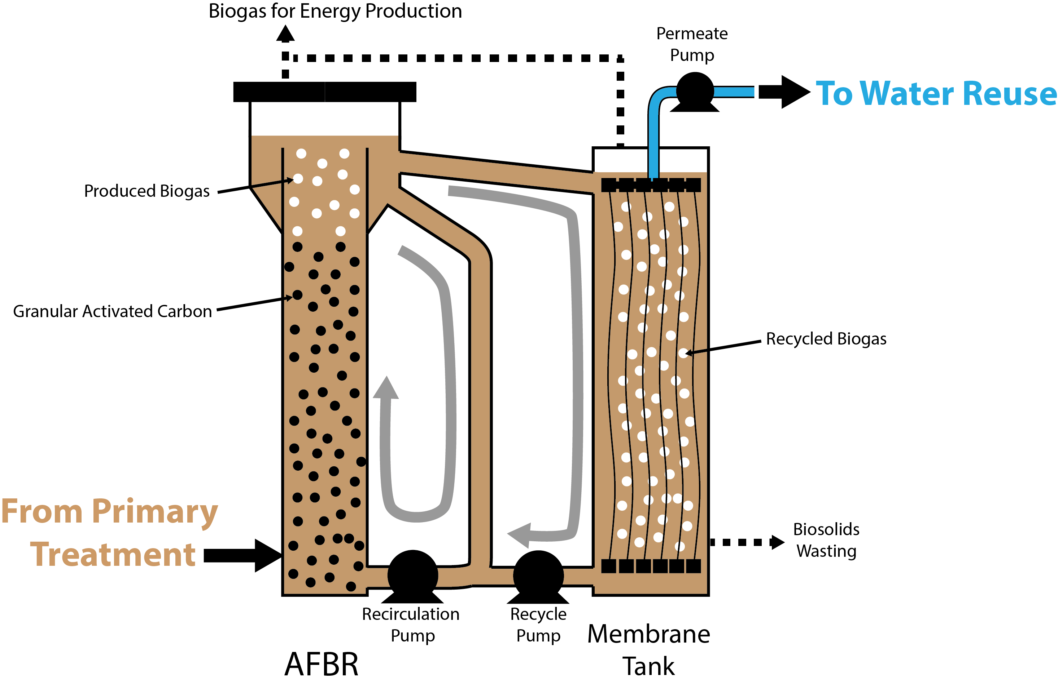
SAF-MBR

Slide 4
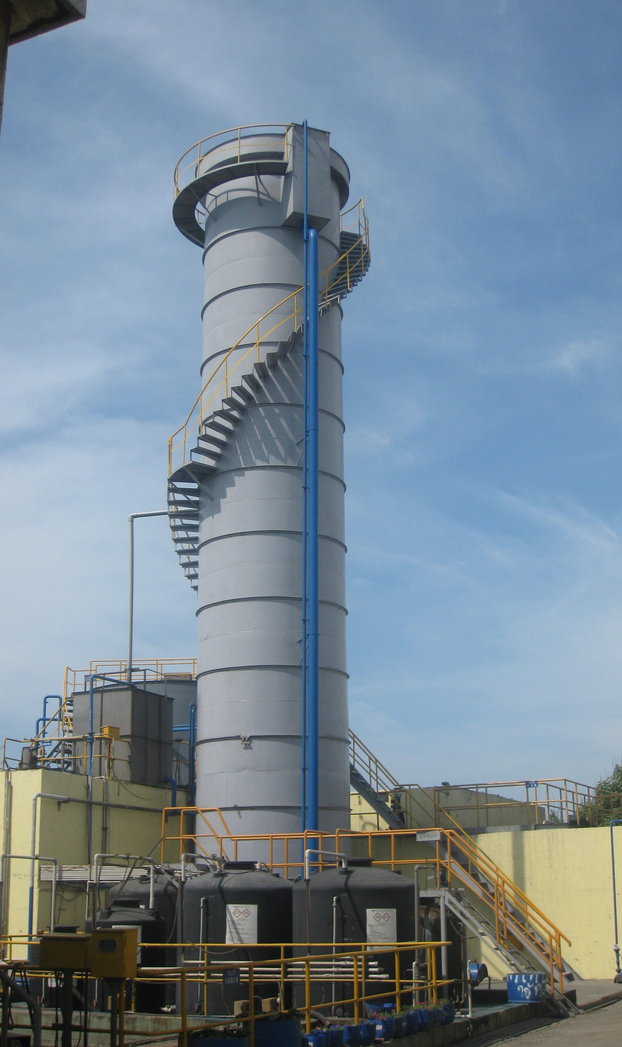
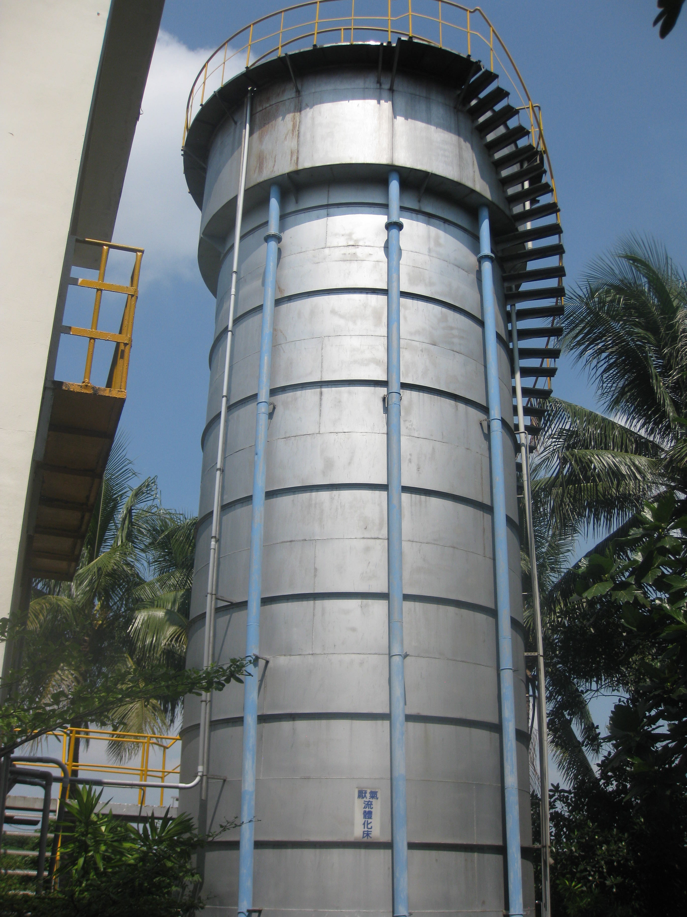
Many full-scale anaerobic FBRs around the world

Slide 5
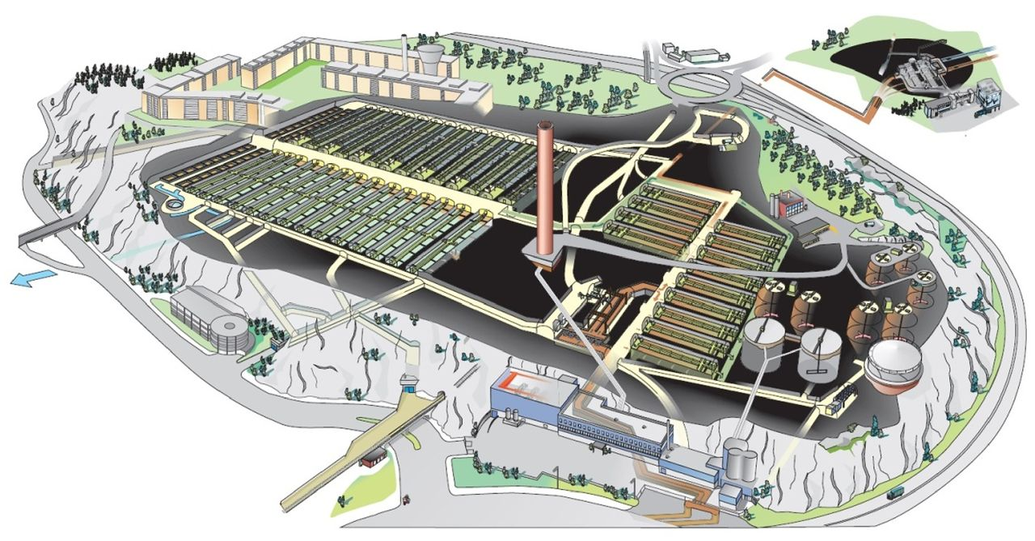
MBRs leveraged for meeting stringent future needs at scale
Henriksdal WWTP in Stockholm – 1 million people served, ~66MGD
Upgrading to 1.6 million PE with Suez LEAPmbr technology
Photo Credit: IWA Water Practice & Technology 11(2) 266-272
Notes:
About 140 MGD

Slide 6
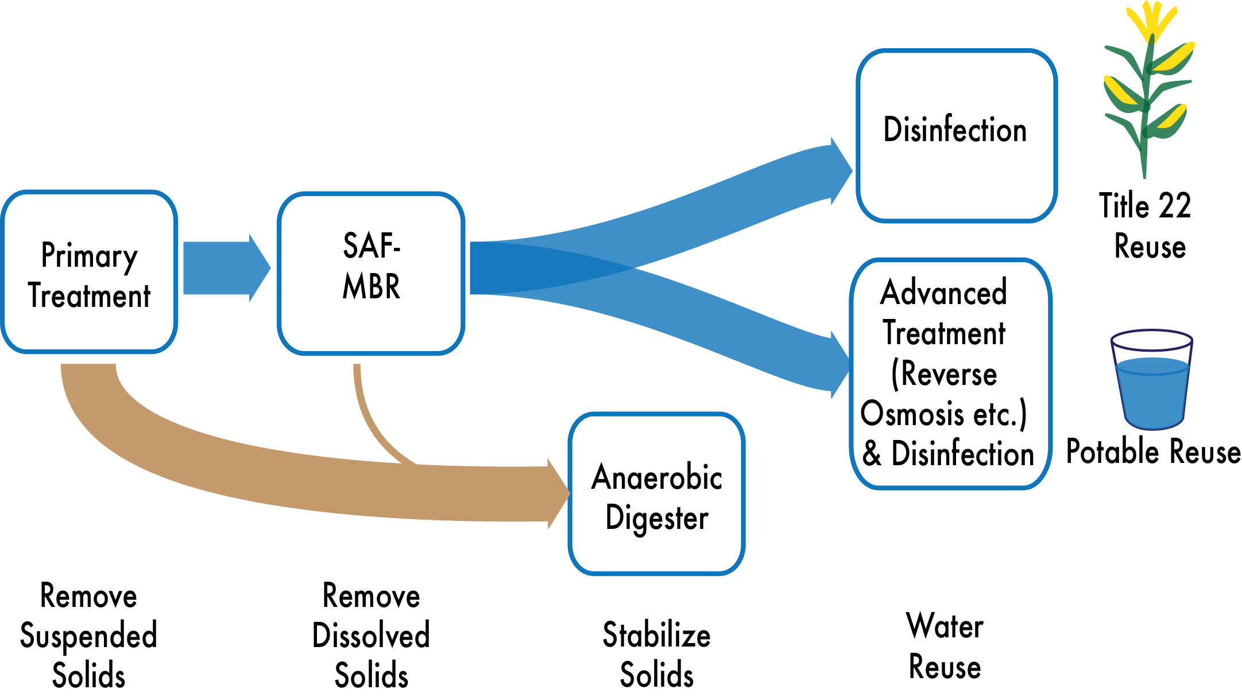
Testing SAF-MBR as Part of Integrated Process Trains for Water Reuse

Slide 7
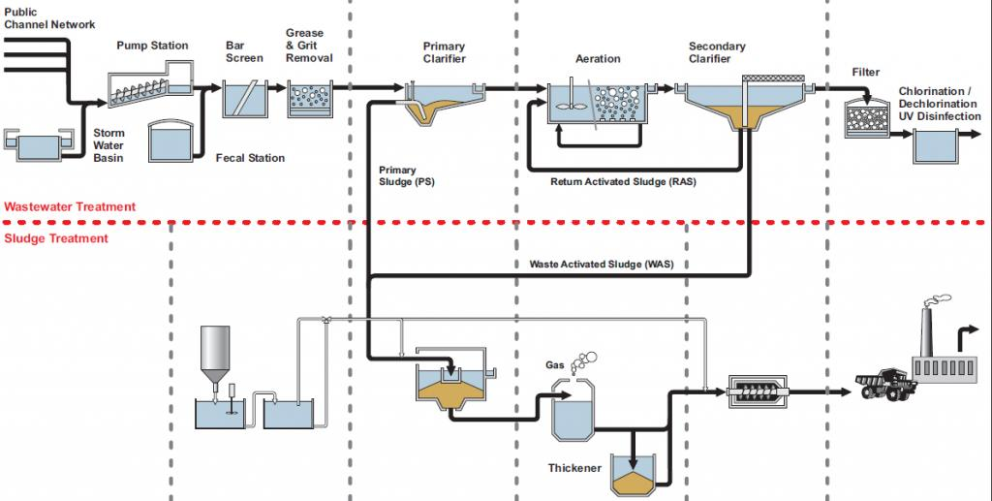
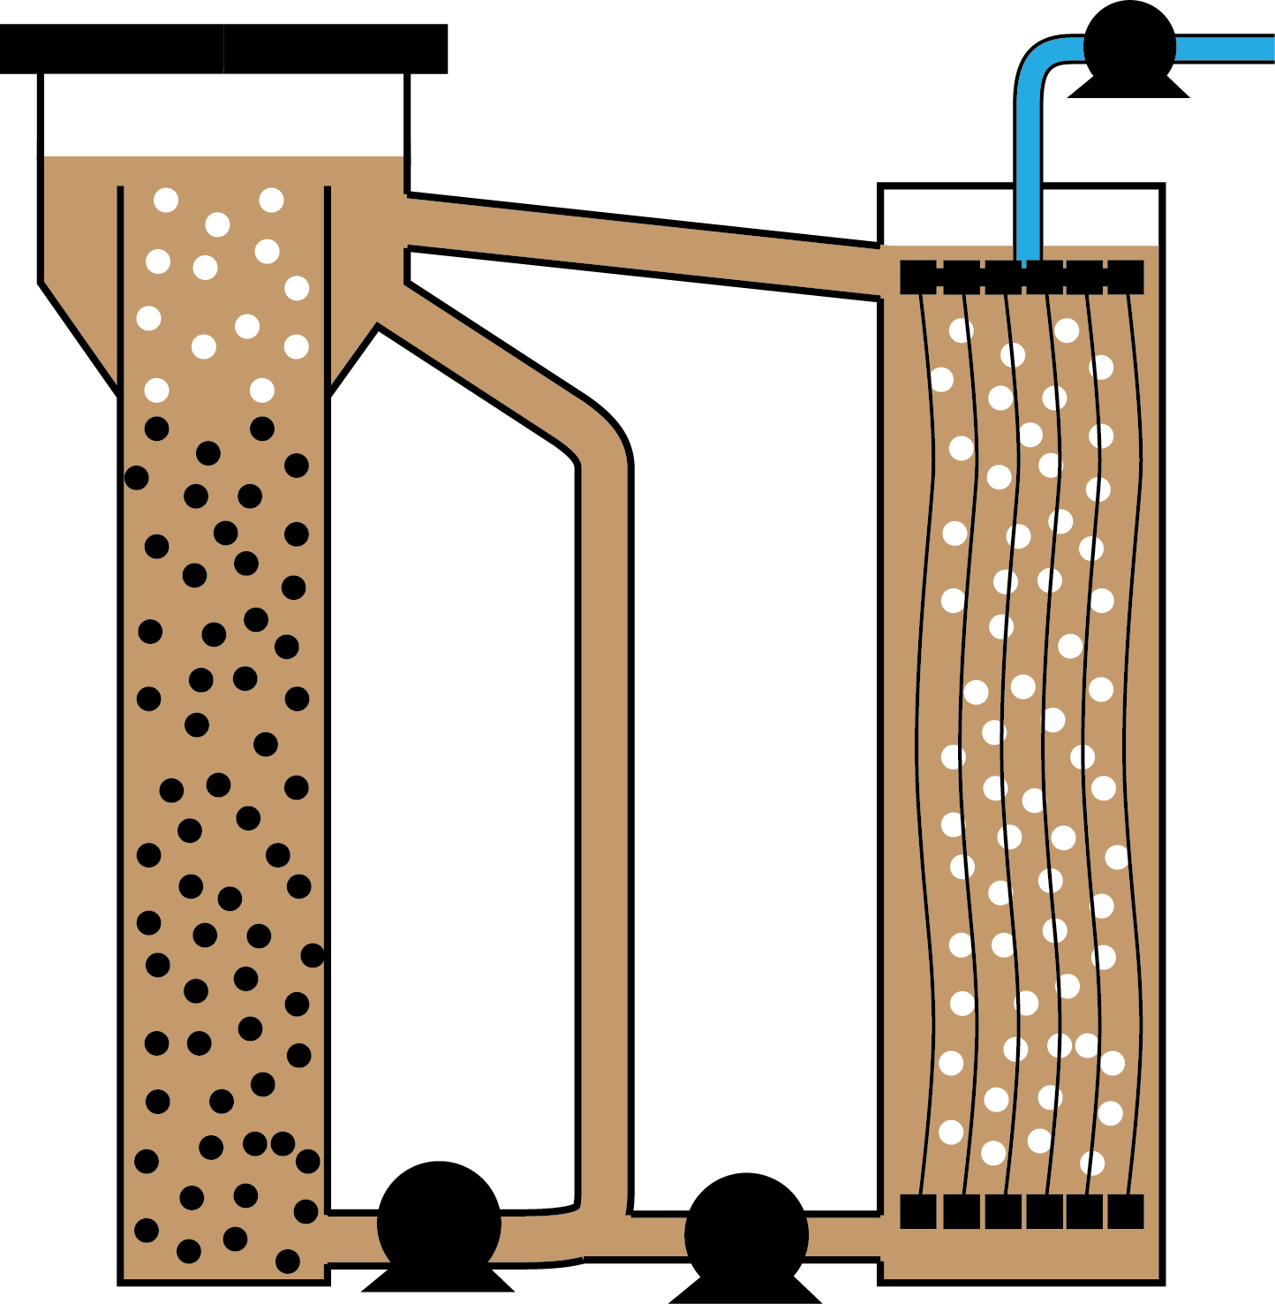
Possible SAF-MBR Benefits for Municipalities
No Secondary Clarifiers
Water Pumps
Gas Sparging Blowers
Membrane Management
No Dual Media Filtration
Much less waste sludge

Slide 8
Possible SAF-MBR Benefits for SVCW
Space for Water Reuse?

Slide 9
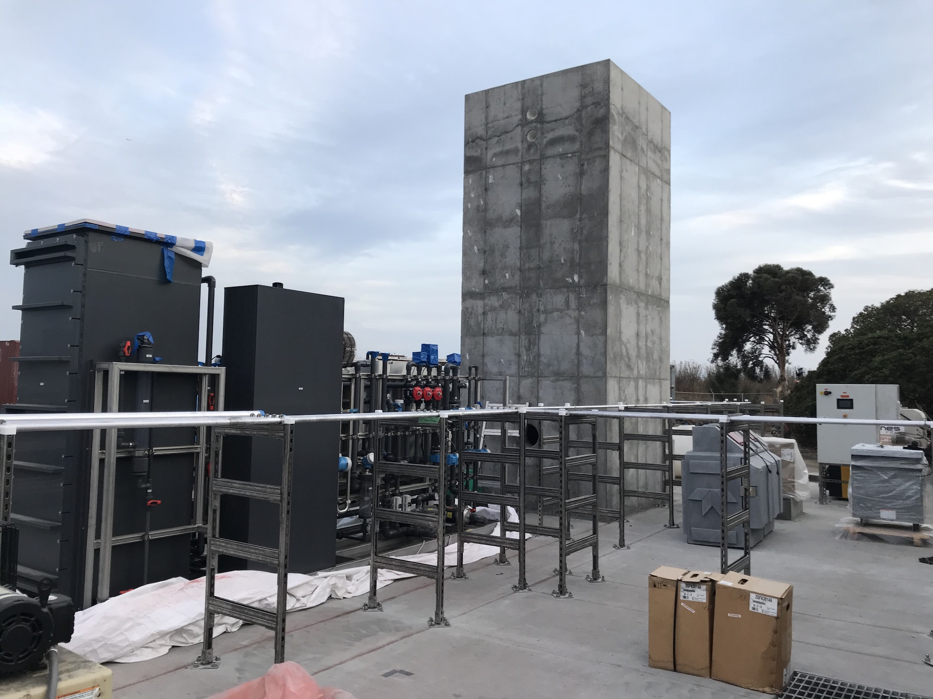
Coming Soon…

