Slide 1
Raw Wastewater Filtration to Increase Organic Removal Efficiency and Achieve Significant Electrical Savings
Presented by
Onder Caliskaner, Ph.D., P.E.

Slide 2
Acknowledgements
California Energy Commission Project Sponsor and Funding Agency
Linda County Water District Full Scale System Deployment Site
Los Angeles County Sanitation District Demonstration System Site
City of Manteca Demonstration System Site
Prof. George Tchobanoglous / University of California, Davis Project Advisor
Aqua-Aerobics Systems, Inc. Primary Filtration System Supplier
Process Wastewater Technologies, LLC Thickening Equipment Supplier
Base Energy, LLC Third Party Energy Measurement and Verification Firm

Slide 3
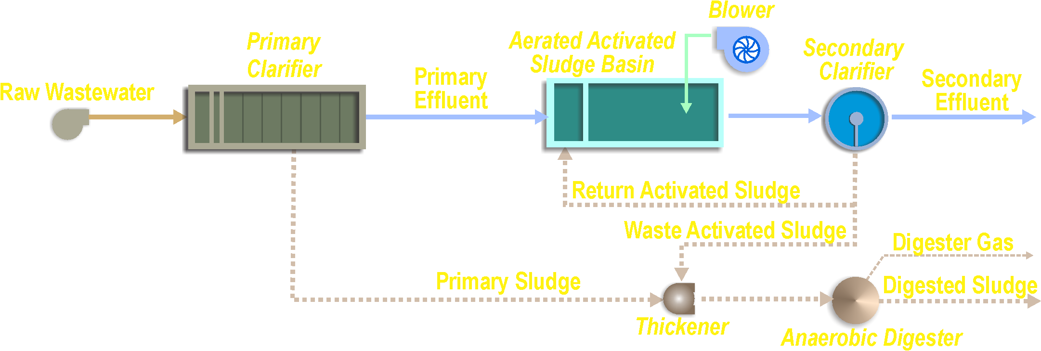


Process flow
Aerated Activated Sludge Basin
Blower
Secondary Clarifier
Replacing Primary Clarifier with Primary Filter
Primary Clarifier
Secondary Effluent
Raw Wastewater
Primary Effluent
Conventional
Return Activated Sludge
Waste Activated Sludge
Digester Gas
Primary Sludge
Digested Sludge
Thickener
Anaerobic Digester
Smaller Blower
(Reduced Air Demand)
Aerated Activated Sludge Basin
(Reduced Size)
Secondary Clarifier
Raw Wastewater
Primary Filter
Filtered
Primary Effluent
Secondary Effluent
Modified
Return Activated Sludge
Waste Activated Sludge
Increased Digester Gas
Filtered Backwash Reject Water
Digested Sludge
Thickener
Anaerobic Digester
Notes:
Take tertiary effluent out and make everything bigger

Slide 4
PRIMARY FILTRATION Objective
Improved Primary Treatment Efficiency
  Primary Treatment Removal
  Aeration Power Consumption
  Secondary Treatment Capacity
  Primary Treatment Footprint
  Digester Biogas Energy Production
  Biological Treatment Efficiency

Slide 5

CEC Primary Filtration Projects
Linda County Water District
Wastewater Treatment Plant (WWTP)
  Full-Scale (complete with solids handling)
  Average Design Capacity of 1.5 MGD
  Peak Design Capacity of 2.5 – 3 MGD
SACRAMENTO
City of Manteca
Wastewater Quality Control Facility (WQCF)
  Demonstration-Scale
  Flow rate of 20 - 85 gpm
Los Angeles County Sanitation District
Lancaster Water Reclamation Plant (WRP)
Demonstration Locations
  Demonstration-Scale
  Flow rate of 20 - 45 gpm

Slide 6
CEC Primary Filtration Projects
Demonstration Timelines
 | 2016 |  |  |  |  |  |  |  | 2017 |  |  |  |  |  |  |  |  |  |  |  | 2018 |  |  |  |  |  |  |  |  |  |  |  | 2019 |  |  |  |  |  |  |  |  |  |  |  | 2020
 | MAY | JUN | JUL | AUG | SEP | OCT | NOV | DEC | JAN | FEB | MAR | APR | MAY | JUN | JUL | AUG | SEP | OCT | NOV | DEC | JAN | FEB | MAR | APR | MAY | JUN | JUL | AUG | SEP | OCT | NOV | DEC | JAN | FEB | MAR | APR | MAY | JUN | JUL | AUG | SEP | OCT | NOV | DEC | JAN | FEB | MAR
Linda WWTP (Full-Scale)
Lancaster WRP
Manteca WQCF
Design, Construction/Installation, and Start-Up
Operation and Analysis
Notes:
Can'

Slide 7
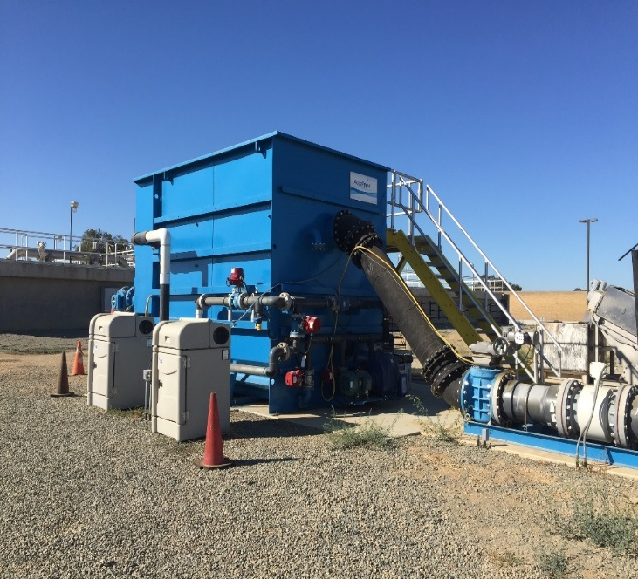
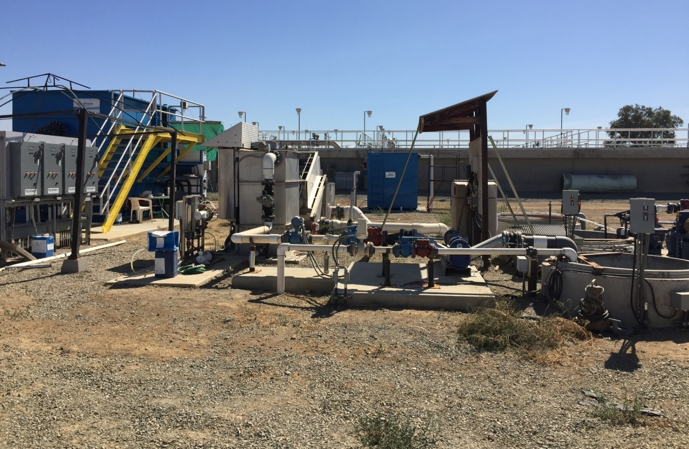
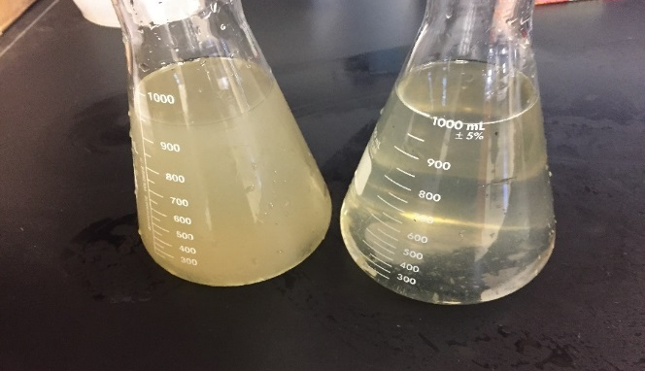
Linda Full-Scale Demonstration
Full-scale System With 1.5 MGD (Average) Design Capacity
Influent
Effluent
Primary Filter Supplied by Aqua-Aerobics Systems, Inc.

Slide 8
Linda Full-Scale Demonstration
Primary Filter TSS Removal
Avg. Inf TSS: 308 mg/L
Avg. Eff TSS: 49 mg/L
Avg Removal: 84%
Note: TSS values were estimated using established TSS/Turbidity correlations factors specific to this project
Notes:
Turbidity_by_month_filter_jan19-july19
J:\2015\1548002.00_CEC_Raw_WW_Filtration\09-Reports\9.01_Field Investigations-Pilot Studies\Linda\Linda Turbidity

Slide 9
Linda Full-Scale Demonstration
Primary Filter Performance - BOD
Avg. Inf BOD: 305 mg/L
Avg. Eff BOD: 123 mg/L
Avg Removal: 58%
Notes:
Linda_RawWWFiltration_LabResults_v4 (BOD Tab)
J:\2015\1548002.00_CEC_Raw_WW_Filtration\09-Reports\9.04_Lab Analyses\Linda

Slide 10
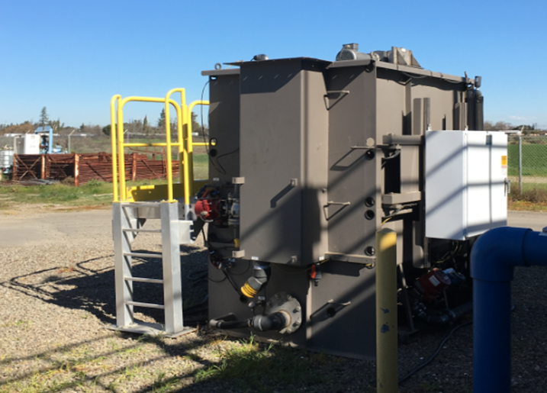
Manteca Demonstration
Demonstration-Scale System with 0.12 MGD Peak Design Capacity

Slide 11
Manteca Demonstration
Primary Filter Performance from Lab Analysis
Constituent | Primary Filter Influent (mg/L) |  | Primary Filter Effluent (mg/L) |  |  | Constituent Average Removal Efficiency (%)
N/A | Range | Average | Range | Average |  | N/A
TSS | 63-880 | 365 | 34-100 | 55 |  | 85
COD | 390-1300 | 757 | 320-420 | 371 |  | 51
BOD | 170-670 | 409 | 130-250 | 179 |  | 56
TKN | 52-77 | 68 | 44-69 | 59 |  | 13

Slide 12
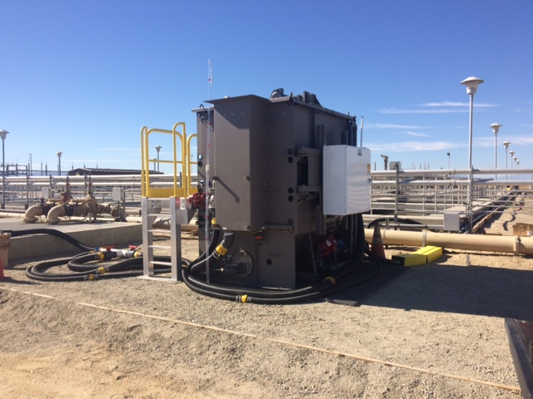
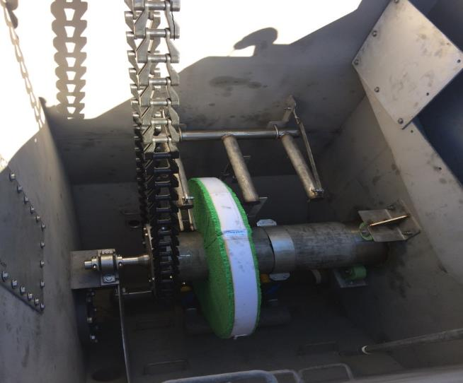
Lancaster Demonstration
Demonstration-Scale System with 0.06 MGD Peak Capacity
Lancaster WRP Pilot System
Aqua MiniDisk® with
5 µm OptiFiber® media

Slide 13
Lancaster Demonstration
Solids and Organics Removal
Average TSS Results
System | No. of Samples | Feed (mg/L) | Effluent (mg/L) | % Removal
Primary Filter | 48 | 396 | 65 | 83
Primary Clarifiers | 39 | 316 | 147 | 54
Average COD Results
System | No. of Samples | Feed (mg/L) | Effluent (mg/L) | % Removal
Primary Filter | 48 | 744 | 325 | 54
Primary Clarifiers | 42 | 747 | 471 | 37

Slide 14
CEC Projects Summary
Comparison of CDF Primary Filter Demonstrations
Facility | City | Pilot Duration | No. of CDF disks | HLR (gpm/ft²) | Removal Efficiencies (%,TSS/BOD/COD)
Manteca WQCF | Manteca, CA | Feb 2018 – July 2019 | 2 | 2 – 5 | 85% / 56% / 51%
Lancaster WRP | Lancaster, CA | Nov 2016 – Dec 2017 | 1 | 2.1 – 3.2 | 83% / 46% / 55%
Linda WRRF | Olivehurst, CA | July 2017 – Ongoing | 8 | 0.5 - 4 | 83% / 58% / 57%

Slide 15
PRIMARY FILTRATION PROJECTS
Comparing TSS & BOD Removal Efficiencies Across Demonstrations
Notes:
J:\2015\1548002.00_CEC_Raw_WW_Filtration\09-Reports\9.09_Report\Technology Transfer
J:\2015\1548002.00_CEC_Raw_WW_Filtration\09-Reports\9.09_Report\Final Report\Figures
Lancaster (83% TSS, 55% COD, 46% BOD, 16% TKN)
Manteca (83% TSS, 47% COD, 50% BOD, 16% TKN)

Slide 16
CONCLUSION
Primary Filtration Increases Carbon Diversion
Primary Filtration Performance Comparison to Primary Clarification | % Range
Increase in Treatment Removal Efficiency | 40-60
Reduction in Aeration Power | 20-25
Reduction in Primary Treatment Footprint | 75-80
Increase in Secondary Treatment Capacity | 20-25
Increase in Digester Gas Energy Production | 30-40

Slide 17
CONCLUSION
Estimated Range of Savings from Primary Filtration
 | Estimated Range of Savings (per MGD of Average Plant Capacity)
Construction Cost Saving | $640,000 to $1.1 million
Annual O&M Costs Saving | $6,000 to $35,000
Net Present Value¹ | $830,000 to $2.2 million
¹For a 30-year period with an interest rate of 3%

Slide 18

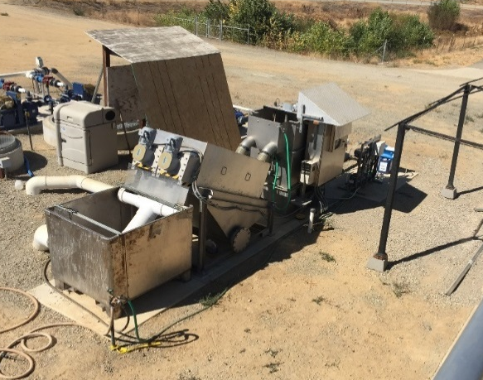

Q&A
Contact Info:
Onder Caliskaner, Ph.D., P.E.
(530) 219-0567
OnderCaliskaner@KennedyJenks.com

