Slide 1

Water and Energy Innovations to Achieve a Low-Carbon Future
Energy Research Innovations in Water Treatment, Delivery and Energy Recovery Workshop
Vice Chair Janea A. Scott
November 19, 2019
California Energy Commission
Notes:
Good morning. I am California Energy Commissioner Janea Scott. Welcome to our Water and Energy workshop.
Just a few years ago we were in a 5 year drought.
With a changing climate, we can expect to see more extreme weather with swings between rain and drought.
As a result, water and energy are high priority areas.
Today’s workshop will provide an opportunity to hear from some of our researchers and public agencies who are working on innovative projects.
We look forward to the conversation on how these projects are working, identify pathways to market and future research needs.

Slide 2

California’s Water System Is Energy Intensive
Water use accounts for about 20% of California’s electricity use and 30% of natural use by businesses and homes for supply, conveyance, treatment and heating of water.¹
Population growth and a changing climate increase pressure on water and energy supplies.
Need to continue adopting policies and innovative technologies to improve water and energy management, increase water supplies and reduce energy use and cost and GHG emissions.
¹ Public Policy Institute, A Water Sector Energy Hog, December 20, 2016, https://www.ppic.org/blog/a-water-sector-energy-hog/
Notes:
Water use accounts for about 20% of CA’s electricity use and 30% of the natural gas use.
This is used to supply, convey, treat and heat water.
The water system is under pressure due to population growth and changing climates.
This emphasizes the need to continue adopting polices and innovative technologies to improve our water and energy management, increase water supplies from non-traditional sources and reduce overall energy use and cost and greenhouse gas emissions.

Slide 3
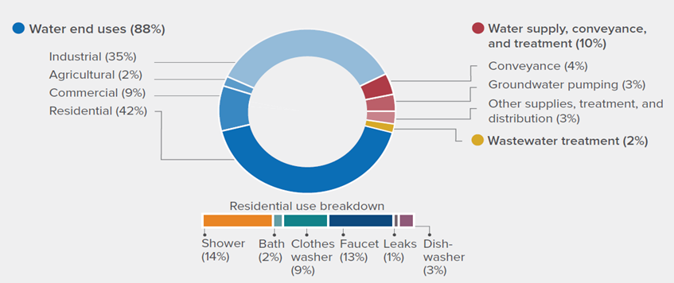
Energy Used by the Water Sector in California (175,950 GWh/year)
Source: GEI Consultants/Navigant Consulting for the California Public Utilities Commission, Embedded Energy in Water Studies, Study 1: Statewide and Regional Water Energy Relationship, Table 3-1, 2010; Public Policy Institute, A Water Sector Energy Hog, December 20, 2016
Notes:
This slide shows how much energy is used by the water sector. The right side focuses on water supply, conveyance and treatment, which uses about 12% of the energy used.
By far the largest are the end users with residential being the biggest energy user. The 175,000 GWh/year includes water-related electricity and natural gas.
Conveyance includes energy used in the California State Water Project, the Central Valley Project, the Colorado River Aqueduct and several regional water systems.
Ground water pumping is for urban and farm uses. Irrigation system management, such as pressurization, is an agricultural water end use.
Residential end uses include energy used in heating water and running appliances, but not the embedded energy for supplying or treating water.

Slide 4
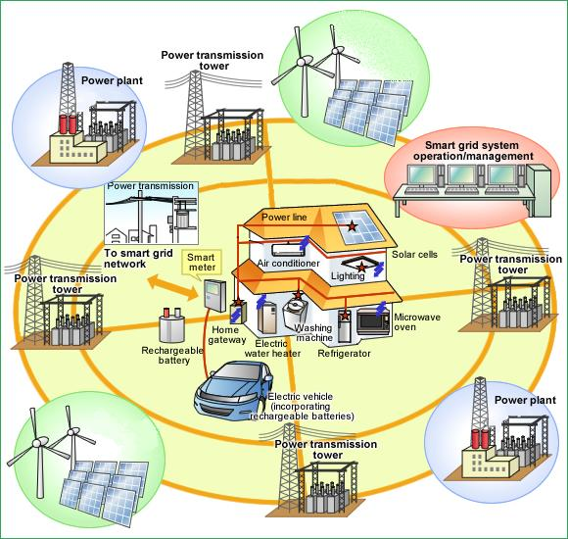
State Policy Drives Need for Innovation
  Increase electricity from renewables to 50% by 2025, 60% by 2030 & 100% by 2045
  Reduce GHG to 40% below 1990 level by 2030 and 80% below 1990 level by 2050
  1.3 GW of storage by 2020
  Double energy efficiency savings by 50%
  1.5 million ZEVs by 2025
  Increase access to clean energy in disadvantaged and low-income communities
Notes:
Our programs are driven by the state energy policy goals, such as the one listed here—increasing electricity from renewables, reducing greenhouse gas emissions, doubling of energy efficiency and increasing assess to clean energy for disadvantaged and low come communities.

Slide 5


Foster Innovation Across the Energy Sector
Strategically invest funds to catalyze change and accelerate achievement of state policy goals
Advance energy technology and facilitate customer learning
Notes:
The Energy Commission has a number of programs that strategically invest funds to catalyze change and accelerate achievement of state policy goals.
We have a number of programs that advance energy technology and facilitate customer learning.

Slide 6
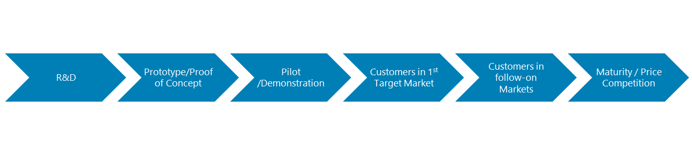
Innovation Ecosystem | Overview
Core Development Grants
Applied Research Grants
$53 M per year
Technology Demonstration & Deployment Grants
$50 M per year
Core Demonstration Grants
CalSEED
Concept award - $150,000
Prototype award - $450,000
BRIDGE
Awards follow-on funding for successful federal- or CEC-funded R&D projects.
RAMP
Accelerate time to reach MRL 8 at CA manufacturing facilities.
Targeted Intervention
Innovation Clusters
Identify 1st target market
Identify manufacturing and supply chain requirements
CalTestBed
Statewide network of open-access testbeds for startups
Procurement Assistance
Overcome technology “lock in” barriers in customer procurement practices
Notes:
Our program funds projects through the innovation pipeline from proof of concept, to pilot to demonstrations and help with facilitating introduction into the marketplace.
Our core grants are applied research (studies and prototypes) and demonstration (large scale deployment in actual commercial applications)
We also have grants for early stage research and market intervention programs to help entrepreneurs get over the valley of death.

Slide 7
CEC’s Energy Research Drives Technology & Strategic Innovation
Electric Program Investment Charge (EPIC) $133M/year
Energy Efficiency & Demand Response
  Water-energy related energy project research
Renewable Energy & Advanced Generation
Smart Grid, Storage, Distributed Energy Resources
Environmental
Electric Vehicle Grid Integration
Market Facilitation
  Natural Gas R&D
  $24M/year
  Energy Efficiency
  Renewable Energy & Adv. Gen.
  Pipeline Safety
  Environmental
  Natural Gas Transportation
All funded projects must result in benefits to investor owned utility ratepayers
All funds are competitively awarded
Notes:
Our core programs are EPIC and natural gas research.
This slide shows the different areas that we have or are currently funding.
Water energy related projects are funded under the energy efficiency activities.
All projects must benefit investor owned utility ratepayers.
All funds are competitively awarded

Slide 8
CEC Water Energy Research
Test and demonstrate innovative technologies that can reduce energy use or demand associated with the following:
  Water or wastewater treatment
  Recover waste or impaired water for on-site or municipal reuse
  Agriculture irrigation practices
  Water demand management
Notes:
Our water energy research focuses on testing and demonstrating innovative technologies and strategies that can reduce energy use or demand associated with:
Water/wastewater treatment
Recover wastewater for on-site or municipal reuse
Improve the efficiency or irrigation practices
Management of water and energy demand

Slide 9
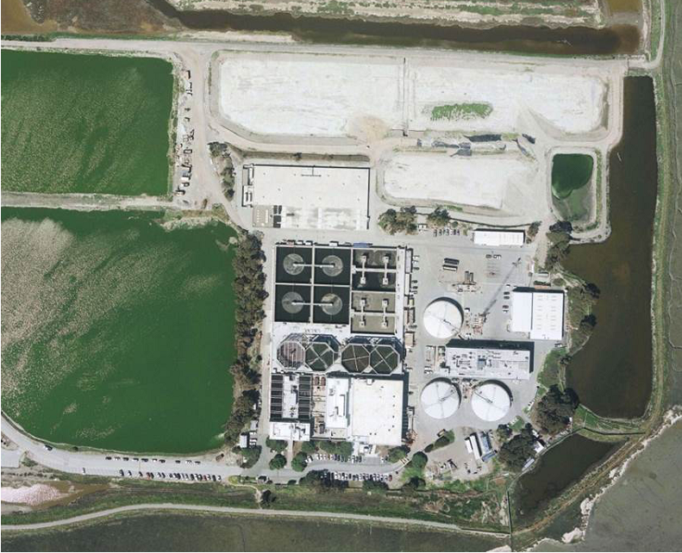
CEC Water Energy Research Project Preview
Funded 48 projects
  Water or wastewater treatment
  Water reuse
  Agriculture
  Demand management
  Tools and studies
Silicon Valley Clean Water Facility in Redwood City, CA
Notes:
Since 2003, we have funded 48 water-related research projects.
The picture on the right is the project at the Silicon Valley Clean Water Facility that is using a new anaerobic process to replace the energy intensive secondary treatment.
You’ll hear more about this project today.

Slide 10
Challenges to Implementing New Energy and Water Saving Technologies
Lack of customer awareness of innovative technologies and approaches
Uncertainty of energy savings, performance and other benefits
Risk averse
Capital, implementation and maintenance costs
Scheduling and timing of retrofits
Future need for expansion may limit what can be done
Regulatory approval needed to enable direct potable reuse
These topics will be discussed at our workshop today
Notes:
There are many challenges (note: they are listed on the slide) to implementing new energy and water saving technologies and our program seeks to address some of these challenges.
At today’s workshop you’ll hear from our researchers and water agencies discuss some of these areas and how they have overcome these challenges.

Slide 11
More Information
To learn more about CEC’s R&D projects- Energy Innovation Showcase:
innovation.energy.ca.gov
To sign up for future solicitations, Energy Commission Listserver and select “Opportunity”
  www.energy.ca.gov/listservers/
Information on the Energy Commission’s Research Programs
https://www.energy.ca.gov/programs-and-topics/topics/research-and-development
Staff contacts
  Kevin Mori, Kevin.Mori@energy.ca.gov (Industrial, Agriculture, and Water Program)
Notes:
There are many challenges (note: they are listed on the slide) to implementing new energy and water saving technologies and our program seeks to address some of these challenges.
At today’s workshop you’ll hear from our researchers and water agencies discuss some of these areas and how they have overcome these challenges.

Slide 12

EmpowerInnovation.net
Find a Partner on
EmpowerInnovation.net
Empower Innovation strives to accelerate your cleantech journey with easy access to funding opportunities from the Energy Commission and other funding providers, curated resources and events, and connections to people and organizations.
Empower Innovation strives to accelerate your cleantech journey with easy access to funding opportunities from the Energy Commission and other funding providers, curated resources and events, and connections to people and organizations.
FIND A PARTNER
Announce your interest in this funding opportunity and message other interested parties to find potential partners.
RESOURCES & TOOLS
Browse the collection of resources for cleantech innovators including Resource Libraries, Funding Sources, Tools, and Databases.
Notes:
There are many challenges (note: they are listed on the slide) to implementing new energy and water saving technologies and our program seeks to address some of these challenges.
At today’s workshop you’ll hear from our researchers and water agencies discuss some of these areas and how they have overcome these challenges.

