Slide 1
Title 24 2022 TDV Factors
Background and Updates
California Energy Commission
October 17, 2019
Snuller Price, Senior Partner
Michael Sontag, Senior Consultant
Brian Conlon, Consultant
Gabe Mantegna, Consultant

Slide 2
Agenda
Title 24 2022 Time-Dependent Value Development
  Background
  Policy Framework
    AB32, SB32, SB100
  Scenarios
Draft TDV Values
Draft Source Energy Metrics
Non-combustion emissions
  Refrigerant gases
  Methane

Slide 3
Time-Dependent Value (TDV) Background

Slide 4
What are TDVs?
The TDVs are a long-term forecast of hourly electricity, natural gas and propane costs to building owners and are used for cost-effectiveness activities in Title 24 Building Code
The TDVs answer the question of what is cost-effective in the long term, as required by the Warren-Alquist Act
Sample Annual Average Electric TDV, 2022, CZ12
Time-differentiation reflects the underlying marginal cost of producing and delivering energy
Area-correlation reflects underlying marginal cost shapes correlated with each climate zones weather file
Similar for natural gas and propane

Slide 5
What are TDVs used for?
Two main uses for TDVs
  Cost-effectiveness analysis in the CASE studies (Codes And Standards Enhancement studies) used to adopt new building measures in the prescriptive standard
  Code compliance for buildings that wish to vary from the prescriptive standard using the ACM (alternative calculation methodology). TDVs are embedded in California Building Energy Code Compliance software (CBECC)

Slide 6
Frequently Asked Questions (1)
Why do we use statewide average electricity and natural gas retail rate levels?
  With this approach, the code has similar overall stringency statewide and there can be similar construction practices across the state. Note that there are still variations for climate.
Why don’t we use the actual retail rate structures that are in place?
  We want the building code to be relatively stable over time and from cycle to cycle, the TDVs reflect a ‘perfect’ marginal cost of service which is a long-term signal for retail rates
  By using the underlying system marginal costs we are reflecting building measures that provide the greatest underlying value to the energy system, even if retail rates are flat or have a different time of use period

Slide 7
Frequently Asked Questions (2)
Why are the units of TDV in kBtu/kWh and kBtu/therm if they measure cost-effectiveness?
  The TDVs are calculated in lifecycle dollars per unit of energy ($/kWh, $/therm) in each hour and climate zone in California
  For the building code compliance, they are converted to different units of kBtu/kWh and kBtu/therm using fixed multipliers

Slide 8
Frequently Asked Questions (3)
What are the source energy factors used for?
  Beginning in the 2022 Title 24 code cycle, the CEC is considering adding an additional metric to measure source energy. The source energy metric would be used to set a maximum source energy consumption in the building. This is complimentary to the measurement of cost-effectiveness.
Why include non-combustion emissions?
  Beginning in the 2022 Title 24 code cycle, the CEC is considering adding the effect of high Global Warming Potential (GWP) gasses including refrigerants and methane leakage. With the interest in heat pumps, this allows greater compliance to be placed on low-GWP options and potentially better leak-prevention and disposal.

Slide 9
TDV Policy Assumptions

Slide 10

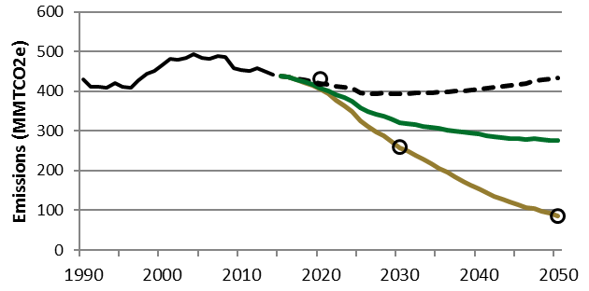
California’s Deep Decarbonized Future
By 2020: return GHGs to 1990 levels (AB 32, 2006)
By 2030: 40% below 1990 levels (SB 32, 2015)
By 2050: 80% below 1990 levels (EO B-30-15 and EO S-3-05)
By 2045: Carbon neutrality (EO B-55-18) not included
California Historical GHG Emissions and GHG Scenarios
Reference
SB 350 Scenario
2030 goal: 40% below 1990
Mitigation Scenarios
2050 goal: 80% below 1990

Slide 11









4 Pillars of Energy Decarbonization
New Buildings will exist in the future energy system which is fundamentally changing
  Demand-side; efficiency, electrification of buildings and vehicles, storage
  Supply-side; renewable and decarbonized generation, biofuels
Energy Demands
Energy Supply
Appliance EE Building shells Urban infill / transport mode-shift | Heat pumps ZEV cars and trucks Industry & off-road vehicles | Renewables & integration Nuclear, fossil with CCS | Biofuels Electrolytic fuels (H₂ and P2X) CCS
Energy efficiency & conservation
Low carbon electricity
Electrification
Low carbon fuels

Slide 12
Major Policy Targets
Major policy included in Title 24
  California electricity sector targets set by SB100 to achieve 60% RPS by 2030, and 100% decarbonized by 2045
  California emissions reductions goals AB32 (1990 levels by 2020), SB32 (40% below 1990 levels by 2030), 80 x 50 (80% below 1990 levels by 2050)
    We have not included Gov. Browns Executive Order for statewide carbon neutrality by 2045
Key Input Assumptions to reflect the policy landscape
  Assumes a statewide economy that meets 2030, 2050 emissions reduction goals
  Included impacts on the grid
    Significant change in generation resource portfolio to decarbonize electricity generation
    Increase in loads due to significant transportation electrification, some building electrification
  Updated cost of emissions abatement in the electricity system
  Introducing biofuel into natural gas pipeline, and reduced pipeline throughput

Slide 13
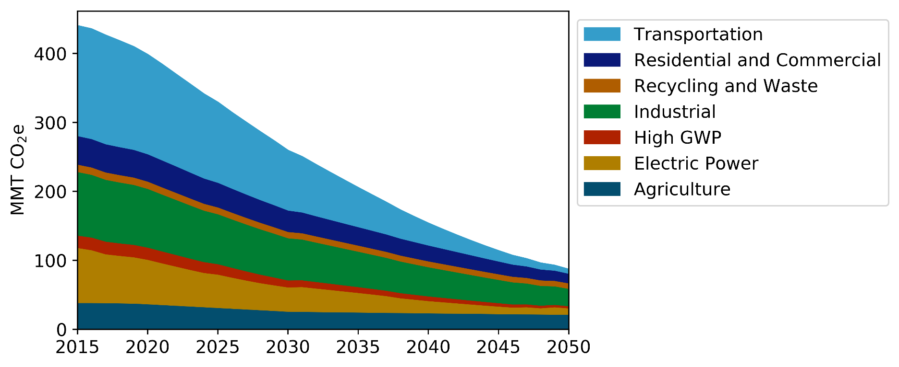
Sector Emissions Projections in Policy Compliant Scenario
Emissions decline in all sectors to reach 80 x 50 target
CA GHG Emissions in Slower Building Electrification Scenario

Slide 14
Building Decarbonization Assumptions
In addition to building electrification, gas efficiency and renewable natural gas are utilized to reduce GHGs from buildings.
  Only very high efficiency natural gas appliances are installed by 2025.
  Renewable Natural Gas is blended in the pipeline, with 10% biomethane blended by 2030 and 19% by 2050, with 7% renewable hydrogen blend by 2050.
From CEC Pathways study, we decided to use the ‘Slower Building Electrification” Scenario which has a mix of electrification and biofuel
  2018 CEC PATHWAYS Study Available HERE. Publication forthcoming of chosen scenario forthcoming in Future of Natural Gas PIER Research.
Comparison to Energy Futures Initiative Study (2019)
  EFI (2019) assessed strategies to meet the 2030 goal with 40% reductions in all sectors, so not directly comparable to a combined 40% reduction by 2030.
  EFI study achieved 40% in buildings with greater assumed gas energy efficiency, greater rates of electrification including all new all-electric construction by 2020, and similar utilization of RNG to the CEC PATHWAYS scenario.
2018 CEC Deep Decarbonization in a High Renewables Future: Updated Results from the California PATHWAYS Model
https://ww2.energy.ca.gov/2018publications/CEC-500-2018-012/CEC-500-2018-012.pdf for

Slide 15
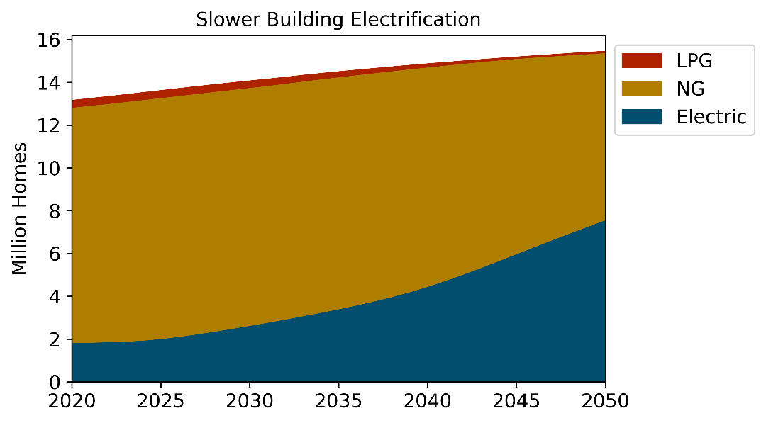
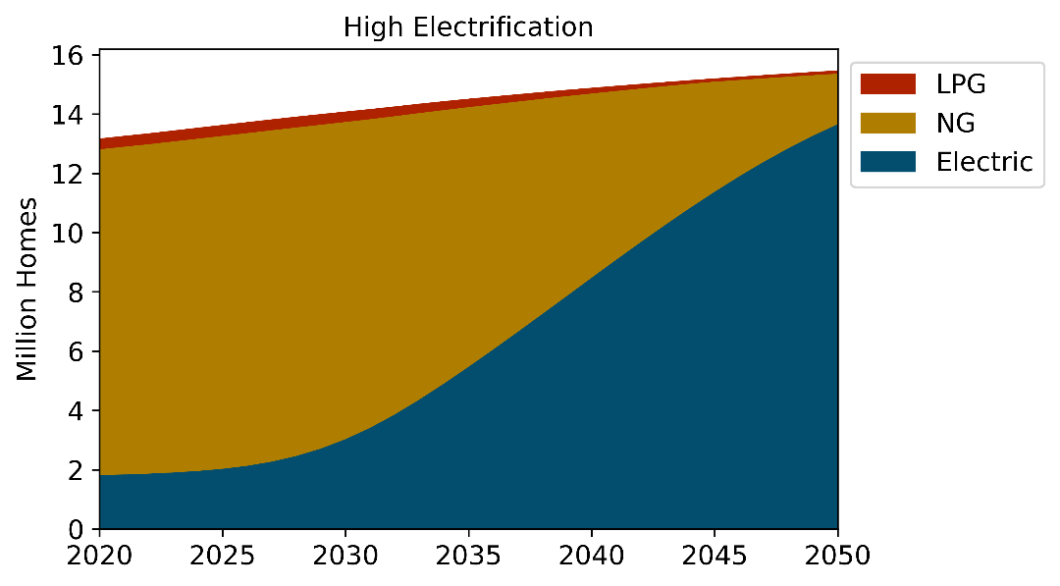
Residential Space Heating Stock (E.g.)
“Slower Building Electrification” scenario reflects a mid-range level of building electrification among scenarios that meet the economywide GHG reduction goals (40% below 1990 levels by 2030 and 80% by 2050).
  About 18% of homes are electrified by 2030 and 49% by 2050.
  Assumes a rollover rate of ~75% for existing buildings
Selected Scenario

Slide 16
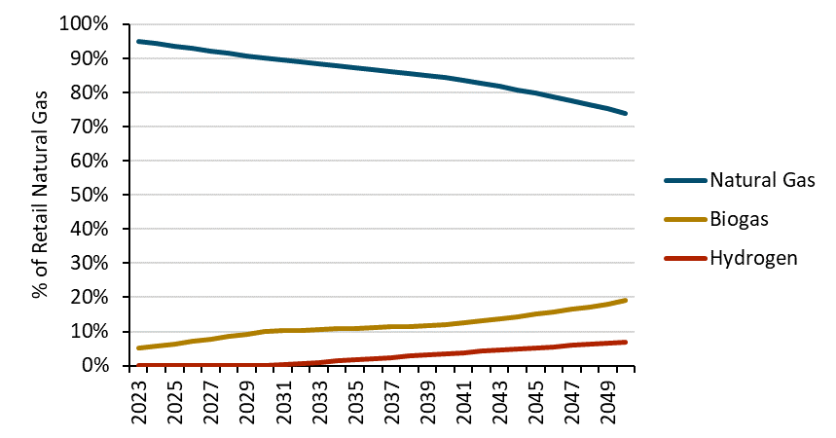
Natural Gas TDV Scenario Analysis
Natural Gas Retail Rates for each Scenario
Policy Compliant
  Uses retail rate forecasts from 2019 CEC Future of Natural Gas study – Multi-Prong with Slower Building Electrification scenario
  Includes CPUC-approved rate increase, has some assumed reduced throughput due to building electrification (conservative compared to other scenarios), has biofuel and H2 costs
  Source energy is lower due to renewable fuel
Mid-IEPR
  Uses 2019 Preliminary IEPR Mid-Demand retail rate forecasts
  Does not include recent CPUC approved retail rate increases over the next 3 years
  Forecast is for 8 years, and then trended to 2050
Source Energy – Share of Fossil Natural Gas

Slide 17
TDV Development

Slide 18
Modeling Framework
New CEC Weather Files
PATHWAYS
RESOLVE
PLEXOS
TDV Spreadsheet
Set major policy and investment requirements necessary to reach Economy-wide GHG targets
Identify optimal statewide electricity resource portfolio to achieve electricity sector goals (SB100)
Simulate detailed electricity-sector operations given new loads including EV and electric buildings, and weather
Combine all outputs to generate 8760 TDV values and source energy metric

Slide 19
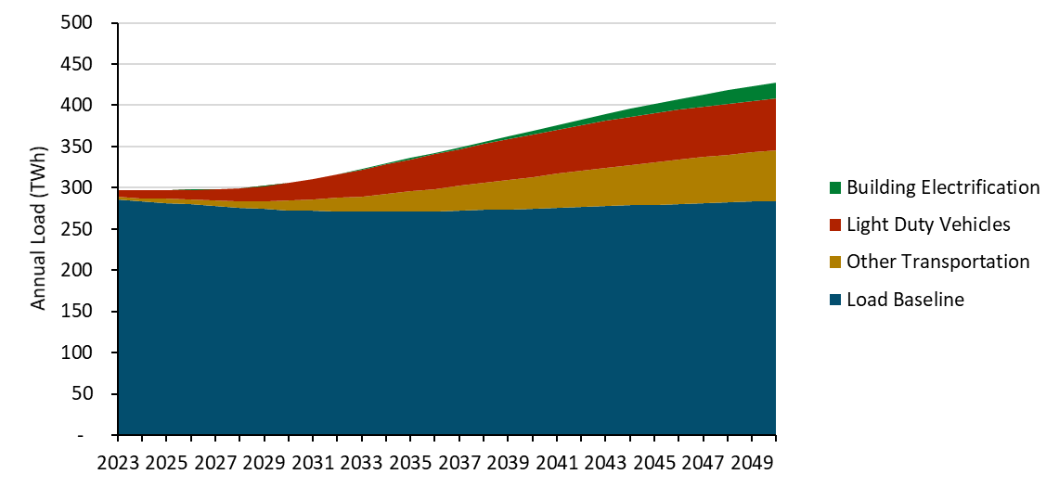
Annual Load Forecast
Annual load forecast taken from this scenario to determine an optimal system plan to meet the new load
  Baseline load decreases over time with energy efficiency, despite population increases projected for California
  New load added from transportation, building electrification

Slide 20
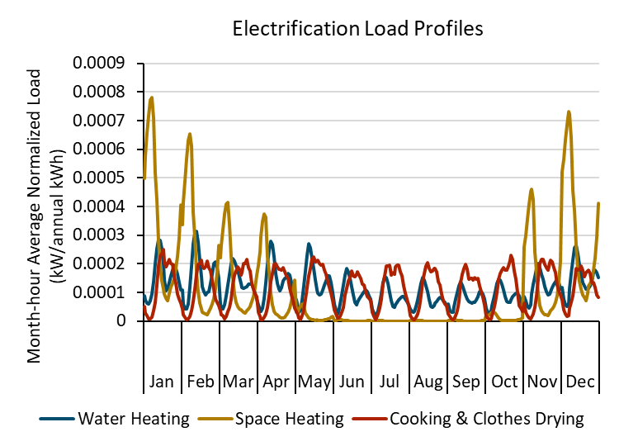
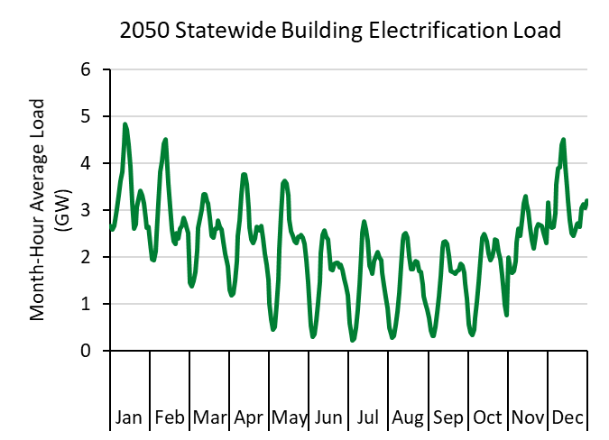
Building Electrification Load Profile
Hourly building electrification load shapes developed using parametric building simulations across 16 climate zones in new CTZ year
Scaled up by end-use, by PATHWAYS scenario annual forecasted load

Slide 21
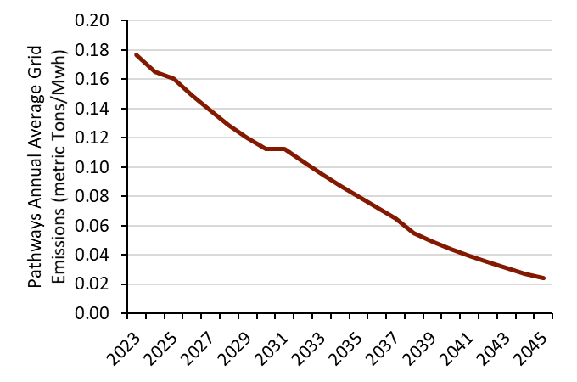
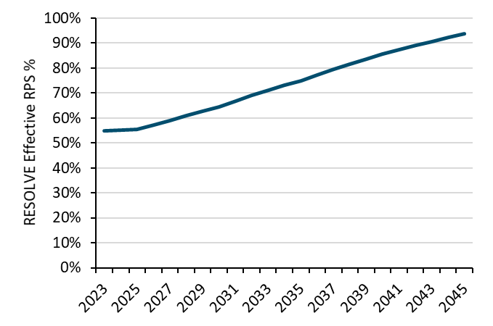
RESOLVE Resource Plan
RESOLVE is a resource procurement model that determines the optimal electricity generation plan to meet statewide energy procurement targets
GHG emissions target comes from PATHWAYS, consistent with statewide emissions scenario
RESOLVE procures renewable resources to serve all electricity load while meeting the GHG constraint. As an effect of this constraint, the RPS% exceeds near-term current state targets

Slide 22
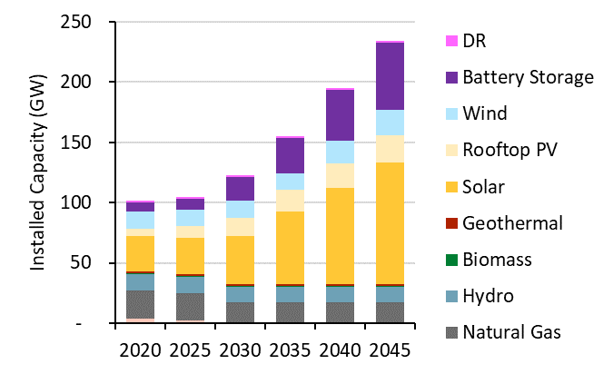
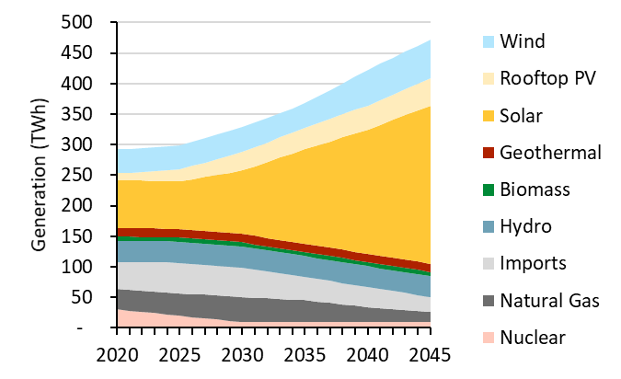
RESOLVE Resource Portfolio
To meet SB100 goals in 2045, as well as emissions targets, RESOLVE builds significant amounts of renewable resources and storage
This analysis is based on the publicly available 2018 CEC statewide RESOLVE model, with updated cost information

Slide 23
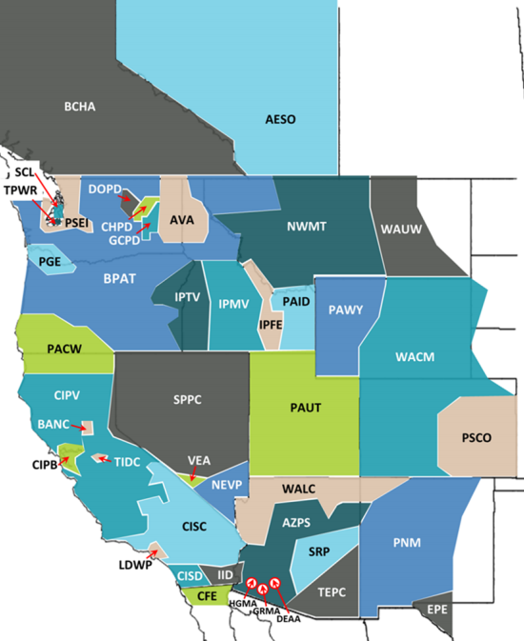
Avoided Energy Costs
New production simulation run in PLEXOS model
Model footprint is entire Western Interconnection to reflect the impacts of interzonal trade, transmission, and generation on California energy prices
CEC and E3 updated inputs to IEPR PLEXOS model
  Changes in annual load due to efficiency, transportation electrification, building electrification
  Changes in hourly load due to new weather year
  Changes in supply side generation mix to meet SB100
  Update renewable generation shapes to match new weather year
wecc.org

Slide 24
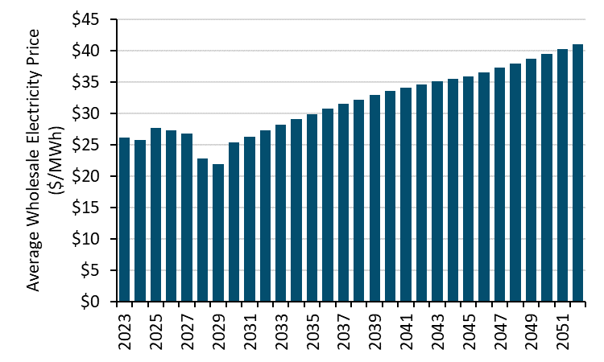
Wholesale Electricity Price Forecast
Marginal energy price shape generated from PLEXOS production simulation modeling at CEC
SB100-compliant portfolio calculated with RESOLVE model
Ran PLEXOS for 2023-2030 and 2045, interpolating prices for complete 2023-2052 scope
2023
2030
2045

Slide 25
PLEXOS Energy Price Shape Example:
SCE 2030

Slide 26
Energy Price Shape Comparison
Higher buildout of solar in PLEXOS drives down midday prices
Abundant near-zero variable cost resources – solar, wind, and storage – contribute to lower prices overall – particularly with Spring’s low loads, high solar, and hydro runoff
Storage discharge reduces peak prices in morning and evening “shoulder hours”

Slide 27
Generation Capacity
System Net Peak expected to transition as renewable penetration increases
  2023 – summer evenings
  2033 – mornings after batteries dispatch
  2045 – winter periods of low renewable energy availability
With significant solar and storage, early morning before sun rises will be capacity defining event
2023
2033
2045

Slide 28
T&D Capacity
CZ12
New weather year used in for T&D Allocator model, along with regional rooftop PV penetration forecasts
Peaks generally remain in historical patterns
T&D avoided costs are calculated using weighted average from the latest utility GRCs, consistent with 2019 CPUC Avoided Cost Calculator
  Transmission: $24.47/kW-yr
  Distribution: $102.54/kW-yr
2023
2033
2045

Slide 29
Emissions Accounting for Electricity
Three emissions cost streams for electricity
  Cap and Trade Emissions: Direct plant emissions from directly serving load
  GHG Adder: Additional cost of procuring the necessary supply-side resources to achieve the electricity-sector long run emissions intensity target. Replaces previous ‘RPS Adder’ field
  Emissions Abatement: Economy-wide cost of abating remaining emissions after supply-side actions have been taken
‘GHG Adder’ calculates cost of incremental renewables
Direct emissions increases subject to Cap and Trade market
Re-optimized RPS portfolio reduces emissions to hit SB100 goals
Biofuels to reduce GHG content of pipeline gas
2
or
Electric Emissions (tonnes)
Remaining emissions put pressure on the 80 x 50 GHG cap and therefore drive costs to meet statewide goal
1
Adding load from new buildings increases emissions
Net long-run GHG emissions
3

Slide 30
Emissions Accounting for Natural Gas
Two emissions cost streams for natural gas
  Cap and Trade Emissions: Direct emissions from non-renewable gas delivered (net of RNG)
  Additional cost of procuring renewable natural gas included in the commodity price.
  Emissions Abatement: Economy-wide cost of abating remaining emissions after supply-side actions have been taken
Direct emissions increases subject to Cap and Trade market
Biofuels to reduce GHG content of pipeline gas
Remaining emissions put pressure on the 80 x 50 GHG cap and therefore drive costs to meet statewide goal
Natural Gas Emissions (tonnes)
Adding demand from new buildings increases emissions
1
Net long-run GHG emissions
2

Slide 31
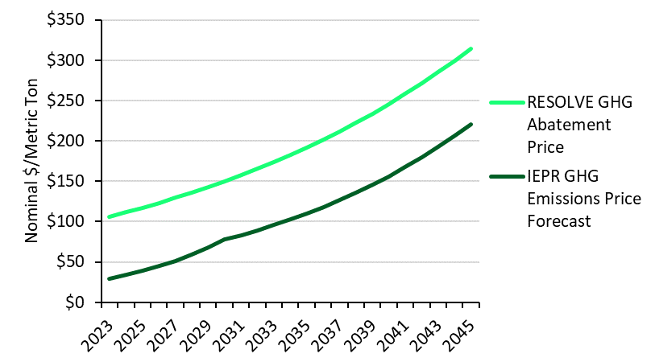
GHG Emissions Accounting
Cap and Trade Emissions: Cost from IEPR GHG Allowance Price forecast; direct cost of emissions from combusting natural gas, factored into retail rates
Emissions Abatement: Assumed that in a SB32-compliant future, cheapest economy-wide incremental emissions reduction is from electricity supply side, so RESOLVE GHG Abatement price is used. Represents cost of meeting state economy-wide emissions target
Used for Electricity GHG Reduction
and
Used for Economy-side Abatement
Used for GHG Allowance Price

Slide 32
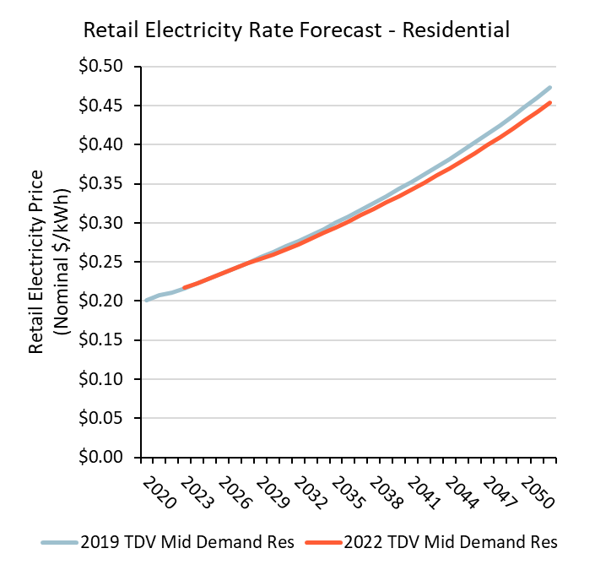
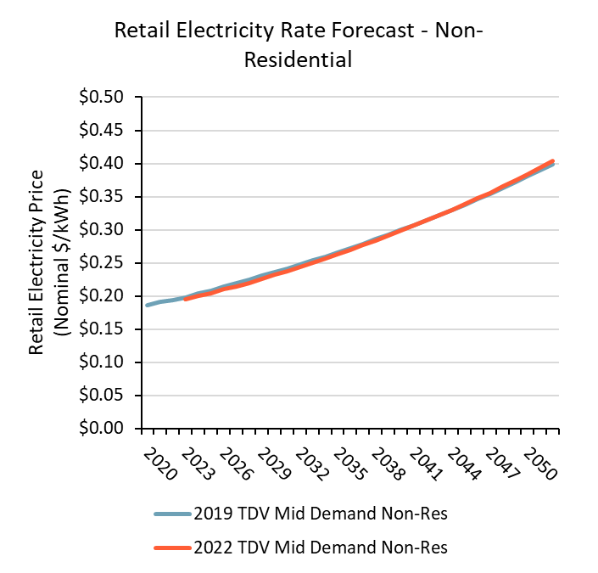
Electricity Retail Rate Adjustment
Little change in electricity retail rate forecasts from 2019 TDV
  2019 TDV used Mid Demand case from 2015 IEPR
  2022 TDV uses Mid Demand case from 2019 IEPR

Slide 33
Title 24 2022 TDV Results

Slide 34
Updated Inputs to Electricity TDV
Updates for 2022 TDVs
Resource balance year, marginal capacity resource
T&D costs, CTZ weather, distributed PV % and profile
Sample Electric 2022 TDV – Residential CZ12
Carbon price forecast, economy-wide abatement costs to hit 80x50
GHG-based procurement of integrated renewables to reduce electricity GHGs
Carbon allowance price forecast
Ancillary services costs
Same loss %’s → new value
PLEXOS simulation with SB100 resource portfolio, loads with CTZ weather and electrification
Electric retail rate forecast

Slide 35
Electricity TDV Changes from Last Cycle
Increase in renewable generation, decrease in natural gas commodity cost drive down wholesale energy costs
  Decrease in volumetric costs is supplemented with fixed costs through retail rate adder
Decrease in TDV in middle of day
2022 TDV Categories
2019 TDVs
2022 TDVs
*
*
*
Former Categories in 2019 TDVs
*Category new to 2022 TDVs

Slide 36
Comparisons between TDVs
CZ 12 Res
Different CZs have different shapes
CZ 7 Res
2019 TDV
2019 TDV
Res and Non-Res have same shape but different retail adjustment factors
CZ 12 Non-Res
CZ 12 Res
2019 TDV
2019 TDV

Slide 37
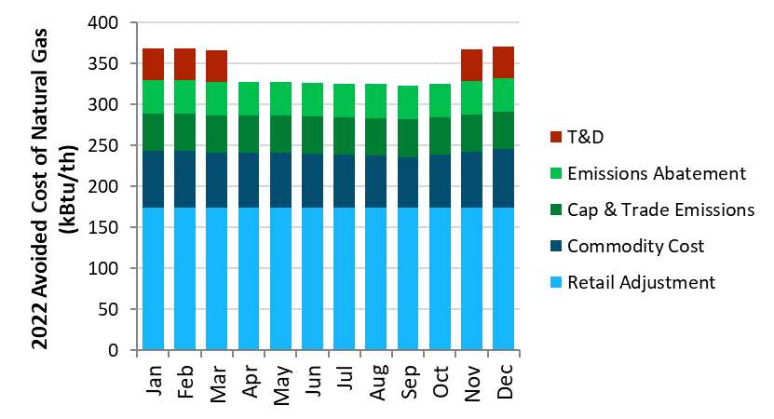
Updated inputs to Natural Gas TDV - Policy
Policy Compliant
Natural Gas 2022 TDV - Res
Residual Emissions Abatement
Updated CO2 allowance price forecast
Updated natural gas commodity price forecast including biofuels
Updated natural gas retail rate forecast

Slide 38
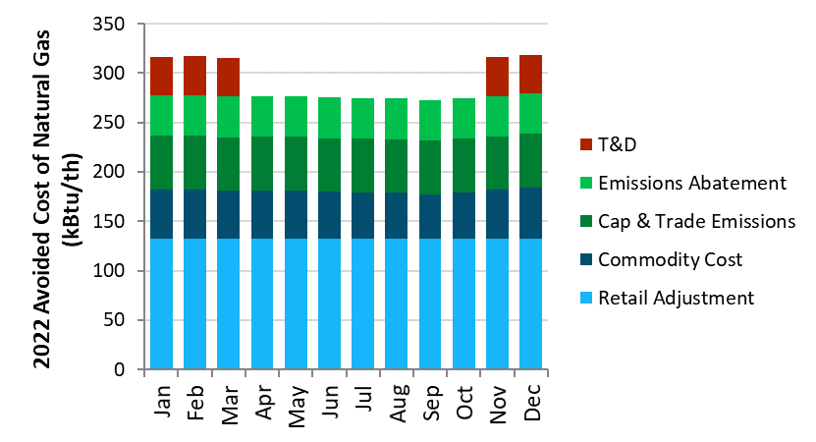
Updated inputs to Natural Gas TDV – Mid-IEPR
Mid-IEPR
Natural Gas 2022 TDV - Res
Added Emissions Abatement
Updated CO2 price forecast
Updated natural gas commodity price forecast
Updated natural gas retail rate forecast

Slide 39
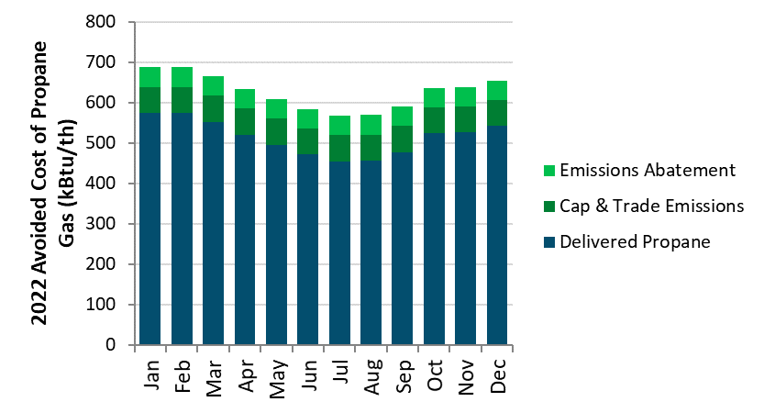
Updated inputs to Propane TDV
Propane 2022 TDV
Added Emissions Abatement
Updated CO2 price forecast
Updated propane retail rate forecast (2019 EIA AEO)

Slide 40
Natural Gas and Propane TDVs Comparison
Natural Gas TDV
30-year NPV Residential, CZ12
Propane Gas TDV
30-year NPV Residential, CZ12
2019 TDVs
2016 TDVs
2019 TDVs
2016 TDVs

Slide 41
Source Energy Metric

Slide 42
Source Energy Metric
Secondary evaluation metric to encourage efficient consumption of input fuels, by calculating the total input fuels for a unit of end-use consumption
Defined as Btu of depletable fuels, averaged over the lifetime of a building or measure
  Renewable energy (ex: wind, solar) and renewable fuels (ex. biogas, hydrogen) are defined as having zero marginal source energy in this definition
As natural gas is the only thermal generation that could be on the margin, the source energy metric correlates with emissions
For electricity end-uses, long run marginal source energy is used
  Factors in supply-side interventions that will occur as a result of incremental load
    Ex. given a 50% RPS, if 1,000 MWh of new annual load is added, a corresponding 500 MWh of new renewable energy must be procured and delivered
    The new renewables will offset some of the initial increase in generation

Slide 43
Formulation - Electricity Source Energy
Implied short run marginal source energy calculated based on hourly wholesale energy price forecast (from PLEXOS)
Avoided source energy from incremental renewable generation is calculated based on hourly profile of new renewable portfolio and short run source energy
Short Run Source Energy
Hourly
Renewable Avoided Energy
Renewable Gen Profile
Short Run Source Energy

Slide 44
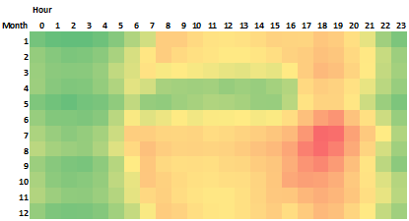
Formulation – Electricity Source Energy (2)
Renewable avoided source energy is generalized to an annual number (renewables integration does need to occur in same hour as new load)
Avoided source energy from incremental renewable is calculated based on hourly generation of incremental renewables and short run source energy
∑
Hourly
Renewable Avoided Energy
Time Independent
Renewable Avoided Energy
Time Independent
Renewable Avoided Energy
Short Run Source Energy
Long Run Source Energy

Slide 45
8760 Long-run Source Energy Factors
Based on achieving an RPS Portfolio over time consistent with SB100
Average of month and hour, Btu/kWh

Slide 46
Natural Gas and Propane Source Energy
Propane source energy is simple unit conversion (100 kBtu/th)
In retail natural gas – blended biogas and hydrogen are counted as 0 Btu/th
  Blended RNG assumption results in lifetime source energy of 86-88 kBtu/th
  Includes compression losses + LUAF

Slide 47
Source Energy Comparison
All electric end uses, especially heat pumps, have lower source energy than analogous natural gas end uses in mixed fuel home

Slide 48
Non-Combustion Emissions

Slide 49
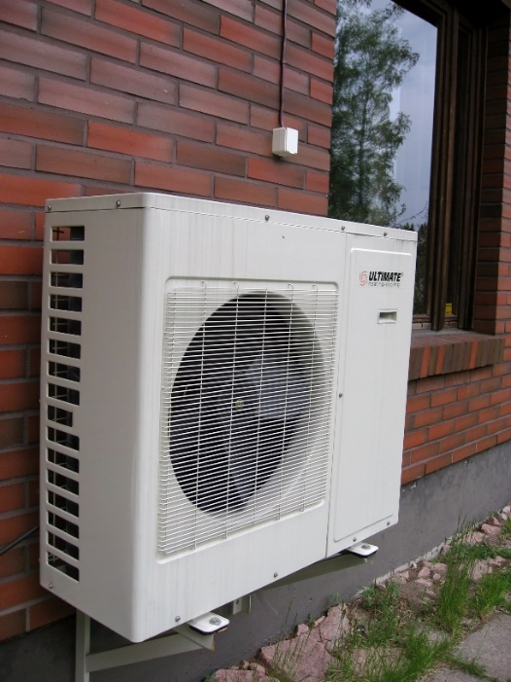
Background on including High GWP emissions
All heat pumps have refrigerants, and nearly all refrigerants in use today are very potent greenhouse gases– up to ~2000x stronger than CO2
  This comparison to CO2 is known as the Global Warming Potential (GWP)
These refrigerants only contribute to global warming when they leak, but leakage is inevitable, and can account for a significant portion of lifecycle emissions from an all-electric building
  Air conditioners use refrigerants too, so mixed-fuel buildings have leakage as well
Including these emissions in the TDV framework will allow us to compare the true lifecycle emissions between all-electric and mixed-fuel buildings, and more importantly, incentivize the use of lower-GWP refrigerants
  Lower-GWP refrigerants are available, but are not widely used in the US, and often require different installation practices as they can be mildly flammable

Slide 50
Background on including High GWP emissions
On the natural gas side, it is also important to account for the potential for avoided methane leakage through building choices
  It is well-known that the natural gas system has leaks, particularly during the production and storage stages
Methane has a 100-year GWP of 25, so leaking methane causes significantly more global warming than burning it
The difficult question is: how much methane leakage could we avoid through electrification?

Slide 51
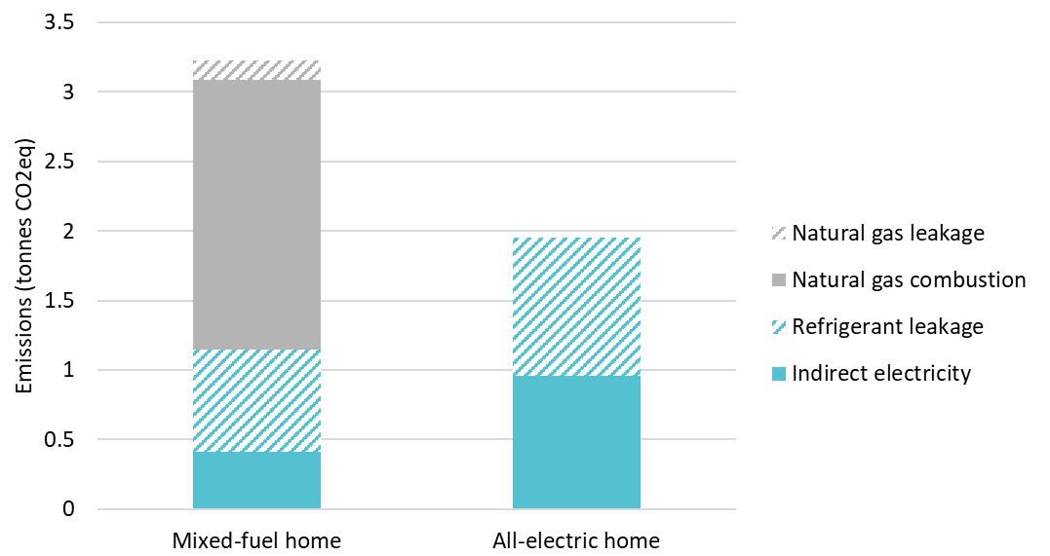
Proposed Mechanism for Non-Combustion Emissions Accounting
Establish for the baseline building types the CO2e for both of the non-combustion emission sources in consideration; refrigerants and methane
In CBECC-Res and CBECC-Com:
  Compute the CO2e of lifecycle refrigerant and methane emissions
  Multiply by the GHG Abatement factor for TDV
  Add to the TDV score based on electricity, natural gas, and propane energy use
Reduction from the baseline non-combustion emissions would then count as a TDV trade-off so that lower non-combustion emissions would be considered in building design tradeoffs
Refrigerant leakage is a significant portion of the GHG emissions from an all-electric home
Example:
Refrigerant leakage
Grid CO2 emissions

Slide 52
Refrigerant leakage
The California Air Resources Board has compiled data on average leakage rates for appliances that use refrigerants
  Leakage happens both during operation and at end-of-life
This allows us to calculate lifecycle refrigerant leakage emissions for any building
  These numbers are of course average, as some buildings will leak more than others
Appliance | Typical refrigerant | Refrigerant GWP | Average refrigerant charge | Average annual leakage | Average end-of-life leakage
Central A/C | R410A | 2088 | 7.5 lbs | 5% | 80%
Air-source ducted heat pump | R410A | 2088 | 8.2 lbs | 5.3% | 80%
Heat pump water heater | R134A | 1430 | 2.4 lbs | 1% | 95%
Heat pump clothes dryer | R134A | 1430 | 0.88 lbs | 1% | 100%
End-of-life leakage
Annual leakage
12-year life
Annualized leakage = (Annual leakage rate) + (End-of-life leakage)/lifetime

Slide 53
Lower-GWP refrigerants
Lower-GWP refrigerants are available, but not yet commonly used in the US
The most promising near-term low-GWP refrigerant for use in residential HVAC heat pumps is lower-GWP HFCs, such as HFC-32
  These refrigerants are generally mildly flammable, so different installation practices are required.
  Fire Code and Mechanical Code currently don’t allow mildly flammable HFCs
For other, smaller heat pumps such as water heaters, the most promising option is HFOs, which are similar to HFCs but have a very low GWP
Another option being used in some places, such as Europe and India, is hydrocarbons such as propane– but flammability is an obvious issue
CO2 can be used as a refrigerant, but requires much higher system pressures, so is currently only viable for smaller systems such as automobiles and heat pump water heaters
Low-GWP refrigerant alternatives
Refrigerant | GWP | Appropriate for…
HFC-32 | 675 | HVAC Heat Pumps
HFO-1234yf | 4 | All heat pumps except HVAC
R-290 | 3 | All
R-744 (CO2) | 1 | All heat pumps except HVAC

Slide 54



Methane leakage
Key question: how much do changes in building natural gas consumption change methane leakage?
Sources of leaks in the natural gas system
Production
(90% outside of California)
Behind-the-meter
Distribution
Transmission & Storage

Slide 55
Estimating methane leakage
We looked at a broad range of studies on methane leakage
None of them answer exactly our question: how much leakage could be avoided by electrifying an appliance or home in California?
Source | Description | Leakage rate
CARB Inventory- behind-the-meter only | Includes both new and existing homes | 0.5%
CARB Inventory | All leakage sources in CA | 0.7%
LA Basin Study (He, 2019) | LA Basin only; attempts to quantify correlation with consumption | 1.4%
Alvarez (2018) | US-wide estimate including production emissions. Not all of this leakage will be marginal. | 2.3%

Slide 56
Sample calculation of emissions using leakage rates
We examined sample CBECC results for a single-family home in CZ12 (Sacramento), to compare the emissions from all-electric and mixed-fuel homes when leakage emissions are included
Air conditioners in mixed fuel homes also have refrigerant leakage
Overall, the all-electric home in this example emits about 40% less GHGs, once leakage emissions are accounted for.
Natural gas leakage
Natural gas combustion
Refrigerant leakage
Grid CO2 emissions

Slide 57
Key takeaways
All-electric homes emit significantly less GHGs, even when refrigerant and methane leakage is accounted for
Low-GWP refrigerants have a significant potential to reduce lifecycle emissions, and therefore could be significantly incentivized through TDV
We will further investigate the potential for electrification to reduce leakage in new homes; the CARB leakage rate of 0.7% is our starting point
Natural gas leakage
Natural gas combustion
Refrigerant leakage
Grid CO2 emissions

Slide 58
Appendix

Slide 59
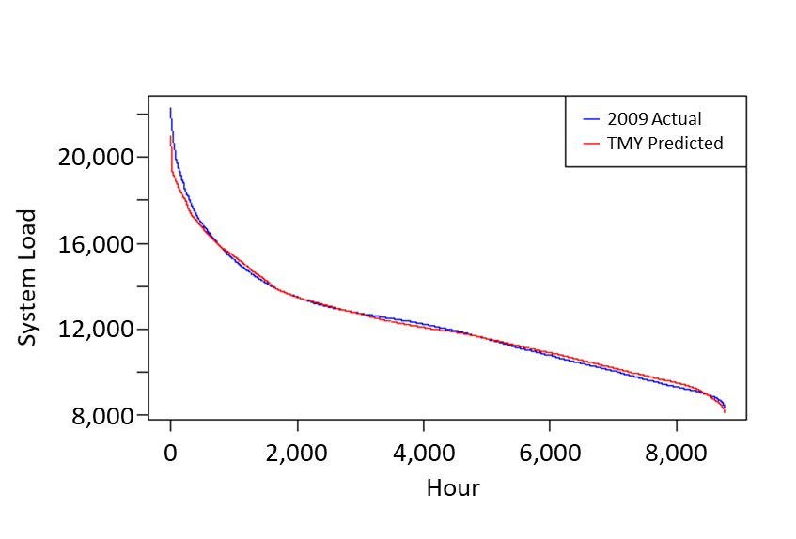
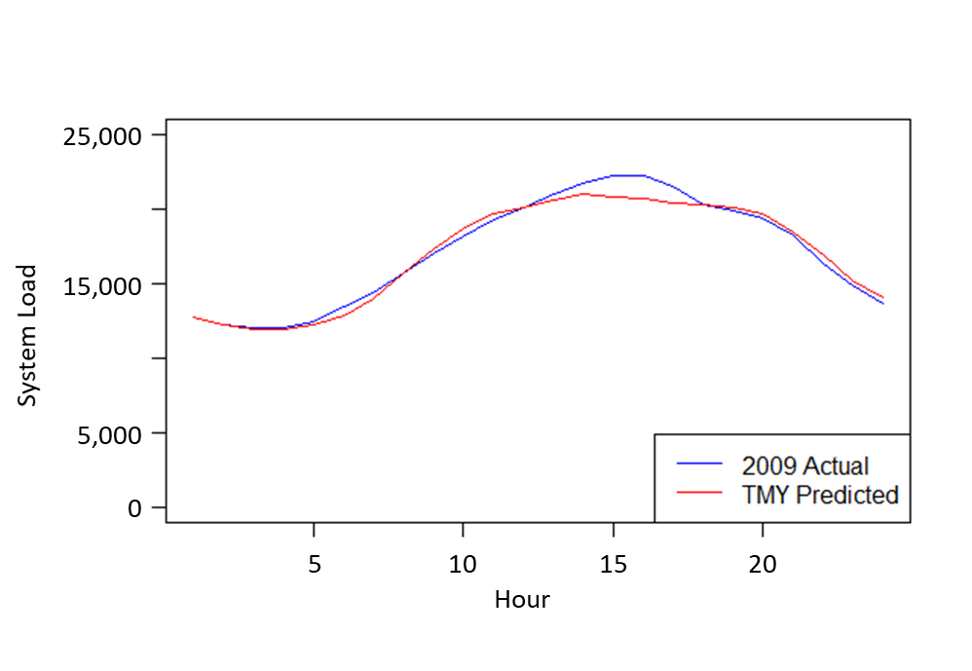
Baseline Load Weather Matching Algorithm
Weather/load prediction algorithm updated from previous code cycles
Regression model for each balancing authority is trained using historical weather data and load data
New weather year characteristics are used to predict hourly load for each balancing authority
Load profiles are normalized and scaled up by annual baseline load

Slide 60
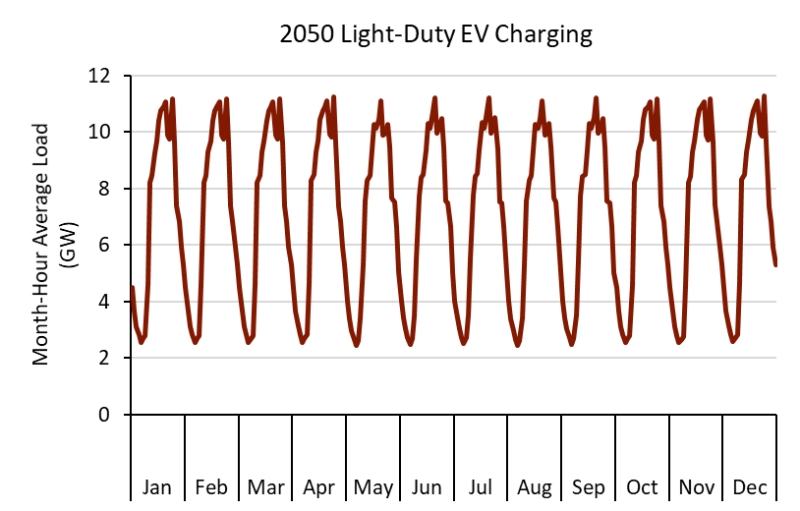
Electric Vehicle Charging Load Profile
Load shape generated by E3 EV Load Shaping Tool, scaled up to PATHWAYS annual average loads
Assumes distribution of EV types (BEV, PHEV, etc), and models driving behavior with historical trip data from the National Household Travel Survey (NHTS)

Slide 61
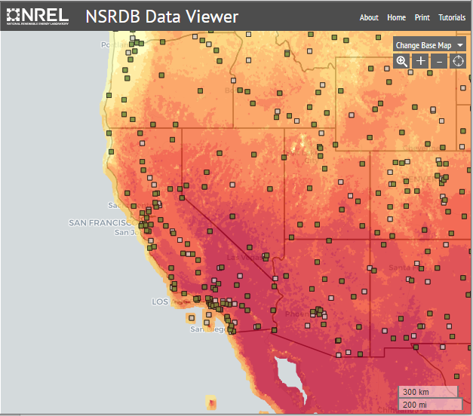
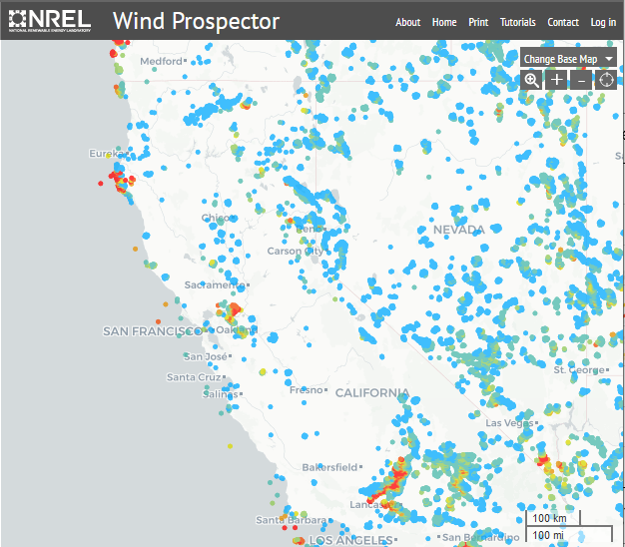
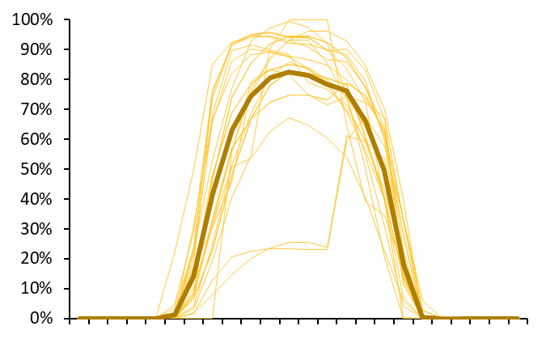
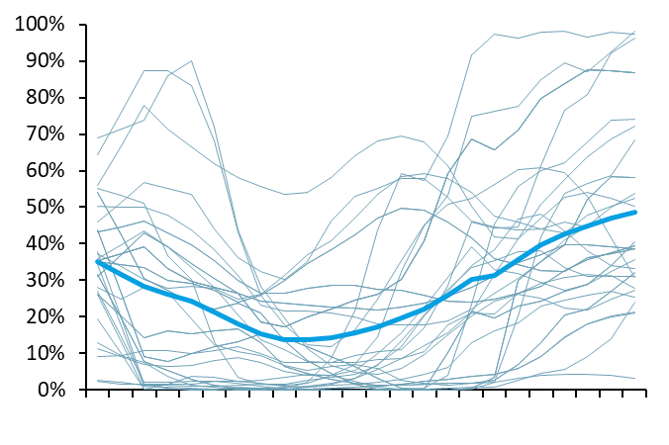
Weather-Matched Renewable Generation
Sampling of site-specific historical NREL data used to calculate generation profiles for candidate renewable resources in the CTZ weather year for production simulation model

Slide 62
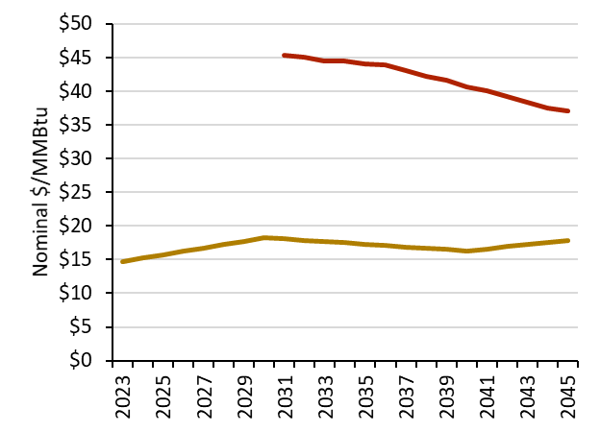
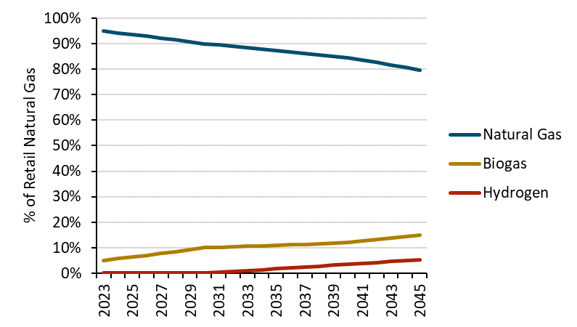
Policy Compliant RNG Costs
To decarbonize retail natural gas, biogas and hydrogen are blended in
  10% biogas by 2030
  7% hydrogen by 2045 (assumed off-grid renewable generation for hydrogen)
The renewable natural gas blend is reflected in both commodity cost and emissions

Slide 63
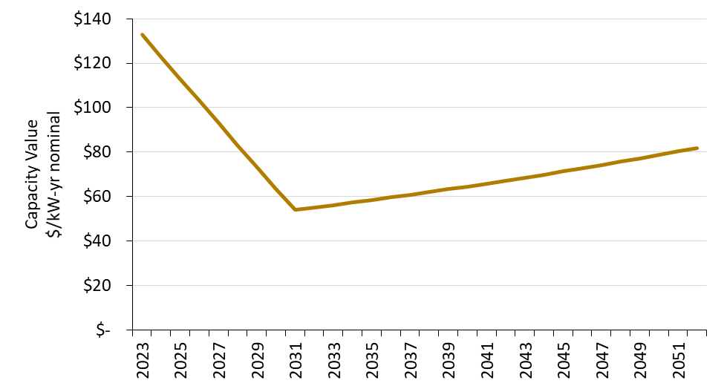
Generation Capacity (2)
Marginal capacity price tracks with transition system net peak
  2023 resource balance year, based on new CT
  2030 based on RESOLVE capacity shadow price
  Beyond 2030 transitions to the cost to keep CCGTs operating to meet winter energy constraints
Near-term Resource Adequacy need
Fixed O&M for CCGT
RESOLVE Capacity Shadow Price

Slide 64
Ancillary Services, Losses
Ancillary Services
  Continue to use 0.5% of energy
Losses
  Continue to use utility-specific loss factors retained from 2019 TDV analysis
Description | PG&E | SCE | SDG&E
Summer Peak | 1.109 | 1.084 | 1.081
Summer Shoulder | 1.073 | 1.080 | 1.077
Summer Off-Peak | 1.057 | 1.073 | 1.068
Winter Peak | 0.000 | 0.000 | 1.083
Winter Shoulder | 1.090 | 1.077 | 1.076
Winter Off-Peak | 1.061 | 1.070 | 1.068
Generation Peak | 1.109 | 1.084 | 1.081
Transmission Peak | 1.083 | 1.054 | 1.071
Distribution Peak | 1.048 | 1.022 | 1.043

Slide 65
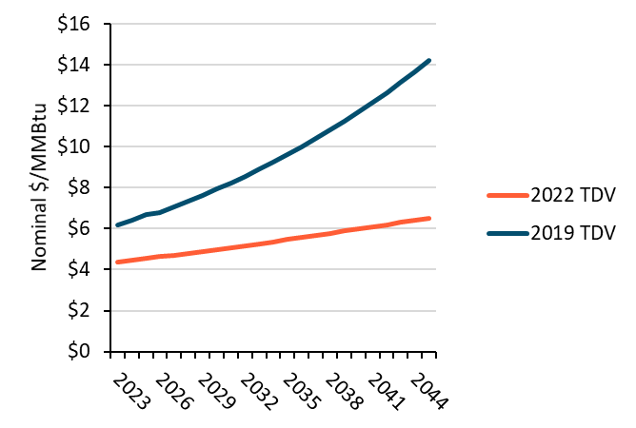
Natural gas retail rate forecasts (Policy Compliant Scenario)
Natural gas commodity price has decreased since 2019 Code Cycle
  Natural gas commodity and burnertip price forecast from 2019 Preliminary IEPR (average of PG&E Backbone and SCG Needles)
Natural gas retail rates based on 2019 CEC Future of Natural Gas study – Multi-Prong with Slower Building Electrification scenario
  Retail rates increase compared to 2019 code cycle due to recently approved safety upgrade costs, somewhat decreased throughput, some blend of biogas and hydrogen
Natural Gas Burnertip
Natural Gas Retail Rates

Slide 66
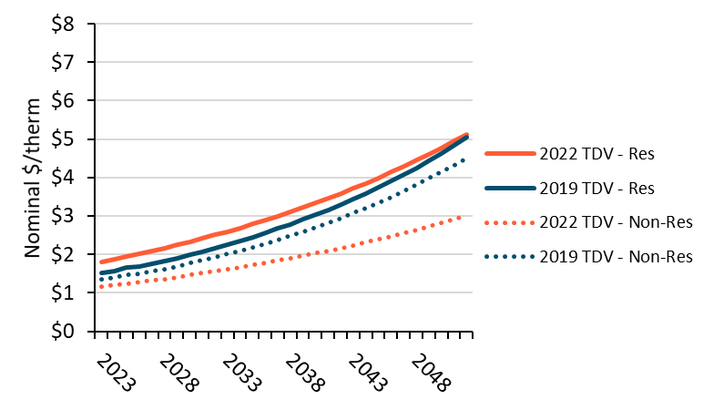
Natural gas retail rate forecasts (Mid-IEPR Scenario)
Natural gas commodity price has decreased since 2019 Code Cycle
  Natural gas commodity and burnertip price forecast from 2019 Preliminary IEPR (average of PG&E Backbone and SCG Needles)
Natural gas retail rates based on 2019 Preliminary IEPR Mid-Demand Retail Rate Forecast
  Residential retail rate forecast has increased compared to 2019 code cycle
  Non-residential retail rate forecast has decreased compared to 2019 code cycle
Natural Gas Burnertip
Natural Gas Retail Rates

Slide 67
Retail Rate Forecast Comparison
Retail Rate forecast scenario is conservative compared to other PATHWAYS scenarios that meet emissions targets
  Alternatives are increased synthetic natural gas, or high building electrification, both of which are expensive
  This scenario compensates for less decarbonization in the building sector with larger, more expensive reductions in other sectors

Slide 68
Natural Gas Scenario Comparison
Natural Gas Retail Rates
Policy Compliant yields higher retail gas rates, which translates to higher TDVs
The difference between scenarios is larger for Non-Res
Natural Gas TDV
Natural Gas TDV

