Slide 1
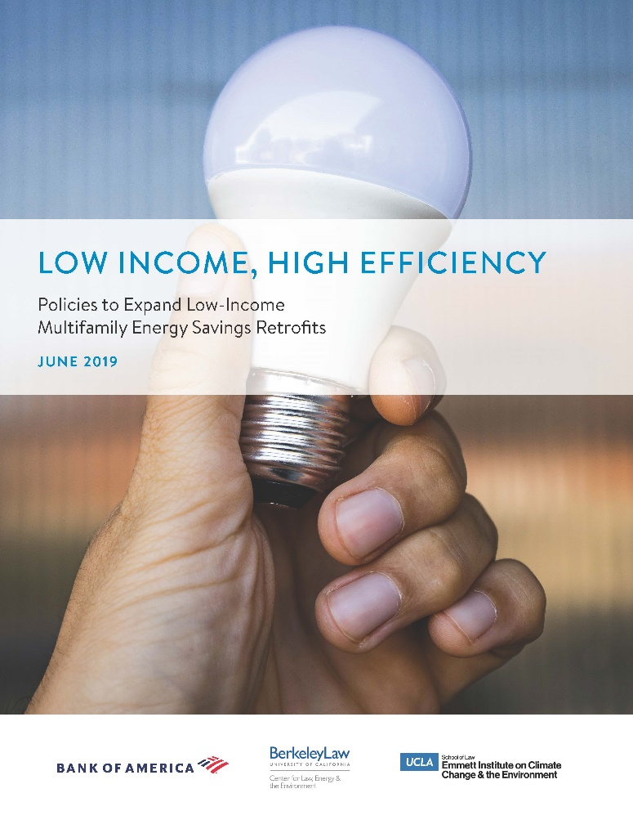
Increasing Access to Energy Efficiency Retrofits in Low-Income Multifamily Buildings
July 30, 2019

Slide 2
Stakeholder Process
UC Berkeley and UCLA Schools of Law convened over 30 policy, industry, and advocacy stakeholders
Stakeholder group identified top barriers to accessing state efficiency incentive programs for retrofits in low-income, multifamily properties
Solutions included:
    Forming a one-stop shop program administrator
    Enabling financing innovations like pay-as-you-save
    Creating a statewide energy and financing database
Notes:
We convened over 30 stakeholders including representatives from Energy Commission, Public Utilities Commission, Treasurer’s Office, Department of Housing and Community Development, utilities, seven property owner/developers, program implementers, and a range of other advocates and experts.
Stakeholders first identified a set of barriers to EE access that tracked closely with those raised in the SB 350 barriers study, grouped into three core categories: lack of program coordination and complexity of access; lack of long-term funding and private capital in the marketplace; and lack of data access.
Stakeholders then identified a set of solutions to these barriers, including:
Forming a one-stop shop program administrator to manage all incentive programs and provide seamless access for customers
Enabling financing innovations like pay-as-you-save and pre-fabricated mass-scale retrofits
Revising Title 24 to facilitate electrification projects that increase overall loads but reduce GHG emissions
Creating state-funded loss reserves to reduce performance risk for smallest owners
Creating a statewide database of property-level energy, financing, affordability, and rehabilitation data to identify highest-yield properties

Slide 3
Case Studies
Wakeland Housing & Development Case Study: The Allison Apartments
    58-unit deed restricted supportive housing property in San Diego
    TCAC timeline determined project timeline, conflicted with LIWP timeline—increased project complexity, cost, and inconvenience
    Single program administrator could increase coordination across relevant agencies like TCAC and CSD to reduce friction
Notes:
This 58-unit property in San Diego consists entirely of deed-restricted supportive housing for very-low-income, disabled, and formerly homeless residents
Together with SDGE and the LIWP program, Wakeland put together a hugely successful project resulting in savings over 1/3 of total building energy use.
But the energy component was a very small part of the total project—just six percent of an $7 million refinancing and rehab. From one perspective, achieving these energy savings at such relatively low cost is an excellent outcome. But for a non-profit owner on slim margins, this means it is really hard to devote staff time and resources to that aspect of the project.
Conversely, the TCAC process for low-income housing tax credits dictated the entire project. As the developer told me, Wakeland simply cannot risk losing its TCAC award by missing any deadlines. In this case, a TCAC award in June required construction to start in mid-December, but the LIWP process (started at the same time) required energy work to be complete by the following March. As a result, Wakeland had to perform rooftop solar and electric heat pump work months earlier than it would have under its construction timeline, had to front-load roof and in-unit work that increased contracting costs and tenant inconvenience. Longer tenant displacements can be particularly challenging for supportive housing residents.
They got the project done, but it placed significant burdens on asset management staff, tenant relocation staff, and contractors to fit the pieces together. Absent the project manager’s personal prioritization, it probably would not have happened or would not have been as effective.. This is potentially putting a lot of projects at risk.
Creating a one-stop shop would not directly solve this issue, but it would help the responsible agencies coordinate and align their timelines and create a forum to address these conflicts systematically.
At the same time, it would facilitate a simpler single point of access for customers like Wakeland and reduce reliance on the extra efforts of individual developers and managers.

Slide 4
Case Studies
MG Properties Group Case Study: Stonewood Gardens
    250-unit property with 50 Section 8 units and 200 market-rate units
    Renegotiation of 40-year ground lease with city and refinancing with Fannie Mae Green Rewards Loan: unique trigger point
    Single program administrator could enhance ability to take advantage of these trigger points for smaller owners
Notes:
This was a property in a somewhat unique scenario, owned by MG Properties but located on land owned by the City of San Diego under a long-term ground lease that requires MG to keep a minimum number of affordable units
As a large developer of properties at all income ranges, MG had the resources to combine a Fannie Mae Green Rewards Loan with state incentives, fully taking advantage of the trigger point that the refinancing event offered
But smaller developers may not have the resources, and other mixed-income properties likely do not operate under ground leases with affordability requirements that allow them to access federal green loans
Consolidating existing incentives under a single program administrator could increase the ability of state and local governments to align their housing affordability and energy efficiency goals with developers’ financial bottom lines
The developer described this arrangement as a de facto public-private partnership—a one-stop shop could help replicate these incentives

Slide 5
One-Stop Shop: Examples
Energy Trust of Oregon
    Comprehensive guidebook of incentives offered by ratepayer-funded (3% utility surcharge) nonprofit
Massachusetts LEAN Program
    Single point of contact across all utilities and regions
New York Multifamily Performance Program
    State energy research and development agency runs program directly
Notes:
Three examples of one-stop-shops our stakeholders raised.
Energy Trust of Oregon, which manages access to all low-income and non-low-income, residential and commercial incentives in the state. Independent nonprofit funded by three percent public purpose charge on utility bills. Estimated savings of $7 billion and 29 million tons of carbon dioxide since 2002, in a state about 1/10 the size of California.
Massachusetts LEAN program is a single-point-of-contact entity exclusively for low-income properties based on a collaboration between the electric and gas utilities and state energy and housing regulators.
New York’s Multifamily Performance Program is run directly by the state’s energy commission, exclusively for low-income buildings.

