Slide 1

Clean Transportation Program Benefits Report for 2019 IEPR
Susan Ejlalmaneshan
July 18, 2019
California Energy Commission

Slide 2

About the Clean Transportation Program
The transportation sector is the largest source of GHG emissions in California with 50% of in-state emissions
State policies requires a rapid transformation from gasoline and diesel toward zero and near-zero emission vehicles and lower carbon alternative fuels

Slide 3
About the Clean Transportation Program
Health and Safety Code 44272(a)
  “…to develop and deploy innovative technologies that transform California’s fuel and vehicle types to help attain the state’s climate change policies… without adopting any one preferred fuel or technology.”
In 2007, the Legislature established the Clean Transportation Program
$100 million per fiscal year from vehicle registration fees

Slide 4
Key GHG, Air Quality, and ZEV Goals and Milestones
Policy Origin | Objective | Goals and Milestones
Assembly Bill 32 Senate Bill 32 Executive Order B-55-18 | GHG Emission Reduction | 2020: to 1990 levels 2030: to 40% below 1990 levels 2045: Achieve carbon neutrality
Clean Air Act CA State Implementation Plans | Air Quality | 2031: 80 percent reduction in NOx
Executive Order B-16-2012 Executive Order B-48-18 | Increase Zero-Emission Vehicles | Vehicles 2025: 1.5 million electric vehicles deployed 2030: 5 million zero-emission vehicles Infrastructure 2020: Support 1.5 million electric vehicles 2025: 250,000 electric vehicle chargers (inc. 10,000 DC fast chargers) and 200 hydrogen refueling stations

Slide 5
Context of the Clean Transportation Program
Supports and complements statewide efforts to decarbonize the transportation sector
Coordinated with other major programs and regulations, including:
  Zero Emission Vehicle Reg.
  Low Carbon Fuel Standard
  Cap-and-Trade / GHG Reduction Fund
  Utility Investments
  Settlement Agreements
  (VW; NRG)
  Air Quality Improvement Program
  Carl Moyer Program

Slide 6
Program Status Update
Now in eleventh fiscal year (2019-2020)
Through March 2019, $820 million awarded to more than 600 projects
71 Biofuel Production Projects | 9,655 EV Chargers
64 Hydrogen Refueling Stations | 70 Natural Gas Fueling Stations
10,850 Electric Vehicle Rebates | 3,150 Natural Gas Vehicles
21 Manufacturing Projects | 17,440 Workforce Trainees
54 Advanced Technology Truck Demonstrations | 52 Regional Readiness Grants

Slide 7
About the Benefits Report
Required with biennial Integrated Energy Policy Report (IEPR)
“The evaluation shall include all of the following:”
  List of projects funded
  Expected benefits
  Overall contribution toward transition to clean, alternative transportation fuels
  Key obstacles and challenges
  Recommendations

Slide 8
ZEV Infrastructure
EO B-48-18 sets goals for deploying 250,000 EV chargers (including at least 10,000 DCFC) and 200 hydrogen refueling stations by 2025.
Through June 2019, more than 600,000 PEVs were sold.
CEC forecasts between 1.5M and 2.4M ZEVs by 2025

Slide 9
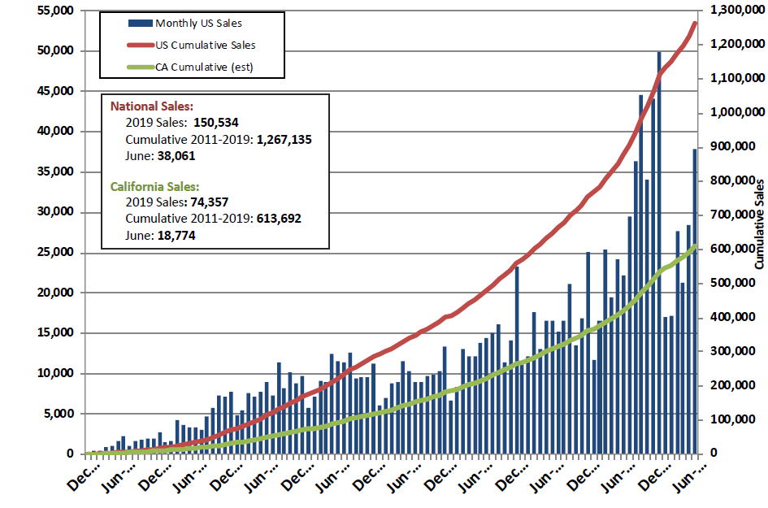
Charging Infrastructure
Charging infrastructure investments support the growth of plug-in electric vehicles
Multiple charging types are necessary to meet drivers’ needs and expectations
Source: Veloz sales dashboard. Updated July 4, 2019.

Slide 10
Charging Infrastructure
Level 2 Connectors
 | Low Scenario | Medium Scenario | High Scenario
EO B-48-18 Goal | 240,000 | 240,000 | 240,000
# of Chargers Installed/Expected | 155,259 | 162,385 | 165,459
Remaining Gap | 84,741 | 77,615 | 74,541
DCFCs
 | Low Scenario | Medium Scenario | High Scenario
EO B-48-18 Goal | 10,000 | 10,000 | 10,000
# of Chargers Installed/Expected | 6,013 | 6,463 | 6,673
Remaining Gap | 3,987 | 3,537 | 3,327

Slide 11
Charging Infrastructure
Charging Connectors Funded by the Clean Transportation Program as of March 1, 2019
Status | Private Access |  |  | Publicly Accessible |  |  | Total
 | Residential (Single & Multifamily) | Fleet | Workplace | Multifamily Housing | Public | Corridor/ Urban Metro
Installed | 3,936 | 115 | 364 | 341 | 3,118 | 226 | 8,100
Planned | 0 | - | 76 | 8 | 191 | 1,280 | 1,555
Total | 3,936 | 115 | 440 | 349 | 3,309 | 1,506 | 9,655

Slide 12
Hydrogen Refueling Infrastructure
AB 8 provides Program funding for hydrogen stations until there are at least 100 publicly available stations in California by 2024.
Executive Order B-48-18: 200 hydrogen refueling stations by 2025.
Total funding by the Program: $125 million
# of H2 stations: 64
Total CEC funded capacity: 17,000 kg/day
Currently open retail CEC funded capacity: 8,000 kg/day (39 stations)

Slide 13
Hydrogen Refueling Infrastructure
Program investments increase the number of regions served by hydrogen refueling stations

Slide 14
Alternative Fuel Production
Zero- and near zero-carbon fuel production
Fuel | Cumulative Awards as of March 2019 (in Millions) | # of Projects
Biomethane Production | $76.8 | 27 Projects
Gasoline Substitutes Production | $39.5 | 16 Projects
Diesel Substitutes Production | $74.2 | 26 Projects
Renewable Hydrogen Production | $7.9 | 2 Projects
Total | $198.4 | 71

Slide 15
Alternative Fuel Production
Projects funded by the Program support the Low Carbon Fuel Standard via in-state fuel production
Source: California Air Resources Board

Slide 16
Vehicle Investments
Activity | Cumulative Awards as of March 2019 | # of Units
Natural gas vehicle deployment | $86.8 | 3,152+ Vehicles
Propane vehicle deployment | $6.0 | 514 Trucks
Hybrid and ZEV deployment (including CVRP, HVIP, and low-income mobility incentives) | $32.0 | 10,700 Cars and 150 trucks
Advanced technology freight and fleet vehicles demonstration | $126.3 | 48 Demonstrations

Slide 17
Related Opportunities
Workforce Training and Development
  Ensure ZEVs’ reliability, support in-state economic development
Manufacturing
  Reduce ZEV and ZEV infrastructure unit costs, expand ZEV and infrastructure offerings, support in-state economic development
Regional Alternative Fuel Readiness Planning
  Reduce ZEV infrastructure installation costs and delays, promote grid reliability

Slide 18
Quantifying Benefits
CEC has contracted with National Renewable Energy Laboratory (NREL) to quantify key benefits
Methods for Quantifying Benefits
  Expected Benefits
  Market Transformation Benefits
Types of Benefits
  Petroleum use reduction
  GHG reduction
  Air quality

Slide 19
Project Information NREL
Key project attributes from CEC
  Project type
  # of hardware units (e.g. trucks, chargers)
  Alternative fuel production / dispensing / use
  Project completion date
  Carbon intensity (if non-standard)
  Displaced vehicle type

Slide 20
Attribution of Benefits
Funded projects help achieve state goals, but not in a vacuum.
CEC projects support, and are in turn supported by, other state programs and regulatory mechanisms
  Low Carbon Fuel Standard
  Cap and Trade
  Zero Emission Vehicle Regulation
Additional support via private or other public investments
Result: Benefits capture other related public and private investment and regulatory activity

