Slide 1
San Joaquin Valley Need for
Electric Vehicle Charging Infrastructure
IEPR Workshop for Electric Vehicle Charging Infrastructure Assessment (AB 2127)
May 2, 2019
San Joaquin Valley Air Pollution Control District
Chay Thao, Program Manager

Slide 2
District Effort in Ongoing Mission to Improve
Air Quality and Protect Public Health
District/CARB have adopted numerous attainment plans
  Toughest stationary/mobile regulations in the nation
  District adopted nearly 650 stringent rules and regulations
  Groundbreaking rules serve as model for others
Stationary source emissions reduced by over 91%
Strong incentive programs (over $2.2 billion in public/private investment reducing over 145,000 tons of emissions)
Due to the significant investments made by Valley businesses and residents and stringent regulatory programs by the District and CARB, the Valley’s air quality continuing to improve
  Valley now in attainment with federal PM10 standard, one-hour ozone standard, and 24-hour PM2.5 standard of 65 µg/m³

Slide 3
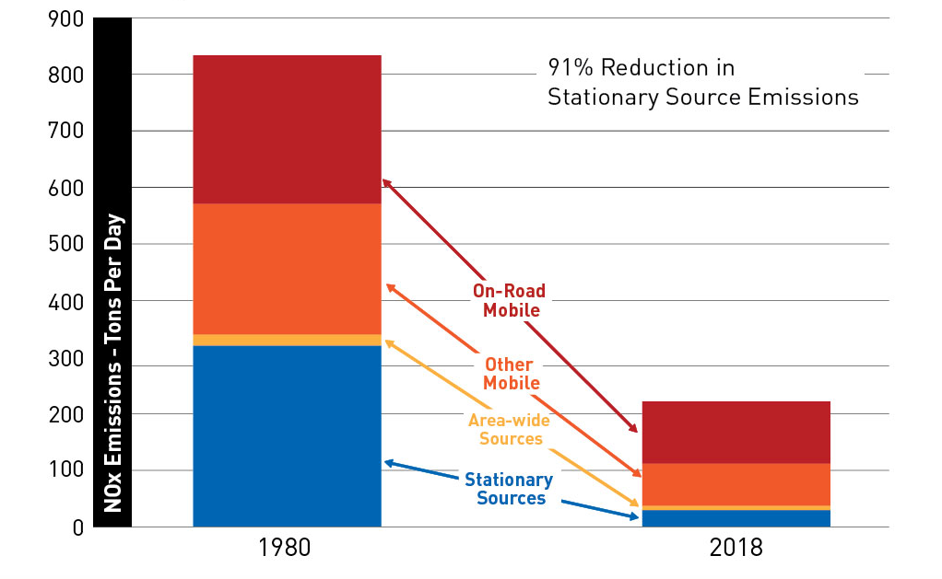
Success in Reducing Valley Emissions

Slide 4
2018 PM2.5 Plan for San Joaquin Valley
Despite progress, Valley still faces significant challenges in meeting latest health-based PM2.5 standards under the federal Clean Air Act
  1997 PM2.5 Standard (24-hour 65 μg/m³ and annual 15 μg/m³)
  2006 PM2.5 Standard (24-hour 35 µg/m³)
  2012 PM2.5 Standard (annual 12 µg/m³)
Plan significantly reduces NOx emissions in the San Joaquin Valley by 66% from 2013 to 2025
Provides for expeditious attainment of 1997, 2006, and 2012 PM2.5 standards by 2020, 2024, and 2025, respectively
Plan includes comprehensive suite of regulatory and incentive-based measures
In addition, recent more stringent 2015 Ozone standard will require additional significant NOx emissions to meet attainment deadline in 2038

Slide 5
New CARB Measures for Valley
CARB committed to reducing an additional 32 tpd of NOx and additional 1 tpd of PM2.5
  Heavy duty truck inspection and maintenance
  Accelerated turnover of trucks/buses through incentives
  Accelerated turnover of off-road equipment through incentives
  Accelerated turnover of agricultural equipment through incentives
CARB measures rely heavily on incentive-based strategies that require $5 billion in funding over 5-yr period
CARB adopted San Joaquin Valley Supplement to the 2016 State Strategy for the State Implementation Plan in October 2018
  Plan includes State’s commitment to secure and provide necessary emissions reductions and associated incentive funding

Slide 6
Mobile Source Emissions Critical to Attainment
Emission reductions from mobile sources critical to attaining federal air quality standards in San Joaquin Valley
Over 85% of NOx in Valley from mobile sources (over 40% come from heavy-duty diesel trucks)
Two main transportation corridors (I-5 and SR-99) in Valley connecting Northern and Southern California (carry up to 80,000 trucks per day)
Nearly all containers transported between sea ports through Valley are by heavy-duty diesel trucks
Valley is growing location for warehousing, distribution and related logistics businesses and leader in national and international agricultural and food production

Slide 7
Pursuing All Feasible Technologies
Pursuing both near-zero & zero-emission technologies
District zero-emission project efforts include:
  Forklifts
  Ag UTV
  Dairy Feed Mixing
  Passenger vehicles
  School Busses
  Upcoming VW program for School, Transit, and Shuttle Busses
  Charging infrastructure grants
  PEV Readiness Plans to understanding obstacles to infrastructure and locations needed
  Support statewide HVIP with additional incentives for Valley Fleets
  Alternative Fuel Mechanic Training
  Clean Green Yard Machines (Residential and Commercial)
  Create Plug In Electric Vehicle Resources Center

Slide 8
Pursuing All Feasible Technologies (cont’d)
Cap and Trade Funded Zero-Emissions Demonstration Projects
  Battery electric locomotive and associated cargo handling equipment
  Replacing all diesel powered freight equipment at Frito Lay Modesto facility with zero and near-zero technology. Electric equipment will include heavy-duty truck, yard trucks, and forklifts.
  High lift capacity battery electric forklift demonstration at the Port of Stockton
  Demonstration of battery electric transit buses in Visalia, Porterville, Fresno County and Modesto
  Electric delivery vehicle demonstrations with the Postal Service and AmeriPride linen delivery services
  Shared mobility services demonstration in disadvantaged communities throughout the District car sharing and ride sharing using electric vehicles
  Electric vanpool demonstration in Merced, Bakersfield, and Fresno Counties

Slide 9
Conclusion
Ensuring sufficient electric vehicle charging infrastructure in the San Joaquin Valley is critical to attainment of multiple stringent federal standards
Need infrastructure to attract early investment into zero-emission technology when commercially available
  Especially important for Class 7 and Class 8 long haul heavy duty trucks

