Slide 1

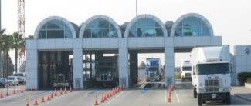
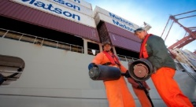
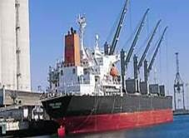

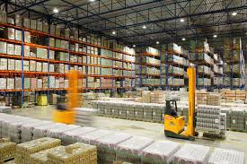
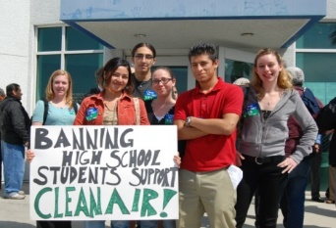
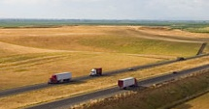
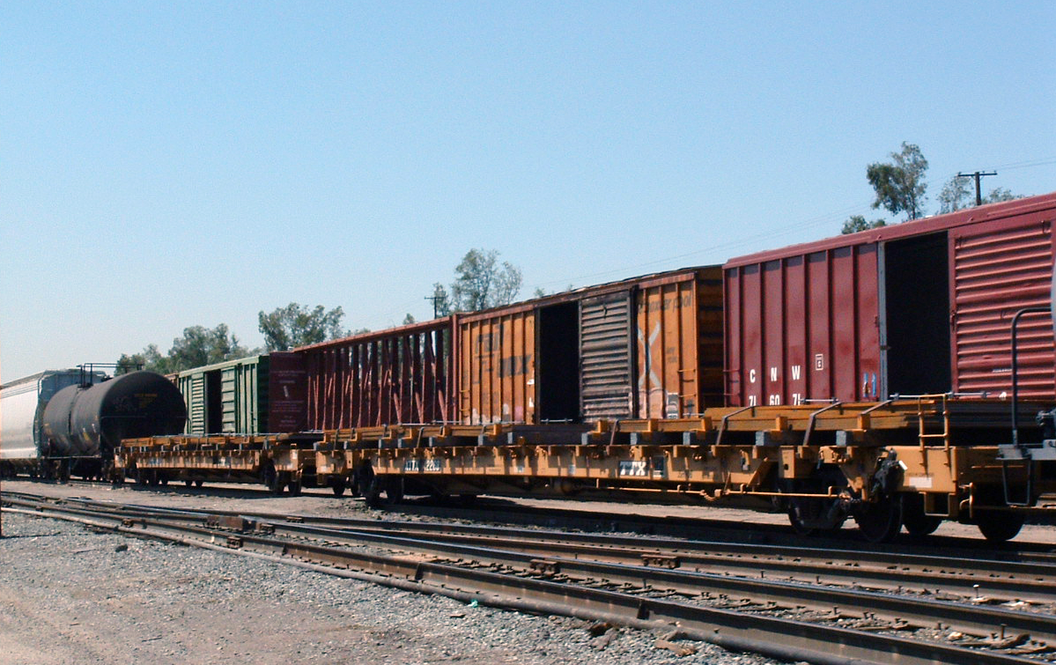
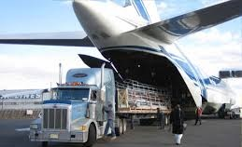

Regulatory Drivers for Transportation Electrification of Freight and Off-Road Equipment
California Energy Commission Workshop on Electric Vehicle Charging Infrastructure Assessment (AB 2127)
May 2, 2019, 1:30 PM

Slide 2
Part I: Mobile Source Strategy
Integrated strategy for multiple goals

Slide 3
California’s Air Quality and Climate Goals
Federal Air Quality Standards
Greenhouse Gas Reduction Targets
2023/ 2030/2031
Community Risk Reduction
5 Million Zero Emission Vehicles
Renewable Energy Targets
Petroleum Reduction Target

Slide 4
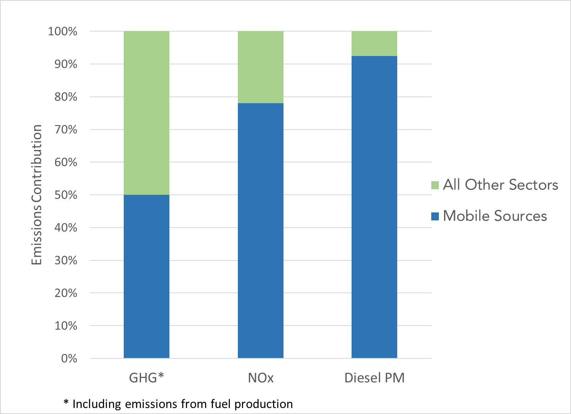
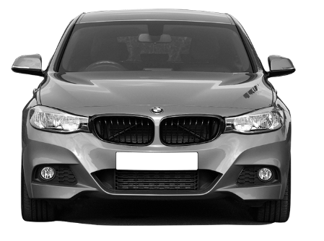
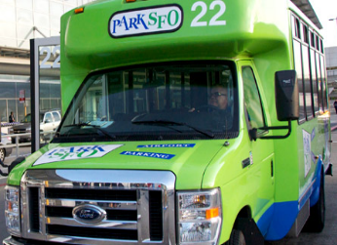
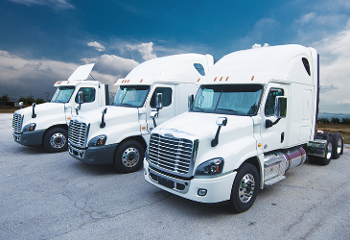
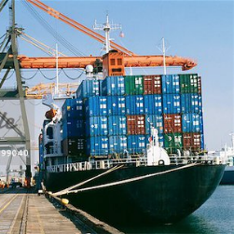
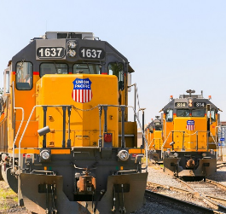
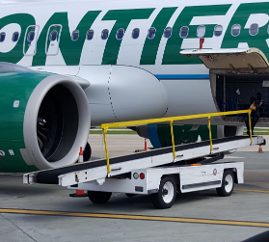
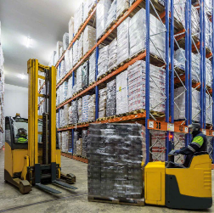
Mobile Source Reductions are Key
Largest Contributor to smog-forming, greenhouse gas and diesel particulate matter (DPM) emissions
Within mobile sources
  GHG- light duty passenger vehicles
  NOx & DPM – heavy duty trucks & off-road

Slide 5
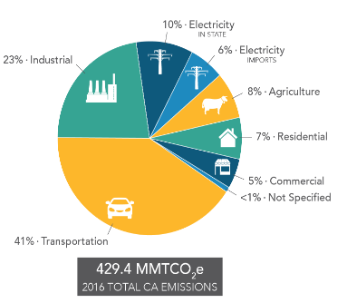
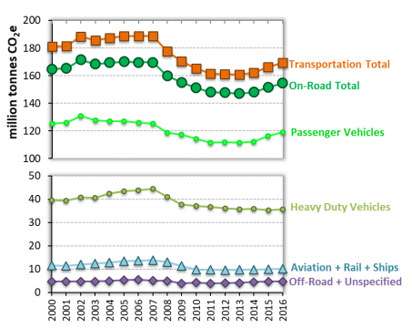
GHG Emissions
https://www.arb.ca.gov/cc/inventory/data/data.htm
https://www.arb.ca.gov/cc/inventory/pubs/reports/2000_2016/ghg_inventory_trends_00-16.pdf
5

Slide 6
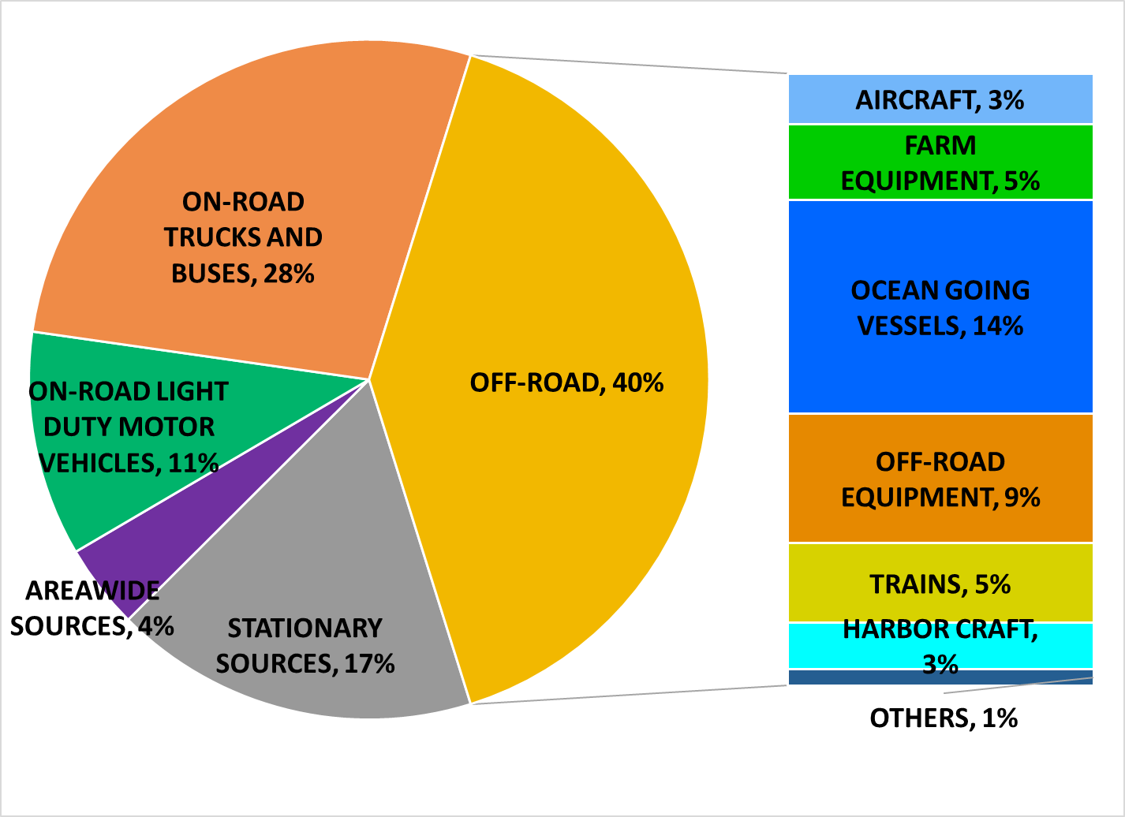
Statewide NOx Emissions, 2018
CEPAM statewide NOx Emission Inventory includes OGV out to 100 nautical miles
https://www.arb.ca.gov/app/emsinv/fcemssumcat/fcemssumcat2016.php

Slide 7
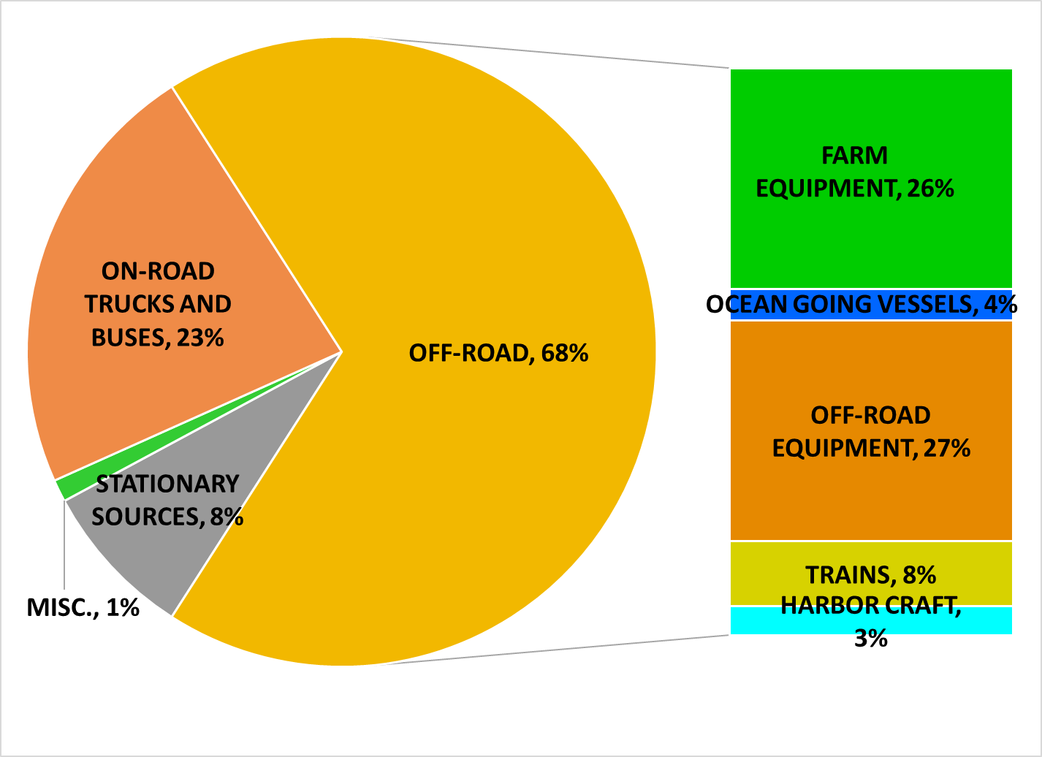
Statewide DPM Emissions, 2018
CEPAM statewide PM10 Emission Inventory includes OGV out to 100 nautical miles
https://www.arb.ca.gov/app/emsinv/fcemssumcat/fcemssumcat2016.php
7

Slide 8
Mobile Source Strategy
An integrated planning process
  Understand emission contributions and existing regulations/standards
  Technology assessments identify status of advanced technologies and fuels
  Consider how actions can best meet multiple goals
Scenario analysis provides framework for coordinated air quality and climate assessment

Slide 9
Key Strategy Actions Identified
Light duty passenger vehicle
  Zero emission technologies
  Curb growth in vehicle miles travelled
Heavy duty sectors (including on and off-road)
  Near-zero emission technologies operate on renewable fuels
  Zero emission technologies
    Electrification
    Fuel cell

Slide 10
Part II: Freight
Goals, Existing Strategies, and Future Actions

Slide 11
CARB Freight and Off-Road Actions Designed to Meet Multiple Objectives
Cut community health risk (support AB 617 emission reductions)
Attain regional air standards (support State Implementation Plan)
Mitigate climate change (support Scoping Plan and SLCP Plan)

Slide 12
Freight Strategies Already Implemented to Cut Emissions and Health Risk
Trucks | Ships | Locomotives | Equipment | Harbor Craft
Fuel/engine In-use trucks/ turnover GHG limits Idling and smoke limits In-use compliance | Fuel At berth reductions Ship incinerator ban | Fuel Fleet emission limits for South Coast Diesel soot reduction at rail yards | Fuel/engine Port & rail equipment Forklifts Airport equipment Transport refrigerators | Fuel Harbor craft engines

Slide 13
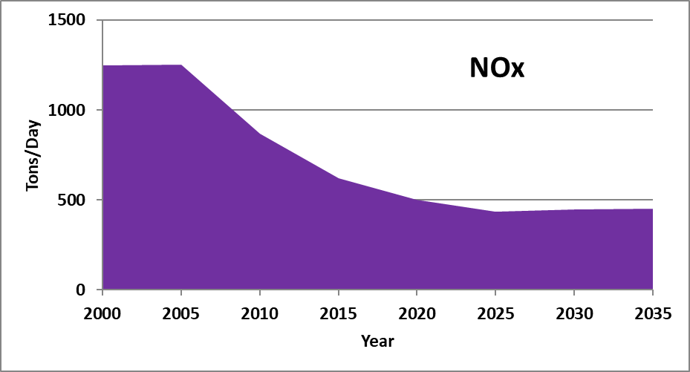
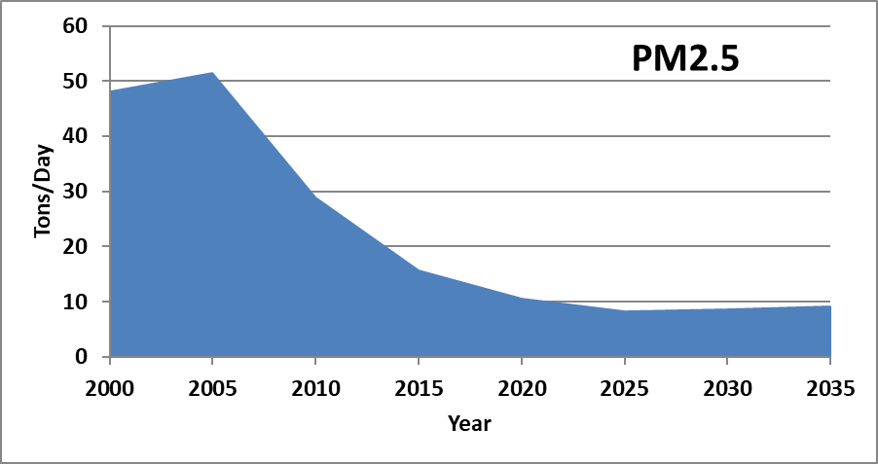
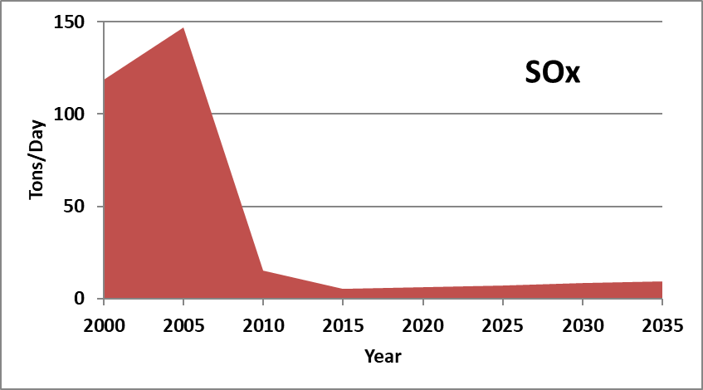
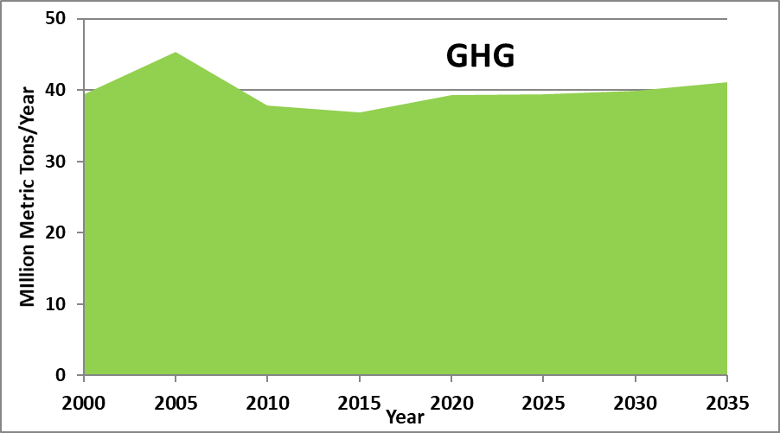
Progress in Reducing Freight Emissions
Statewide, 2000-2035

Slide 14
Need for Zero-Emission Infrastructure Planning
Zero and near-zero technologies in heavy-duty, freight, and off-road sectors are critical to achieve air quality goals
Grid-connected and battery-electric technologies will likely play a major role to achieve zero-emission targets
Infrastructure needs, charging standards/connections, and power capacity needs vary widely, and are under various stages of development by source category

Slide 15
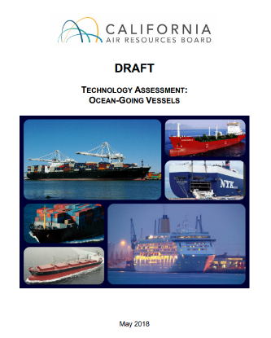
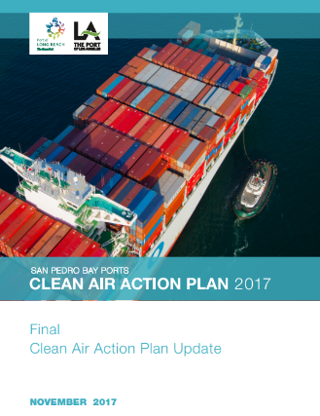
Data Collection Opportunities for AB 2127 Assessment
CARB Technology Assessments (2015-2018)
https://ww2.arb.ca.gov/resources/documents/technology-and-fuels-assessments
Findings from CEC and CARB funded advanced technology demonstration projects
CPUC data collection for utility transportation electrification projects
Tracking assessments lead by ports on terminal/equipment electrification (e.g. San Pedro Bay Ports Clean Air Action Plan)

Slide 16
Selected CARB Regulatory Actions with Current or Potential Future Requirements for Electrification
Ships At-Berth
Transport Refrigeration Units
Harbor Craft
Cargo Handling Equipment
Locomotives
Heavy-Duty Trucks
Forklifts
Airport Ground Support Equipment (GSE)
Airport Shuttle Buses

Slide 17
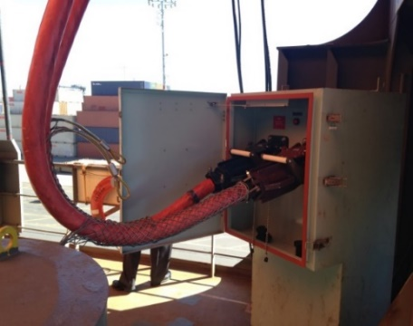
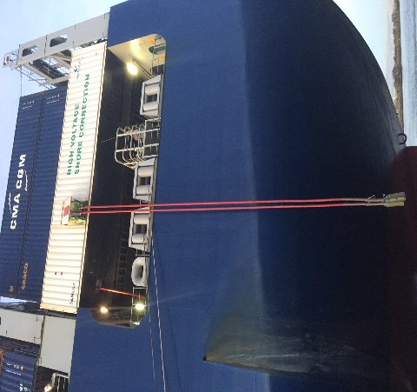
Ships At Berth
Typical uses: | Vessel types include container, reefer, cruise, auto carrier, and tanker vessels
Population | ~1250 unique ocean going vessels, and new regulation will likely require an ~85 additional container, cruise, or refrigerated cargo vessels expected to comply using shore power
Concepts | Reduce at berth emissions by controlling more visits, vessel types, and ports
Timeline | Phase-in anticipated 2021 to 2029
Electric Infrastructure Needs | Electrical demands at berth vary per vessel type: container, reefer, and auto carrier ~1 MW, cruise ~3-11 MW, tankers ~0.5-2.5 MW
Shore Power

Slide 18
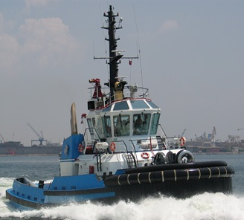
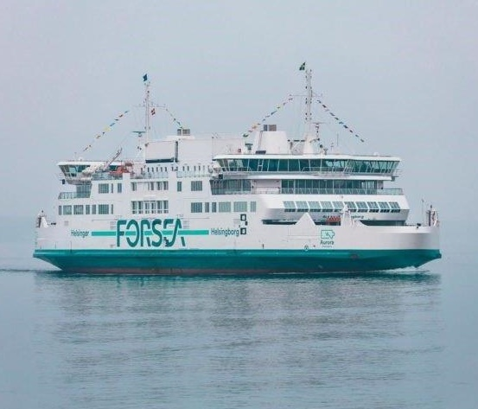
Harbor Craft
Typical uses: | passenger and freight vessels, such as ferries, tugboats, barges, dredges
Population | ~3,500 vessels
Concepts | Focus on cleaner combustion but support introduction of zero-emission technologies where feasible
Timeline | Phase-in anticipated to begin in 2023
Electric Infrastructure Needs | Additional electrification expected to support augmented use of shore power and charging for emerging full zero-emission or “plug-in hybrid” diesel vessels with battery storage

Slide 19
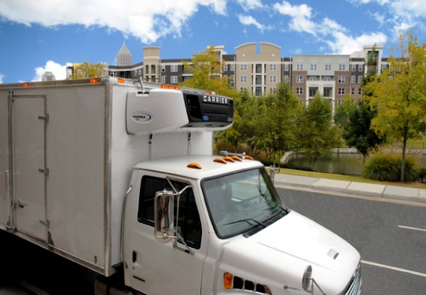
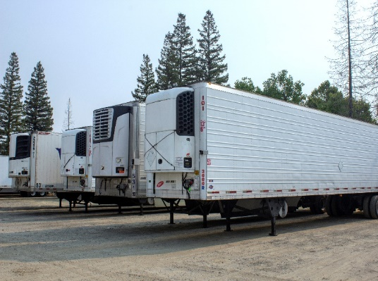
Transport Refrigeration Units
Typical uses: | Provide climate control for ocean-going and domestic containers, box trucks, rail cars, and truck transported refrigerated trailers.
Population | ~200,000 TRUs and generator sets.
Concepts | Require Trucks to use 100% zero-emission TRUs, Trailer TRUs to be zero when stationary, and facilities to provide infrastructure to allow for zero-emission operation on-site.
Timeline | Phase-in anticipated to begin in 2025
Electric Infrastructure Needs | Substantial. Up to 10,000 facilities (warehouses, stores, truck stops, etc.) may need to install electric (or other zero-emission technology) infrastructure.
Truck TRU
Trailer TRU

Slide 20
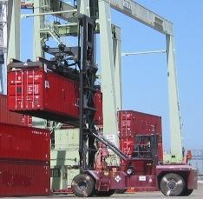
Cargo Handling Equipment
Typical uses: | Moving container, bulk, or liquid cargo at ports and intermodal rail yards
Population | ~5,000 pieces of equipment statewide
Concepts | Transition to full zero-emission technologies
Timeline | Phase-in anticipated to begin in 2026
Electric Infrastructure Needs | Under development - considerations include charging rate required for battery electric equipment, and use of electric versus other zero-emission alternatives.

Slide 21
Part III: Zero-Emission Vehicle and Off-Road Programs
Current and Future Actions

Slide 22
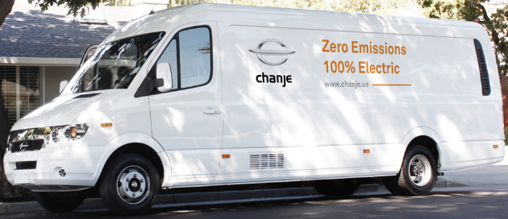
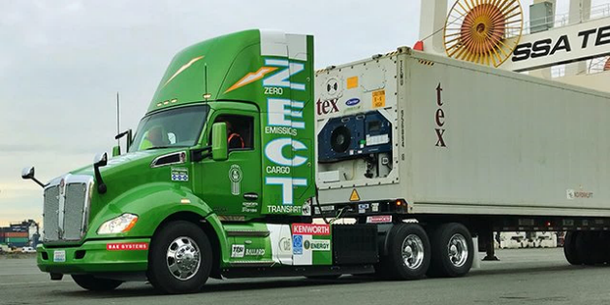
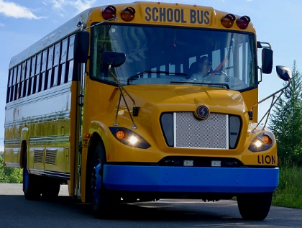
Advanced Clean Trucks (ACT) &
Zero-Emission (ZE) Fleet Rules
Typical uses | Pickup and delivery, drayage, utility, refuse, public, shuttle, others
Population | ~70,000 ZE trucks or more by 2030
Concepts | ZE trucks as a percent of manufacturers sales Future fleet rules/other policies
Timeline | ACT and fleet rules: Implementation 2024+
Electrical Infrastructure Needs | Overnight depot charging initially Public fast-charging network later on

Slide 23
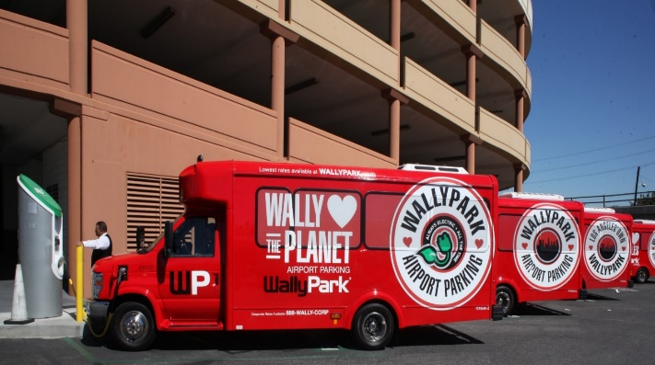
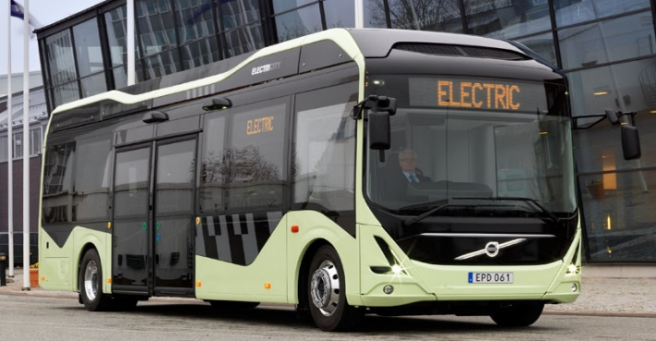
Airport shuttle
Typical uses: | Transport passengers around airport property and between airports and nearby businesses (e.g. hotels, off-airport parking)
Population | ~1,000 shuttles
Concepts | Fully transition to zero-emission technologies
Timeline | 2027 to 2035
Electric Infrastructure Needs | Majority of chargers will be 50 kW and above. This will likely require infrastructure upgrades at all regulated airports and most regulated businesses.

Slide 24
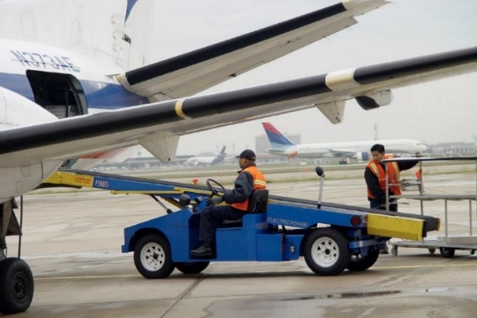
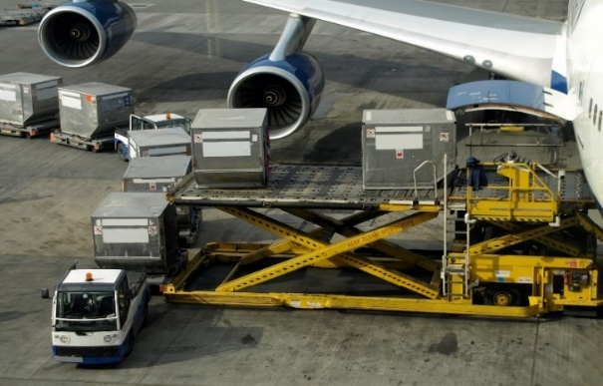
Airport GSE
Typical uses: | Transport baggage, cargo, and passengers to and from aircraft; move, service and provide ground power to aircraft
Population | >7,000 pieces of equipment
Concepts | Accelerate transition to zero-emission GSE
Timeline | Board Hearing: September 2020 Implementation 2023 to 2031
Electric Infrastructure Needs | Charging rates up to 80 kW or more (e.g., multiport, multi-equipment charger) with a significant variation in charging demands for different types of GSE

Slide 25
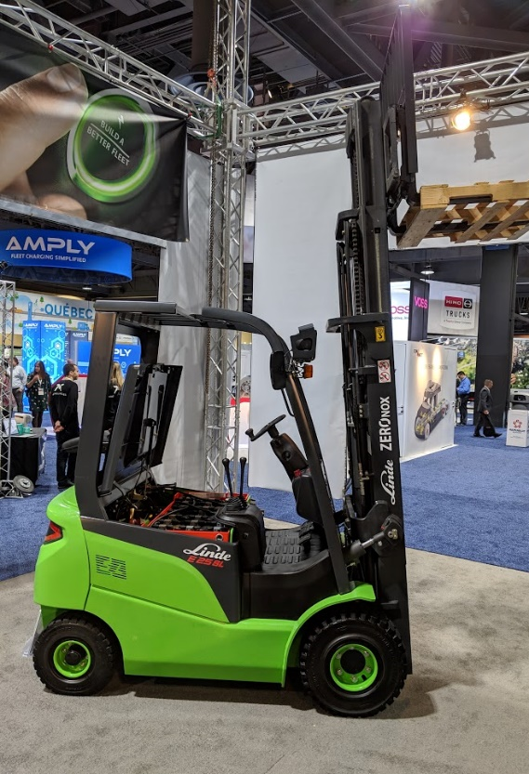
Forklifts
Typical uses: | Warehousing, distribution centers, ports, manufacturing
Population | ~100,000 (~50% new purchases are electric)
Concepts | Require fleets of forklifts (<8,000 lb.) to transition to zero-emission technology
Timeline | Implementation 2023-2035
Electric Infrastructure Needs | Worksite-specific charging needs; Conventional (5kW) and Fast-charging (30+ kW) options

Slide 26
Next Steps
Continue consultation with CEC pursuant to AB 2127 electric vehicle charging assessment
Maintain focus on developing zero-emission in-use and zero-emission equipment manufacturer requirements
Expand equipment standard development to include focus on connection standards, projections of energy demands, and identifying charging locations
Collaborate and engage facilities, utilities, and other agencies in zero-emission planning discussions

Slide 27
Contact Information
Kathy Jaw, Manager
Sustainable Transportation and Communities Division
Kathy.Jaw@arb.ca.gov
(916) 322-1720
David Quiros, Manager
Transportation and Toxics Division
David.Quiros@arb.ca.gov
(916) 327-7213
Craig Duehring, Manager
Mobile Source Control Division
Craig.Duehring@arb.ca.gov
(916) 323-2361

