Slide 1
Alternative and Renewable Fuel and Vehicle Technology Program
Renewable Hydrogen Production Roadmap Interim Findings
Akasha Kaur Khalsa, Host
April 4, 2019
California Energy Commission
Fuels and Transportation Division
Advanced Fuel Production Office
Notes:
We are recording this WebEx. You will be able to listen to it within a few days.

Slide 2
Commitment to Diversity
The Energy Commission encourages disadvantaged and underrepresented businesses and communities to engage in, and benefit from, our many programs by:
Engaging with disadvantaged and underrepresented groups throughout the state.
Notifying potential new applicants about the Energy Commission's funding opportunities.
Assisting applicants in understanding how to apply for funding from the Energy Commission's programs.
Surveying participants to chart progress in diversity outreach efforts.
Conducting outreach efforts.
Notes:
The Energy Commission adopted a formal resolution strengthening its commitment to diversity in our funding programs. We continue to encourage disadvantaged and underrepresented businesses and communities to engage in and benefit from our many programs. To meet this commitment, staff is:

Slide 3
Commitment to Diversity
Fairness – Increase funding accessibility to all Californians.
Inclusion – Small businesses make up a significant portion of the U.S. economy.
Job Creation – Projects can create jobs for residents of the under-served communities.
Diversity of Ideas – Great ideas occur in a variety of areas.
Diversity in Communities’ Needs – Needs vary widely from one area to the next (air quality, socioeconomic, etc.).
Notes:
The Energy Commission is committed to taking steps toward broadening the pool of applicants to our various programs, especially under-represented groups, disadvantaged communities, and small businesses. These outreach workshops are part of a continuing effort to diversify the participants in Energy Commission programs which will help:
Ensure equitable access to Energy Commission funding.
Create jobs and provide economic stimulus in under-represented and disadvantaged communities.
Increase competition to ensure the best opportunities are identified and funded.
Ensure local needs are identified and addressed.

Slide 4
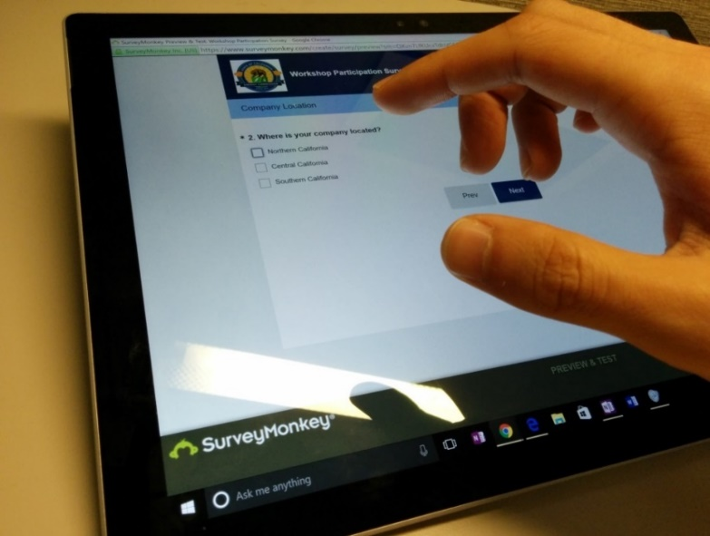
We Want to Hear From You!
Survey https://www.surveymonkey.com/r/7LMKTXC
1 Minute Survey
  The information supplied will be used for public reporting purposes to display anonymous overall attendance of diverse groups.
  Does your company identify as an underrepresented group?
  Where is your company located?
  How did you hear about the workshop?

Slide 5

Submit your Comments
Submit by April 18, 2019, 5 p.m.
Re: Docket 17-HYD-01 RH2 Webinar2
    E-commenting: upload your pdf or letter
    energy.ca.gov/altfuels/2017-HYD-01/
    Email to: docket@energy.ca.gov
    Mail to: California Energy Commission
Docket Unit, MS-4
1516 Ninth Street
Sacramento, CA 95814-5512

Slide 6
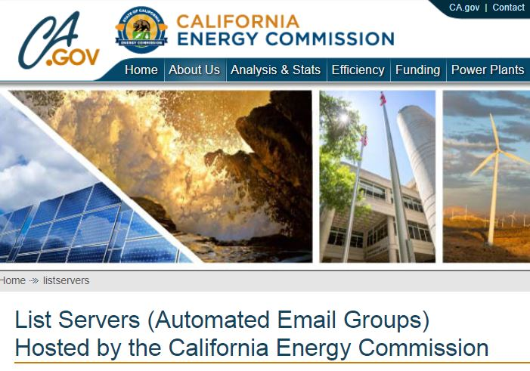
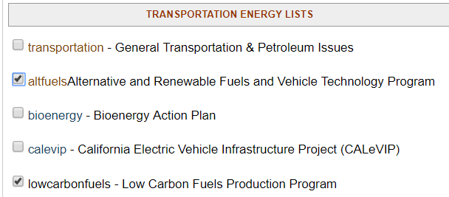
Stay Updated with Email
  energy.ca.gov/listservers
  Subscribe to the list server of your choice
6
Notes:
The Energy Commission has an email listserv system to distribute timely information on Commission announcements, programs, funding opportunities, workshops, and more.

Slide 7
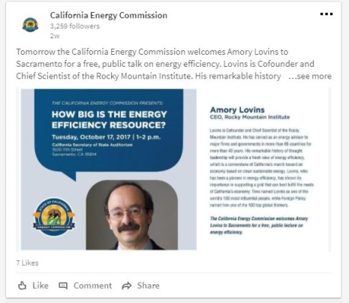

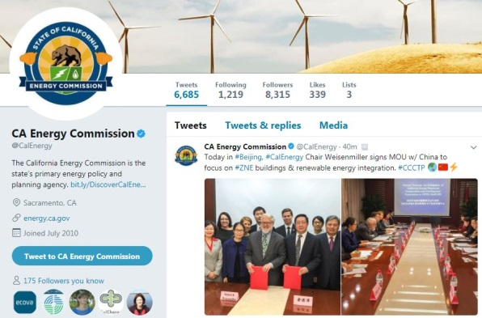
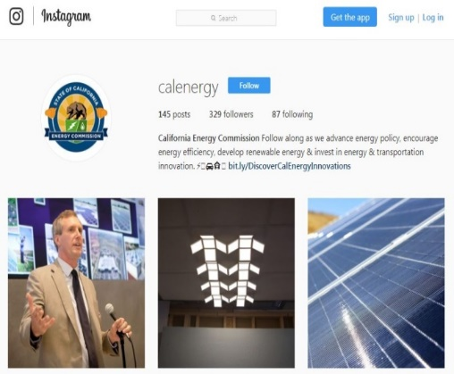




facebook CAEnergy twitter @CAEnergy
linkedin.com/company/california-energy-commission/
Instagram connection CalEnergy
7

