Slide 1
Southern California Gas Company –
Gas Acquisition Department
January 11, 2019
Notes:
Panel I: Southern California Natural Gas Supply
We ask that those presenting on this topic to consider the following questions:
• What are the factors in Southern California that are impacting the natural gas prices at the SoCal Citygate Hub and how are these factors different from other Hubs in the Southern California region?
• How are natural gas suppliers and marketers reacting to the physical supply constraints in the Southern California region?
• Why are the natural gas pipelines not full, and what can be done to increase natural gas pipeline utilization?
• Why haven’t steps been taken to procure liquified natural gas?
• What are possible solutions for increasing natural gas supply in Southern California?
Panel II: Natural Gas Price Impacts on Electric Generation Market
We ask that those presenting on this topic to consider the following questions:
• Why do California natural gas-fired electric generators depend more heavily on interruptible transmission contracts than similar natural gas-fired electric generators in other states? Does this dependence on interruptible natural gas supplies impact the current situation?
• Why do natural gas-fired electric generators buy at the SoCal Citygate Hub rather than the SoCal Border Hub?
• Why isn’t there more hedging done by Electric Generators?
• Are there mismatches between the California Independent System Operator’s (CAISO) market rules and natural gas market rules that create difficulties for natural gas-fired electric generators?
• How effective is the current operational flow order (OFO) structure?
• How have the following factors impacted natural gas-powered electric generation and electricity prices: lower hydroelectric generation, fires, and distributed and renewable generation?
• What are potential solutions for mitigating impacts of natural gas price fluctuations on power prices in Southern California?

Slide 2
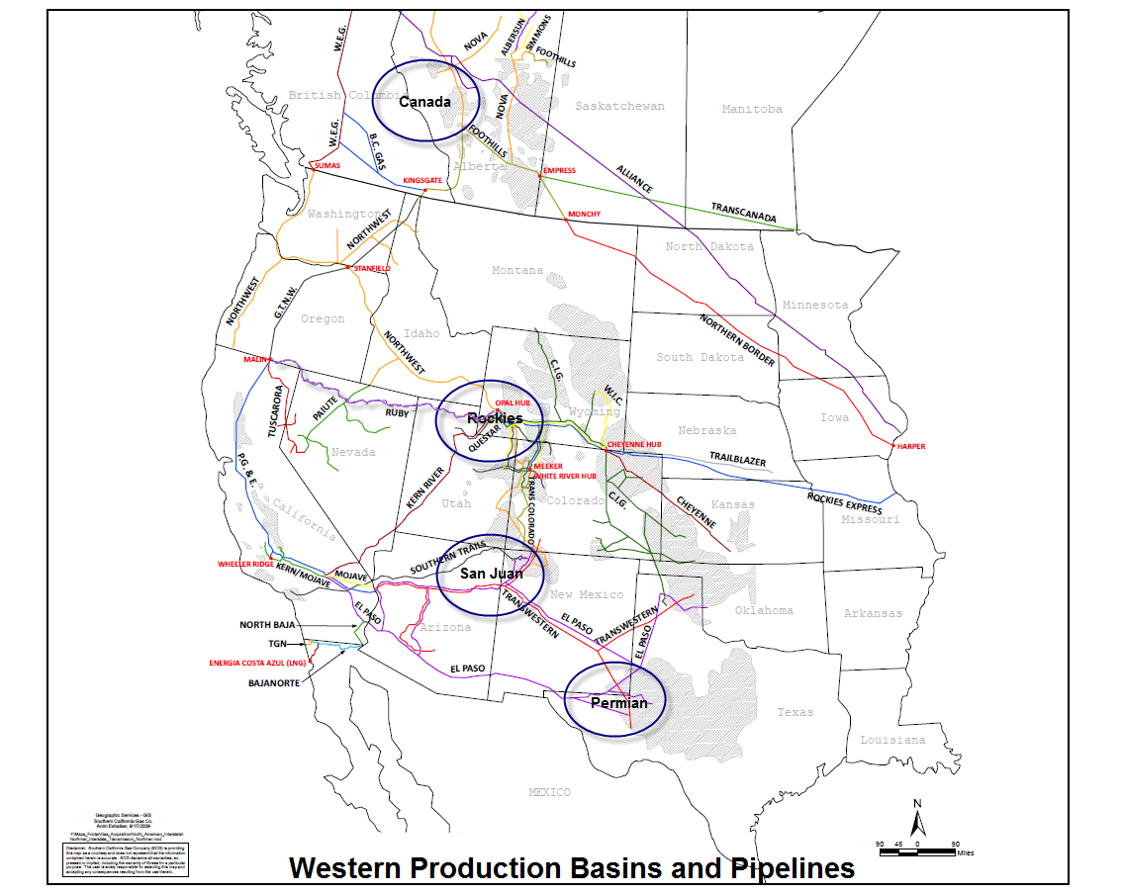
Diversity of Gas Supply

