Slide 1
Joint Agency Workshop on Southern California Natural Gas Prices
Evelyn Kahl
Indicated Shippers and Energy Producers and Users Coalition
January 11, 2019

Slide 2
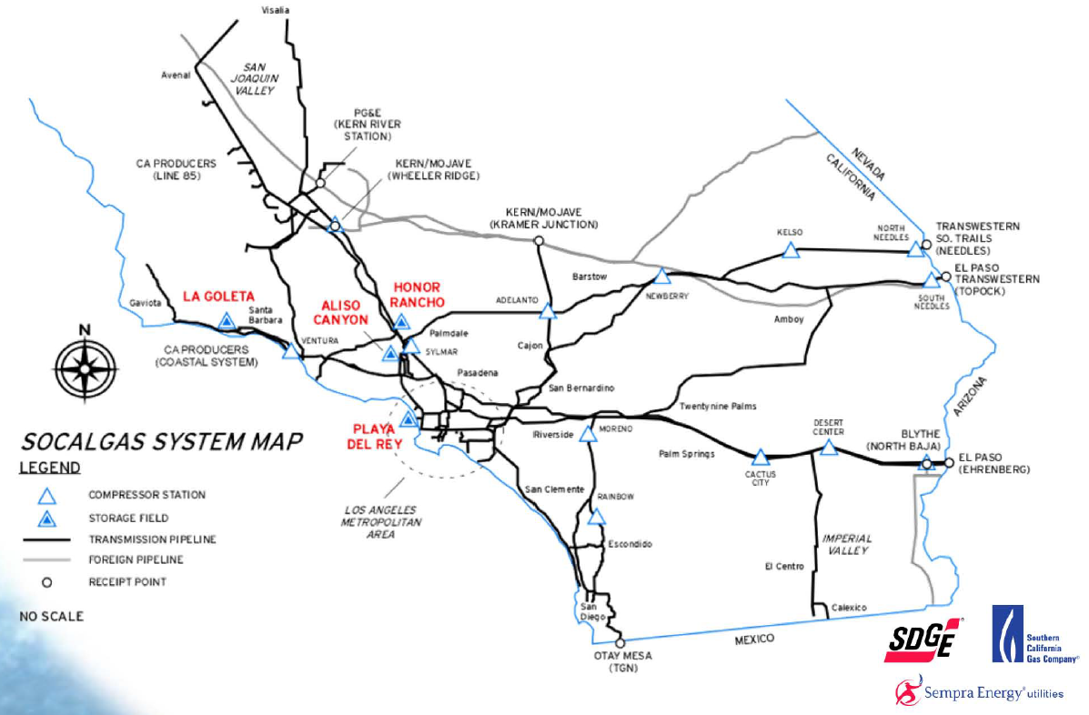
SoCalGas System Receipt Points and Constraints
Line 85
Lines 4000/235
Line 3000
550 MMCFD
540 MMCFD
150 MMCFD
1210 MMCFD
Capacity (Bcf) | Jan-15 | Oct-17 | Jan-19
Receipt | 4.0 | 2.5 | 2.9
Withdrawal | 3.6 | 1.0 | 1.0
Total | 7.6 | 3.5 | 3.9
400 MMCFD

Slide 3
Effects of Constraints on Border-City Gate Differential

Slide 4
Core Forecast Error Remains Troubling

