Slide 1
SoCalGas
January 11, 2019
Rodger R. Schwecke
Senior Vice President - Transmission, Storage and Engineering
Notes:
Panel I: Southern California Natural Gas Supply
We ask that those presenting on this topic to consider the following questions:
• What are the factors in Southern California that are impacting the natural gas prices at the SoCal Citygate Hub and how are these factors different from other Hubs in the Southern California region?
• How are natural gas suppliers and marketers reacting to the physical supply constraints in the Southern California region?
• Why are the natural gas pipelines not full, and what can be done to increase natural gas pipeline utilization?
• Why haven’t steps been taken to procure liquified natural gas?
• What are possible solutions for increasing natural gas supply in Southern California?
Panel II: Natural Gas Price Impacts on Electric Generation Market
We ask that those presenting on this topic to consider the following questions:
• Why do California natural gas-fired electric generators depend more heavily on interruptible transmission contracts than similar natural gas-fired electric generators in other states? Does this dependence on interruptible natural gas supplies impact the current situation?
• Why do natural gas-fired electric generators buy at the SoCal Citygate Hub rather than the SoCal Border Hub?
• Why isn’t there more hedging done by Electric Generators?
• Are there mismatches between the California Independent System Operator’s (CAISO) market rules and natural gas market rules that create difficulties for natural gas-fired electric generators?
• How effective is the current operational flow order (OFO) structure?
• How have the following factors impacted natural gas-powered electric generation and electricity prices: lower hydroelectric generation, fires, and distributed and renewable generation?
• What are potential solutions for mitigating impacts of natural gas price fluctuations on power prices in Southern California?

Slide 2
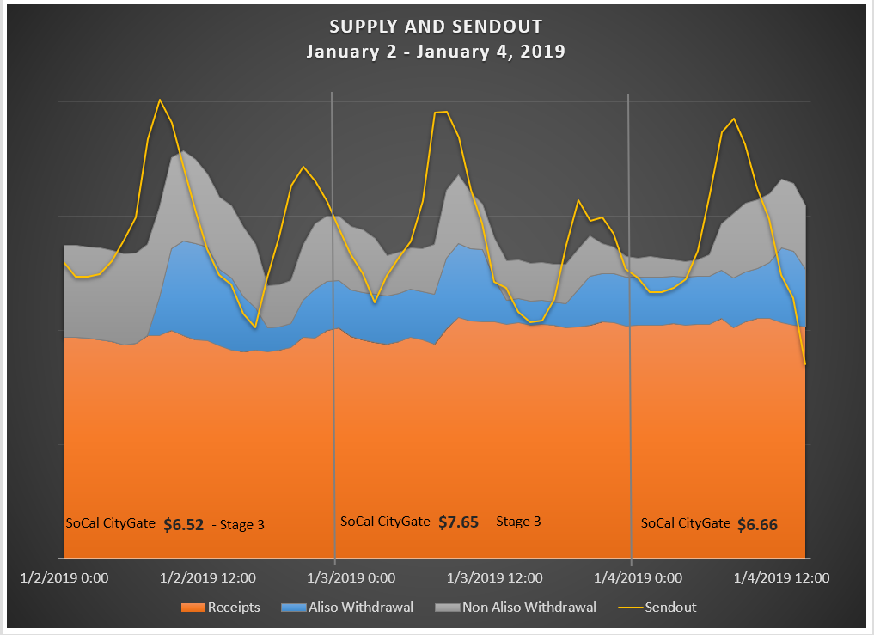
Notes:
City Gate Prices
Jan 2 is 6.52
Jan 3 is 7.65
Jan 4 is 6.66
Low-OFO Stage 3 called for Jan 2 & 3

Slide 3
Recent Winter Event (12/26/18-1/4/19)
Experiencing colder weather than last winter and already have less natural gas in our non-Aliso storage fields than this time last year (33.5 Bcf as compared to 39.7).
SoCalGas has withdrawn (over the 9 days) approximately 6.1 billion cubic feet (Bcf) from the non-Aliso storage fields with 66% of storage inventory remaining.
Greatest demand Day 1/2/19:
Forecasted demand at 3.6 billion cubic feet per day (BCFD) with actual being demand reaching 3.5 BCFD.
Peak hourly rate of approximately 200 million cubic feet per hour (MMcfh) at 7:50 AM, the equivalent of a 4.8 BCFD.
The total withdrawal for this day was 1.2 billion cubic feet (BCF). The maximum withdrawal capacity of the non-Aliso fields was 970 MMcfd.
SoCalGas will continue to work with the California Independent System Operator and Los Angeles Department of Water and Power (collectively, the “Balancing Authorities”) to reduce electric generation demand through voluntarily curtailments.
Without greater use of Aliso Canyon to manage inventory and deliverability at the non-Aliso fields, SoCalGas expects further reductions in inventory and withdrawal capacity at the non-Aliso storage fields

Slide 4
Demand Response
Winter DR Summary – Week of 12/31
SoCalGas activated three Smart Therm demand response (DR) events during the previous week on 1/2, 1/3, and 1/4. All three events were activated for the morning period between 5am-9am.
Customers participating in the DR program received a notice at least nine hours before the events occurred. During the events, thermostats were lowered up to four degrees from their current setpoint. Once the peak period came to an end, thermostats were returned to their original setpoints.
Winter DR Events*
[1] Partial participation – Device only participated in a portion of the DR activation because it was either “off” or in an incompatible mode for the rest of the time period.
[2] Opt-Out – Customer overrode the DR settings either before or during the activation.
[3] Other – Device was either “off”, in an incompatible mode, or was not accessible due to technical issues.
[4] Internal estimates based on anticipated savings from 2017-2018 winter program.
* These are preliminary results. SoCalGas intends to conduct a load impact evaluation following the conclusion of the program.
Date | 1/2/2019 | 1/3/2019 | 1/4/2019
Time | 5-9am | 5-9am | 5-9am
Devices Targeted | 10,780 | 10,789 | 10,790
Full Participation | 46% | 48% | 49%
Partial Participation [1] | 7% | 9% | 6%
Opt-Out [2] | 28% | 26% | 28%
Other [3] | 19% | 17% | 17%
Therm Savings
Internal Estimate [4] | 279.4 | 286.6 | 286.6
Dates | Time | Thermostat
1/2 | 5am - 9am | Nest and ecobee
1/3 | 5am - 9am | Nest and ecobee
1/4 | 5am - 9am | Nest and ecobee
Winter DR Enrollments
*Results are cumulative,
Total | As of 1/4
Customers enrolled | 9,189
Devices enrolled | 10,939
Unenrolled | 25

Slide 5
BTS Rights By Shipper Type
 |  | Core and Noncore Balancing Agents | Core Balancing Agents | Noncore Balancing Agents | No Balancing Agent Responsibilities | Total
2017 | (Dth) | 166,440,473 | 378,528,111 | 343,099,268 | 140,873,978 | 1,028,941,830
 | (%) | 16% | 37% | 33% | 14%
Jul-Sep | (Dth) | 44,417,314 | 85,268,659 | 97,989,329 | 30,587,629 | 258,262,931
 | (%) | 17% | 33% | 38% | 12%
2018 | (Dth) | 166,993,457 | 435,130,685 | 296,328,260 | 163,564,550 | 1,062,016,952
 | (%) | 16% | 41% | 28% | 15%
Jul-Sep | (Dth) | 70,411,983 | 87,987,604 | 80,314,260 | 42,383,401 | 281,097,248
 | (%) | 25% | 31% | 29% | 15%

Slide 6
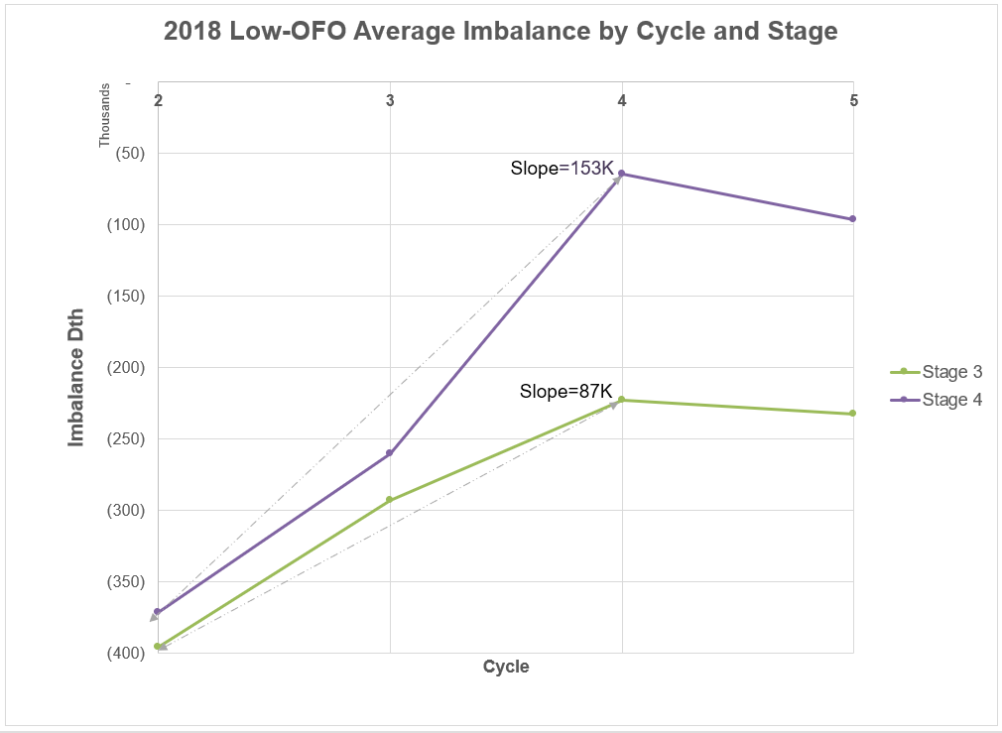
Rate of Imbalance Correction 2018
Notes:
Slope represents the avg. imbalance response rate from cycle 2 to 4
Data is from January to November 2018.

Slide 8
Recomendation
Allow Aliso Canyon to be used regularly as a market tool adding to supplies available
  This change can be done immediately
  Will clearly reduce the number of OFOs
  Will increase supply by giving the market access to the working gas in Aliso Canyon

