Slide 1


Southern California Natural Gas Prices
January 11, 2019
California Public
Utilities Commission
California Energy Commission

Slide 2
Workshop Agenda
An update from Energy Commission and CPUC staff on natural gas price trends in Southern California.
Presentations from industry and consumer groups representatives about the impact of high wholesale natural gas prices on electric generation prices and customer bills, both core (residential and small commercial) and noncore (large commercial, industrial, and agriculture facilities).
Discussion of potential mitigation measures including stakeholder presentations to reduce the impact of high wholesale natural gas prices on core and noncore customers.
An opportunity for public comment.

Slide 3
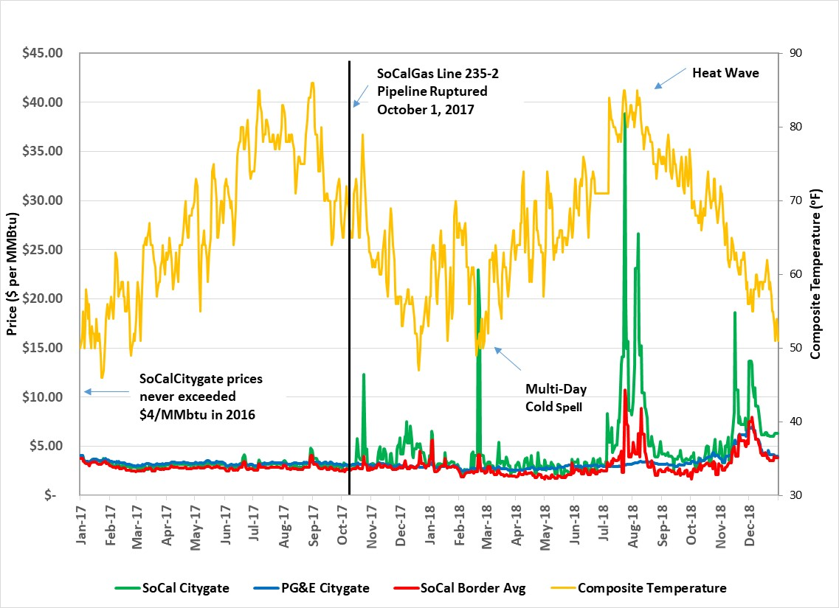
SoCalGas Citygate Shows Spikes versus SoCal Border Prices Several Times Since the Line 235 Rupture
Data Source: Point Logic and IHS Company

Slide 4
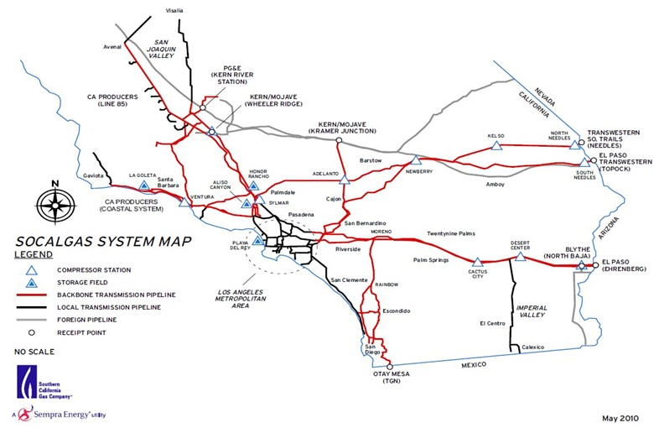
SoCalGas Receipt Point Capacity Reduced by 770 MMcfd due to Status of Lines 235, 3000 and 4000

Slide 5
SoCalGas System Receipt Point Capacity is Reduced by the Outages & Will Remain So for Some Months

Slide 6
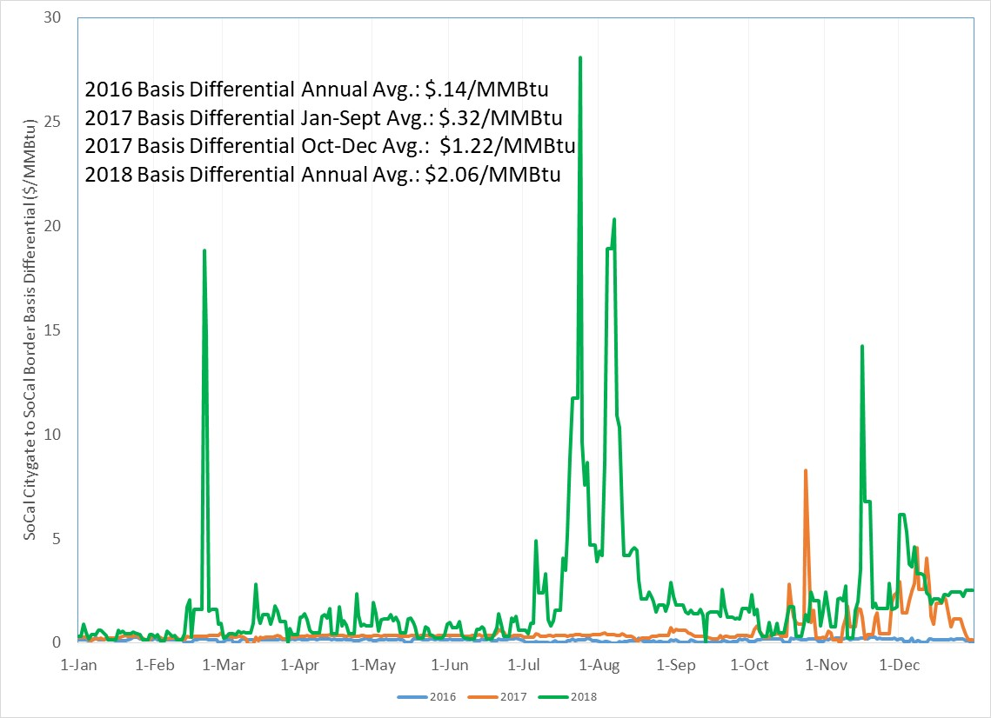
SoCalGas Citygate to SoCal Border Price Differential Shows Periodic Spikes + Larger Basis Differential Overall
Data Source: Point Logic and IHS Company

Slide 7
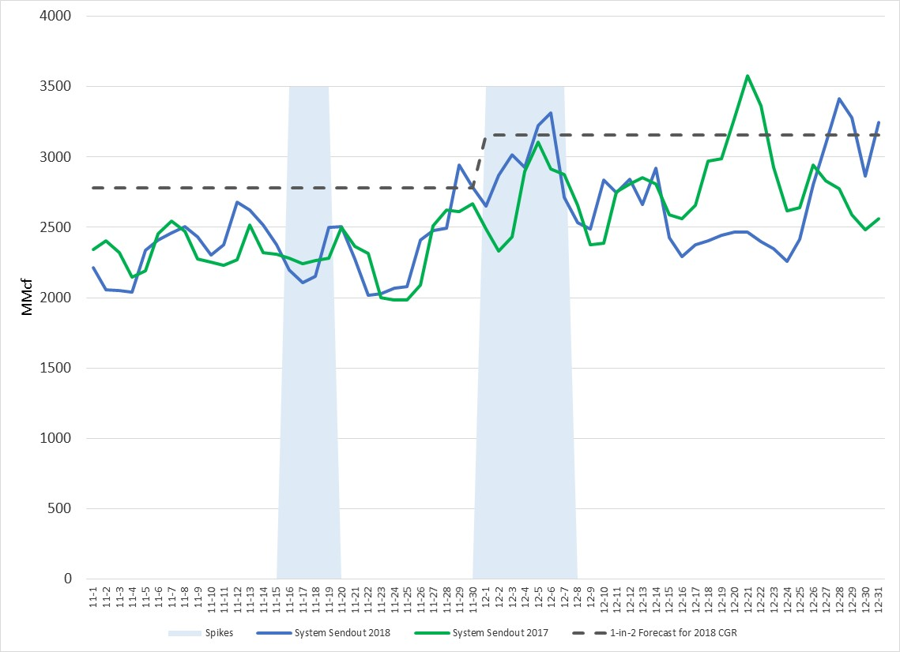
Spikes Don’t Seem Related to Sendout: November & December 2018 SoCalGas Sendout Similar to 2017’s
Data Source: SoCalGas Envoy, 2018 California Gas Report, Point Logic and IHS Company

Slide 8
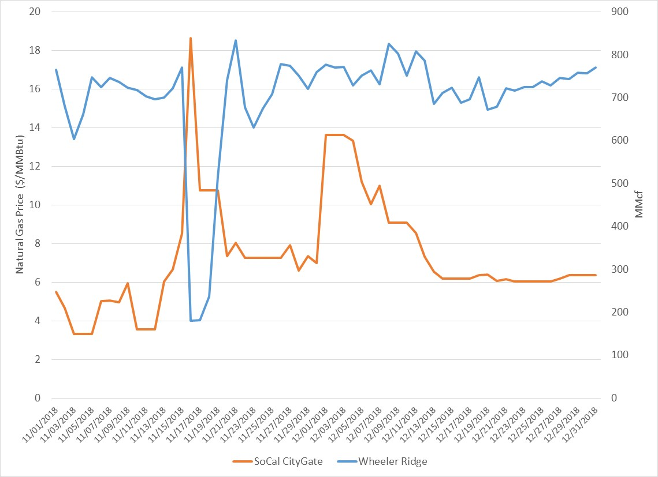
Spikes Somewhat Correlated to “Planned” Maintenance at Wheeler Ridge Further Reducing Receipt Point Capacity
Data Source: Point Logic and IHS Company and SoCalGas Envoy
Notes:
Planned Maintenance Event at Wheeler Ridge Nov. 16 (Fri), 17, 18.

Slide 9
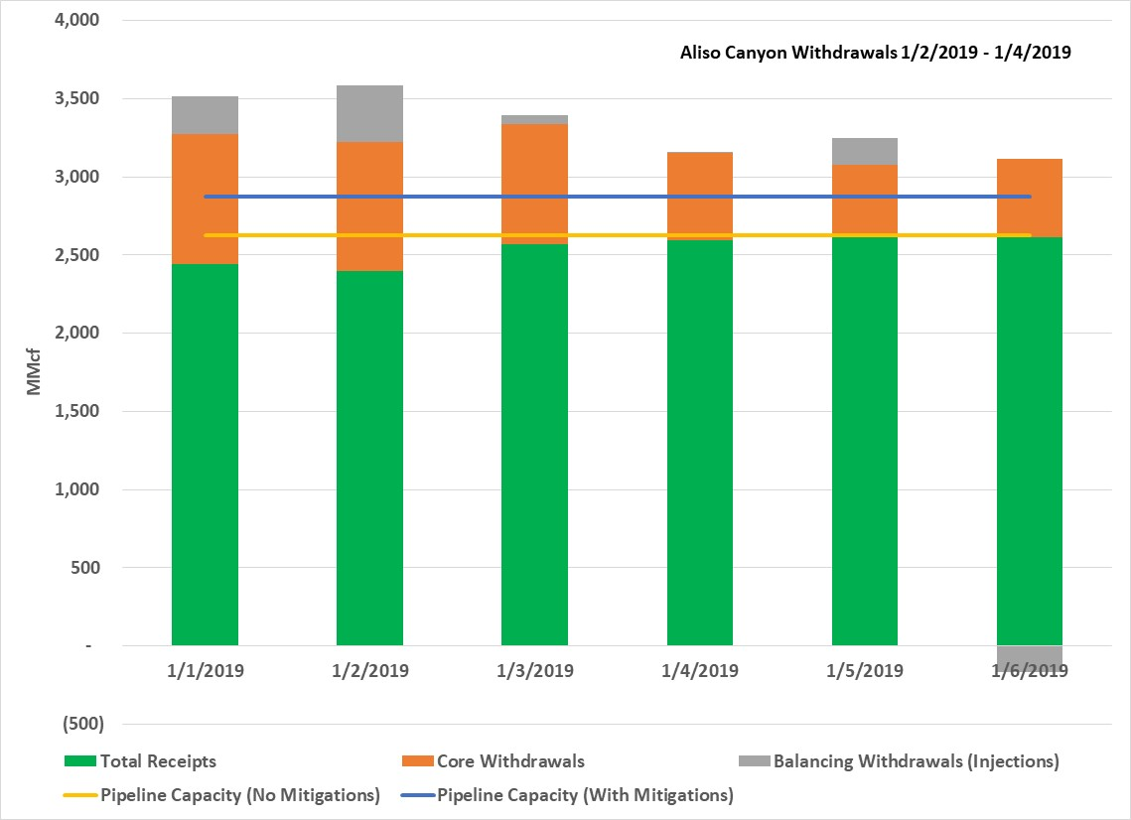
Pipelines not Full During Recent Cold Snap Week of Jan 1, 2019
Data Source: SoCalGas Envoy

Slide 10
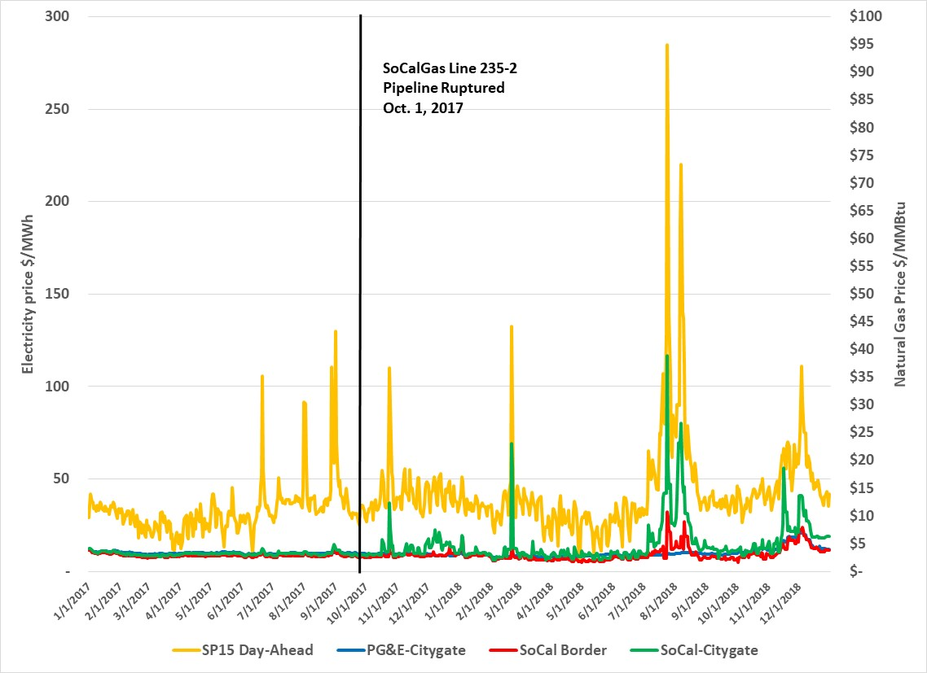
High Natural Gas Prices Translate to High Electricity Prices
Data Source: Ventyx

Slide 11
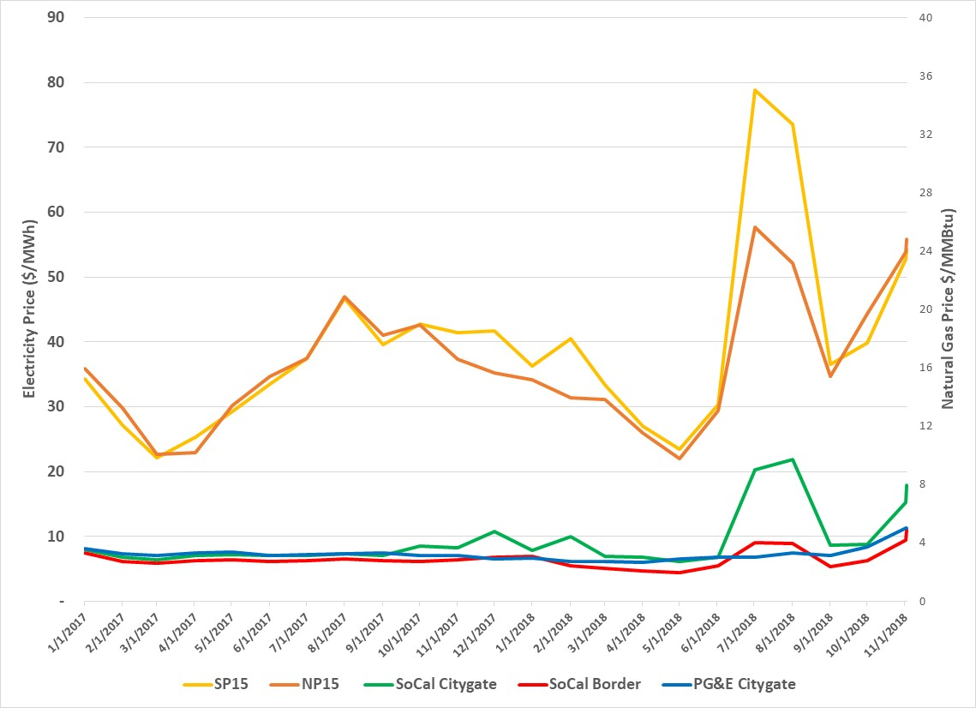
Electricity Prices this Past Summer Increase Significantly from 2017 Levels
Data Source: Ventyx

Slide 12
          Questions?

