Slide 1
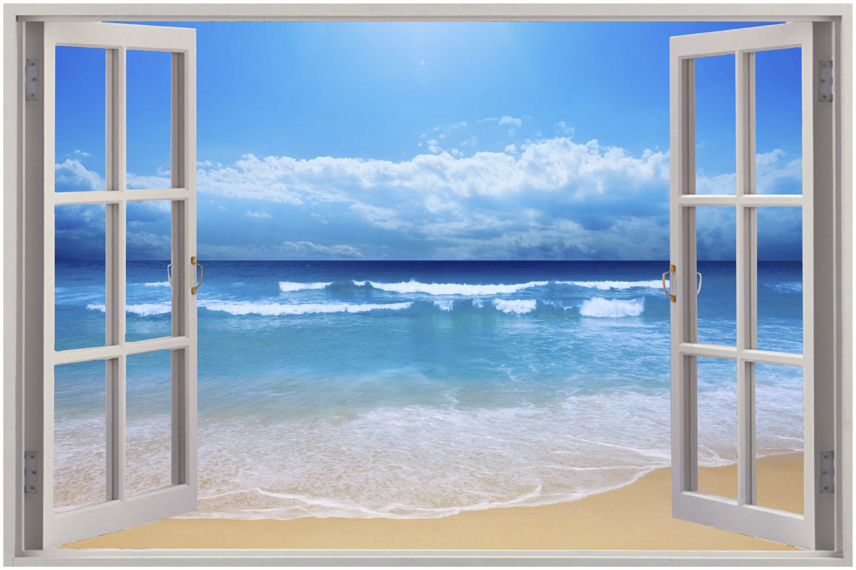
California Partnership for Advanced
Windows (C-PAW)
Thin Center Glass Triple Pane Windows
A Window Into Protecting the
Pale Blue Dot

Slide 2

Organizations Supporting C-PAW
C-PAW was formed in summer of 2018 to facilitate widespread market transformation to advanced thin center glass (skinny) triple pane windows, this effort is supported by:
California Energy Commission (CEC)
Lawrence Berkeley National Labs (LBNL)
California Building Industry Association (CBIA)
Pacific Gas and Electricity (PG&E)
Southern California Edison (SCE)
Sacramento Municipal Utility District (SMUD)
Cooperating Window Manufacturers Include:
Anderson Windows
Alpen Windows
Anlin Windows
PlyGem Windows
Builder support is offered by De Young Properties

Slide 3
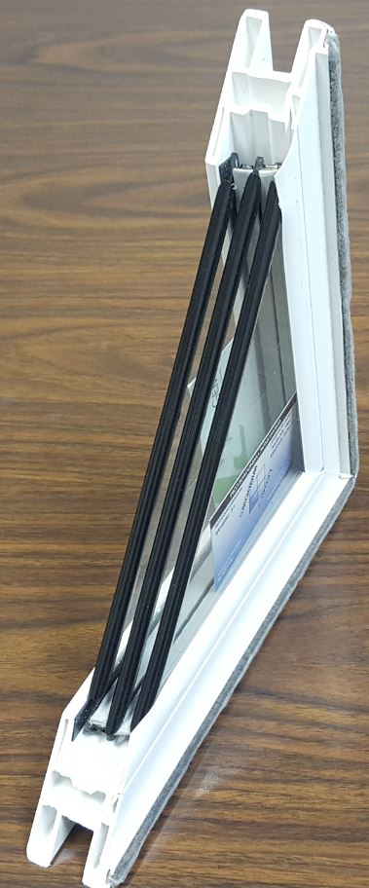
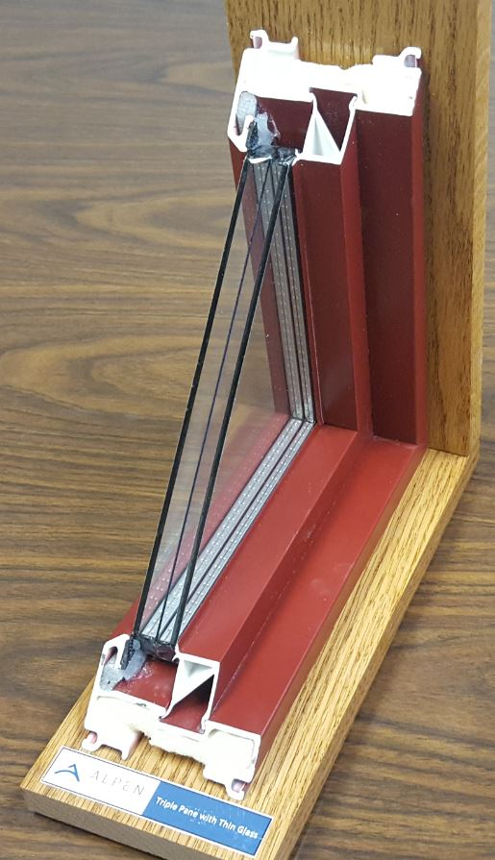
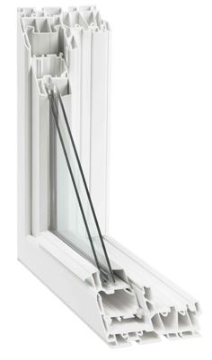
Skinny Triple Pane Versus Chunky Triple Pane Windows
Standard Center Glass “Chunky” Triple Pane
Thin Center Glass “Skinny” Triple Pane
Standard Double Pane

Slide 4
2019 Standards and Advanced Windows (AW)
The 2019 Standards have several features that may encourage builders consider AW
Stricter high performance attics and walls (HPA and HPW) requirements
Quality insulation installation (QII) as a prescriptive requirement
Removing the PV tradeoff against building envelope efficiency features
Overall fewer viable compliance options available for performance compliance
As a result, AW may emerged as a potential compliance option that builders can use to trade away other envelope features, such as 2x6 framing for HPW, or to help achieve overall compliance
Thin triple pane windows offer the best opportunity for AW to be used for tradeoffs
  Same dimensions as double pane windows – no change in construction practice
  Reasonable costs and very high performance in terms of U-factor and SHGC
  Significant compliance credit for tradeoffs
  Suitable for new construction, existing building retrofits, and residential and nonresidential buildings

Slide 5
2019 Standards High Performance Attics and Walls
HPA:
Requires R19 below deck cavity insulation – Limited to southwest hot dry climates
Some builders view this as a big change in construction practice and may want to trade away
R19 roof deck contributes 4.2 Energy Design Rating (EDR) points in the performance path
HPW:
Requires R20 in 2x6 framing and R5 continuous insulation – Works across all climate zones
Some builders view switching to 2x6 framing as a significant change in construction practice
2x6 framing with R20 cavity insulation contribute 1.7 EDR points in the performance path
Quality Insulation Installation (QII) – Works across all severe climate zones
Requires third party HERS verification of all insulation
Unable to verify once drywall goes up
Contributes 2 EDR points in the performance path
Thin center glass triple pane windows:
Represent no change in construction practice – Widespread application across North America and beyond
0.20 U-factor and SHGC window contribute 2.2 EDR points, enough to go back to 2x4 construction, not require QII, or trade away the attic insulation in combination with another efficiency measures

Slide 6
LBNL Highly Insulating Windows RD&D
40+ year history of engagement with window industry
  Technology, Test facilities, Design and Rating tools,…
Essential Partnership Role in bringing Low-E to Market
  Now ~90% residential market share; $150B savings
Heat Loss from Windows:
  Low-E Market Saturation - but “Stalled” at R3/double-glazed platform
  R6+ Windows -> Net Zero envelope, $20B/yr savings
Create “Alliance” to Advance Near Term, Cost Effective, Scalable Solutions, transform markets to “high R”
  DOE Project support: “R8 Thin Glass/IGU” Innovation Platform
  Technology agnostic: conventional triples, vacuum insulating glass, etc
Build Business Case: Energy, Comfort, Grid, Resilience,…
  New and Retrofit; Residential and Commercial
Market Pull Programs: Validation, Tools, Codes, Demos, Rebates, Grid impacts, Zero Energy homes, Passive House ...

Slide 7
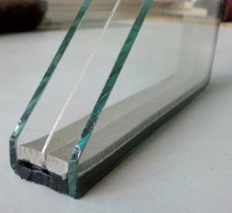
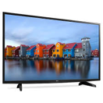
Drop-In “Thin Lightweight Triple”
“upgrade” all R3 double glazed windows to R4-7 without redesign
Platform: U: ~.10-.15
Thin float glass
  .3, .5, .7, 1.1 mm
Multiple suppliers
2 Low-E coatings
Krypton gas fill
Non-structural center
  2 seals, not 4
Infrastructure exists
“Affordable”
Surface
#1
#2
#3
#4
#5
#6
0.7mm thin glass center layer
Low-e
Foam spacer
Butyl sealant
Notes:
=
R2 double →R3 lowE with drop in R4 IGIU

Slide 8
Emerging Technology (R6-R10 IGU)
Technical Validation
Simulation
Optimization
Climate Modeling
Prototypes
Coatings
Supply chain Partners
Thin Glass
Coatings
Gas supply
Gas fill
Spacer design
IGU fabrication
Collaborative
R&D
I
Market Scale Up (R4-R8 window)
Technical Evaluation
Laboratory Testing
Field Demonstrations
Utility Incentives
Codes and Standards
Net Zero advocates
ENERGYSTAR Criteria
Window Partners
Andersen Windows
Alpen Windows
Market Intelligence
Cost Optimization
II
Collaborative
R&D
Notes:
Currently in the stage with Window partners. Utilities can help in the highlighted stage though and in this stage by asking for analysis in their areas.

Slide 9

Questions?
    Questions?
9

