Slide 1
Commissioner Workshop on the Draft 2018 Integrated Energy Policy Report Update
October 19, 2018
Heather Raitt
California Energy Commission

Slide 2
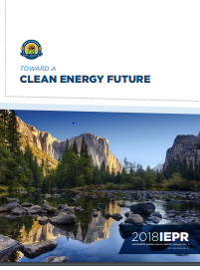
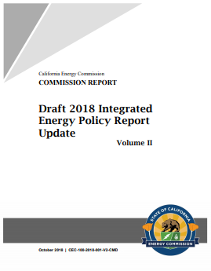
2018 IEPR Update Process
This year’s IEPR has two parts:
  Volume I, adopted August 1, 2018
  Volume II, to be considered for adoption February 2019
Held 12 IEPR public workshops and webinars
Workshop scheduled for December to discuss updated electricity forecast
Volume I and Draft Volume II, workshop materials, & transcripts are available at:
http://www.energy.ca.gov/2018_energypolicy/

Slide 3

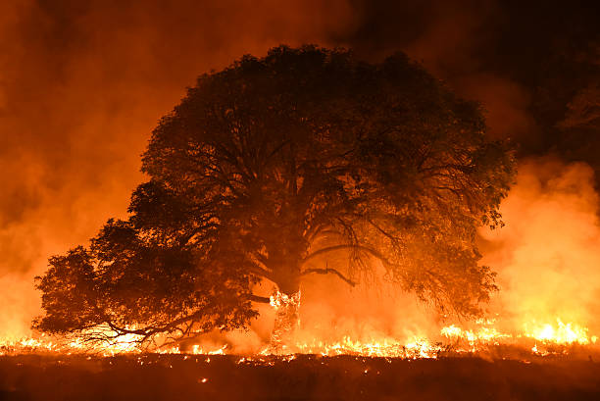

Impacts of Climate Change
California’s Fourth Climate Change Assessment
The Governor’s Office of Planning and Research, the Energy Commission, and California Natural Resources Agency
Results show:
  Severe wildfires
  Rising sea levels
  Increased flooding
  Coastal erosion
  Extreme heat
  More frequent & longer droughts
http://www.climateassessment.ca.gov/

Slide 4
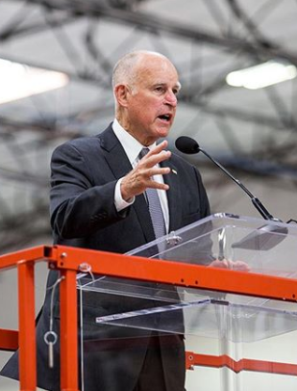
California Leadership to Reduce GHG Emissions
AB 32 (Núñez, 2006)
  Reduce GHG emissions to 1990 levels by 2020
SB 350 (de León, 2015)
  Increase RPS to 50% by 2030
  Double energy efficiency savings by 2030
  Advance transportation electrification
  Ensure benefits of clean energy reach low-income and disadvantaged communities
SB 32 (Pavley, 2016)
  Reduce GHG emissions 40% below 1990 levels by 2030
SB 1383 (Lara, 2016)
  Reduce methane and hydrofluorocarbon refrigerants to 40% below 2013 levels by 2030

Slide 5
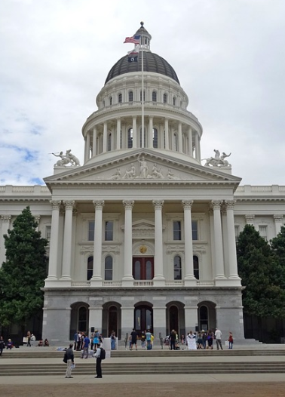
California Leadership to Reduce
GHG Emissions – Sept. 2018
SB 100 (de León, 2018)
  100% zero-carbon electricity by 2045
  Increase 2030 renewables target from 50% to 60%
Executive Order B-55-18
  Statewide goal to achieve carbon neutrality (zero-net GHG emissions) by 2045
  Maintain net negative emissions thereafter
Hosted Global Climate Action Summit

Slide 6
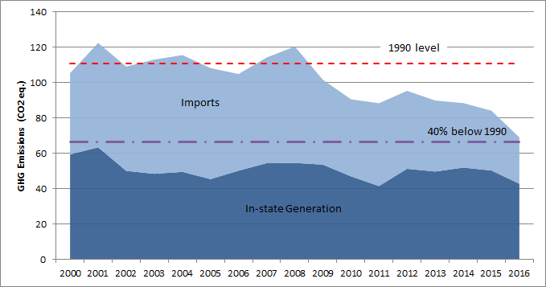
California’s Electricity Sector
Leads the Way
Electricity sector GHG emissions in 2016 were 37.6% below 1990 levels
Electricity sector accounted for only 16% of statewide emissions
In 2017, 32% of electricity served from renewables
36% of state’s renewable generation was solar in 2017

Slide 7
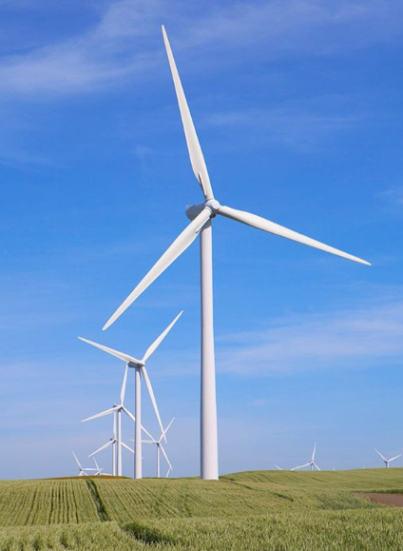
Increasing Flexibility to Integrate
More Renewables
Some gains in flexibility since 2017
Multiple tools are needed:
  Performance standards for inverter-connected solar and wind power plants
  Energy storage
  Grid regionalization
  Increasing flexibility of loads

Slide 8

A Changing Electricity Market
Household choices about energy are increasing, such as:
  Self generation
  Community choice aggregators
New opportunities and questions

Slide 9
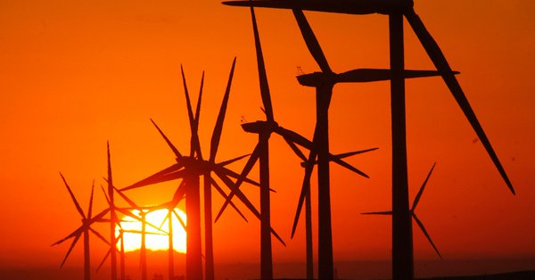
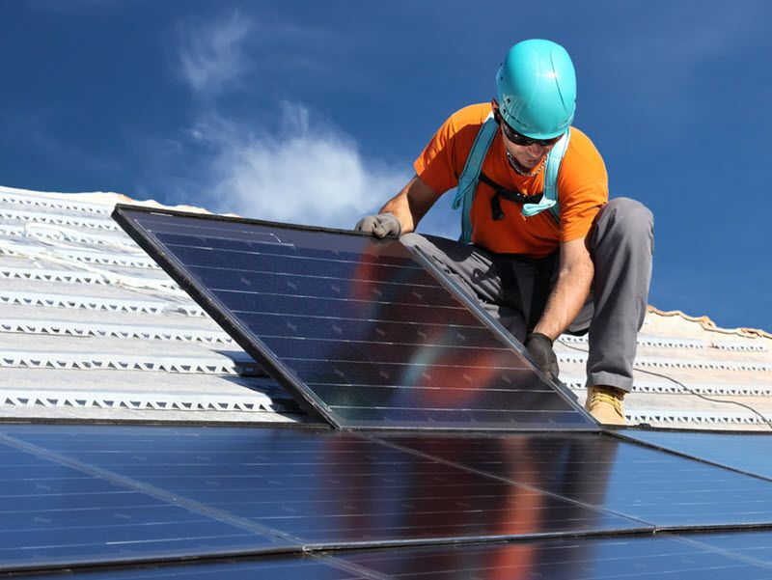
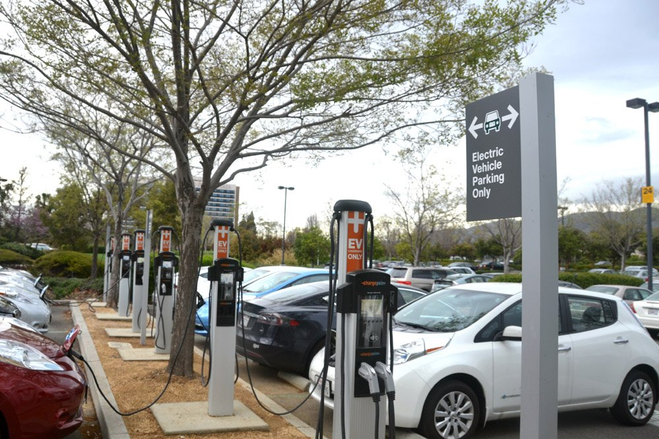
California’s Energy
Demand Forecast is Evolving
Update to forecast in 2017 IEPR will include refreshed projections of:
  Solar photovoltaic system adoptions
  Plug-in electric vehicle adoptions
  Community choice aggregators
  Time-of-use rate impacts
Monthly peak loads as well as forecasts of consumption and annual peak load
Proposed adoption January 2019

Slide 10
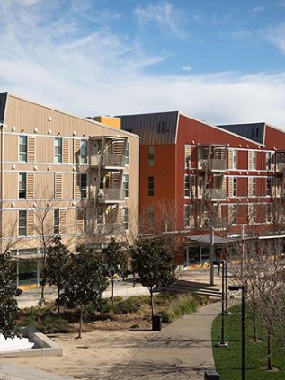
Decarbonizing Buildings
Emissions from buildings are second only to transportation
Need to move to zero-emission buildings
Electrification is a key strategy, coupled with load management strategies

Slide 11
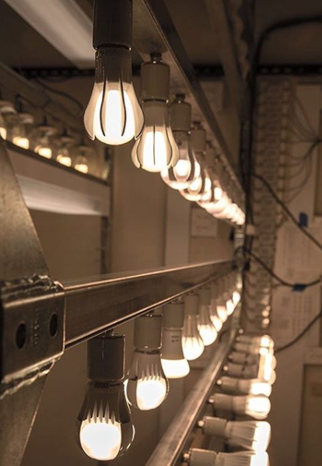
Energy Efficiency
Doubling Savings by 2030
Opportunities for EE investments are precious and have long-term effects
Agriculture and industrial sectors are promising
  Account for about 25% of state energy consumption
Building standards adopted in 2018
  Require solar on new homes beginning in 2020

Slide 12
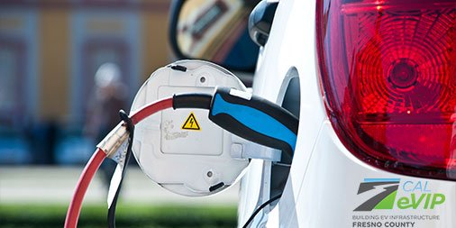
Increasing Access to
Clean Energy Benefits
Progress implementing the Barriers Study
Energy Commission:
  Energy Equity Indicators webpage
  Draft Clean Energy in Low-Income Multifamily Buildings Action Plan
California Air Resources Board:
  One-Stop-Shop Pilot Project
  Low-Carbon Transportation
  Equity Projects

Slide 13
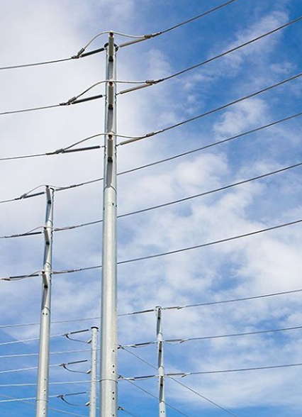
Maintaining Energy Reliability in Southern California
Joint agency team:
  Energy Commission
  California Public Utilities Commission
  California Independent System Operator
  LADWP in Aliso Canyon effort
Closure of San Onofre Nuclear Generation Station and of coastal power plants
  Watching Mesa Loop-in project
Massive leak at Aliso Canyon natural gas storage facility and pipeline outages
  System more constrained than in 2017

Slide 14

Commissioner Workshop on the
Draft 2018 IEPR Update
Thank you
Written comments due November 2
Final report will be released in January for a proposed adoption in February

Slide 15
Commissioner Workshop on
Draft 2018 IEPR Update
Public Comments
(3 min each)

Slide 16
Commissioner Workshop on
Draft 2018 IEPR Update
Written Comments due Friday, November 2, 2018
2018 IEPR Update is using e-filing:
  http://www.energy.ca.gov/2018_energypolicy/
  Click on the “Submit e-Comment” link in the “Proceeding Information” box
Select No. 18-IEPR-01 – General/Scope
Enter your contact information and title of the comment
  Select “IEPR Public Comments” for subject
  You may include comments in the box titled “comment text” or attach a file with your comments
  Attached comments must be in a Microsoft® Word (.doc, .docx) or Adobe® Acrobat® (.pdf) formatted file

