Slide 1
Webinar on Forms and Instructions to Collect Electricity Demand Forecast and Electricity Resource Plan Data from Load-Serving Entities
Robert Kennedy and Cary Garcia
October 2, 2018
California Energy Commission

Slide 2
Webinar Format and Agenda
Introductions
Format
Regulations and Authority
Demand Forms Walkthrough
Supply Forms Walkthrough
Docket Procedures
Important Dates and Next Steps

Slide 3
Regulations and Authority
California Public Resources Code Section 25301 – 2019 Integrated Energy Policy Report
California Public Resource Code 2516 and 2516.5 provides authority to collect information “on all forms of energy supply, demand…”
California Code of Regulations § 1347 – Electricity Resource Plans

Slide 4
Demand Forms
Cary Garcia
October 2, 2018
California Energy Commission

Slide 5
Who Must File
LSEs whose annual peak demand in the last two consecutive years exceeded 200 MW.
Including utility distribution companies (UDCs), energy service providers (ESPs), community choice aggregators (CCAs)
  UDCs - Forms 1 through 6 and Form 8
  ESPs - Forms 7 and 8
  CCAs - 7.2 and 8.1a (CCA)

Slide 6
2019 Demand Forms
Form | Form Description
1 | Historical and Forecast Electricity Demand – annual sales and peak demand, private supply, and hourly loads
2 | Forecast Input Assumptions–economic and demographic assumptions and electricity rate forecasts
3 | Incremental Demand Side Management Program Impacts, including energy efficiency, demand response, and distributed generation program impacts
4 | Forecast Methodology Documentation
6 | Demand Side Management Methodology Documentation
7 | CCA and ESP Load Forecasts
8 | Price and Rate Forms

Slide 7
Deadlines
February 11, 2019
  Sales 1.1a and PV Interconnection 1.8
April 15, 2019
  Remaining Forms 1-7
June 3, 2019
  Form 8 Retail rate and price forms
LSEs that require additional time may request an extension by submitting a written request to the Executive Director of the Energy Commission

Slide 8
Changes for 2019
Separate templates for IOUs, POUs, CCAs, ESPs.
Forms removed:
  Forms 1.6c-1.6d Res and Non-Res Loadshapes;
  Form 3.3 Cumulative Incremental Impacts of Distributed Generation;
  and Form 8.2 Monthly Residential Sales by Baseline are no longer required.

Slide 9
Changes for 2019
Forms 1.7a, 1.7b, and 1.7c were updated to streamline collection of DER impacts
Form 4 was updated to include a description of the data and methodology used to prepare forecast of DERs.

Slide 10
Changes for 2019
Forms 8.1a-8.1b, revenue requirements, received minor updates.
  New line items for data previously reported in aggregate.

Slide 11
Form 8.1a Updates
Procurement costs for storage resources
Catastrophic event memoranda accounts
Greenhouse gas allowance proceeds returned to customers
An “All Other” revenue requirement category for both generation and distribution revenue requirements

Slide 12
Form 1.8: PV Interconnection
Requests behind-the-meter PV system interconnection data from UDCs
For years 2014 – 2018 provide:
    Total # of BTM PV systems
    Total capacity of BTM PV systems in kW (AC)
      Grouped by Zipcode, county, interconnection year and month, and customer class

Slide 13
Form 1.8: PV Interconnection

Slide 14
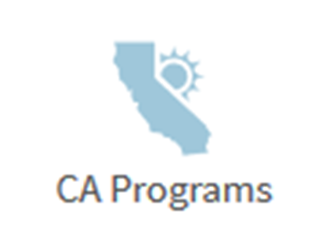
Public Datasets Don’t Provide a Complete Picture
Existing data sources are incomplete or have been discontinued.
PV incentive program data
  Programs are either expired or winding down
    California Solar Initiative (CSI)
    Publicly Owned Utilities SB1 Solar Program (SB1 POU)
  More customers are installing systems without participating in programs
PV interconnection data
  NEM Interconnection dataset by CPUC.
    Only covers IOU interconnection data.
    Data does not include non-export PV systems.

Slide 15
Transitioning to the Future
…but not quite there yet.
Form 1306C data allows staff to analyze and forecast PV adoption at a more disaggregate level.
  Working with the NREL to develop a PV adoption model using disaggregate data.
Form 1.8 Interconnection data have been accurate and comprehensive datasets.
  Verify accuracy and completeness of 1306C submissions before transitioning to relying solely on 1306C.
  Reliable data source if issues arise with 1306C data submission or data processing.

Slide 16
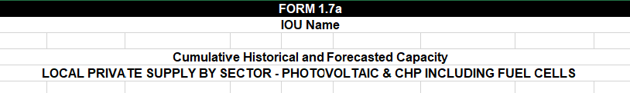
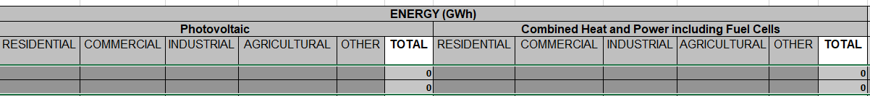
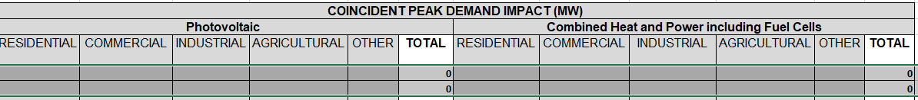
Form 1.7a

Slide 17
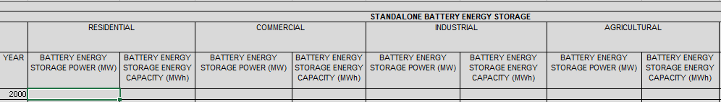
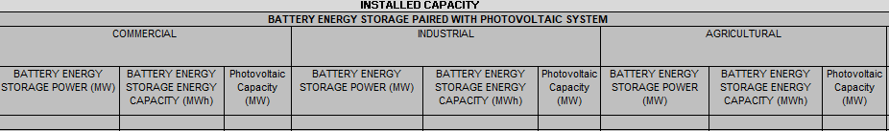
Form 1.7b – Installed Capacity

Slide 18
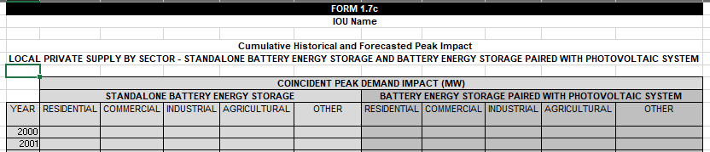
Form 1.7c

Slide 19

Questions

Slide 20
Supply Forms
Robert Kennedy
October 2, 2018
California Energy Commission

Slide 21
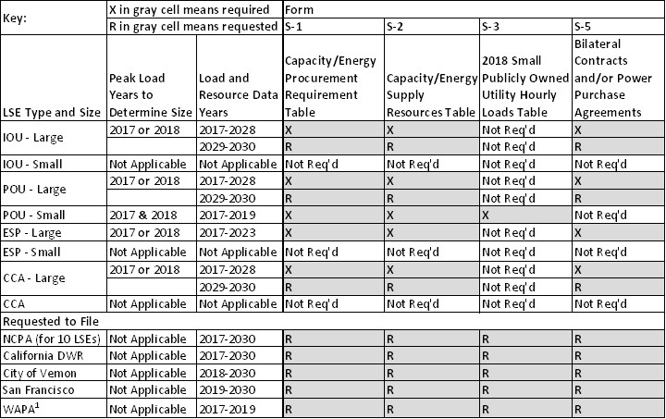
Supply Forms- Who Reports What

Slide 22
Supply Forms - Proposed Timeline
Business Meeting Date: November 7, 2018
Proposed Due Date: April 19, 2019 for POUs, ESPs, and CCAs*
Proposed Due Date: April 26, 2019 for IOUs.
*Publicly owned utility (POU); Electric service provider (ESP); Community choice aggregator (CCA)

Slide 23
Supply Forms- Changes from Last Report
The S-1 and S-2 forms have been re-arranged and re-named.
Individual hydroelectric capacity must not be listed.
Cells were greyed out and protected to promote more correct data entry.
Instructions have been re-written.
Request to forecast out to year 2030.

Slide 24
Supply Forms Walkthrough
Administration Information
S-1 Capacity/Energy Procurement Requirement Form
S-2 Capacity/Energy Supply Resources Form
S-3 2018 Small Publicly Owned Utility Hourly Loads
S-5 Bilateral Contracts and Power Purchase Agreements

Slide 25
Docket Procedures
Submit Questions, Reports to the Docket
  19-IEPR-02 – Electricity Resource Plans
  19-IEPR-03 – Electricity and Natural Gas Demand Forecast
Request Confidentiality
Request Submittal Extension
Comments are due to the docket by Friday, October 12, 2018

Slide 26
Contact Information:
Supply Forms: Robert Kennedy
(916) 654-5180
Robert.kennedy@energy.ca.gov
Demand Forms: Kelvin Ke
(916) 654-4502
Kelvin.Ke@energy.ca.gov

