Slide 1
Wrap Up- Path Forward For Addressing Energy and Transportation Equity
Improved understanding of clean transportation and energy barriers
Broader collaboration and partnerships
Adjusting policies and programs
Exploring new, innovative and transformative approaches
Seeing results/progress on the ground

Slide 2
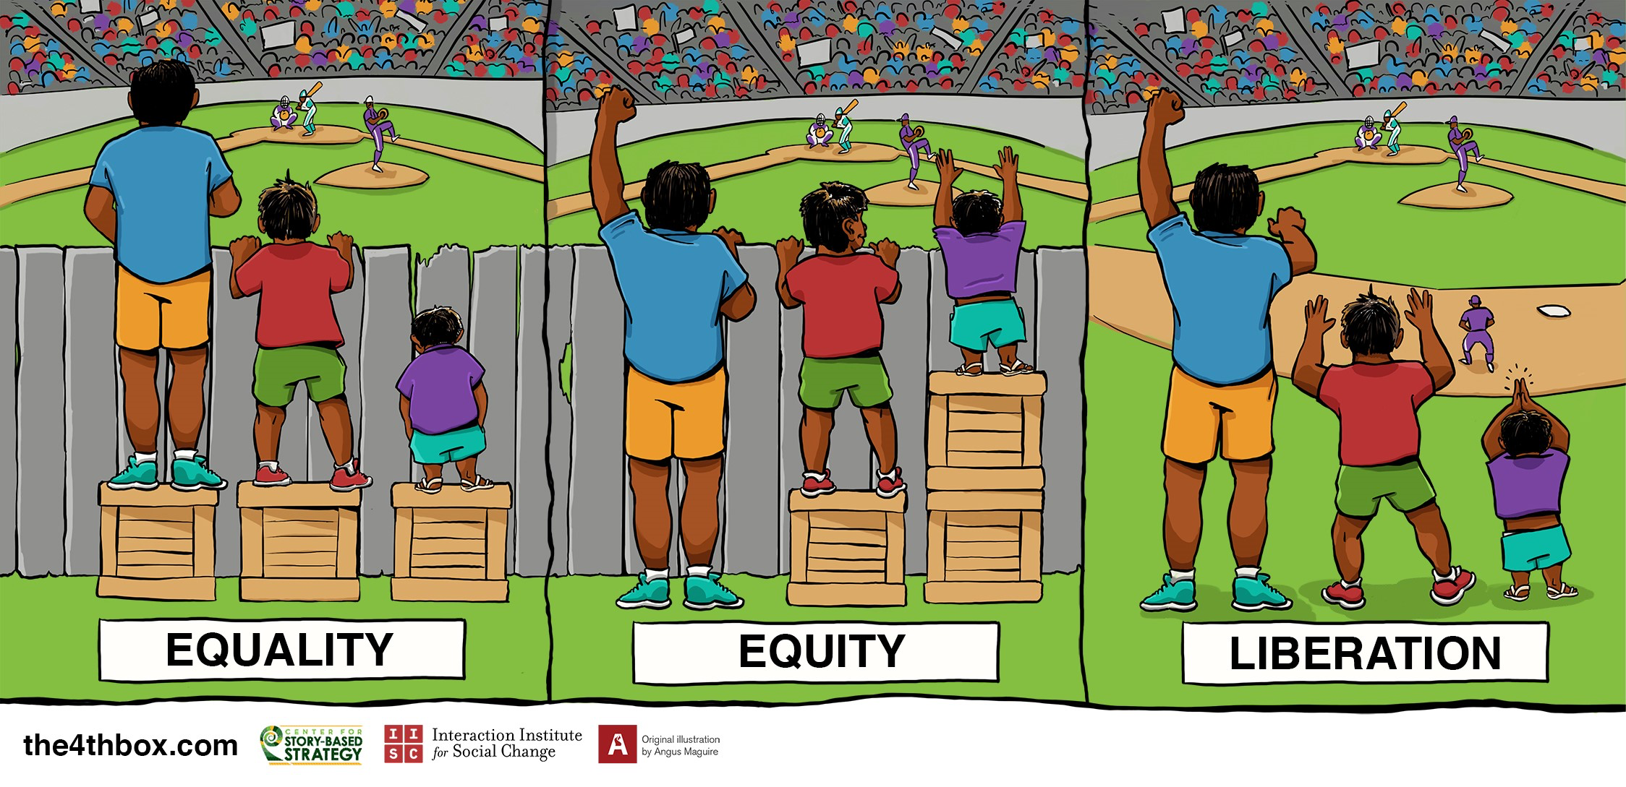
Wrap Up- Path Forward For Addressing Energy and Transportation Equity
ENGAGEMENT
Graphic:

