Slide 1






Presented by: Jaime R. Lemus; Sac Metro Air District

Slide 2
Program Overview
Phase | Funding (GGRF funds) | Sites (2 Electric Vehicles per site) | Chargers
1 | $1.3 million | 4 Subsidized Housing locations | 8 dedicated level 2 chargers 1 DC Fast Charger
2 | $1.0 million | 3 Subsidized Housing locations | 6 dedicated level 2 chargers
*RideHail – New component introduced in Phase 2

Slide 3

Lessons Learned
Program Launch Challenges
  Contracting timelines
  Construction timelines
    Weather Delays
Managing members and vehicle use
Outreach and Education – LOTS!!!
  How material is provided
    Fliers, Emails, Workshops
  Benefits
    Free Transportation
  Understanding Barriers
    Language, technology, time, distrust
    App savvy
    Common Communication Methods include Facebook and Texting
    Material overload
  Frequency
    Weekly site visits
  Moving Forward

Slide 4
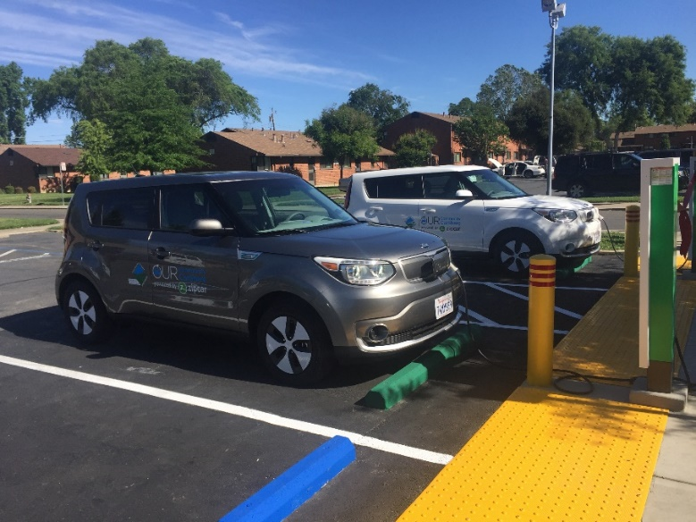
Looking to the Future
Currently
  4 sites launched (Phase 2: 3 sites by end of 2018)
  6,000+ trips taken
  92,000+ miles driven
  150+ Members
Additional Funding
  Expand to more sites
  Include more transportation options
  Provide a sustainability solution

