Slide 1
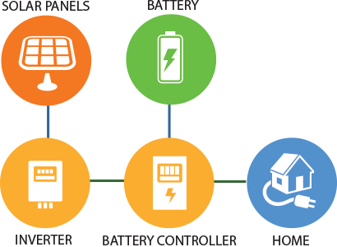
Commissioner Workshop on Solar Equipment List
Energy Storage Systems
Joseph Omoletski
Renewable Energy Division
August 16, 2018
Notes:
Moderating and providing context via presentation

Slide 2
Agenda
Motivation for a Storage List
Relevant References
Scheduled Panelists
Discussion Questions

Slide 3
Motivation for a Storage List
Accelerating growth of intermittent renewables
Increasing rate of storage installations
Added value of energy storage (rate changes) and prices beginning to fall
Addition of product offerings
Notes:
Accelerating growth of renewables has prompted an additional need to match generation with load.
There is a need to increase power quality associated with intermittent renewables
Storage can fulfill many applications associated with power quality (frequency and voltage regulation, peak shift, 4 quadrant operation)
Storage is growing, and identified need from stakeholders (utility, mfrs, etc) for more accessibility to storage data
Growth spurred by added value of storage, the increase in product offerings and lowering prices

Slide 4
Relevant References - Safety
Not all-encompassing, and there are additional standards in development
ANSI/UL 9540: Energy Storage Systems
ANSI/UL 1973: Batteries for Use in Stationary Applications
UL 9540A: Thermal Runaway in Battery Energy Storage Systems
Notes:
In general, equipment list includes safety and performance
Many standards both nationally and internationally be developed
UL 9540 is ANS but only applicable to whole systems
UL 1973 is applicable to a wide range of battery technologies
UL 9540A is a test protocol to identify thermal runaway dangers

Slide 5
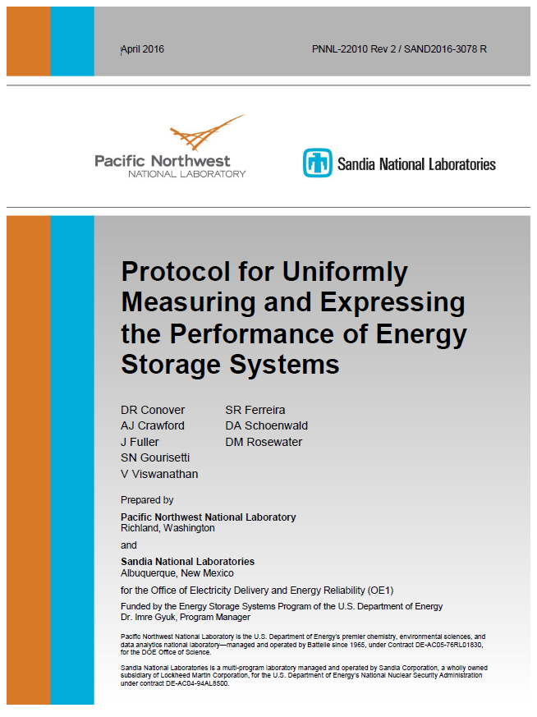
Relevant References - Performance
Challenges with non-standardized methods, or technologies that are not accurately covered by available standards and protocols. Some available:
Protocol for Uniformly Measuring and Expressing Performance of Energy Storage Systems (Pacific Northwest and Sandia National Labs)
IEC 62933: Electrical Energy Systems (parts in development)
Notes:
There are many standards in development for different technology performance, and remains to be seen when these will pass. Includes flow batteries, sodium based, and others.
PNNL-Sandia protocol developed by many stakeholders and is good for measuring performance of entire system. David Rosewater as author can comment further
IEC 62933 covers safety and performance in different parts but portions are not yet approved or published.

Slide 6
Scheduled Panelists
Robert Chan, PG&E
James Frasher, SMUD
Brad Heavner, California Solar and Storage Association
Jin Noh, California Energy Storage Alliance
David Rosewater, Sandia National Laboratories
Sarah Walinga, Tesla
Byron Washom, UC San Diego
Timothy Zgonena, UL
Notes:
Industry, utilities, research institutions

Slide 7
Discussion Questions
Is there a benefit to adding battery storage to the Solar Equipment Lists?
If the Energy Commission lists storage equipment, what should be included – storage systems, batteries, storage inverters, other?
Energy Commission staff is exploring specific battery technologies for inclusion in the Storage Equipment List, such as lead-acid, lithium ion, nickel metal hydride and nickel cadmium. What information and issues should we consider in making these decisions?
Energy Commission staff is considering primarily supporting distributed generation scale applications. Is there a need to incorporate larger scale applications and their related storage technologies (like flow batteries)?
What specific performance data should the Energy Commission include in the listing of battery storage on the Storage Equipment List? (e.g. round trip efficiency, charge/discharge rate, cycle life, etc.)

