Slide 1
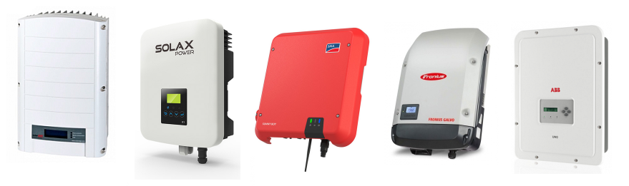
Commissioner Workshop on Solar Equipment List
Energy Commission’s Inverter List
Abtin Mehrshahi
Renewable Energy Division
August 16, 2018

Slide 2
Agenda
Background
Smart Inverters
Energy Commission’s Inverter List
Scheduled Panelists
Discussion Questions

Slide 3
Background of Inverter List
California Senate Bill 1 (SB 1)
Public Resources Code (PRC 25782)
SB 1 Guidelines
http://www.energy.ca.gov/sb1/documents/
Notes:
Senate Bill 1 (SB 1), passed in 2006, directed the California Energy Commission in consultation with the Public Utilities Commission, local publicly owned electric utilities, and interested members of the public, to establish eligibility criteria for solar energy systems receiving ratepayer funded incentives. In part, SB1 required the Energy Commission establish rating standards for equipment, components, and systems to assure reasonable performance. Further the legislation directed the Energy Commission to develop standards that provide for compliance with the minimum ratings.
To address the mandates of SB1, the Energy Commission developed and adopted the Guidelines for California’s Solar Electric Incentive Programs, more commonly referred to as the SB1 Guidelines. The most recent Sixth edition of the Guidelines, which were adopted in November 2016, are accessible at the link shown here.
Included in the SB1 Guidelines is a requirement that all major solar energy system components eligible for ratepayer funding are required to be included in the Energy Commission’s lists of eligible solar equipment.
The solar equipment lists were created to support solar incentive programs but it is a fact that these lists are used for other purposes as well. As an example, the IOUs rely on the lists to support the processing of interconnection.

Slide 4
Smart Inverters
CPUC’s Rule 21 tariff
Smart inverter requirements to interconnect
  The territory of California Investor Owned Utilities (IOUs)
    Pacific Gas & Electric Company (PG&E)
    Southern California Edison (SCE)
    San Diego Gas & Electric (SDG&E)
Notes:
The volume of distributed generation PV systems has continued to increase and the penetration levels have the potential to impact grid operations.
Potential impacts include transient grid voltage fluctuations, steady-state grid voltage problems and frequency deviations.
Smart inverters which can modulate output and communicate actively with grid operators are increasingly seen as a way to enhance grid stability and enable wider adoption of distributed energy resources (DER). New functions of smart inverter can enhance grid stability, allowing the grid to support more DERs while minimizing costly upgrades to the grid.
The California Public Utilities Commission’s (CPUC) Electric Rule 21 is a tariff that describes the interconnection, operating, and metering requirements for generating facilities connected to the investor-owned utilities’ (PG&E, SCE, SDG&E) distribution systems over which the CPUC has jurisdiction. The tariff provides a process for customers who install generating or storage facilities on their premises to have access to the electric grid while protecting the safety and reliability of the distribution and transmission systems at the local and system levels.
In 2013, a collaboration between the California Energy Commission and CPUC identified the development of smart inverter functionality as an important strategy to mitigate the impact of high penetrations of distributed energy resources (DERs). Smart inverter functionalities are being implemented in in 3 phases .
Phase 1 has already been implemented on September 8, 2017, and includes autonomous functions that all inverter-connected DERs in IOU service territory in California will be required to perform. An amendment to Phase 1 requirements was issued in Resolution E-4920 (April 26, 2018) which approved a modification of Rule 21 requiring the inclusion of reactive power priority effective three months following the resolution.
Phase 2 includes the default protocols for communications between IOUs, DERs, and DER aggregators. Phase 2 is expected to be implemented on Feb 22nd, 2019.
Phase 3 is currently considering additional smart inverter functionality that may or may not require communications. Some functions of Phase 3 is expected to be implemented on Feb 22nd, 2019 and the other functions will be implemented sometime in 2019.

Slide 5
Energy Commission’s Inverter List
 | Grid Support Utility Interactive (Smart Inverters, listed since September 2017) | Utility Interactive (Non-Smart Inverters)
Added from Last Year | 470 | 110
Total on the List | 470 / 3,500 | 3,000 / 3,500
% of Total Equipment on the List | ~ 13% | ~ 87%
Number of Manufacturers | 34 | 171
Notes:
Currently, the Energy Commission’s Solar Inverter List includes 2 categories of inverters:
Utility Interactive inverters” are Non-Smart inverters that have been listed since 2007 and are currently still listed by the Energy Commission at this time
“Grid Support Utility Interactive Inverters” are the official name for smart inverters certified under UL 1741 Supplement SA, or UL1741 SA. These are commonly referred to as smart inverters,
As of September 8, 2017, any solar project that applies for interconnection to the grid in one of the IOU service territories must use a smart inverter. IOU Interconnection processes refer to the Energy Commission’s Lists of Solar Equipment to support approval of interconnection applications. Therefore, the Energy Commission expanded the procedures and requirements for inverter listing requests in 2017, to support the evaluation of smart inverter listing requests. We also revised the format of the inverter list to allow the continuation of non-smart listings but also to clearly identify and distinguish smart inverters.
To date, the Energy Commission has listed over 470 smart inverters in addition to the 3000 non-smart inverters currently on the list. As shown here this represents 13% of all inverters maintained on the list.

Slide 6
Scheduled Panelists
Benjamin Airth, Center for Sustainable Energy
Magnus Asbo , SolarEdge
John Berdner, Enphase
Brad Heavner, California Solar & Storage Association
Ken Parks, SDG&E
Blair Reynolds, SMA
Arash Saidi, LADWP
Roger Salas, SCE
Matthew Seitzler, SMUD
Chase Sun, PG&E

Slide 7
Discussion Questions
Do you have any concerns around the Energy Commission considering no longer accepting applications for non-Smart Inverters for inclusion to the Solar Equipment Lists?
If the Energy Commission removes all non-Smart Inverters from the current list, should we post an archive list of these non-Smart Inverters for a period of time?
What are the incremental costs of a Smart Inverter compared to a non-Smart Inverter?
As distributed solar systems age and require maintenance and replacement of parts, how can we encourage system owners to retrofit non-Smart Inverters with Smart Inverters? Are there potential barriers to replacing non-Smart Inverters with Smart Inverters or exclusively installing smart inverters originally?

