Slide 1
Hydrogen station capacity calculation – Sample Stations
Sam Sprik, Danny Terlip, Dani Murphy, Mike Penev, Josh Eichman, Maggie Mann, Kevin Nixon, Jen Kurtz
July 20, 2018
CEC Workshop

Slide 2
Agenda
HySCapE overview (30 minutes)
  Objective
  Assumptions
Sample Stations (2.5 hours)
  Delivered gas - small
  Delivered gas – large
  Delivered gas – liquid
  On-site production – electrolysis
  Delivered gas – large, 2 dispensers – Not yet ready
Next steps (30 minutes)

Slide 3
HySCapE 1.0
Objective
  Calculate dispensing capacity of hydrogen stations for potential use in the LCFS and CEC grant solicitations
  Simple, consistent
Assumptions
  CSA HGV 4.9 the basis for defining a fill
  Station will not see more demand than the “Chevron gasoline profile”.
  Vehicles are full at 5 kg, with a starting pressure of 10 MPa
  Ambient temperature used to calculate pressures
  Station storage is 100% at start
  Linear compression, scaled based on suction pressure
Notes:
Define model objectives

Slide 4
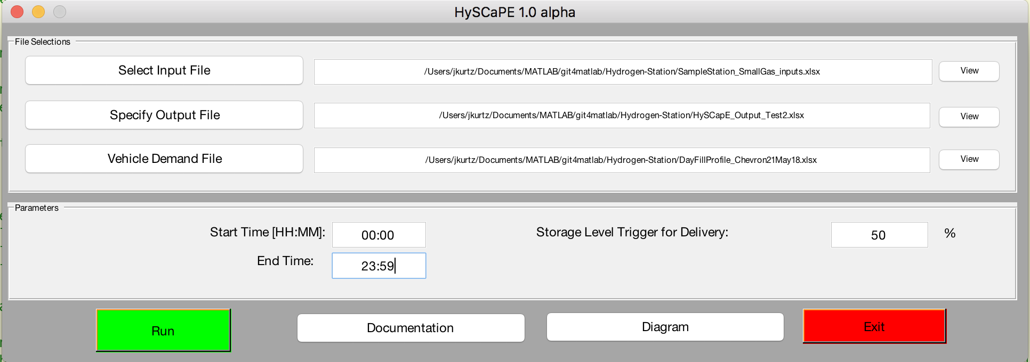
HySCaPE User Input Screen
Currently allows a vehicle demand profile (Excel spreadsheet) to be selected
  Using the Chevron profile developed from average gasoline station data.
  Published version will only allow Chevron profile.
Allows for delivery or onsite production to begin when storage drops below a percentage.
  Starts full at midnight for published version
Start/End time not adjustable for published version

Slide 5
Fill Profile Sample
Notes:
5 kg if full for vehicle.
Default is for vehicles to fill immediately following the previous one (with prescribed wait time). Also have option for vehicle fills to be spread out during each hour.
Should profile be evenly spread out in an hour?
Last fill for each hour may start at higher SOC to fill out the demand profile for that hour
Partial fills
Partial fills currently counted towards station capacity.

Slide 6
Sample Station
Delivered Gas
< 200 kg Storage

Slide 7
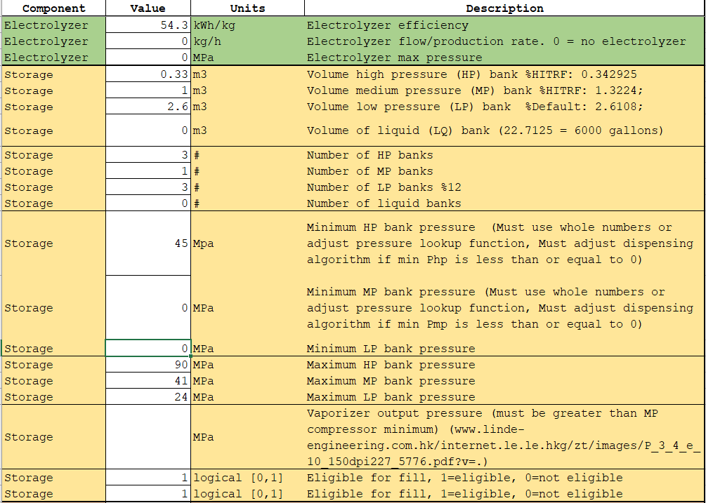
Small delivered gas
Inputs
Be sure to zero out electrolyzer production rate if no onsite electrolyzer
Fill from High pressure and medium pressure banks? [0 or 1]

Slide 8
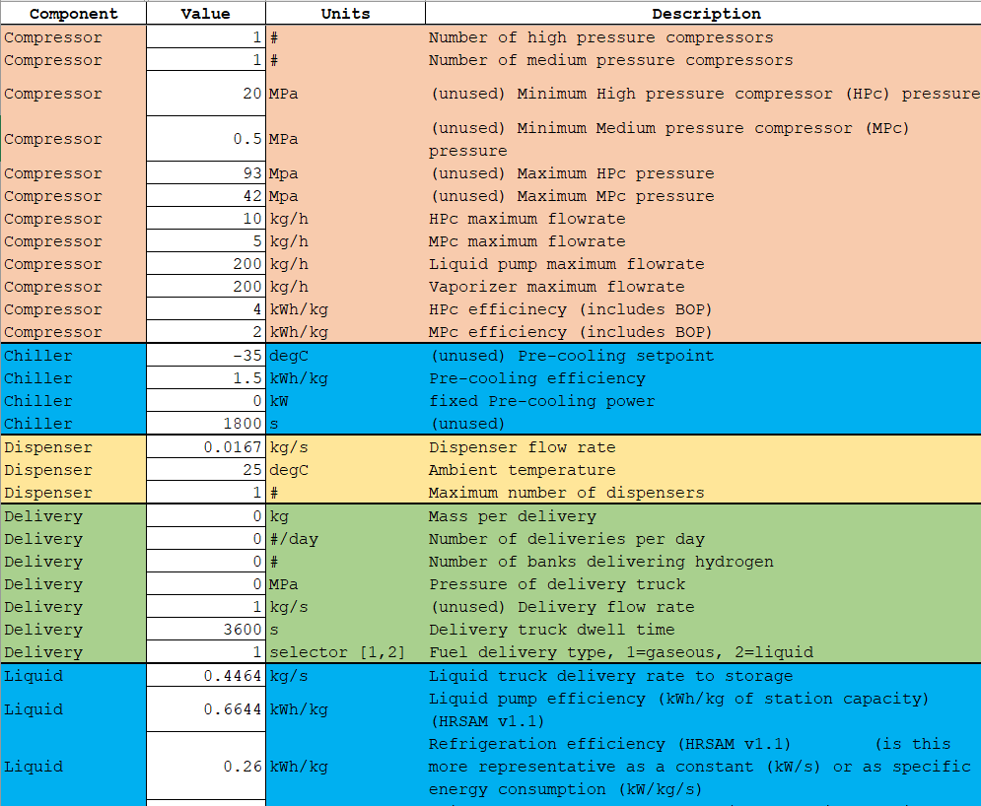
Small delivered gas
Inputs
Fuel delivery type 1=gaseous, 2=liquid

Slide 9
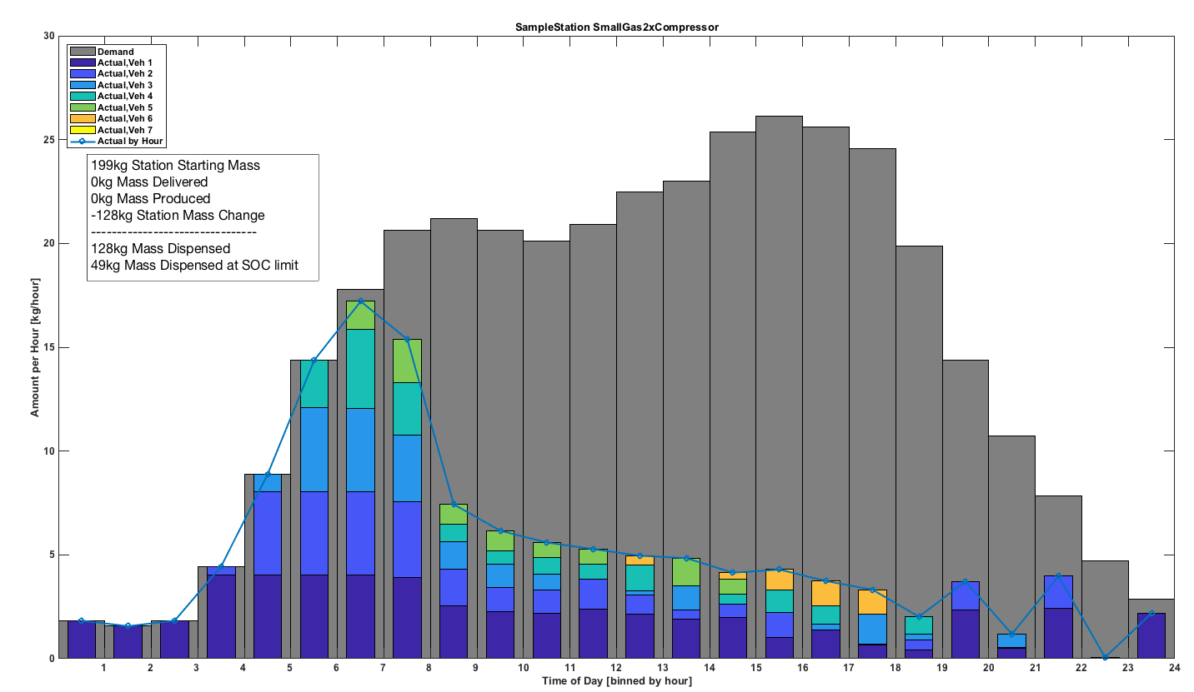
Small delivered gas
Fill Profile
Assumes only a delivery at the start of the day and continues to fill even if SOC isn’t reached

Slide 10
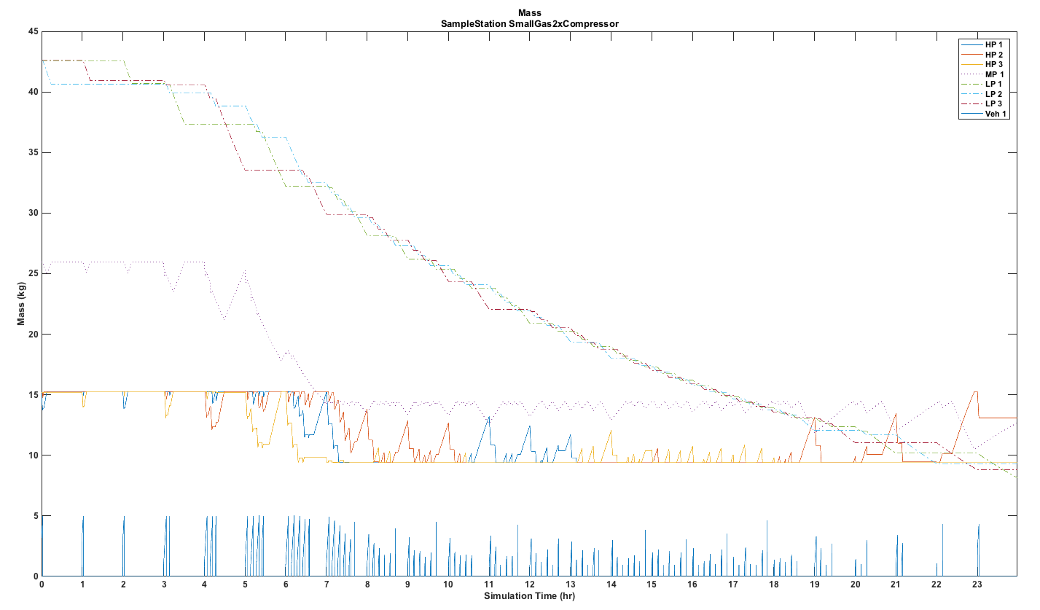
Small delivered gas
Storage/Dispense Output
Mass in each storage bank and in vehicles for the simulation run (24 hours)

Slide 11
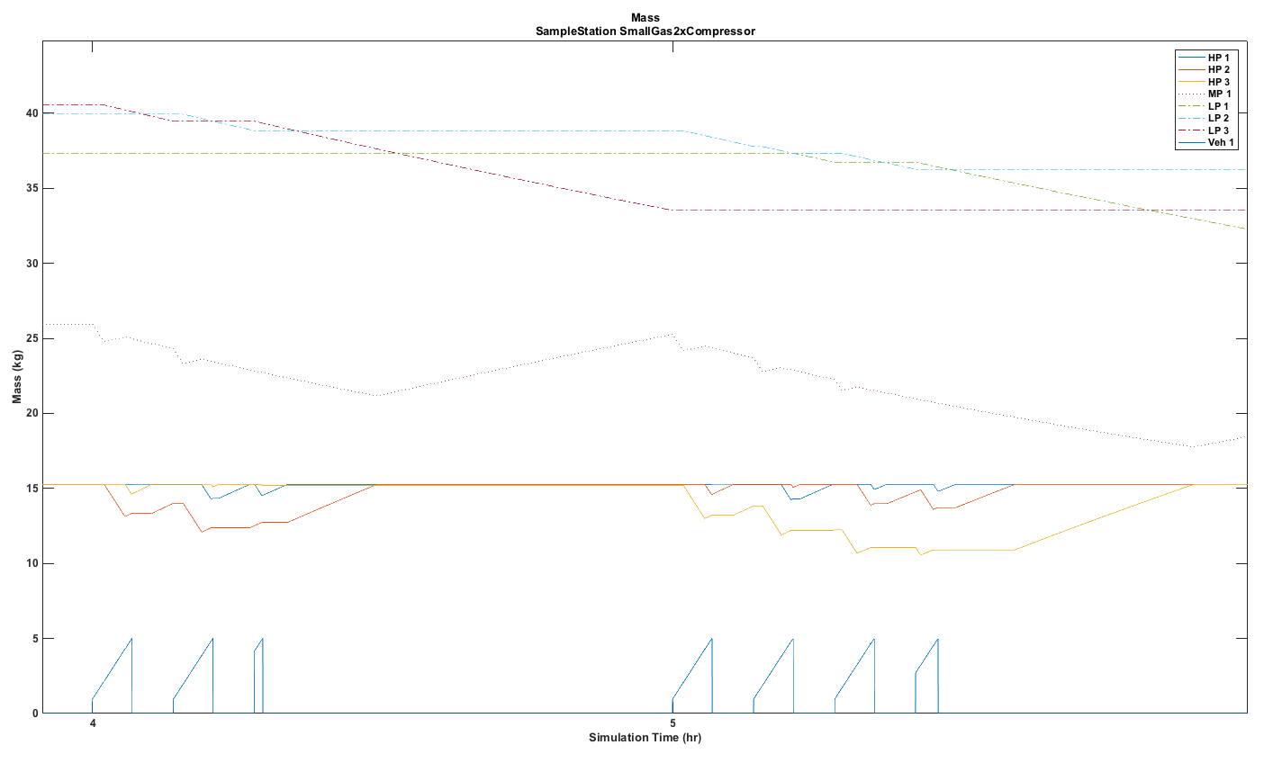
Small delivered gas
Storage/Dispense Output Zoomed In
Last fill in the hour has more in tank at beginning of fill

Slide 12
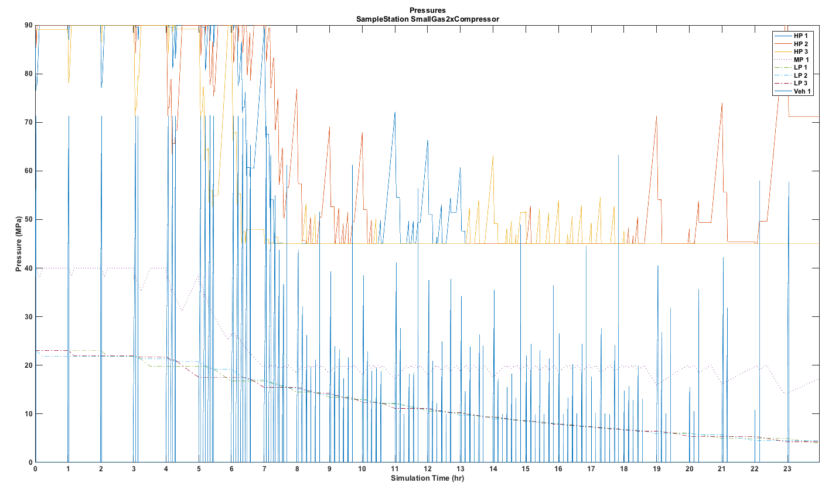
Small delivered gas
Storage/Dispense Pressures
Pressure in each storage bank and in vehicles for the simulation run (24 hours)

Slide 13
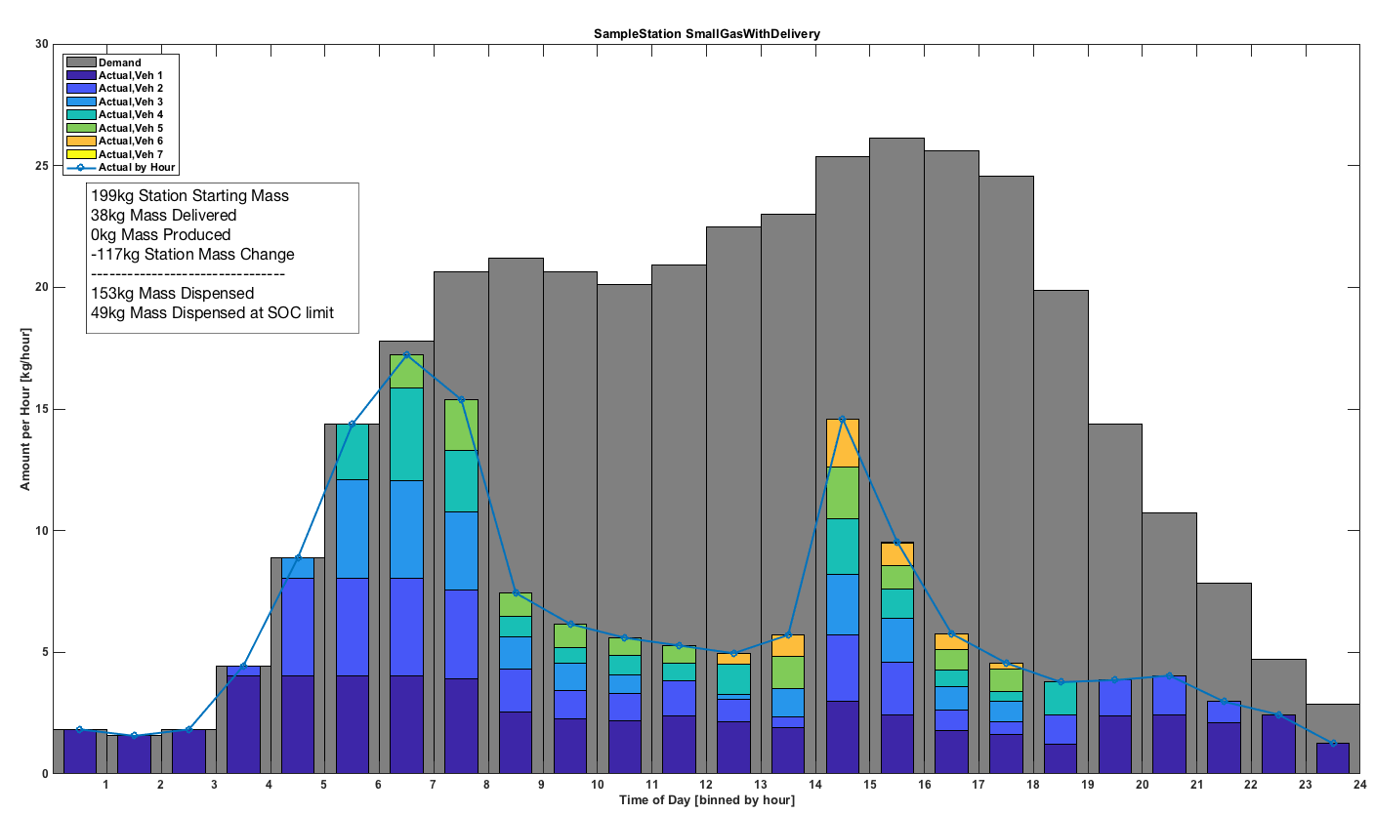
Small delivered gas
Fill Profile with Delivery
Currently trouble-shooting the delivery alogrithm

Slide 14
Sample Station
Delivered Gas - Large
> 600 kg Storage

Slide 15
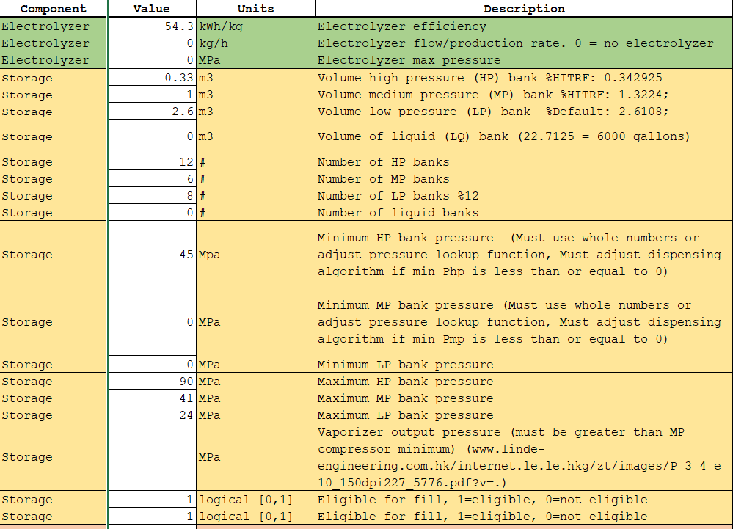
Large delivered gas
Inputs

Slide 16
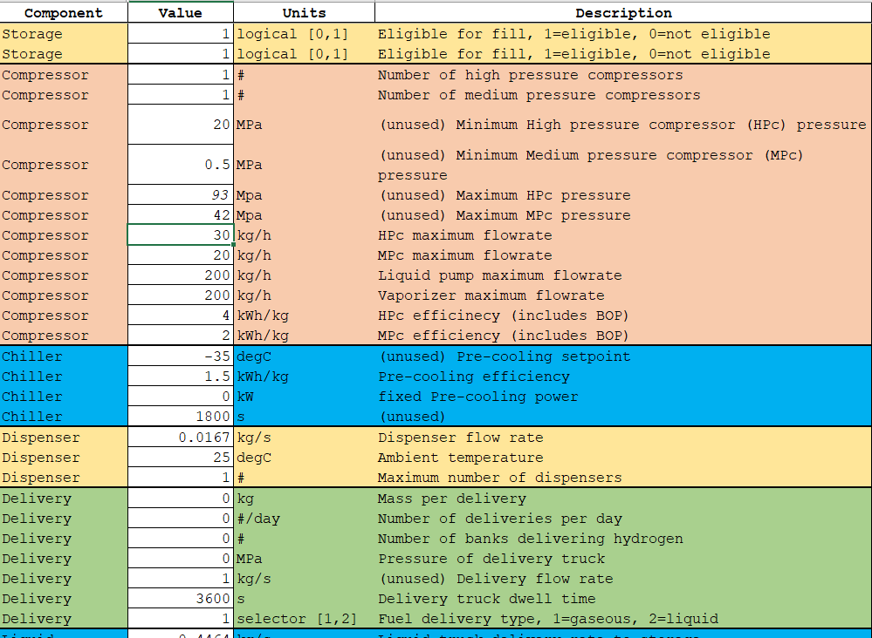
Large delivered gas
Inputs

Slide 17
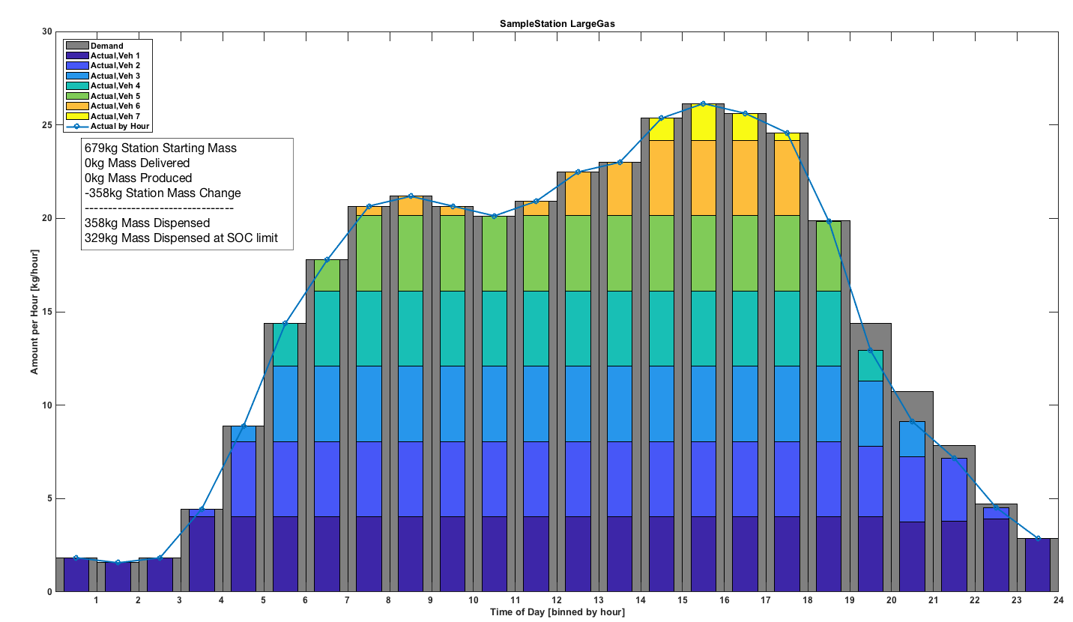
Large delivered gas
Fill Profile

Slide 18
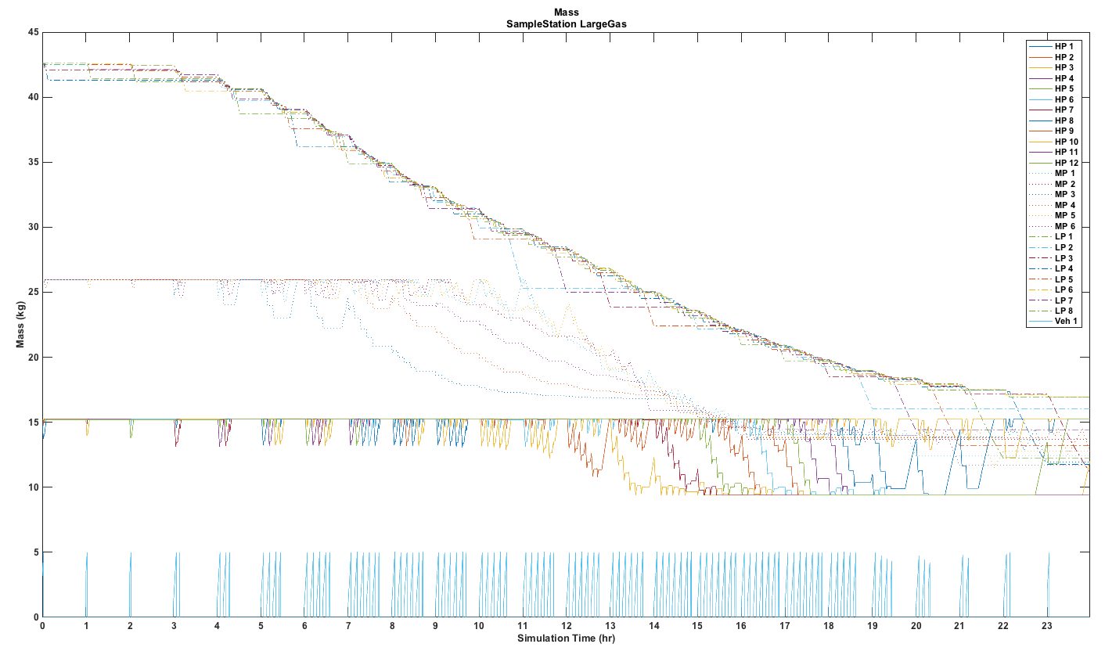
Large delivered gas
Storage/Dispense Mass

Slide 19
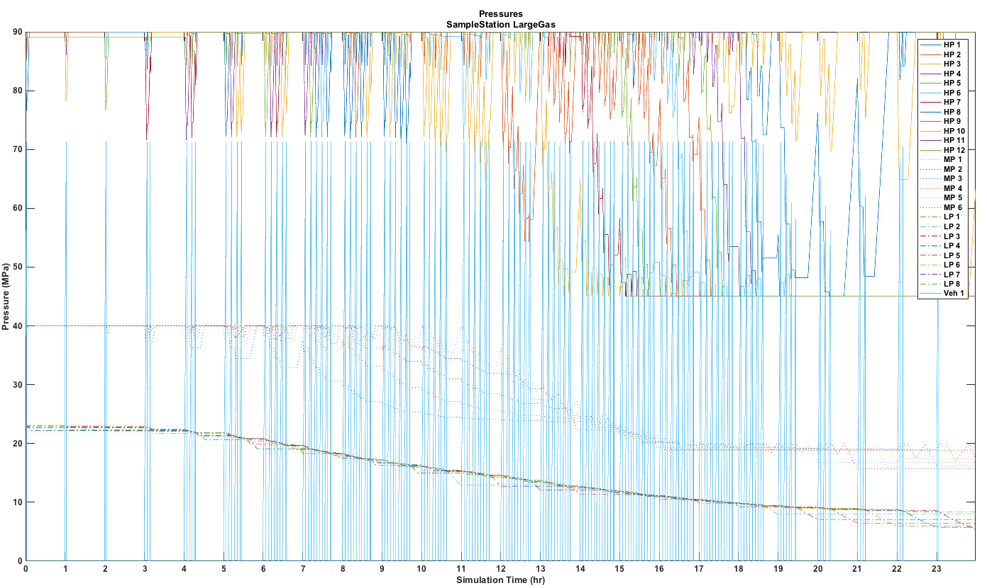
Large delivered gas
Storage/Dispense Pressures

Slide 20
Sample Station
Delivered Liquid - Large

Slide 21
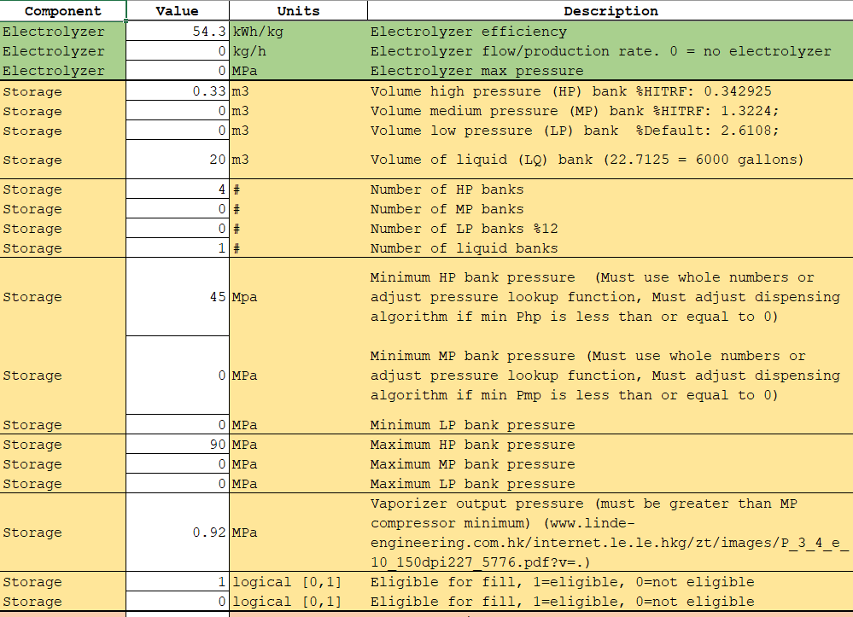
Liquid delivered
Inputs

Slide 22
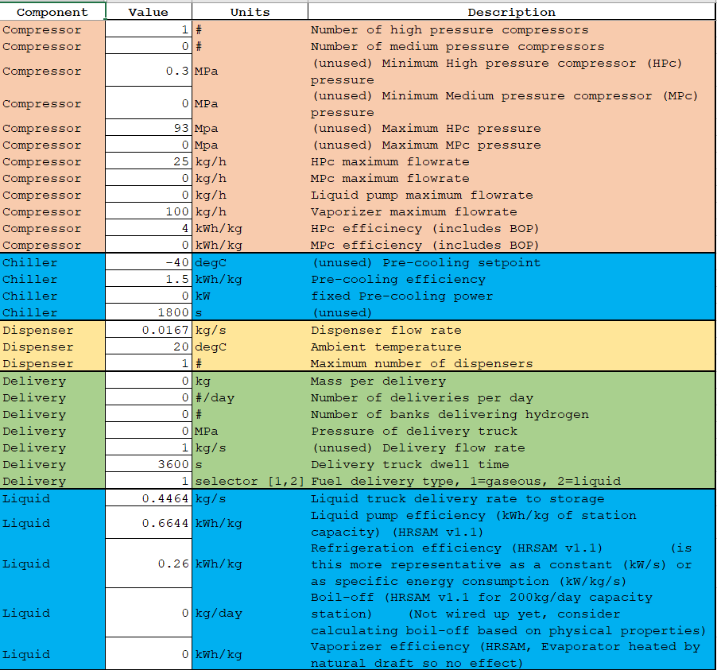
Liquid delivered gas Inputs

Slide 23
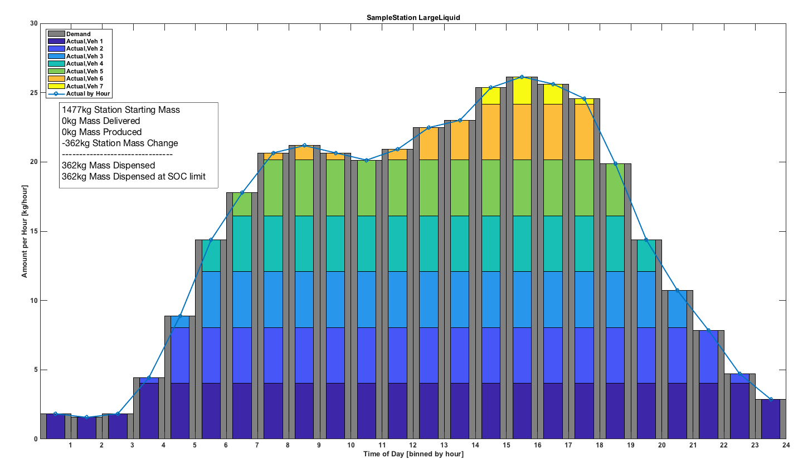
Liquid delivered
Fill Profile

Slide 24
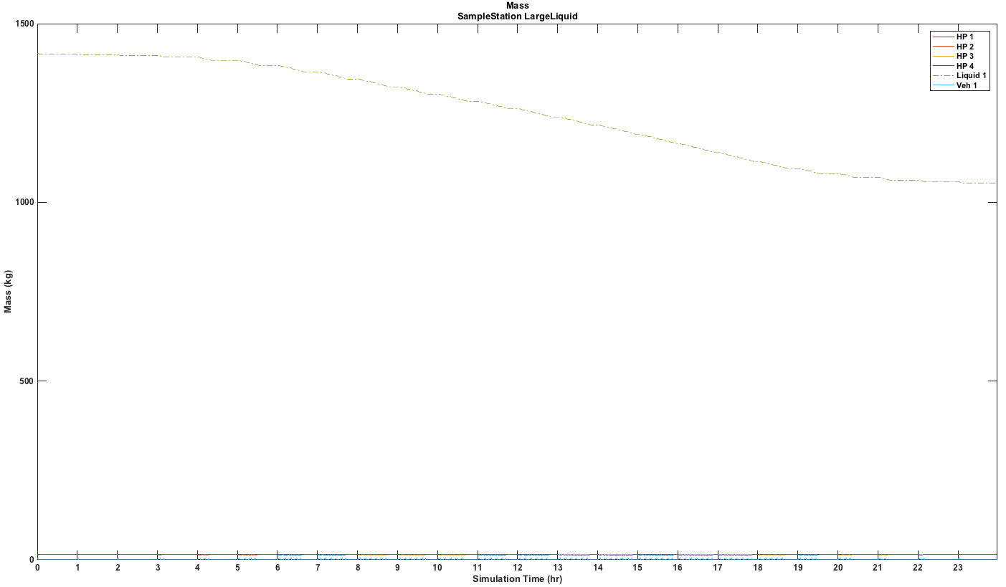
Liquid delivered
Storage/Dispense Mass

Slide 25
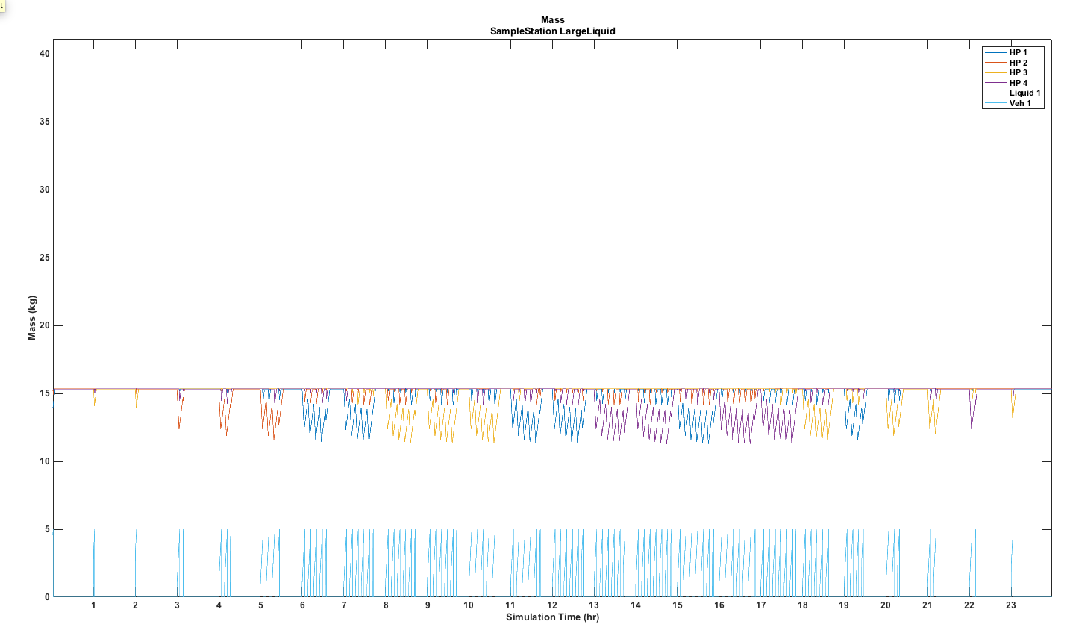
Liquid delivered
Storage/Dispense Output

Slide 26
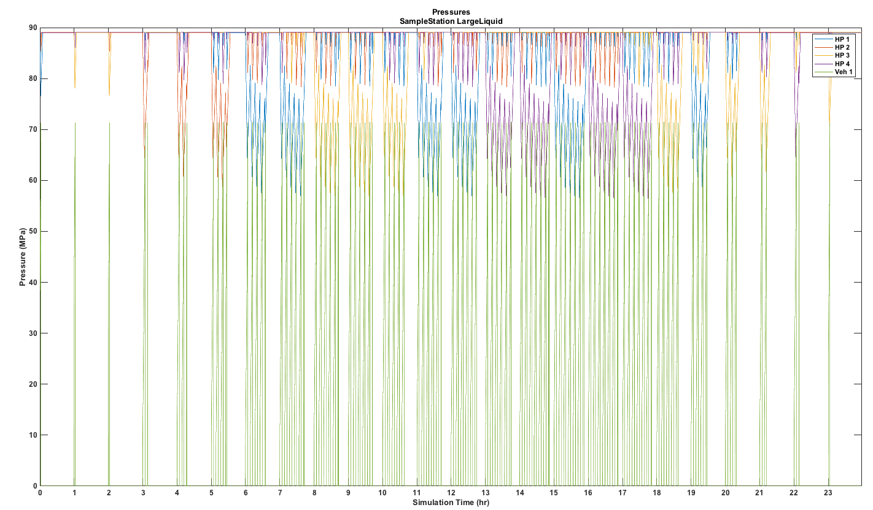
Liquid delivered
Storage/Dispense Pressures

Slide 27
Sample Station
On-site production
.5 MW Electrolysis (8 kg/hr)

Slide 28
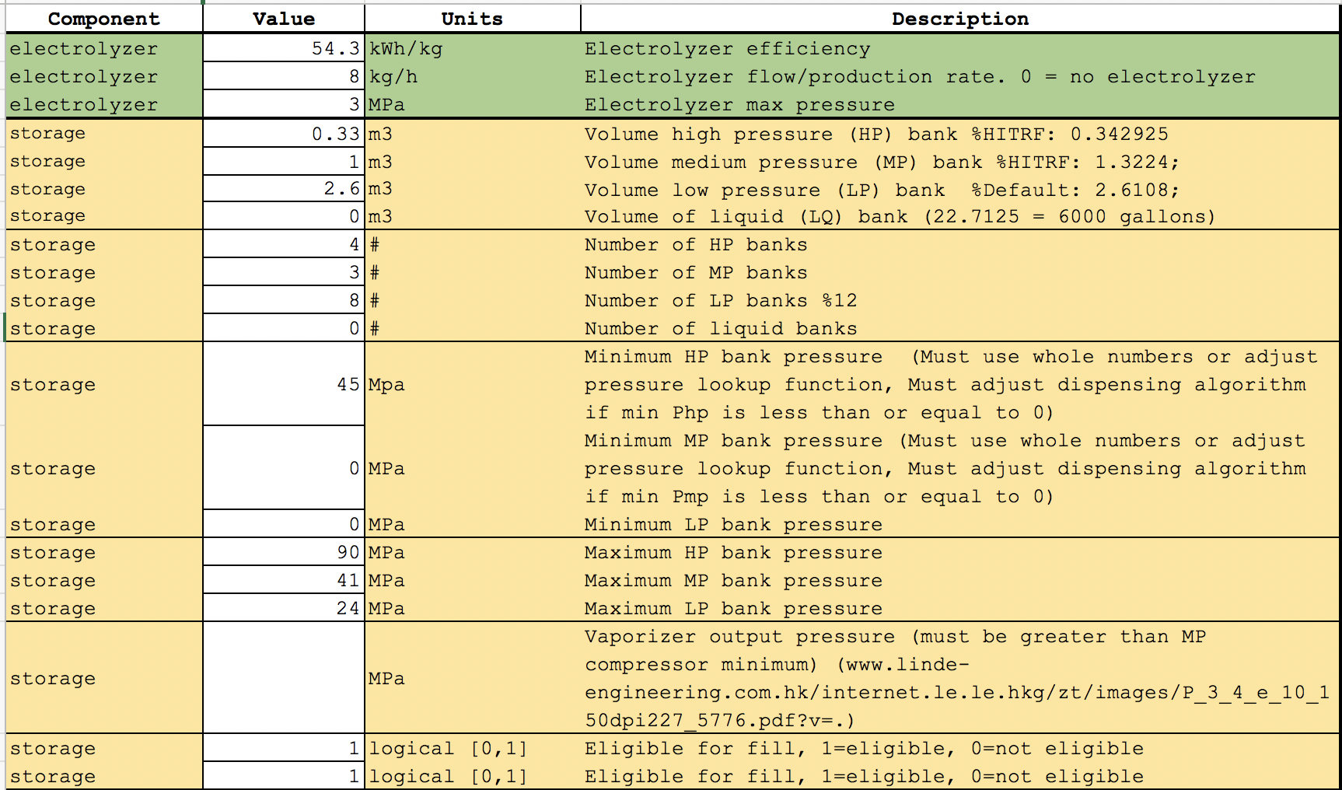
On-site electrolysis
Inputs

Slide 29
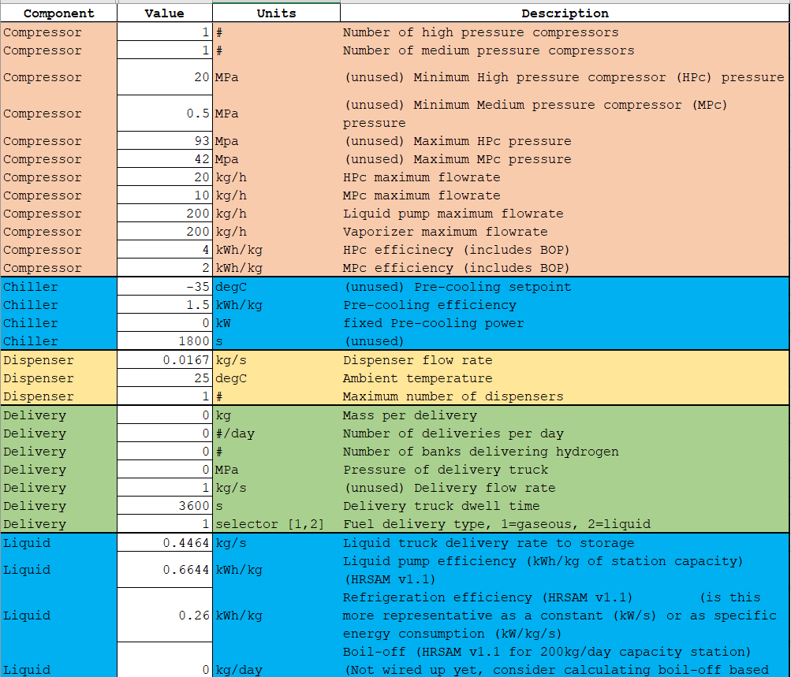
On-site electrolysis
Inputs

Slide 30
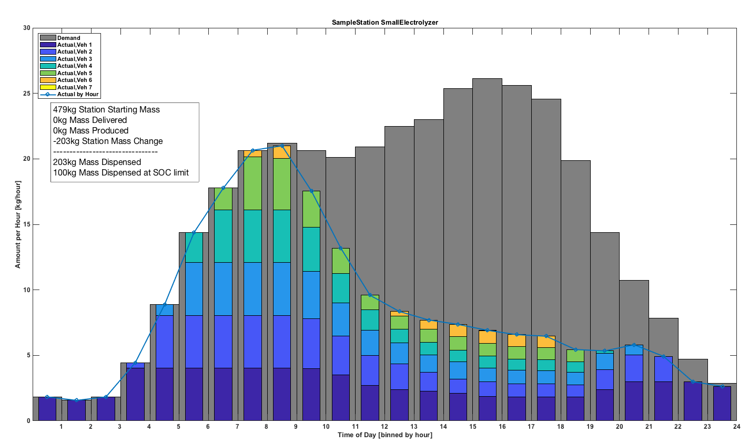
On-site electrolysis
Fill Profile

Slide 31
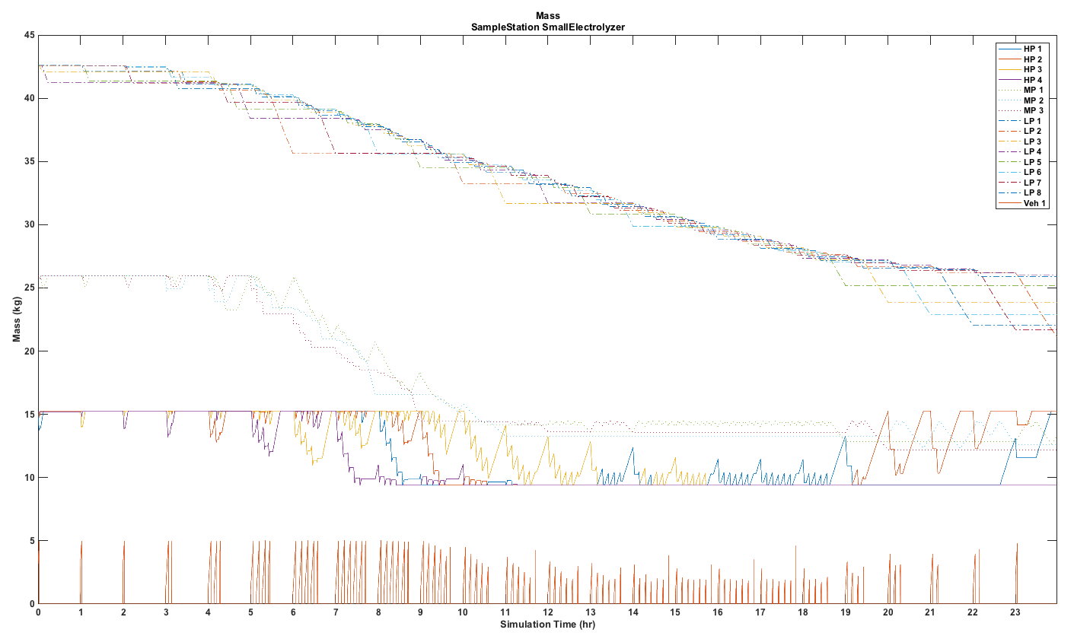
On-site electrolysis
Storage/Dispense Output

Slide 32
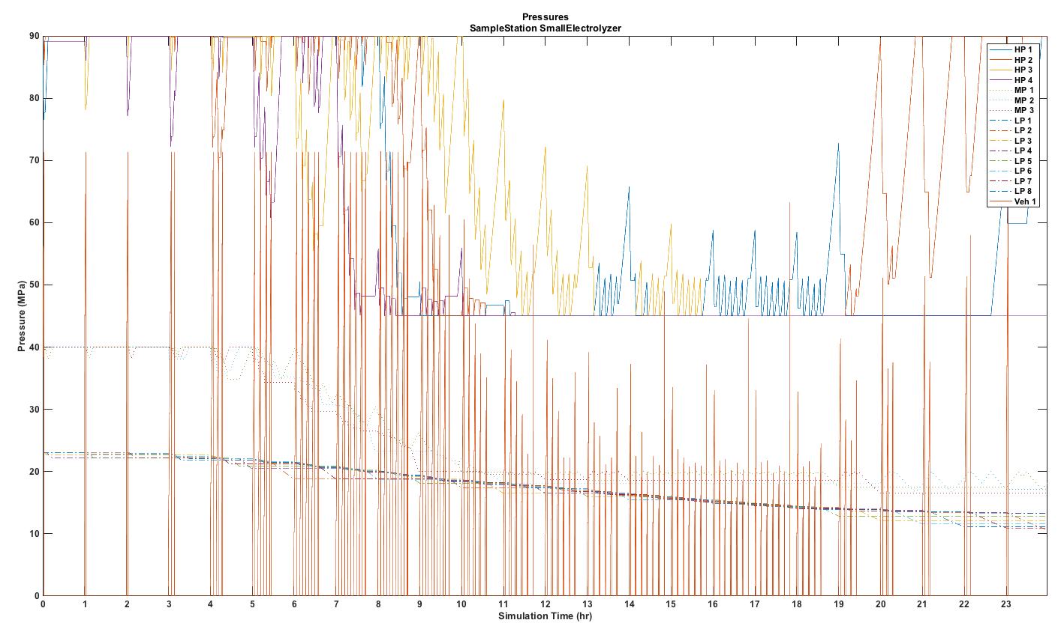
On-site electrolysis
Storage/Dispense Output

Slide 33
Next Steps
Compile to Matlab and upload to CEC docket – 7/23 close of business
Finalize liquid delivery algorithm – 7/24
Finalize 2 fueling positions – 7/24
Feedback on beta version due – 7/25
Validation continuing – 7/30
  Liquid, gas, and on-site production data sets utilized
Deliver compiled model to CEC and CARB, with model user documentation – 7/31
Technical report on model development and validation – 9/28
Online user interface available (no changes to model) – 9/28

Slide 34
Thank you
Publication Number

