Slide 1
Hydrogen Station Capacity Evaluation Tool
Danny Terlip, Sam Sprik, Josh Eichman, Dani Murphy, Mike Penev, Maggie Mann, Dan Leighton, Kevin Nixon, Jen Kurtz
June 18, 2018

Slide 2
6/18 Agenda
Introduction, Logistics, Diversity, and Workshop Objectives
Hydrogen Station Capacity Evaluation tool introduction - current
HySCapE Station Configurations
HySCapE Assumptions and Inputs
HySCapE Outputs
HySCapE Timeline
Discussion

Slide 3
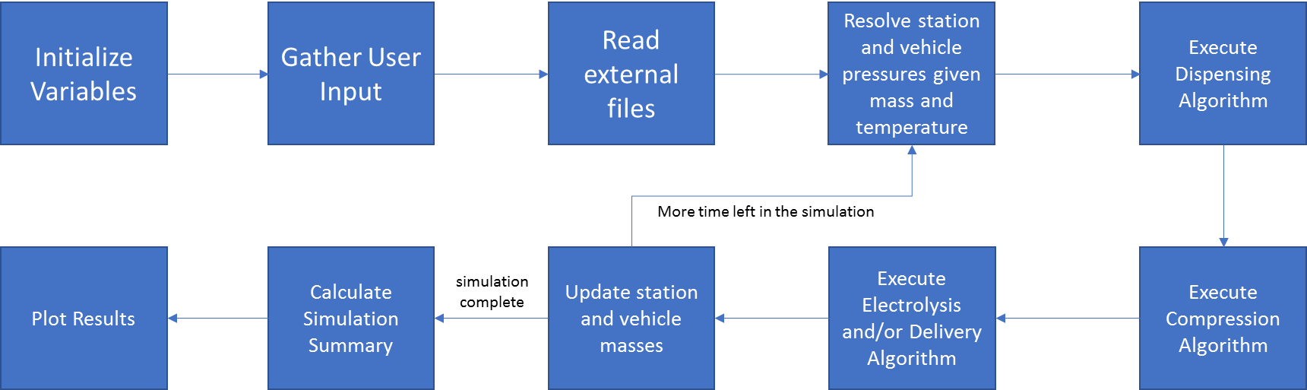
HySCapE 1.0 Overview
More time left in the simulation
Simulation complete
Draft block diagram based on current stage (alpha) of HySCapE 1.0

Slide 4
HySCapE 1.0 Station Configurations
Production
Storage
Compression
Dispense
Current version
  Gas storage
  Cascade fill
  1 fueling position
  Delivery or electrolyzer
Additions planned
  Liquid storage
  Multiple fueling positions
  Thermal effects
E1
LP
C1
MP
C2
HP
D1
Draft configurations based on current stage (alpha) of HySCapE 1.0

Slide 5
HySCapE 1.0 Inputs
Hydrogen production profile – details the start time, duration and rate of hydrogen production
Hydrogen delivery profile – details the start time of transfer and amount of hydrogen that arrives in delivery trucks
Station component characteristics – details the specifications of major station components
Draft inputs based on current stage (alpha) of HySCapE 1.0

Slide 6
HySCapE 1.0 Inputs
Draft inputs based on current stage (alpha) of HySCapE 1.0
System Component | Technical Specification | Source | Example Values
Station Compression | Flow Rate | Station Developer | f(x) = x² + x + 3, where x = inlet pressure
 | Minimum Suction Pressure | Station Developer | 4 MPa
 | Maximum Discharge Pressure | Station Developer | 93 MPa
 | Compression Constraints | Station Developer | Do not compress while dispensing
Station Dispensing | Filling Protocol | Station Developer | SAE J2601 H70 T40 Tables
 | Number of Independent Fueling Positions | Station Developer | 1
Pre-cooling | Heat exchanger temperature when idle | Station Developer | -45 C
 | Heat exchanger material | Station Developer | aluminum
 | Heat exchanger effective thermal mass | Station Developer | 600 kg
 | Chiller working fluid | Station Developer | R404a
 | Chiller capacity | Station Developer | 3 ton

Slide 7
HySCapE 1.0 LCFS Fill Scenario
(based on CSA 4.9)
12 hour
SAE J2601 fill
Same amount (5 kg), temperature (20ºC), and starting SOC (10 MPa) for each fill
Duration – 6 am – 6 pm
Min 4 minutes, 15 seconds between fueling
Fill schedule ”Chevron Friday profile, 6 am – 6 pm”
Fill ending SOC >= 95%
12 hours allowed for recovery
Fill scenario pre-defined and consistent for all LCFS capacity calculations
Maximum station capacity for LCFS calculation 1,200 kg/day
https://www.arb.ca.gov/fuels/lcfs/lcfs_meetings/061118presentation_update.pdf
Draft LFCS calculator fill scenario based on current stage (alpha) of HySCapE 1.0

Slide 8
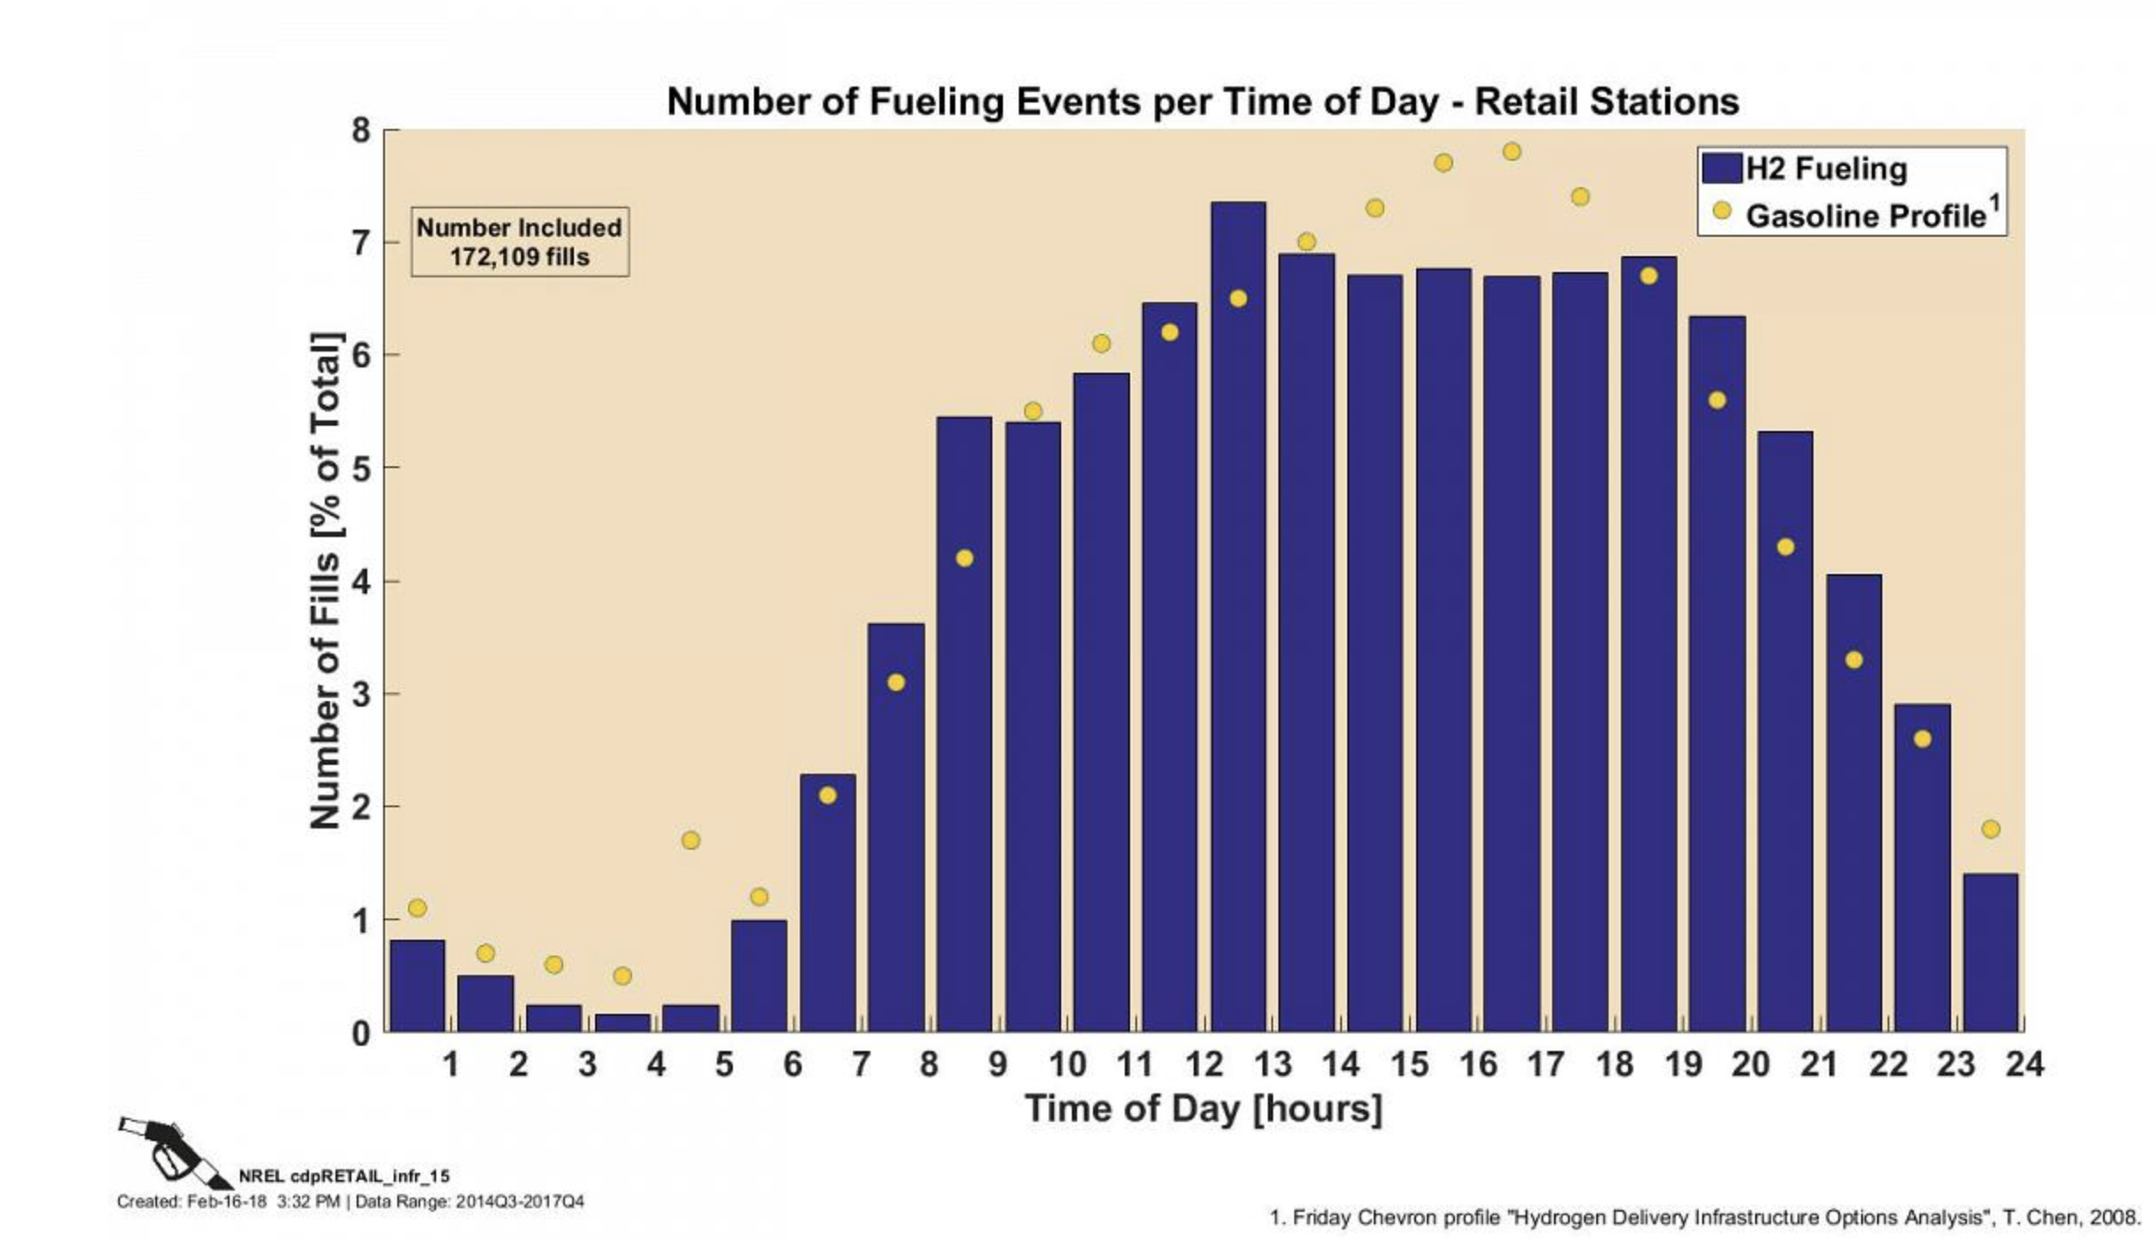
HySCapE 1.0 Fill Schedule Example
Use “Friday Chevron profile” for 12 hour fill distribution between 6 am and 6 pm
Draft fill schedule based on current stage (alpha) of HySCapE 1.0

Slide 9
HySCapE 1.0 Outputs
Fill count – the number of fills performed over the duration of the test
Fill amount – the mass of hydrogen dispensed for each fill
Duration – the amount of time from the start of the test to when an ending condition is met
Ending SOC – the final SOC of every vehicle fill
Cumulative kg – the total mass of hydrogen dispensed during the test
Draft outputs based on current stage (alpha) of HySCapE 1.0

Slide 10
HySCapE 1.0 Output Example
Assumes 5 kg fills, average 1 kg/min rate, and 255 seconds between fills – HySCapE will calculate what a station is capable of based on a maximum fill count per fill position and the station components

Slide 11
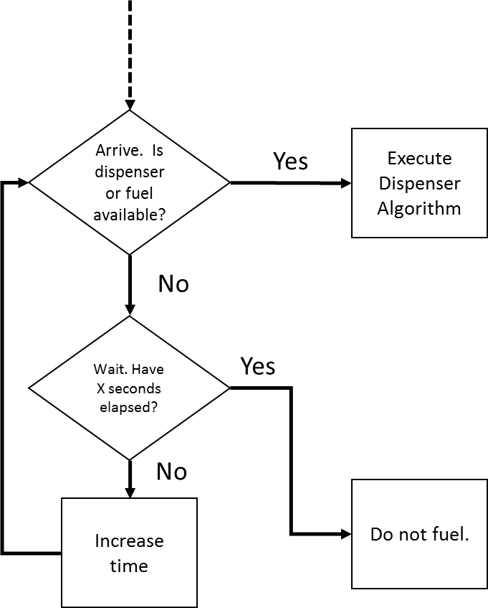
HySCapE 1.0 – Dispenser Algorithm
Draft model components based on current stage (alpha) of HySCapE 1.0

Slide 12
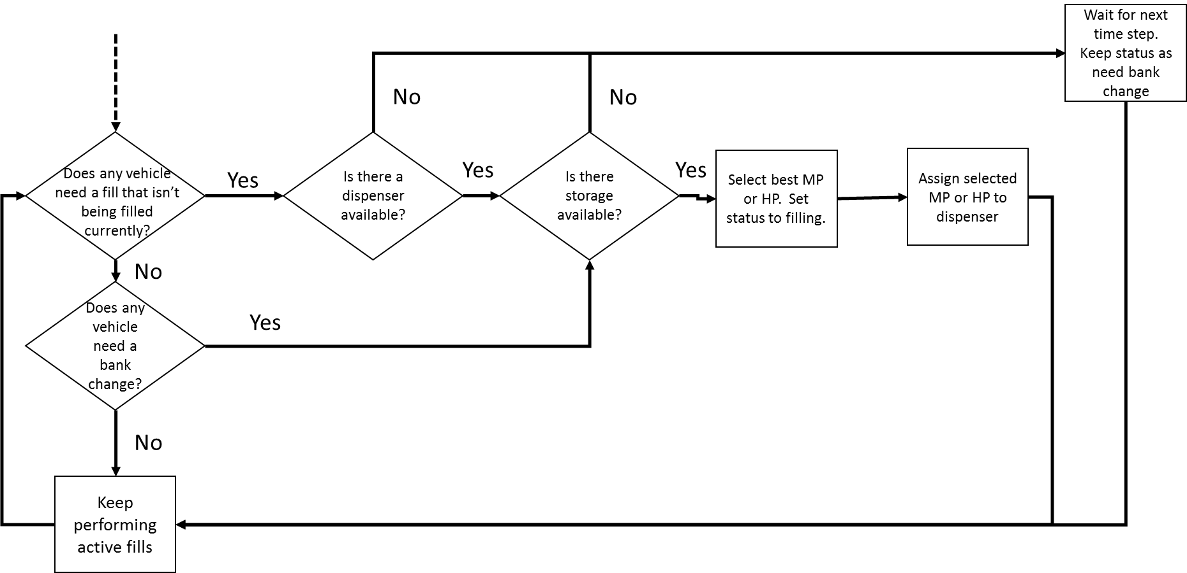
HySCapE 1.0 – Dispenser Algorithm
Draft model components based on current stage (alpha) of HySCapE 1.0

Slide 13
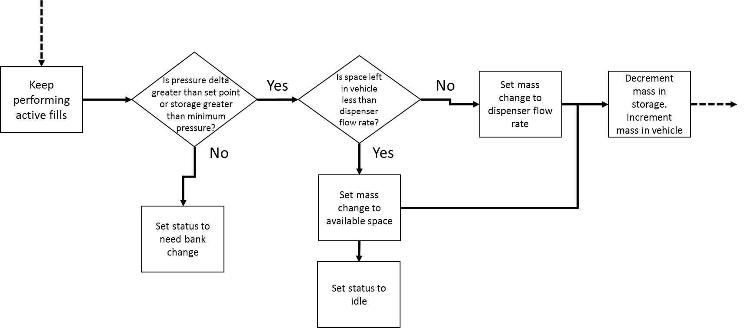
HySCapE 1.0 – Keep performing fills
Draft model components based on current stage (alpha) of HySCapE 1.0

Slide 14
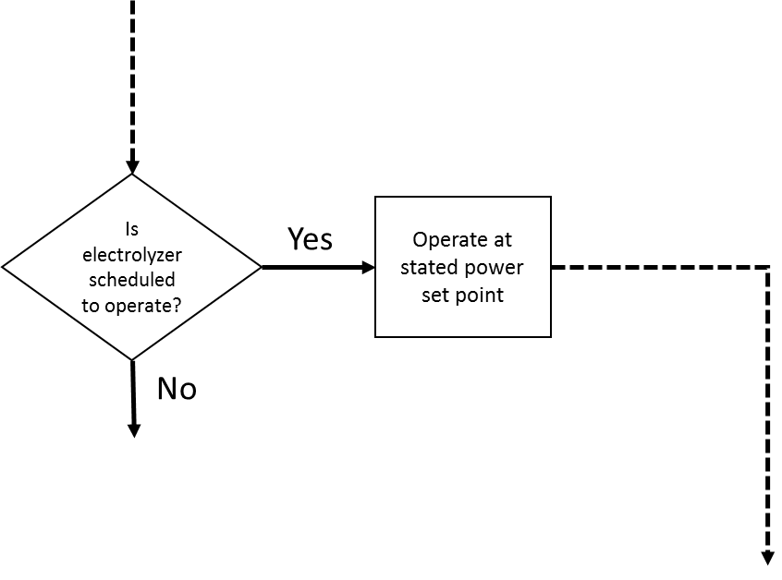
HySCapE 1.0 – Production Algorithm
Draft model components based on current stage (alpha) of HySCapE 1.0

Slide 15
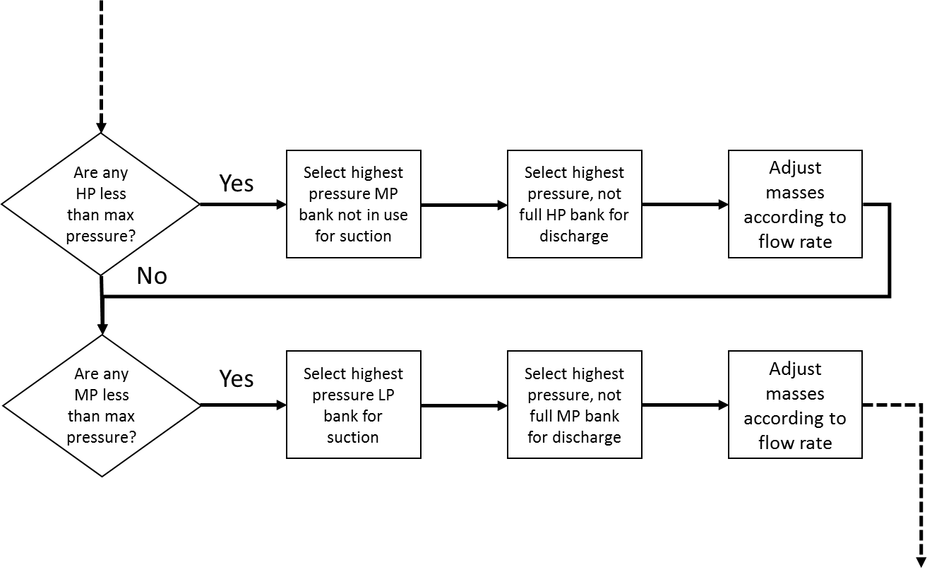
HySCapE 1.0 – Compressor Algorithm
Draft model components based on current stage (alpha) of HySCapE 1.0

Slide 16
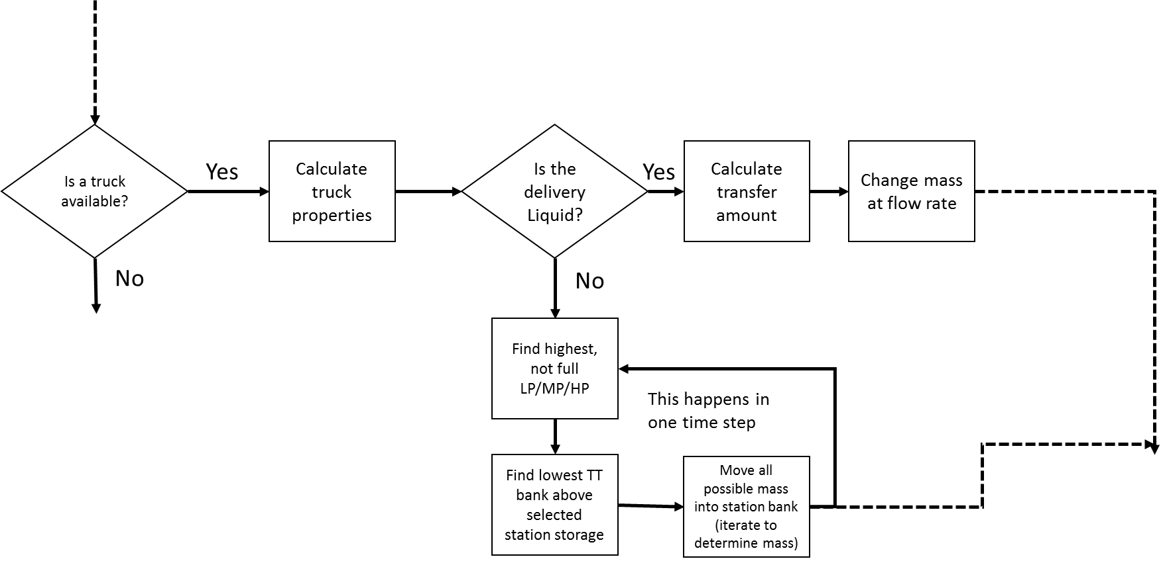
HySCapE 1.0 – Delivery Algorithm
Draft model components based on current stage (alpha) of HySCapE 1.0

Slide 17
HySCapE 1.0 Timeline
Alpha development
  Documentation
  Validation
    NREL’s experimental data
    Existing retail hydrogen fill data
  Define input/output/assumptions
  Webinar
Beta development
  Added features (e.g., liquid storage, multiple fuel positions)
  Limited user trial
  Model iteration
  Documentation update
  Webinar
Model release
  Version 1.0 documentation and model share

Slide 18
HySCapE
HySCapE 1.0 is
  Applied consistently for 12-hour capacity calculations
  Simple, physics based capacity model with pre-defined fill scenario(s)
  Publicly available
  Available for station proposal evaluation of capacity
  Maintained and updated at least annually, expected to be available via a web interface
HySCapE 1.0 is not
  Fully representative of all possible scenarios
  Predictive of actual fueling performance
  A design tool

Slide 19
Thank you
Publication Number

Slide 20
Backup

Slide 21
HySCapE 1.0 Example Fill Scenarios
(based on CSA 4.9)
DRAFT
1 hour | 12 hour | 24 hour | Max back-to-back
SAE J2601 fills
Same amount (5 kg), temperature (20ºC), and starting SOC (10 MPa) for each fill
Duration – 1 hour | Duration – 6 am – 6 pm | Duration – 24 hour | Duration – limited to 24 hours
Min 3 minutes, 45 seconds between fueling | Min 4 minutes, 15 seconds between fueling | Min 4 minutes, 15 seconds between fueling | Min 4 minutes, 15 seconds between fueling
Fill schedule – as fast/many as possible | Fill schedule ”Chevron Friday profile” | Fill schedule ”Chevron Friday profile” | Fill schedule – as fast/many as possible
Fill ending SOC >= 95% | Fill ending SOC >= 95% | Fill ending SOC >= 95% | Fill ending SOC >= 95%
No ending station performance requirement (e.g., fill immediately the next hour) | ? ending station performance requirement (e.g., fill immediately the next hour) | ? ending station performance requirement (e.g., fill immediately the next hour) | No ending station performance requirement (e.g., fill immediately the next hour

Slide 22
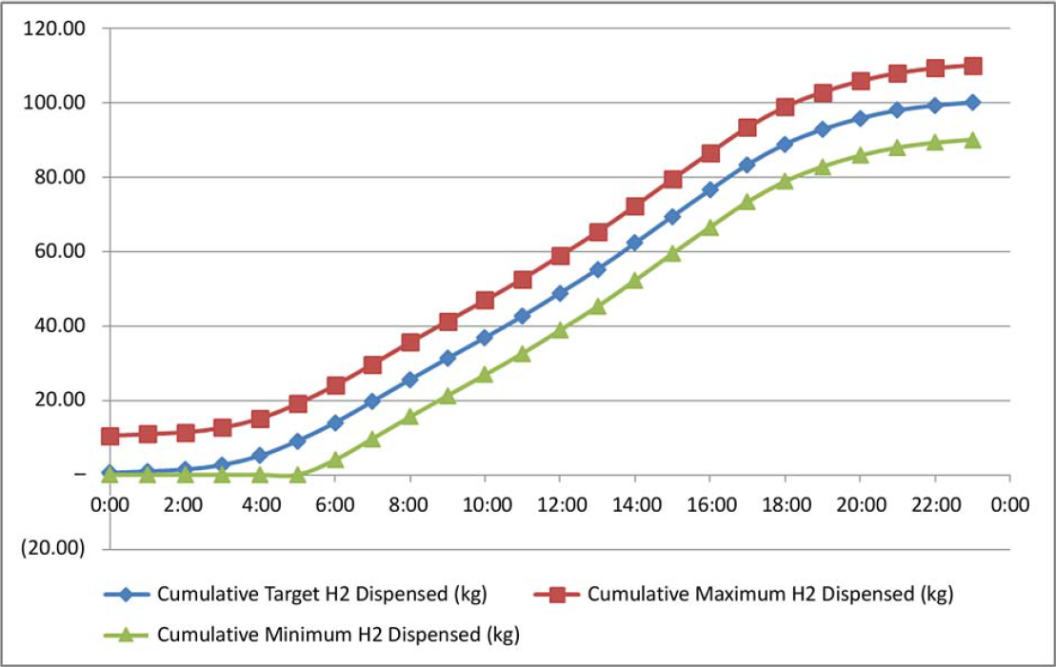
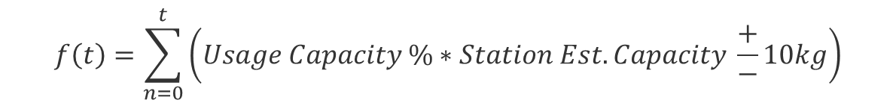
HySCapE 1.0 Daily Capacity –
CSA 4.9 Example
Allow for mass dispensed corridor as specified in CSA HGV 4.9 Appendix B.4.2
Cumulative H2 Dispensed at hour t:
$$f\left(t\right)=\sum_{n=0}^{t}{\left(Usage Capacity \%∗Station Est. Capacity \frac{+}{−}10kg\right)}$$

Slide 23
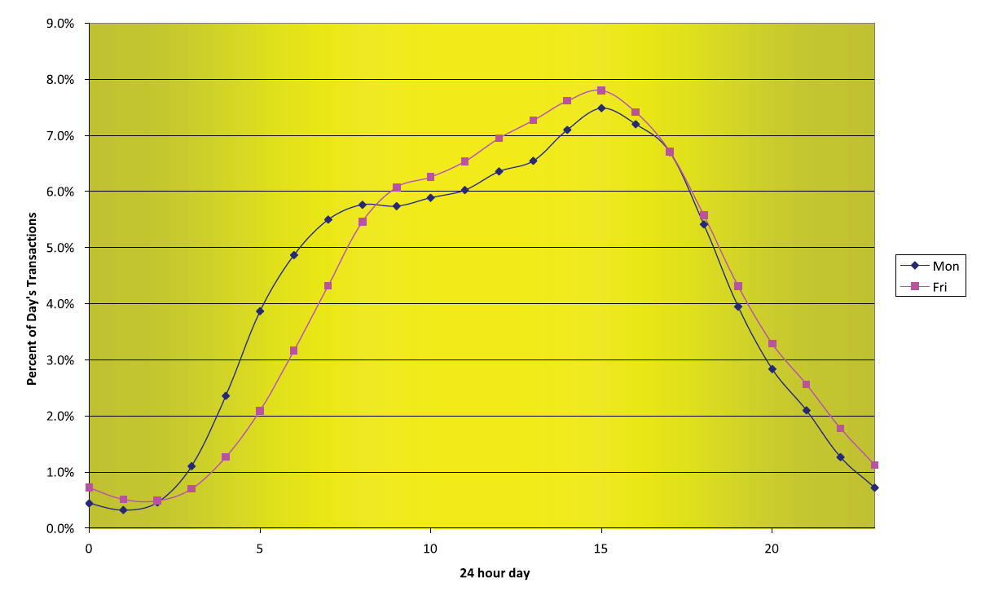
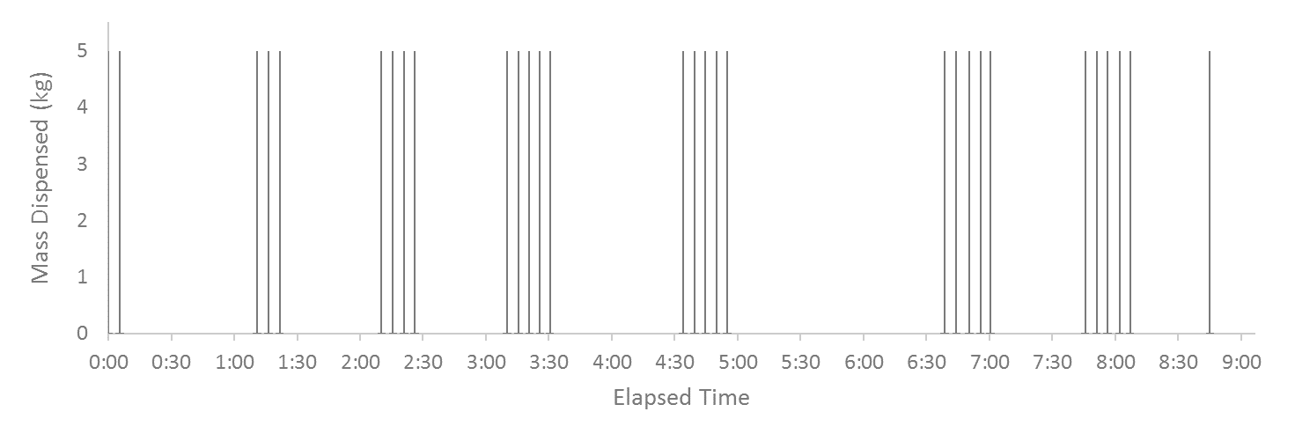
HySCapE 1.0 Fill Schedule Examples
DRAFT
NFCTEC CDP INFR 15
CSA HGV 4.9 Figure B.1
Reference NFCTEC, Chevron or define new fill profiles
Fill profile will remain consistent across station capacity modeling
Example fill schedule used for validation with HITRF data

Slide 24
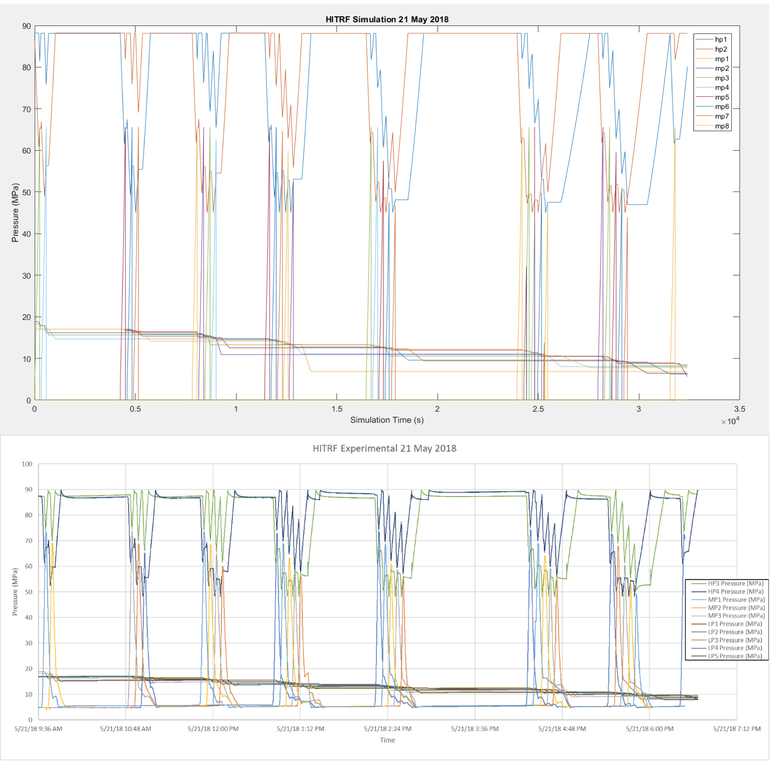
Example Validation – HITRF Simulation

Slide 25
Example Validation – HITRF Actual

Slide 26
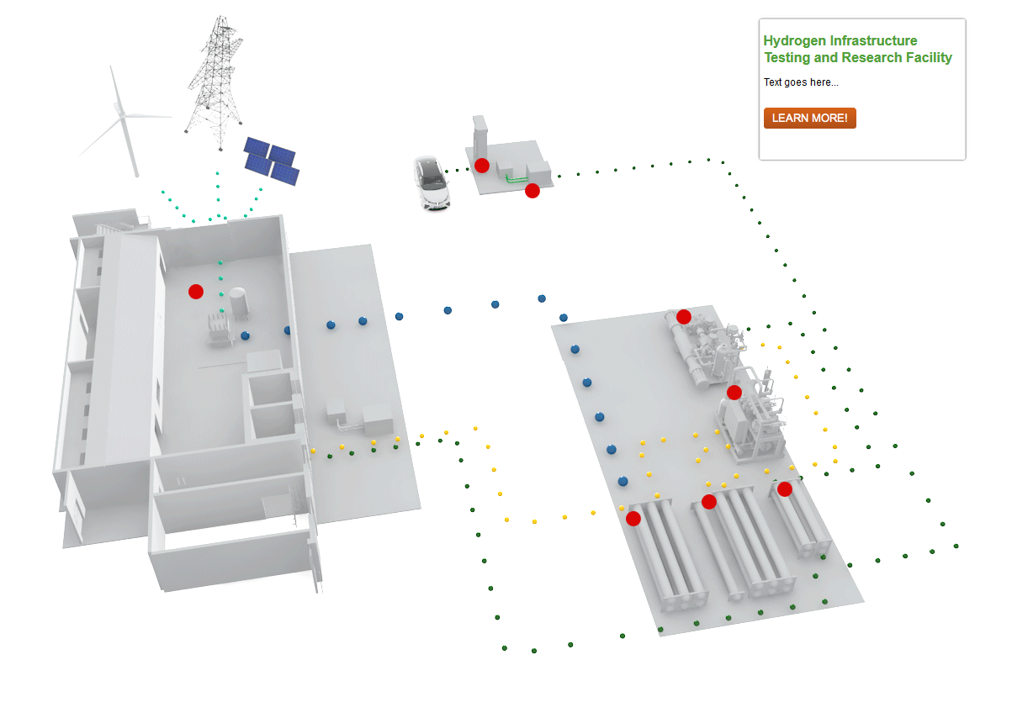
HITRF Schematic
Hydrogen Infrastructure Testing and Research
Dispensing
Hydrogen Chilling
Outreach
Renewable Hydrogen Production
Technology Validation
Compression
Safety
Storage
Notes:
Integrated research platform to support renewable hydrogen generation, H2@scale, and system/component research and mimics real-world environment with simulation capabilities
Link has an animation

