Slide 1


Slide 2
Study Purpose and Key Questions
Conduct an independent scientific assessment of the past, present, and potential future uses of underground natural gas storage in California
Key Question 1: What risks do California’s underground gas storage facilities pose to health, safety, environment and infrastructure?
Key Question 2: Does California need underground gas storage to provide for energy reliability in the near term (through 2020)?
Key Question 3: How will implementation of California’s climate policies change the need for underground gas storage in the future?

Slide 3
Qualitative Risk-Related Characteristics
Notes:
Managing Risk
Risks associated with underground gas storage can be managed and mitigated.
The new draft regulations are a major step, have room for improvement, and should undergo regular review.
Conduct methane monitoring for early identification of leaks.
Minimizing Impact
Consider population proximity and density.
Require information on gas composition and be ready for rapid monitoring and modeling of gas dispersion.
Facility-by-Facility Evaluation
A few facilities have relatively higher risk than others in California.
Quantifying risks for each facility allows examining tradeoff between risk and benefits of individual facilities.

Slide 4
Gas storage functions
  Winter Peak Day Demand
  Winter peak
  demand is 11.8 Bcfd
  Import capacity is 7.5 Bcfd
  Shortfall is 4.3 Bcfd
Without storage, California would be unable to consistently meet winter demand for gas.
Notes:
If storage can meet winter demand then it can do all the other functions:
intraday balancing,
compensating for steady production,
creating an in-state stockpile for emergencies, and
allowing arbitrage and market liquidity.

Slide 5
There is no “silver bullet” to replace underground gas storage in the 2020 and 2030 time frame
Gas storage is likely to remain a requirement for reliably meeting winter peak demand. Peak demand is not projected to decrease enough by 2030 to change that.
Two possible longer-range physical solutions include new pipelines or LNG peak shaving units would
  be extremely expensive -- $15B eg
  carry their own risks
  incur barriers to siting
  commit CA to more gas infrastructure
No policy or market mechanisms done for electricity will have much effect on the peak winter demand because this demand is caused by demand for heat and CA has no policy to electrify heat.

Slide 6
Demand for heat peaks in winter, when solar and wind outputs are minimal.
Electrified heat could be a key strategy in lowering emissions, but would further exacerbate supply-demand mismatch.
Required backup from gas equal to renewable energy capacity

Slide 7
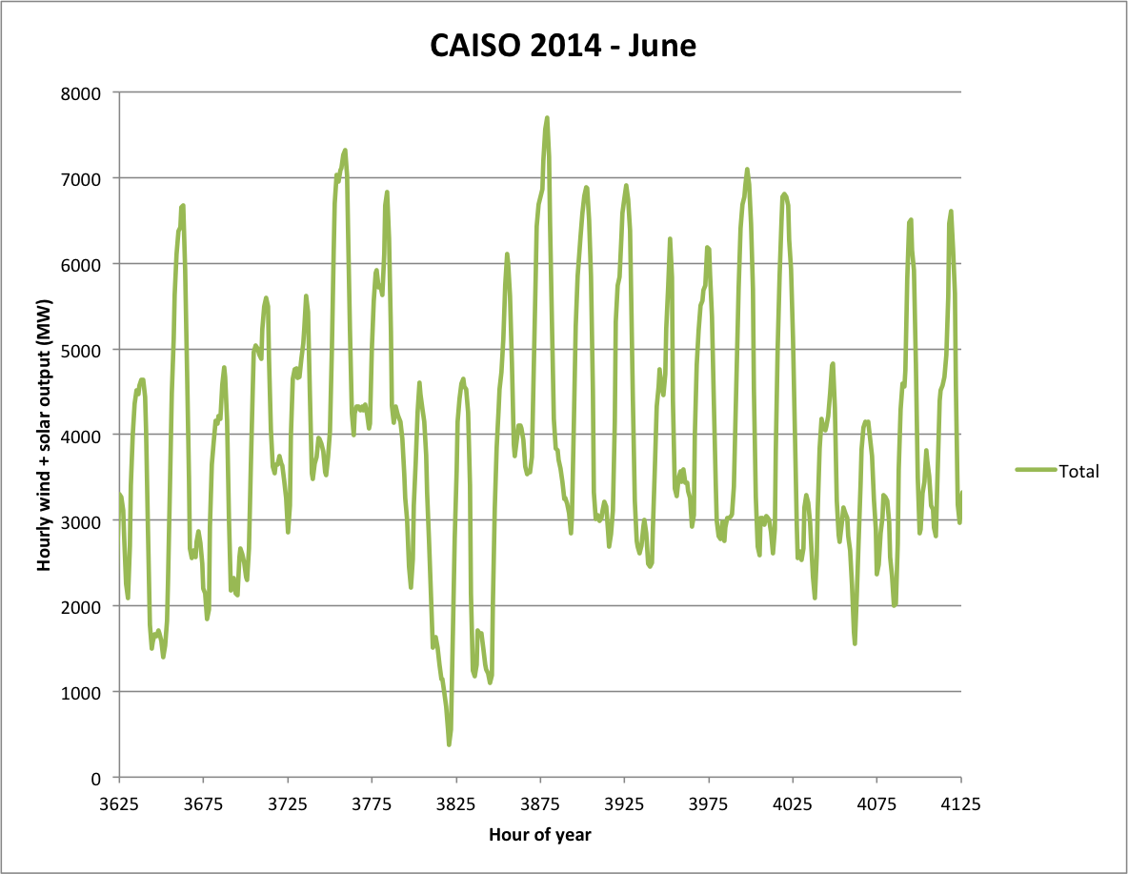
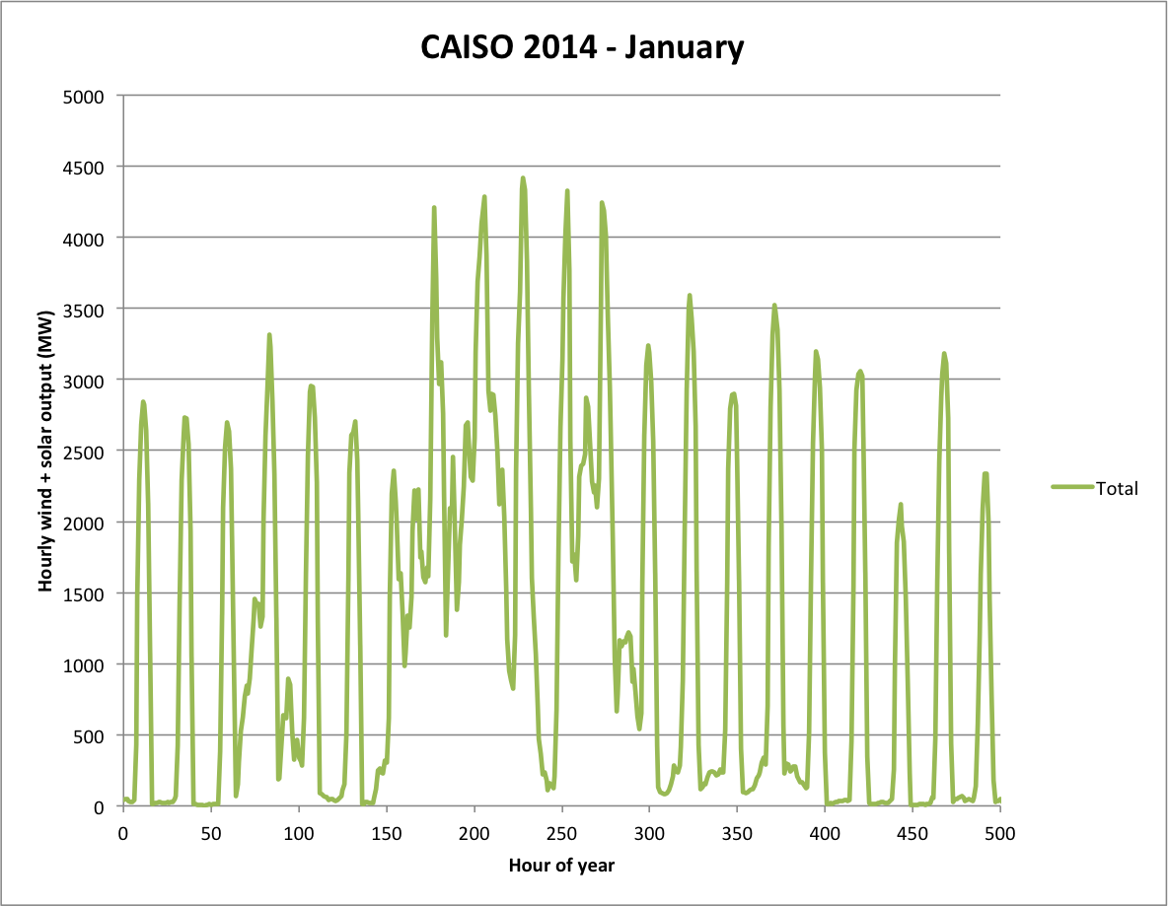
Projected 2030 electricity capacities
Peak electricity demand (~60 GW)
Average electricity demand (~35 GW)
Minimum electricity demand (~15 GW)
1
3
5
7
9
11
13
15
17
19
21
2
4
6
8
10
12
14
16
18
20
22
January
June

Slide 8
Daily load balancing of electricity
How to address dunkelflaute (“dark doldrums”) conditions?
Peak electricity demand ~60,000 MW
CAISO 2014 - January
CAISO 2014 - June
8000
7000
6000
1.3 GW CA energy storage mandate (6 hrs. assumed)
Typical battery storage duration (2-8 hrs.)
Capacity of largest pumped hydro facility in California
(San Luis: 0.4 GW, 298 hrs.)
1
3
5
7
9
11
13
15
17
19
21
2
4
6
8
10
12
14
16
18
20
22
January
June
Figure ES-3.2. Combined wind and solar output
Notes:
Intraday balancing—managing changes in gas demand over a 24-hour period—could possibly be addressed by various forms of energy storage, flexible loads or imports/exports
Multiday or seasonal supply-demand imbalances must be addressed with low-GHG chemical fuels:
Examples: biomethane, synthetic natural gas, and hydrogen (H₂)
Have same storage challenges as natural gas
May introduce new constraints (e.g., H₂ or CO₂)
The total amount of UGS needed unlikely to change by 2030

Slide 9
Logic diagram for 2050 scenarios
How much intermittent renewables?
High
How much low-carbon gas?
Electricity system
Gas system
Low
Hydrogen: replace some electrification
Type of flexible generation?
Non-fossil
Low
High
Fossil
Fossil-CCS + building electrification
Flexible non-fossil gen. + bldg. electrif.
Intermittent renewables + bldg. electrif.
Intermittent renew. + low-carbon gas
Challenging to implement
NG use vs. today:
~150%
~40%
~60%
~100%
Net UGS impact:
Increase
Decrease
Unclear
Unclear
New storage needed:
Yes (CO₂)
No
No
Maybe (H₂, CO₂)

Slide 10
Conclusions and Recommendations
Flexible, non-fossil generation might minimize reliability issues currently stabilized with natural gas generation.
There are widely varying ideas about energy systems that might meet the 2050 climate goals. Some of these would involve some form of gas (methane, hydrogen, CO₂) infrastructure including underground storage, and some may not require as much UGS as in use today.
California should evaluate the relative feasibility of achieving climate goals with various reliable energy portfolios, and determine from this analysis the likely requirements for any type of UGS in California.

Slide 11
Take Away Messages: Key Question 3
Energy storage, flexible loads, and imported (or exported) electricity could play a role in firming intermittent renewable energy.
Only chemical energy storage—which requires UGS—can supply power in dunkelflaute conditions for multiple days and seasonally.
Electrification of heat could increase electricity demand in winter at the same time that solar and wind output declines.
More flexible, non-intermittent or baseload low-GHG resources (e.g. geothermal, CCS, nuclear, WY wind, wave power, etc.) could reduce UGS use significantly.
California needs a plan for energy that accounts for both capacity and reliability at all time scales.

Slide 12
Concluding Remarks
With appropriate regulation and oversight, the risks associated with underground gas storage can be managed and and mitigated.
California’s energy system currently needs natural gas and gas storage to run reliably.
California’s current energy planning does not include adequate feasibility assessments of the possible reliable and low carbon future energy system configurations.

