Slide 1
2019 Building Energy Efficiency Standards
2018 IEPR Joint Agency Workshop on
Energy Reliability in Southern California
Dave Ashuckian, P.E., Director, Efficiency Division
May 8, 2018
California Energy Commission

Slide 2
Progress Towards ZNE
    The 2019 Standards:
    Make progress toward the ZNE goal within the confines of cost effectiveness, NEM, and life cycle cost rules
    Contribute to the State’s GHG reduction goals
    Promote self-utilization of the PV generation by encouraging or requiring demand flexibility and grid harmonization strategies
    Provide independent compliance paths for both mixed-fuel and all-electric homes
    Provide the tools for local governments to adopt ordinances to achieve ZNE through Part 11 Reach Codes, and other beyond code practices

Slide 3
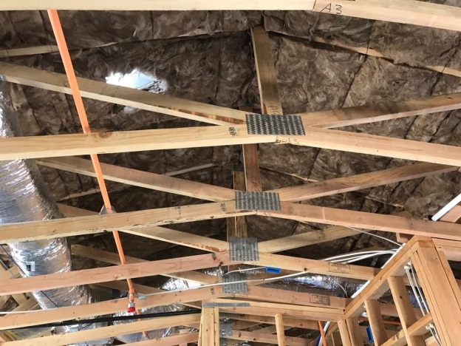
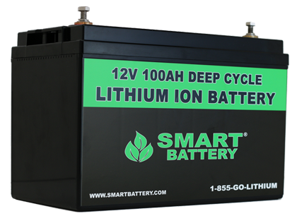
2019 Standards Approach
    The 2019 Standards recognize the following priority for efficiency and generation resources:
    1. Envelope efficiency
    2. Appropriately sized PVs
    3. Grid harmonization strategies that maximize self-utilization of the PV output and limit exports to the grid

Slide 4
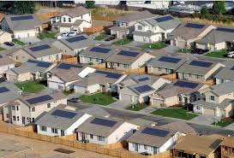
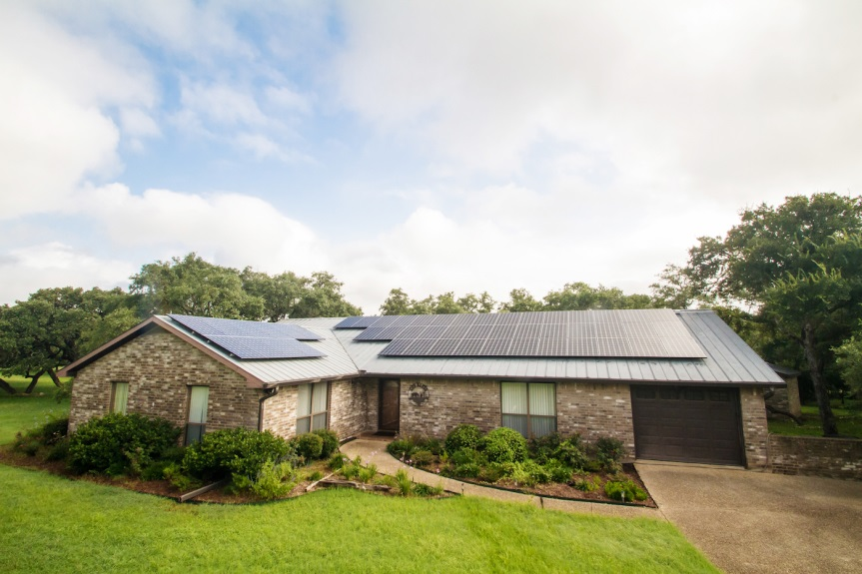
All-Electric Home Option
  Standards allow all-electric home’s PV size be the same as an equally sized mixed fuel home with similar features:
  The larger PV needed to displace the all-electric home kWhs, makes grid harmonization strategies, more important
  Requiring a much larger PV system on an all-electric home to displace the larger annual kWh may discourage all-electric homes

Slide 5
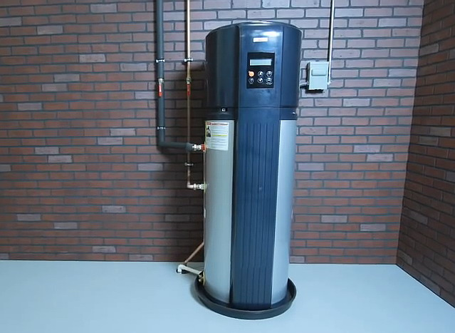
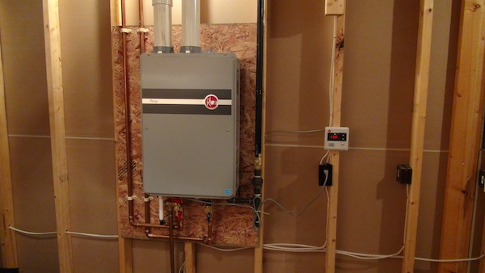
Parallel Prescriptive Paths
  There will be two parallel prescriptive paths for compliance, one for each of:
    Mixed fuel homes
    All-electric homes
  This allows the all-electric and mixed fuel homes to have their own prescriptive paths
  NEEA Tier 3 HPWH models can easily be used to meet or exceed standard design using the performance path

Slide 6
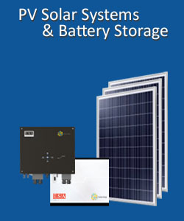
PV System Sizing
    For Part 6, PV is sized to net out the building’s expected annual kWhs
    Larger PV array can be installed but will not receive additional compliance credit
    For Part 11 compliance, CBECC allows PV array coupled with a 6 kWh battery storage system to be oversized by a factor of up to 1.6
      The battery enables the increased PV capacity to be used by the utility to meet demand during critical peak periods
      Promotes self-utilization on peak since PV system is coupled with battery storage

Slide 7
Compliance determined by
Energy Design Rating
    A target EDR establishes a performance benchmark that the building must meet for compliance
    CBECC-Res software has the capability to calculate EDR scores for EE and PV separately
    Builders can use a combination of envelope energy efficiency features, better appliances, PVs, and other strategies to get to the target EDR
    Target EDR is fully compatible with reach codes. Local jurisdiction can simply identify a lower target EDR

Slide 8
Next Steps
Energy Commission adoption hearing May 9th
California Building Standards Commission approval Fall 2018
Effective date of standards January 1, 2020
Ability to adopt local ordinances available now

Slide 9
Questions?
CBECC modeling tool for energy and GHG emissions available for download:
http://www.energy.ca.gov/title24/
California Energy Commission - energy.ca.gov
dave.ashuckian@energy.ca.gov

