Slide 1
Northern California Gas Storage Services
May 2018

Slide 2
Potential Opportunity to Serve Southern California System
Greater connectivity between the PG&E and Southern California systems could provide cost-effective storage services and improve reliability to Southern California
  Solution would leverage existing storage capacity in Northern California (modern facilities
located in rural areas)
Independent Storage Providers (ISP) on the PG&E System have abundant capacity and the technical capability to provide firm gas storage service to the Southern California system for relatively minimal interconnection costs
  Over 100 Bcf of ISP storage capacity on the PG&E System
  No new pipeline or storage facility required
  Would require only a 1,400-ft interconnect plus additional compression
The pathway from Wheeler Ridge appears to be less constrained than other parts of
the Southern California system

Slide 3










A new interconnection between PG&E and Kern/Mojave at Arvin would allow gas to flow to Wheeler Ridge and Daggett
Gill Ranch
PG&E
Line 300
Arvin
Kern River
Daggett

Slide 4
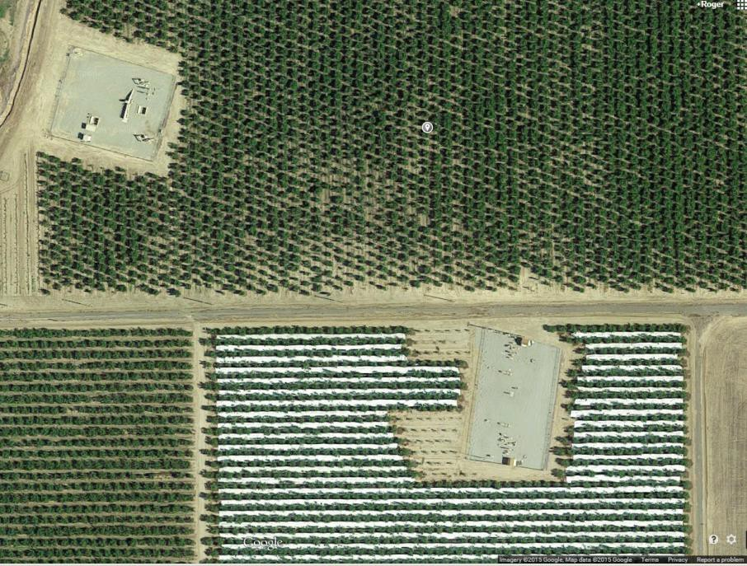

An Arvin interconnection would be located next to existing pipeline station facilities
PG&E Backbone Station
Kern/Mojave Station
Distance: 1,400 ft

